Slide 1
2021 Fall Fires: Structural Debris Removal & Hazard Tree Removal Services
Department of Resources Recycling and Recovery
Invitation for Bids (IFB) DRR21062
Mandatory Pre-Bid Meeting
November 10, 2021
10:00 A.M. to 11:30 A.M.

Slide 2
Agenda
Welcome
Bidding Timeline Overview
Operations Overview
Contract Overview
Questions

Slide 3
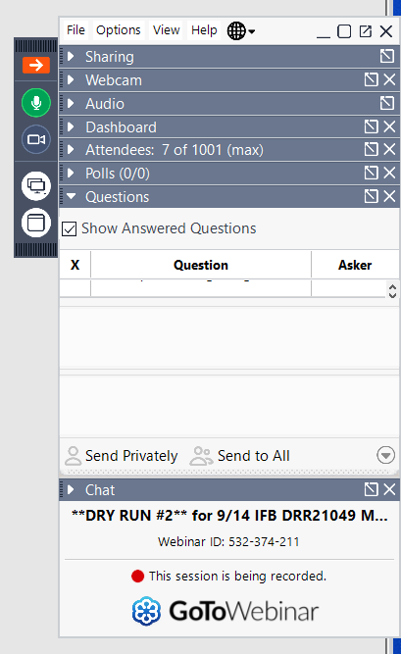
Questions
Questions regarding required bid documents and timelines will be answered during this meeting. You may submit your questions via the GoToWebinar side panel.
Answers given here today are non-binding on CalRecycle.
To receive a written answer to questions regarding operations and contracts or other items, submit your questions to Contracts@CalRecycle.ca.gov by November 12, 2021, by 5:00 PM.
All questions will be answered in an Addendum to the IFB which will be posted on CalRecycle’s website at https://www.calrecycle.ca.gov/Contracts
Once published, written answers will be binding on CalRecycle

Slide 4
Solicitation Timeline
SCHEDULE | DATE
Advertisement Date | November 5, 2021
Mandatory Pre-Bid Meeting | November 10, 2021
Written Questions Due by 5:00 P.M. | November 12, 2021
Submittals Due by 2:00 P.M. | December 3, 2021
Bid Opening at 2:15 P.M. | December 3, 2021

Slide 5
Service Needed:
CalRecycle has been tasked by the California Governor’s Office of Emergency Services (Cal OES) to manage coordinated Structural Debris and Hazard Tree Removal Operations in numerous counties throughout California to remove fire structural debris material from parcels where structures were destroyed by numerous fires, and the removal of Hazard Trees damaged by these fires that present an imminent threat to public infrastructure including public Rights-of-Way (ROW). CalRecycle intends to perform this work in an expedited manner in full coordination with the affected Counties, Cal OES and FEMA requirements as outlined in this IFB, while protecting public health and safety and the environment.

Slide 6
Functions described:
Structural Debris Removal Function: This work will include the preparation, removal, transport, and recycling or disposal of metals, ash, debris, concrete foundations and flatwork, potentially dangerous trees, and contaminated soil on residential properties included in the Structural Debris Removal Function, due to the wildfires listed below. For the Structural Debris Removal Function, a “potentially dangerous tree” is defined as a tree that poses a risk to debris removal and hazard tree removal crews. These trees are removed at the contractor’s expense.
(Work to be Performed Exhibit A pg. 5-24)
Some commercial properties will also be included in this program at the direction of Cal OES. These properties will be addressed in Item 7 and Item 8 of the Bid Items. Receiving facilities will be identified by the Bidder. A list of landfills that are capable of accepting ash and debris from these Operations is included in Section 4, Reference Documents, Attachment D.
Hazard Tree Removal Function: In addition to the Structural Debris Removal Function, and for the purposes of addressing the immediate threat to public safety due to hazard trees, Cal OES has also authorized a Hazard Tree Removal Function.

Slide 7
DDHTR Contractor
Disaster Debris and Hazard Tree Removal (DDHTR) Contractor: The Contractor hired to remove disaster debris and hazard trees identified by the Assessment and Monitoring Contractor.
Crews:
Structural Debris Removal Crew
Hazard Tree Removal Crew
Log Deck / Yard Processing Crew

Slide 8
EPP
ENVIRONMENTAL PROTECTION PLAN (EPP)
The State will prepare or direct (under a separate contract) the preparation of an Environmental Protection Plan (EPP). The EPP addresses the environmental and historic preservation areas of concern and presents the required Best Management Practices (BMPs) and Avoidance and Minimization Measures (AMMs) to protect them.
DDHTR Contractor shall implement the BMPs and AMMs listed in the EPP throughout the Operation, as described in Section 10.A.b. An example EPP, addressing both structural debris removal and hazard tree removal functions, similar to the EPP anticipated for these Operations is included as part of the IFB, Attachment C (for reference only).

Slide 9
Health and Safety
HEALTH AND SAFETY
DDHTR Contractor shall, at all times, operate equipment and perform labor in a safe workmanlike manner to ensure the safety of its employees and the public. DDHTR Contractor shall pay particular attention to operations around local roads and take all necessary precautions. DDHTR Contractor shall note the number of the power lines crossing the site, dead trees, chimneys, and all underground utilities.
Contractor Safety Plans should comply with all CalOSHA requirements and include a COVID-19 plan.

Slide 10
Chart of Counties
County | *Preliminary Estimate: Destroyed Residential Structures | *Preliminary Estimate: Hazard Trees
Operation Area A, Northern Division
Mendocino | 30 | 819
Shasta | 90 | 2,457
Del Norte | 0 | 928
Operation Area B, | Central Division
Kern | 19 | 519
Tuolumne | 8 | 218
Tulare | 12 | 328

Slide 11
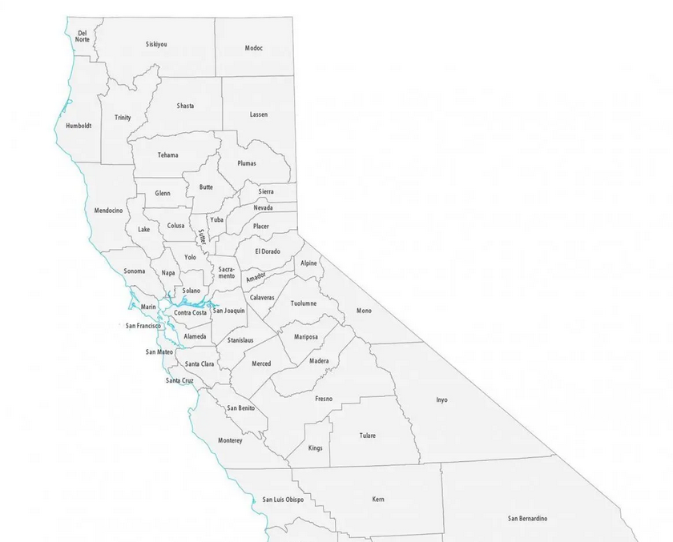
Northern Division
Del Norte, Mendocino & Shasta
Central Division
Kern, Tulare & Tuolumne

Slide 12
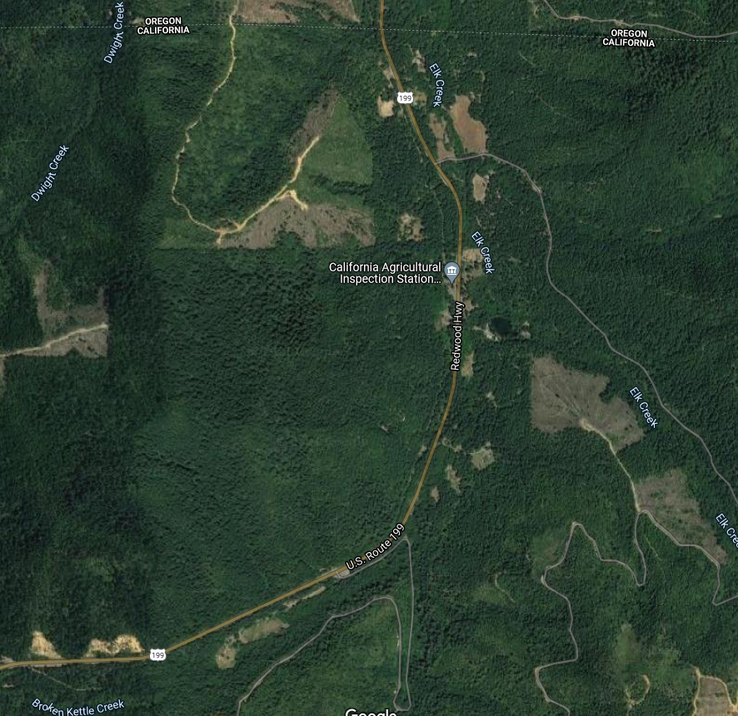
Northern Division
Del Norte Trees

Slide 13
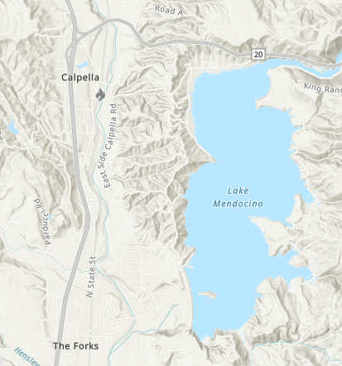
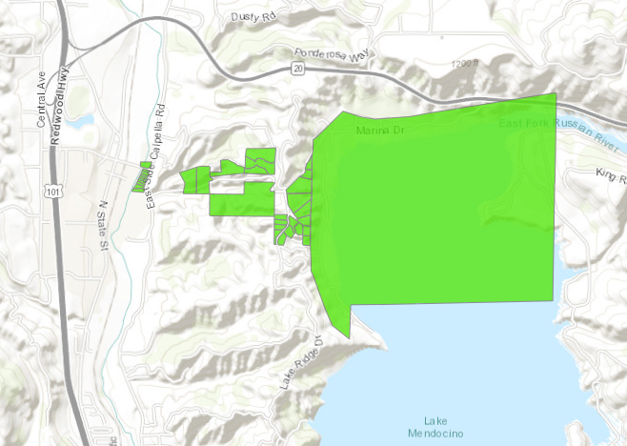
Northern Division
Mendocino County Hopkins Fire

Slide 14
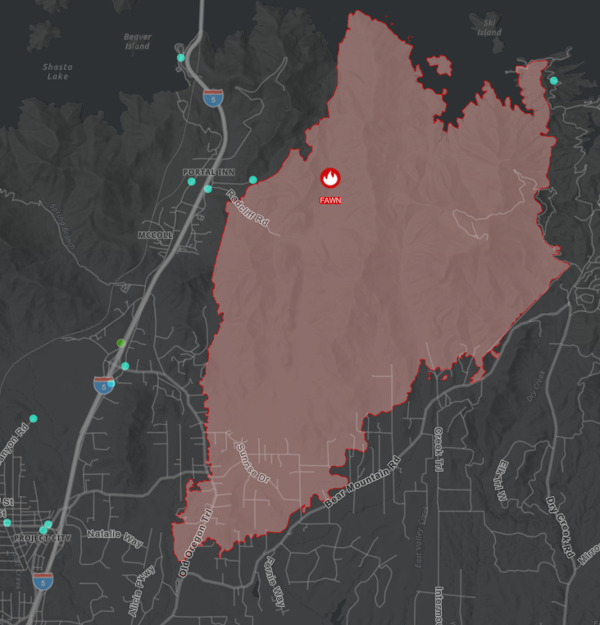
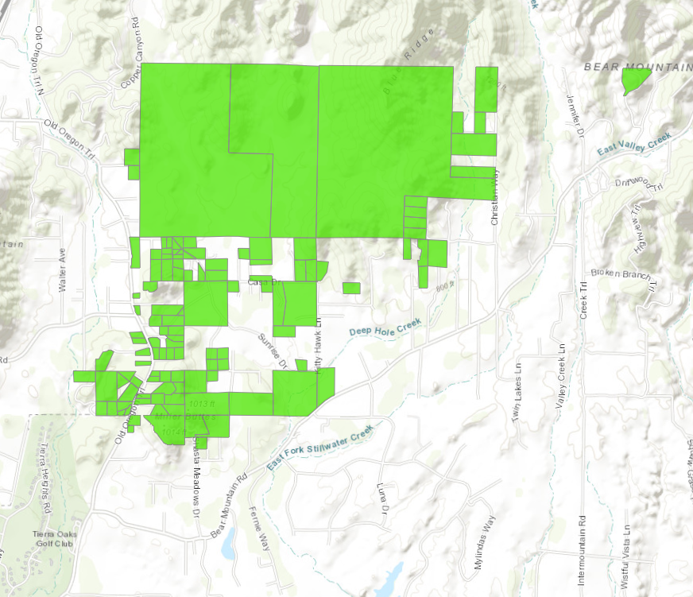
Northern Division
Shasta County Fawn Fire

Slide 15
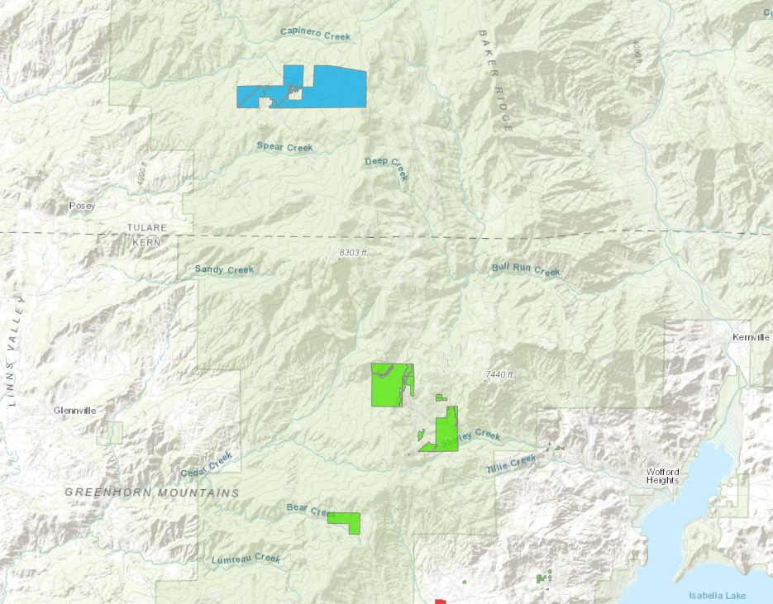
Central Division
Kern & Tulare Counties
Windy and French Fires

Slide 16
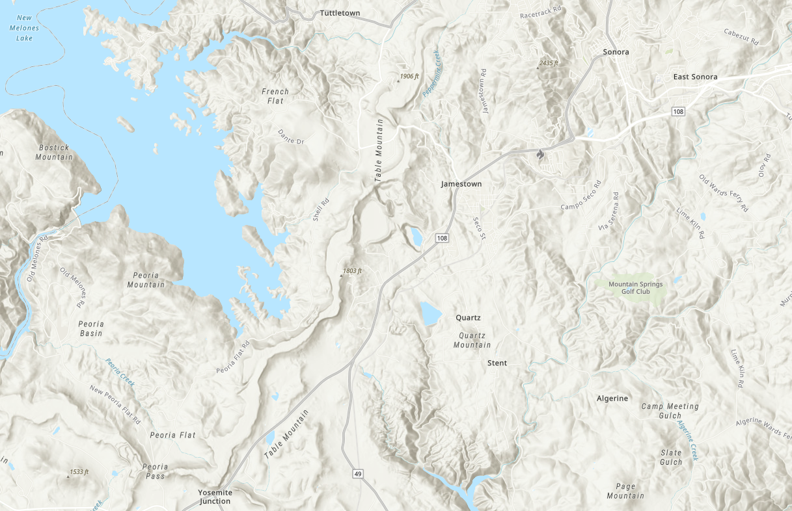
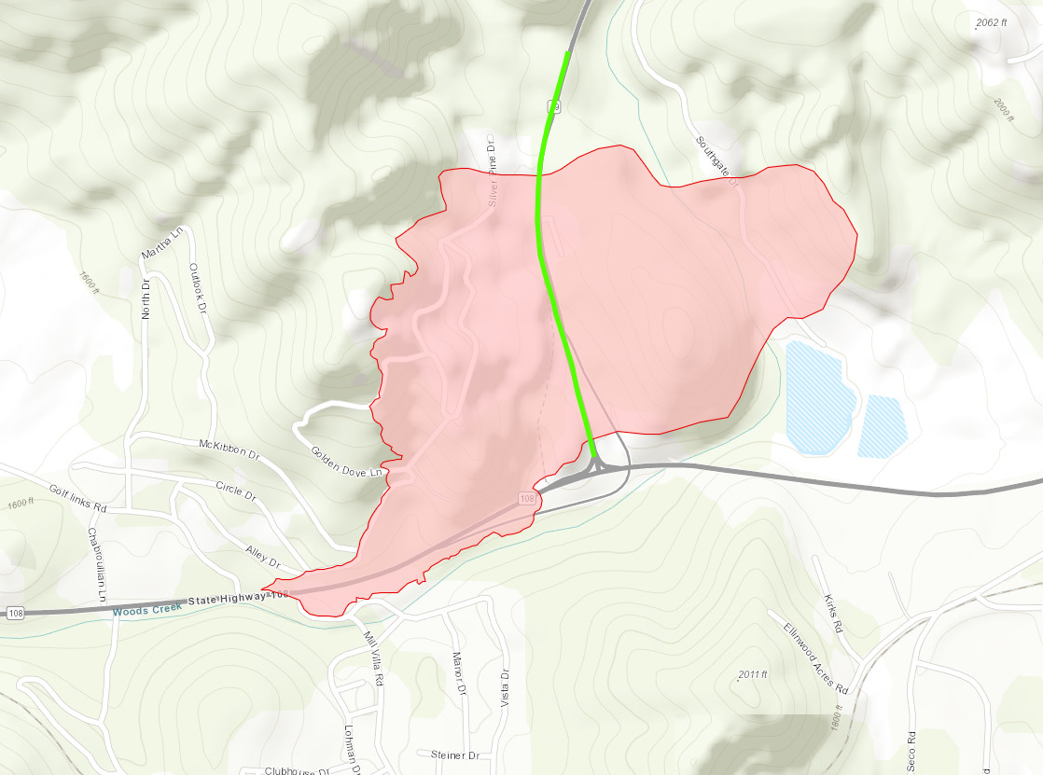
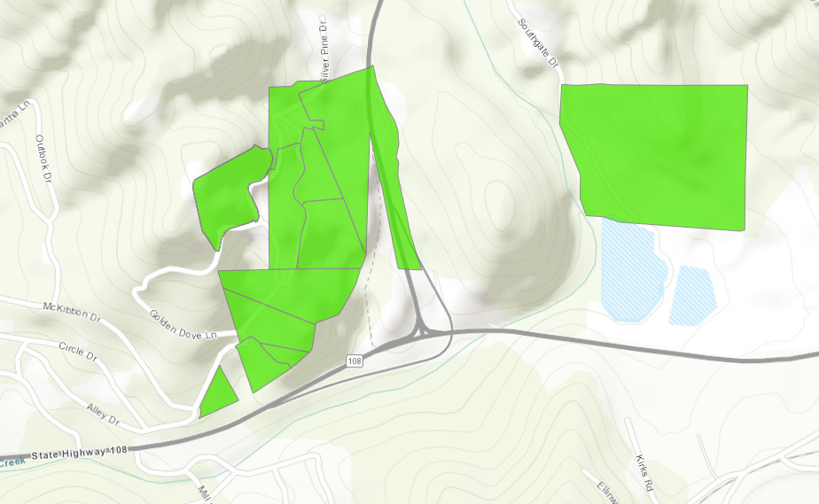
Central Division
Tuolumne County
Washington Fire

Slide 17
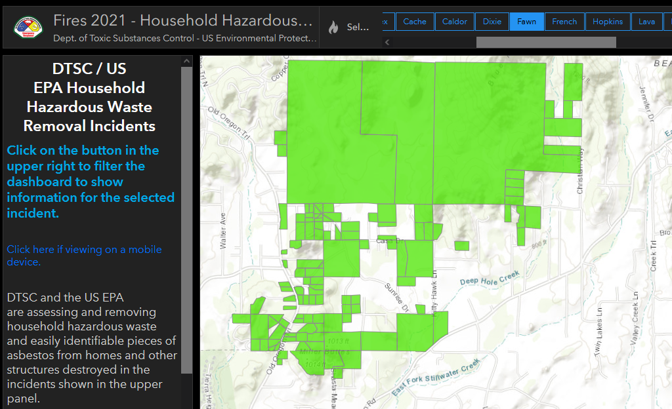
Other helpful map link
DTSC – 2021 Fires
https://dtsc.maps.arcgis.com/apps/dashboards/cecc021ffd47412aae9921e8a9296693

Slide 18
ICS and IMT
Incident Command System (ICS): A standardized approach to the command, control, and coordination of emergency response providing a common hierarchy within which responders from multiple agencies can be effective.
Incident Management Team (IMT): Designated personnel who provide support to incident management at the Branch Level. Includes the Branch Director, Branch Planner, Debris Group Supervisor, Finance Unit Leader, Logistics Unit Leader, and their respective designees.
The IMT will be made up of State Staff from CalOES and CalRecycle.
Assessment and Monitoring Contractor Staff may fill the Planning Function of the IMT.
Notes:
Good Morning and welcome everyone, my name is Emily Kentta. I am an engineering geologist in the Office of Debris Recovery at CalRecycle. I will be giving an overview of just some aspects of this IFB that may be slightly or significantly different than past solicitations. Of course, I will not be able to go in to all the details so please read all the solicitation documents thoroughly, as I am sure you all are.
This operation will be managed using the Incident Command System which is a standardized approach for coordination of emergency response. The Incident Management Team will be made up of State Staff from CalRecycle and CalOES and the Planning Function may be filled by staff from the Assessment and Monitoring Contractor, as requested by CalRecycle.

Slide 19
Assessment & Monitoring Contractor
Assessing and Monitoring Debris Footprints
Asbestos Assessment and Monitoring of Removal and Disposal
Assessing and Marking Hazard Trees
Monitoring and Tracking Debris and Hazard Tree Removal Crews
  Environmental Compliance
  Safety
  Proper Debris Removal, Loading, Transport of Debris
  Proper Felling, Processing, Transport of Trees
  Record/Document Cradle to Grave of all Materials Generated by the Operation
It is the documentation provided by the A&M Contractor that the State will submit to FEMA for reimbursement.
Detailed Scope of Work at www.calrecycle.ca.gov/Contracts Click on Awarded DRR21048
Also, tasks to be performed by the A&M Contractor can be found in Exhibit H.
Notes:
It is the documentation provided by the A&M Contractor that the State will submit to FEMA to get maximum reimbursement for these disaster clean-ups.

Slide 20
Exhibit H Special Provisions
Contains specifications for tasks to be performed and general order of operations
Also describes how the tasks to be performed by the A&M Contractor and the DDHTR Contractor interrelate.
The working relationship between the A&M Contractor and DDHTR Contractor(s) should be one of constant communication throughout the day at all levels of the operation.
Notes:
Each operation is unique, and the IMT in coordination with the A&M and DDHTR may develop and add additional processes and procedures to increase efficiency, accuracy of documentation and/or better communications and to ensure that all program requirements are met.

Slide 21
Permit Requirements
The Bidder is required to provide:
Name(s) and Location(s) of Temporary Log Storage and Processing Facility(ies), Laydown Yard(s), Temporary Debris Management Sites, and/or Temporary Housing Facilities that the Contractor plans to use.
Name(s) and Location(s) of currently operating and permitted landfills, concrete, and metals recycling facilities, and wood materials end-use facilities (properly permitted to receive intended materials) that the Bidder plans to use.
Letter(s) of interest from these currently operational and permitted (i.e., these facilities must be actively operating at the time of bid submittal) landfills, concrete and metals recycling facilities and wood materials end-use facilities to enter into an agreement with the Bidder to receive said materials from the facilities that the Bidder plans to use.
Bidder acknowledges that, if Awarded, Bidder will be required to obtain all relevant permits. All lease arrangements with the property owners for this(these) facility(ies) shall be the responsibility of the Contractor.
Notes:
There are many permitting requirements in these operations. From operating permits for end use facilities to environmental permits and roadway encroachment permits. Bidders are notified that proposed end use facilities proposed at the time of bid must be actively operating and fully permitted. Additionally, all operating and environmental permits shall be provided to CalRecycle for review and approval prior to any materials being sent to an end use facility.

Slide 22
Permit Requirements (Exhibit H)
Requirement/ Permission | Entity Responsible for Obtaining | Comments
Property owner Site Access/ Authorization for ROE and Access only ROEs | Counties | Executed forms are required by owners before work can begin on their property.
Property owner Access only Agreement | Counties | Executed forms from non-User Agency program property owners to provide access to properties that are part of the User Agency program.
California Environmental Quality Act (CEQA) | Exempt | Operations undertaken, carried out, or approved by a public agency to maintain, repair, restore, demolish, or replace property or facilities damaged or destroyed because of a disaster are exempt from CEQA. Public Resources Code, §§ 21080(b) (3), 21172; see also, 14 CCR 15269(a).
Section 1602 or 1610 Streambed Alteration, California Department of Fish and Wildlife (CDFW) | CDFW; User Agency | User Agency’s PSC, OSC, Environmental Unit Lead, and/or A&M Contractor will consult with CDFW for removal of dangerous burned trees. Typically, the Operation does not include work in, or through, a streambed. If a stream crossing is necessary to access and remove burned debris, User Agency will consult with CDFW to determine whether work is consistent with the EPP or will need to submit a Lake or Streambed Alteration Program Notification of Emergency Work Permit to CDFW within 14-days of commencing with streambed crossing.
Federally Funded or on Federal Property Follow National Environmental Policy Act (NEPA) | FEMA as lead Agency; User Agency | User Agency’s PSC, OSC, Environmental Unit Lead, and A&M Contractor will Consult with FEMA or Federal lead agency regarding the debris removal operation and potential impacts on federally protected resources (i.e., waters of the US, etc.) endangered species, and historical and cultural artifacts, etc. to be addressed and incorporated in the EPP.
Federally Funded or on Federal Property -- Federal Section 7 Permit for Federally Endangered Species | FEMA as lead Agency; User Agency | User Agency’s PSC, OSC, Environmental Unit Lead, and A&M Contractor will consult with FEMA or Federal lead agency regarding the debris removal operation and potential impacts on federally endangered species or endangered species habitat as described in the EPP. Including submittal of final reports per the direction of the FEMA consultation with USFWS, and/or NOAA Marine Fisheries Service. Maps will be produced using GPS at sub-meter accuracy.
Federally Funded or on Federal Property – Section 106 National Historic Preservation Act assessments | FEMA as lead Agency; User Agency | User Agency’s PSC, OSC, Environmental Unit Lead, and A&M Contractor will consult with FEMA who will consult with the State Historic Preservation Office (SHPO) to determine if there are any archeological sites of interest/concern within the footprint of the debris removal operation. If so, determine how to mitigate, as addressed in the EPP. A&M will provide Archaeologists to perform assessment and monitoring, and draft and submittal of final reports per the direction of the FEMA consultation with SHPO. Maps will be produced using GPS at sub-meter accuracy.
Federally Funded or on Federal Property ---- US Army Corps of Engineers (USACE) Non-Reporting Nationwide 33 Streambed crossing or Regional General Permit to address Clean Water Act (CWA) Section 404 Regional General Permit for Clean Water Act Section permit | User Agency or its A&M Contractor | User Agency PSC, OSC and/or its A&M Contractor will consult with the USACE regarding the applicability of the Nationwide 33 permit for the emergency response/recovery activities affiliated with the operation or whether a Regional General Permit to address CWA Section 404 is required. Permit applications will be submitted per the February 10, 2016 Updated Map and Drawing Standards, including the use of sub-meter accurate GPS readings for the Ordinary High Water Mark. A 401 Permit approval from the local Regional Water Quality Control Board (RWQCB) may be required, as addressed in the EPP.

Slide 23
Permit Requirements (cont…) (Exhibit H)
Requirement/ Permission | Entity Responsible for Obtaining | Comments
401 Permit | CalEPA State Water Resources Control Board; User Agency or its A&M Contractor | User Agency’s PSC, OSC, Environmental Unit Lead, and/or A&M Contractor will consult with the RWQCB, and submit information required for review and approval as addressed in the EPP.
Laydown and storage yards, and other necessary operations supporting facilities will likely require National Pollutant Discharge Elimination System (NPDES) Stormwater permits | DDHTR Contractor for support facilities. Some support by the A&M Contractor | DDHTR Contractor will coordinate with the landowner, the City or County land use municipality and the RWQCB to apply for and obtain NPDES permits as required and install and maintain necessary BMPs.
Road Use or Special Permits for accessing private properties from roads on Federal lands (BLM, USFS, etc.) | DDHTR Contractor for access across roads on federal lands. EHP support from the A&M Contractor. Plus, may require additional assistance from state agencies and User Agency CM and /or OSC or designee. | Permits will require biological and historical preservation assessments and likely bmp protections to be installed and maintained and ultimately removed.
CalFire Forest Practice Rules Permits for Timber Harvest activities (1104.1b, 1039g, 1052). | DDHTR Contractor’s LTO to prepare, sign, and implement permit(s) and their requirements. May obtain assistance from A&M Contractor’s RPF. | Prior to felling any Hazard Trees, the DDHTR Contractor shall confer with the CalFire Regional Office and the RWQCB representatives to confirm necessary permits and/or confirm applicable exemptions then submit obtain and implement required BMPs and AMMs, under A&M Contractor Forester’s oversight and support.
County Encroachment Permit | DDHTR Contractor (May be waived) | Use of temporary trailers or storage units on County ROW will require submittal of an application.
County Demolition Permit | User Agency (may be waived) | Counties to issue a blanket permit to demolish all structures destroyed by the fire under this program.
Air District Asbestos Demolition Permit/ Notification | User Agency (may be waived) | User Agency or its A&M Contractor will make appropriate notification to local Air Quality Management District (AQMD), California air Resources Board (CARB), and/or Federal EPA for demolition of any remaining standing structures and chimneys that fall under the requirement, as necessary.
Site Hazardous Waste Transport | User Agency | User Agency will submit and emergency Department of Transportation (DOT) waiver to allow for the transport and consolation of hazardous materials at a predefined staging area within the immediate burn scar area.
Traffic Control (city, county roadways and state highways | DDHTR Contractor | User Agency DDHTR Contractors apply for and obtain all road and highway permits in support of these operations and will supply necessary signage as required by the permitting agency(ies).
Hazardous Waste Disposal | User Agency | User Agency will contact the DTSC if any household hazardous waste is found on properties. User Agency will direct DDHTR Contractors to place such materials at one location on each property and/or in an environmentally protective, safe, and secure storage area (as appropriate) and arrange for the DTSC to make special collection trips, “milk runs”, to collect and appropriately transport and dispose of such materials.
Temporary Heliport Authorization | CalTrans | For temporary take-off and landing facilities related to debris or tree removal via helicopter.
Notes:
Here the list continues and identifies specific permits that the DDHTR Contractor is responsible for obtaining.

Slide 24
Environmental Compliance Liaison (New)
“DDHTR Contractor’s Environmental Compliance Liaison (ECL) is responsible to ensure that the DDHTR Contractor meets all of the environmental permit requirements and all EPP BMPs are properly implemented for all of the DDHTR Contractor’s temporary facilities (including but not limited to: laydown yards, log processing and storage yards, materials processing and transfer facilities, vehicle adjudication facilities, DOT inspection yards, and other temporary facilities as required for the Operation) . The ECL is responsible for preparing and overseeing the appropriate implementation of each of the water quality BMPs, and Historic Preservation AMMs required in the Operational permits enforced by CAL FIRE with respect to CEQA and NEPA environmental protection requirements, for protection of endangered and impacted species and their habitats under emergency Operations, summarized in the EPP.”
Notes:
This solicitation requires that the DDHTR Contractor have a dedicated, experienced person on staff who is responsible for obtaining permits, submitting for review and implementing the permits. The State will facilitate communications with regulatory agencies and support the liaison when needed.

Slide 25
Liaison to the Registered Professional Forester (RPF)
“Forest Practice Rules do not require the use of a RPF for the submittal or operations of the above identified Exemption Notices, however, there are specific Forest Practice Rule regulations (per 14 CCR sections 1038(b) and 1038.1, and 14 CCR section 1104.1) which prevent the use of the Exemption Notice in certain environmental situations. Since this Operation is being coordinated with other regulatory agencies, DDHTR Contractor shall provide a Liaison to RPF (Liaison) to the A&M Contractor’s RPF. The Liaison shall be responsible for the preparation and submittal of the Notices of Exemption.
The Liaison(s) shall oversee, monitor, and manage the Hazard Tree removal Operations and related activities, and assure their operation follows the Forest Practice Rules and the Public Agency, Public and Private Utility ROW Exemption documents.”

Slide 26
Liaison to the Registered Professional Forester (RPF)
(cont…)
“The Liaison is responsible for the following:
Sign and file on behalf of the Department, the Public Agency, Public and Private Utility ROW Exemptions for public agency removal of timber per 14 CCR section 1104.1, relating to conversion exemptions of the Forest Practice Rules.Upon execution and submittal of valid Public Agency, Public and Private Utility ROW Exemptions to the appropriate CalFire RPF, DDHTR Contractor and/or their respective Liaison shall provide written notification to the appropriate California Regional Water Quality Control Board (RWQCB), and the IMT.
Verify clear access to trees on each assigned property prior to sending Hazard Tree Removal Crews to the assigned property.
Determine if any trees require crane assisted removal and notify the OSC or designee, prior to sending Tree Removal Crews to the assigned property.
Identify and notify the OSC or designee if there is/are water courses that either need to be crossed to access a property or are in close proximity to any trees to be removed on a property for which a valid ROE has been received by the IMT.”

Slide 27
Work Plans and Milestones
Exhibit A Section 14. Operational Milestones, Mobilization Requirements, and Metrics
Contractor will be required to submit several work plans throughout the operation and is advised to staff adequately for work plan development, writing and field execution.
Some work plans outlined in Exhibit A Section 14 include:
Workforce Housing Plans
Hauling and Reuse/Disposal Plans by County
Hazard Tree Removal Work Plan
Each operation is unique, and the Incident Management Team may request additional work plans for specific or unforeseen situations.

Slide 28
Bid Line Items
Attachment 1 – Cost Bid Schedule
Item 1 – Mobilization/Demobilization Per Crew
½ Paid at Mob and ½ Paid at Demob
May be paid more than once at the sole discretion of CalRecycle
Items 2,3,6 – Per Lot Costs, all inclusive
Item 4 – Soil Removal Rescrape
Regardless of the number of re-scrapes required or the quantity of soil removed, this bid item will be paid only once per parcel and for no more than 25% of the total number of parcels where debris removal is performed. Further re-scrapes necessary, as determined by CalRecycle, shall be performed without compensation. These compensation limitations do not apply to parcels where CalRecycle determines that cleanup goals cannot be met due to site conditions unrelated to the disaster, at the sole and exclusive discretion of CalRecycle.

Slide 29
Bid Line Items (cont...)
Attachment 1 – Cost Bid Schedule
Item 5 – Vehicle Removal
5a – Vehicle Adjudicated On-site, 5b – Vehicle Adjudicated Off-site
Items 7, 8 – Costs for Public or Commercial Parcels
Item 10 – Non-Working Days
Not a bid item. Set at 1.5% of Item 2 per crew per day

Slide 30
Bid Line Items (cont...)
Attachment 1 – Cost Bid Schedule
DDHTR Contractor shall provide up to four (4) bridges of up to 50 feet per bridge to be installed simultaneously to ensure that the overall debris and hazard tree removal operations’ productivities are not negatively impacted from meeting the operational schedule.
Item 9 – Temporary Long Bridges
Bridges that the IMT agrees are necessary and are greater than fifty (50) feet in length, as determined by the ordinary high-water marks (as determined by the permitting agency(ies)) or existing damaged bridge pre-fire length, shall be paid by CalRecycle as a 15% of flat per parcel cost listed by the DDHTR Contractor as Bid Item No.2 per IMT approved bridge setup. This cost includes mobilization, permitting costs, labor, materials, and equipment required for setup and takedown and demobilization.

Slide 31
Core Values for the Project
Integrity
Respect
Service
Resiliency
Leadership
All our actions should be consistent with these values in the workplace and in the community in which we are guests.
Our job is to quickly and safely remove fire debris and hazard trees so that these communities can begin rebuilding their lives.

Slide 32
Questions
Questions regarding required bid documents and timelines will be answered during this meeting. You may submit your questions via the GoToWebinar side panel.
Answers given here today are non-binding on CalRecycle.
To receive a written answer to questions regarding operations and contracts or other items, submit your questions to Contracts@CalRecycle.ca.gov by November 12, 2021, by 5:00 PM.
All questions will be answered in an Addendum to the IFB which will be posted on CalRecycle’s website at https://www.calrecycle.ca.gov/Contracts
Once published, written answers will be binding on CalRecycle

