Slide 1
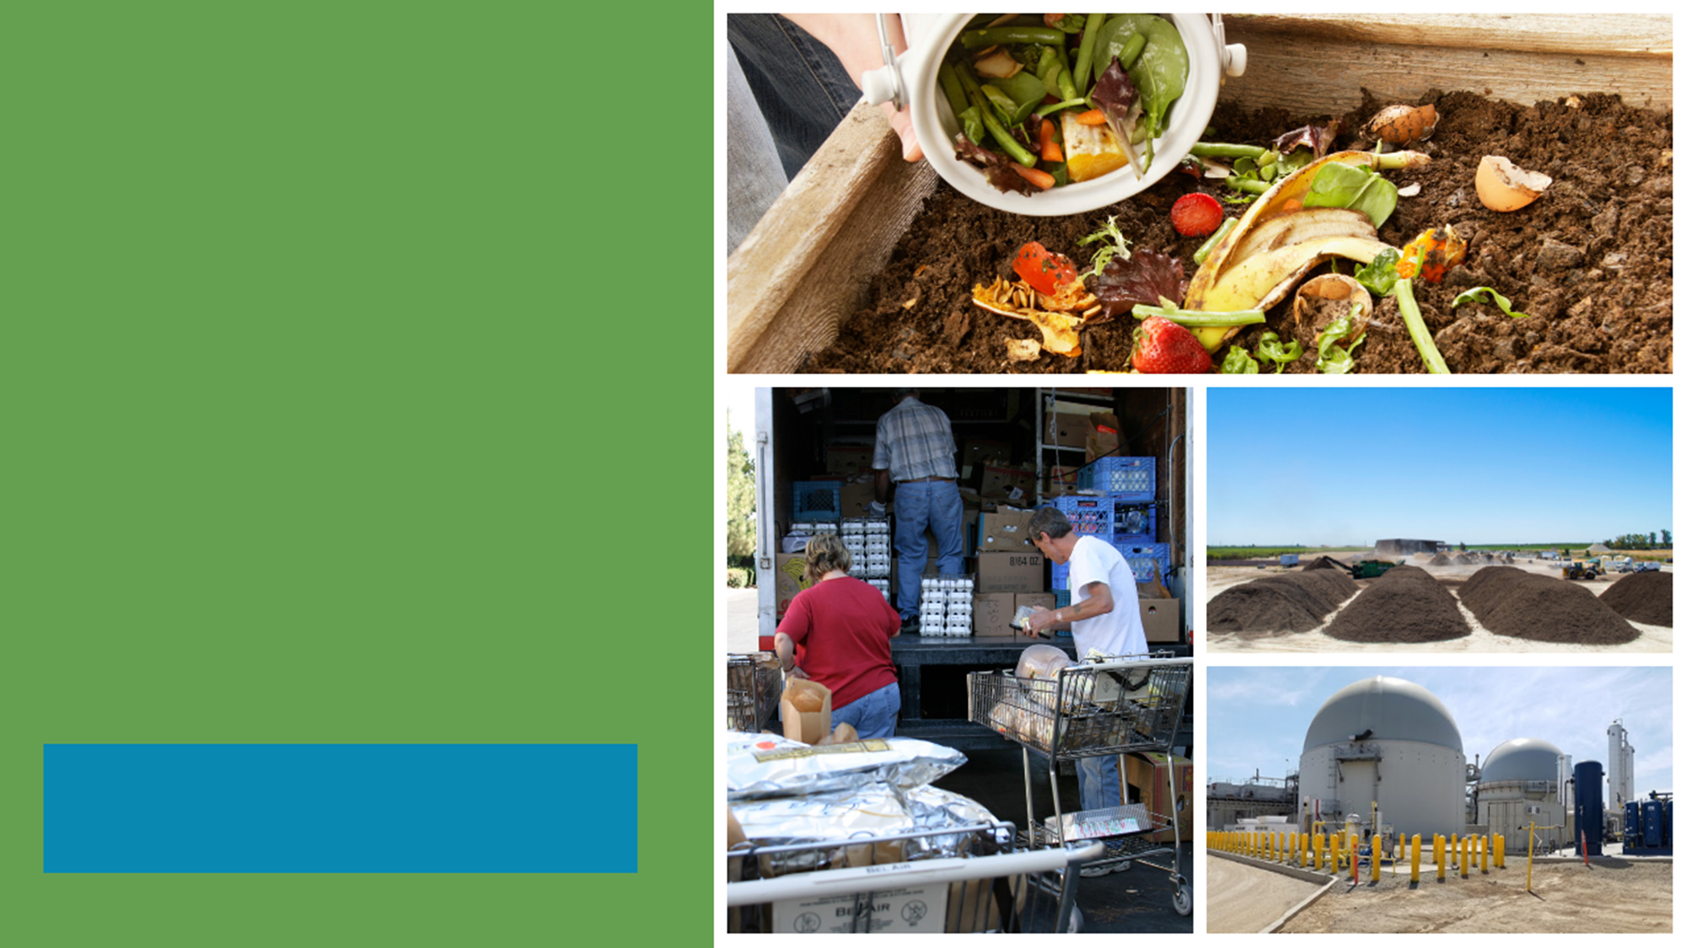
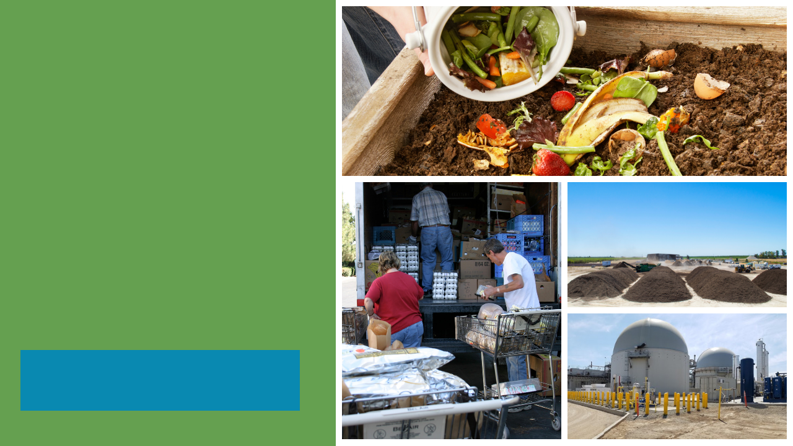
SB 1383
Reducing Short-Lived Climate Pollutants in California
An Overview of SB 1383’s Organic Waste Reduction Requirements
Notes:
Note to presenter: This slide presentation was developed for local jurisdiction staff by CalRecycle staff to educate city council and board of supervisor members, city and county staff, decision-makers, and other impacted colleagues. The slides include suggested talking points. We have also provided a handful of slides with artwork, images, and icons that can be used to build new content if needed. Please view this presentation in slideshow mode before presenting to familiarize yourself with the animations. If you have any questions, you can contact the CalRecycle Office of Public Affairs: opa@calrecycle.ca.gov.
Presentation Introduction
SB 1383 (Lara, Chapter 395, Statutes of 2016) is the most significant waste reduction mandate to be adopted in California in the last 30 years.
SB 1383 requires the state to reduce organic waste [food waste, green waste, paper products, etc.] disposal by 75% by 2025. In other words, the state must reduce organic waste disposal by more than 20 million tons annually by 2025.
The law also requires that 20% of currently disposed edible food be recovered for human consumption by 2025.
This has significant policy and legal implications for the state and local governments.
SB 1383 establishes a statewide target and not a jurisdiction organic waste recycling target.
Given that it is a statewide target and there are not jurisdiction targets, the regulation requires a more robust approach (this is different than AB 939).
CalRecycle must adopt regulations that impose requirements necessary to achieve the statewide targets.
This makes the regulation more similar to other environmental quality regulations where regulated entities, i.e., jurisdictions, are required to implement specific actions, rather than achieve unique targets.
For example, AB 32 established GHG reduction targets for the state, and the implementing Cap-and-Trade regulations require businesses to take specific actions.
The individual businesses are not required to achieve a specific target.
They are required to take actions prescribed by the date.
Overview of Presentation
Background and Context of SB 1383: Why California passed this law
SB 1383 Requirements: A big picture look at the law’s requirements and objectives
Jurisdiction Responsibilities: What SB 1383 requires of local governments:
Provide mandatory organic waste curbside collection to all residents and businesses
Establish an edible food recovery program that recovers edible food from the waste stream
Conduct outreach and education to all affected parties, including generators, haulers, facilities, edible food recovery organizations, and city/county departments
Capacity Planning for Organic Waste and Edible Food Recovery
Procure recycled organic waste products like compost, mulch, and renewable natural gas (RNG) and recycled content paper and paper products
Inspect and enforce compliance with SB 1383
Maintain accurate and timely records of SB 1383 compliance
Reporting to CalRecycle
CalRecycle Oversight Responsibilities
SB 1383 Key Implementation Dates
SB 1383 Key Jurisdiction Dates
Additional Resources
CalRecycle’s Short-Lived Climate Pollutants (SLCP): Organic Waste Methane Emissions Reductions webpage has more information: https://www.calrecycle.ca.gov/Climate/SLCP/

Slide 2

Organic Waste Is the Largest Waste Stream in California
1 in 5 Californians are
Food Insecure
California Disposed of approximately 24 million tons of organic waste in 2018
California Throws Away More than 6 Million Tons of Food Waste Every Year!
Notes:
When we are talking about organic waste for the purposes of SB 1383 we are talking about materials such as green waste, wood waste, food waste, and also fibers, such as paper and cardboard.
Organic waste comprises over half of our waste stream.
According to CalRecycle’s waste characterization study in 2018, food waste comprised 13 percent of what we disposed.
SB 1383 requires California to recover 20 percent of currently disposed edible food for human consumption.
We currently don’t know how much of the food waste stream is donatable.
CalRecycle conducted a waste characterization study in 2018/19 that took a closer look at our food waste stream.
The results of this study will help determine how much edible food waste is landfilled on average throughout the state.
Here’s what we know:
1 in 5 children go hungry every night in California – redirecting perfectly edible food that is currently being disposed to feed those in need can help alleviate this.
For every 2 ½ tons of food rescued, that’s the equivalent of taking 1 car off the road for a year. (https://www.epa.gov/energy/greenhouse-gas-equivalencies-calculator)
Recovering one ton of edible food could provide more than 1600 meals to hungry people.

Slide 3
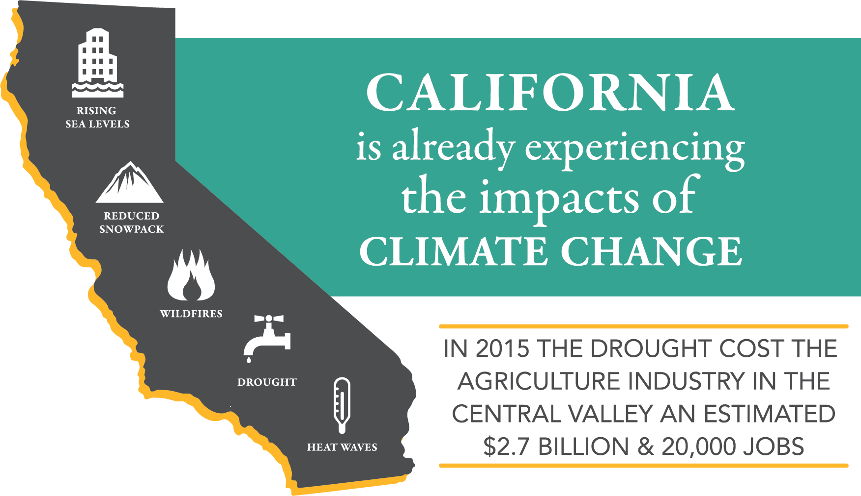

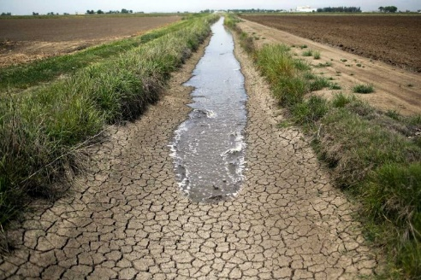
Climate Change Negatively Impacts California
Landfilled Organic Waste Emits
Methane Gas—
A Super Pollutant
More Powerful than C02
Methane Gas Contributes to
Climate Change in California
Notes:
Landfilling organic waste leads to the anaerobic breakdown of that material, which creates methane.
Landfills are responsible for 21% of the state’s methane emissions.
Landfills are the third largest producer of methane in the state.
Methane is 84 times more potent than Carbon Dioxide (C02) over a 20-year horizon.
Climate change may seem like a distant problem, but there are other more localized environmental impacts associated with landfill disposal of organic waste that have immediate negative impacts on our community now.
Landfilling organic waste is a significant source of local air quality pollutants (NOX and PM2.5).
These pollutants have an immediate negative impact on the air our community and it can cause respiratory issues and hospitalizations.
Diverting organic waste to recycling can significantly reduce these local air quality emissions and the associated negative impacts.
We are starting to see the effects of climate change in cities and counties throughout California.
Longer droughts and warmer temperatures are drying our forest and contributing to the ever-increasing number of wildfires in CA (which also impact air quality).
Cyclical droughts
Bigger storms
Coastal erosion due to rising sea levels
We should not underestimate the cost of these climate change impacts.
The state and communities are spending billions fighting wildfires, removing debris, and rebuilding homes.
That means we are paying for the effects of climate change today.
The financial and public health impacts are already here and we need to take action to mitigate climate change now
That is why the state enacted SB 1383, which is designed to reduce the global warming gasses like methane, which are the most potent and are “short-lived”
SB 1383 is a fast-track to fighting climate change
Reducing this gas now, through actions like organic waste recycling, will significantly reduce emissions, and will reduce the impacts of climate change in our lifetime.

Slide 4
SB 1383 Requirements
2020
50 Percent Reduction in Landfilled Organic Waste
(11.5 Million Tons of Organic Waste Disposal Allowed)
2022
Regulations Take Effect
75 Percent Reduction in Landfilled Organic Waste
(5.7 Million Tons of Organic Waste Disposal Allowed)
2025
20 Percent of currently disposed edible food must be recovered for human consumption
2025
Notes:
Overview of SB 1383:
SB 1383 establishes aggressive organic waste reduction targets.
SB 1383 also builds upon the Mandatory Commercial Organics Recycling law (AB 1826).
Our jurisdiction has been implementing this law since 2016.
SB 1383 requires Californians to reduce organic waste disposal by 50% by 2020 and 75% by 2025.
These targets use CalRecycle’s 2014 Waste Characterization Study measurements when 23 million tons of organic waste were disposed.
These disposal reductions will reduce at least 4 million metric tons of greenhouse gas emissions annually by 2030.
Additionally, as a part of the disposal reduction targets the Legislature directed CalRecycle to increase edible food recovery by 20 percent by 2025.
The food recovery goal is unique.

Slide 5
SB 1383 Key Implementation Dates
Jan. 2019
January 1, 2025
Two Years of Informal Rulemaking Ends. Formal Rulemaking Begins
75% Reduction in Organics Disposal
Jan. 1, 2022
Fall 2020
Regulations Take Effect and State Enforcement Begins
20% Increase in Edible Food Recovery
September 2016
Regulations Adopted
Jan. 1, 2020
Jan. 1, 2024
SB 1383 Adopted
50 Percent Reduction in Organic Waste Disposal
Regulations Require Local Governments to Take Enforcement
2016-2019
2020
2021
2022
2023
2024
2025
Notes:
Highlighted here on the slide are the key dates for SB 1383 implementation and milestones.
CalRecycle conducted two years of informal hearings with local governments and stakeholders.
Formal Rulemaking
CalRecycle began the formal regulation rulemaking January 18, 2019.
CalRecycle collaborated with jurisdictions and other stakeholders over 4 years to complete the regulations.
The Office of Administrative Law approved the regulations on November 3, 2020.
Regulations Take Effect on Jan. 1, 2022.
Jurisdictions must have their programs in place on January 1, 2022.
In 2024 Jurisdictions will be required to take enforcement against noncompliant entities.
To meet the deadline of January 1, 2022, CalRecycle expects that jurisdictions will be planning and making programmatic and budgetary decisions regarding the requirements in advance of the deadline.
CalRecycle can begin enforcement actions on jurisdictions and other entities starting on Jan. 1, 2022.

Slide 6






SB 1383 Key Jurisdiction Dates
2022
2024
Provide Organics Collection Service to All Residents and Businesses
Starting January 1, 2024 Jurisdictions must take action against non compliant entities
Establish Edible Food Recovery Program
Conduct Education and Outreach
Procurement
Capacity Planning
Notes:
CalRecycle expects that jurisdictions will be planning and making programmatic and budgetary decisions regarding the requirements in advance of the January 1, 2022 implementation deadline.
CalRecycle can begin enforcement actions on jurisdictions and other entities starting on Jan. 1, 2022.
This slide outlines the major programmatic activities for jurisdictions and the following slides will cover more details.
CalRecycle has some funding through competitive grant programs, as well as a loan program, for establishing the infrastructure for recycling organic waste and recovering edible food. However, for the programmatic activities, such as inspections, enforcement, education, collection we will need to plan for budgetary changes to address these.
CalRecycle published a number of tools that we can begin utilizing, such as a model enforcement ordinance, franchise agreement models, and education materials. Using the 2018 and 2020 Statewide Waste Characterization Studies, jurisdictions will have data needed to conduct some of the capacity planning requirements.
Jurisdictions should now be in the process of implementing the programmatic and budgetary changes required to be in place by January 1, 2022.

Slide 7
Jurisdiction Responsibilities
Provide Organics Collection Services to All Residents and Businesses
Conduct Education and Outreach to Community
Secure Access to Recycling and Edible Food Recovery Capacity
Establish Edible Food Recovery Program
Procure Recyclable and Recovered Organic Products
Monitor Compliance
and Conduct
Enforcement
Notes:
Jurisdictions will be required to adequately resource these programs:
1. Provide mandatory organic waste curbside collection services to all residents and businesses.
This means for all organic waste, including green waste, wood waste, food waste, manure, fibers, etc.
Containers have prescribed colors
There are container labeling and contamination monitoring requirements
We need to assess our current collection programs and determine what may need to be expanded or changed
2. Establish edible food recovery program for all Tier 1 and 2 commercial edible food generators
This means ensuring that there are edible food recovery organizations that have enough capacity
This may entail providing funding to ensure there is adequate capacity and collection services
3. Conduct education and outreach to all generators
This will require education to be provided to all generators, and when applicable education may need to be provided in other languages.
4. Our jurisdiction will be required to procure certain levels of compost, renewable gas used for transportation fuels, electricity, heating applications, or electricity from biomass conversion produced from organic waste. Also, we will need to purchase recycled content paper and paper products.
5. Plan and secure access for recycling and edible food recovery capacity
6. We will be required to monitor compliance and conduct enforcement
Monitoring and education must begin in 2022
Enforcement actions must start Jan 1, 2024
7. We will need to adopt an ordinance, or similarly enforceable mechanism that is consistent with these regulatory requirements prior to 2022.

Slide 8










SB 1383 in Action
Local Government Roles and Responsibilities
City Council
Board of
Supervisors
Public
Transportation
Fleets
City Manager
CAO
Environmental Health
Finance
Legal
SB 1383 doesn’t just apply to waste management and recycling departments.
Every local department plays a role in SB 1383 implementation.
Public Parks
Purchasing
Public
Works
Notes:
This law extends beyond directing waste management and recycling operations and staff.
Each department will need to understand how SB 1383 impacts their work.
Recordkeeping and reporting requirements extend to all of these departments, and jurisdiction leaders will play a vital role in ensuring compliance with SB 1383.
City Councils and Boards of Supervisors will need to pass local enforcement ordinances to require all residents and businesses to subscribe to these services.
City Managers and Chief Administrative Officers will be involved in capacity planning, directing procurement of recycled organic products like compost and renewable natural gas, recycled content paper, and establishing edible food recovery programs.
Finance and Legal staff will be involved in local enforcement ordinances, new collection fees, and ensuring programs are adequately resourced.
Purchasing staff will be central to procuring recycled organic products and recycled content paper.
Procure does not necessarily mean purchase, but this department is likely aware of current compost, mulch, renewable natural gas, and paper product purchases for the jurisdiction.
Public Works staff are involved with hauler agreements, local waste management processing facilities, and organic waste recycling facilities (like compost and anaerobic digestion facilities). They may also be involved in civil engineering activities where compost may be utilized (as in erosion control along city streets and embankments).
Public Parks staff may be involved with assessing the need for local compost application to parks and city landscaped areas.
Environmental Health staff may be tasked with enforcement duties, including inspecting commercial food generators for compliance with edible food recovery requirements.
Public Transportation and Fleet departments could be involved in procuring renewable natural gas for city or county owned vehicles.

Slide 9
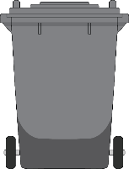
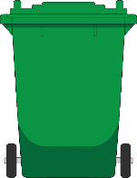




SB 1383 in Action
Jurisdiction Requirements
Organic Waste Collection Services
Three-Container “source separated” Collection Service
Organics prohibited from black container
All organic waste segregated for collection and recycling
Two-Container Collection Service
One container for collection of segregated
organic waste
One container for collection of mixed waste (subject to 75% organic content recovery standard)
One-Container Collection Service
One container for collection of mixed waste (subject to 75% organic content recovery standard)
Provide organics collection service to all residents and businesses
Minimum contamination monitoring and reduction requirements
Collection waivers authorized for certain documented circumstances
Notes:
(Note to presenter: You might customize this slide to reflect your jurisdiction‘s collection system for residential and commercial recycling programs. Remember this law/regulation is about all organic waste so that means the fibers, foodwaste, greenwaste, manure, etc.)
The most basic element of the regulation is that jurisdictions are required to provide a mandatory organic waste curbside collection service to each of their residents and businesses.
The regulations also require all residents and businesses to use an organic waste recycling service that meets the regulatory requirements.
Jurisdictions must have enforceable requirements on its haulers that collect organic waste in the jurisdiction, and also for commercial and residential generators and self-haulers.
There is a lot of detail regarding the types of allowable collection programs (several pages of regulatory text dedicated just to this). These are the high-level requirements.
Each resident and business, must subscribe to an organic waste collection service that either “source-separates” the waste (e.g., separate bins), or transports all unsegregated waste to a facility that recovers 75% of the organic content collected from the system.
The regulations allow for a menu of collection options.
A one-can system – all contents are transported to a facility that recovers 75% of the organic content
A two-can system – at least one of the containers (whichever includes organic waste and garbage) must be transported to a facility that recovers 75% of the organic content
A three-can system – organic waste is required to be source separated (paper in blue, food and yard in green). No recovery rate
The three-can option also allows additional separation at the hauler/generator’s discretion. For example, some jurisdictions provide separate containers for yard (green) and food (brown) waste so they can be managed separately
The same rules will apply to entities not subject to local control, and CalRecycle will oversee State Agencies, UCs, CSUs, Community Colleges, K-12 schools and other entities not subject to local oversight.

Slide 10
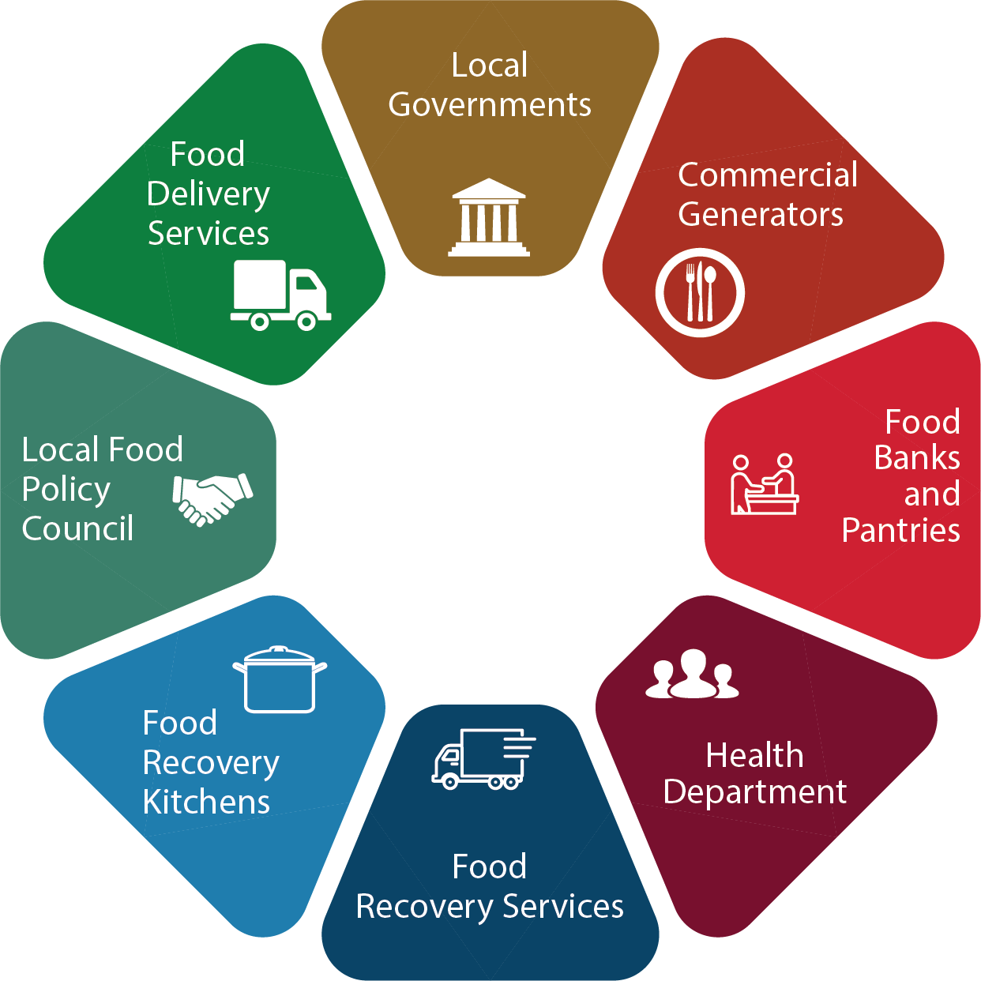

SB 1383 in Action
Edible Food Recovery Program
Jurisdiction Requirements
Identify Existing Food Recovery Capacity
Expand Existing Food Recovery Capacity
(if needed)
Ensure Commercial Edible Food Generators Have Access to Food Recovery Services
Monitor Commercial Edible Food Generators for Compliance
Establish Edible Food Recovery Program
Notes:
(Note to presenter: You may want to customize the speaking points depending on how much your community is already doing to implement edible food recovery programs)
SB 1383 requires that we strengthen our existing infrastructure for edible food recovery and distribution.
Jurisdictions are responsible to implement Edible Food Recovery Programs in their communities. This includes:
Assessing Capacity of Existing Food Recovery
Establishing Food Recovery Program (And Expand Existing Infrastructure if necessary)
Inspecting Commercial Generators for Compliance
Conducting Education and Outreach
Even in communities where existing infrastructure already exists, there are new recordkeeping and inspection tasks that will need to be implemented.
We should get a head start on implementation by assessing the infrastructure that currently exists within the community. We need to assess the following:
How many commercial edible food generators do we have? How much edible food could they donate?
How many food recovery organizations exist, and what is their capacity to receive this available food?
What gaps do we have in our current infrastructure and what do we need to do to close them?
How can we fund the expansion of edible food recovery organizations? (Grants, partnerships, sponsorships, etc.)
What partnerships currently exist and what new partnerships need to be established?
CalRecycle has developed some tools to assist jurisdictions with this assessment.

Slide 11





SB 1383 in Action
Education Requirements
Jurisdiction Requirements
Annually educate all organic waste generators, commercial edible food generators, and self-haulers about relevant requirements
Jurisdictions must provide print or electronic communication.
Jurisdictions may Supplement with Direct Communication.
Appropriate educational material must be provided to linguistically isolated households
Conduct Education and Outreach to Community
Notes:
Jurisdictions must conduct education and outreach to:
All businesses and residents regarding collection service requirements, contamination standards, self-haul requirements, and overall compliance with 1383
Commercial edible food generators regarding edible food donation requirements, and available edible food recovery organizations
Educational material must be linguistically accessible to our non-English speaking residents.

Slide 12
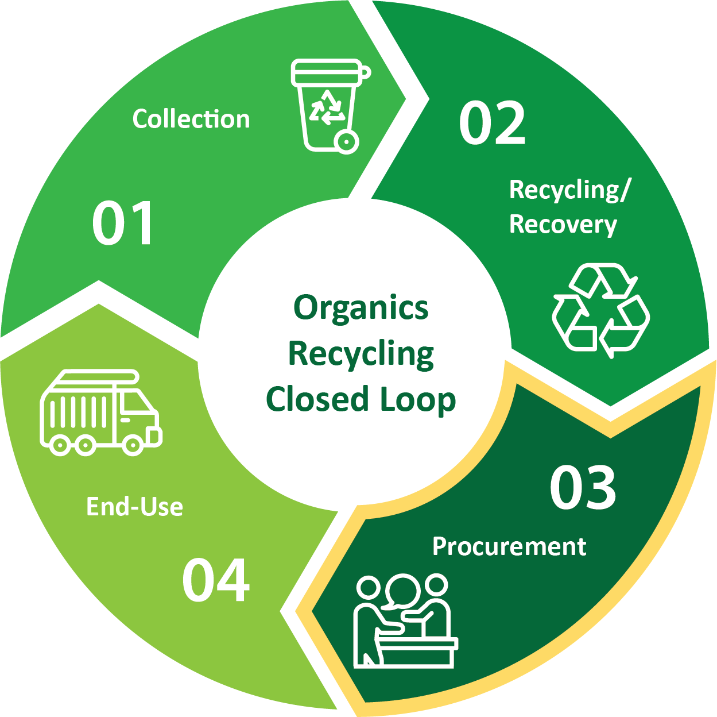

SB 1383 in Action
Procurement Requirements
Jurisdiction Requirements
COMPOST, MULCH, RENEWABLE NATURAL GAS & ELECTRICITY
Procurement Target
PAPER PROCUREMENT REQUIREMENTS
Recycled Content
Recyclability
Close the Loop
PROCUREMENT OPTIONS
Direct Procurement
Direct Service Provider
Procure Recycled and Recovered Organic Products
Notes:
Beginning January 1, 2022, each jurisdiction (a city, a county, or a city and county) will have an annual procurement target, which establishes the minimum quantity of recovered organic waste products a jurisdiction is required to procure annually.
The procurement target is based on a jurisdiction’s population size.
There is a portfolio of products jurisdictions can procure to meet their targets, including compost, mulch, biomass-derived electricity, or renewable gas from anaerobic digestion (used for transportation fuel, electricity, or heating applications).
Jurisdictions can decide what mix of eligible products they want to procure.
The regulations outline the conversion factors that will be used to convert each jurisdiction's procurement target into quantities of recovered organic waste products.
CalRecycle has developed a calculator tool to assist jurisdictions with these calculations and with tracking their progress towards meeting the target.
A jurisdiction can meet their procurement requirements by directly procuring products for use or giveaway.
A jurisdiction can also meet their target through a direct service provider, who is required by written contract to procure recovered organic waste products on behalf of the jurisdiction and provide written documentation of such procurement to the jurisdiction.
Procurement doesn’t necessarily mean purchase.
A jurisdiction may also produce or otherwise acquire eligible products (e.g., free delivery of compost from a hauler) and subsequently use or give away those products to meet their procurement target. For example, a jurisdiction could use compost or mulch or host community giveaways.
The same goes for the jurisdiction’s direct service providers. For example, a jurisdiction’s hauler that uses eligible transportation fuel from renewable gas to fuel their trucks could be a contracted direct service provider and procure on behalf of the jurisdiction.
Separate from the procurement target, SB 1383 also requires that jurisdictions procure recycled-content paper when it is available at the same price or less than virgin material. These must also meet Federal Trade Commission (FTC) recyclability guidelines (essentially products we purchase must be “recyclable”).
This applies to Printing and Writing Papers & Paper Products.
The paper procurement requirements also apply to a broader scope of “jurisdictions” and include special districts that provide solid waste collection services.
There are recordkeeping requirements for both the procurement of recovered organic waste products and recycled-content paper.

Slide 13
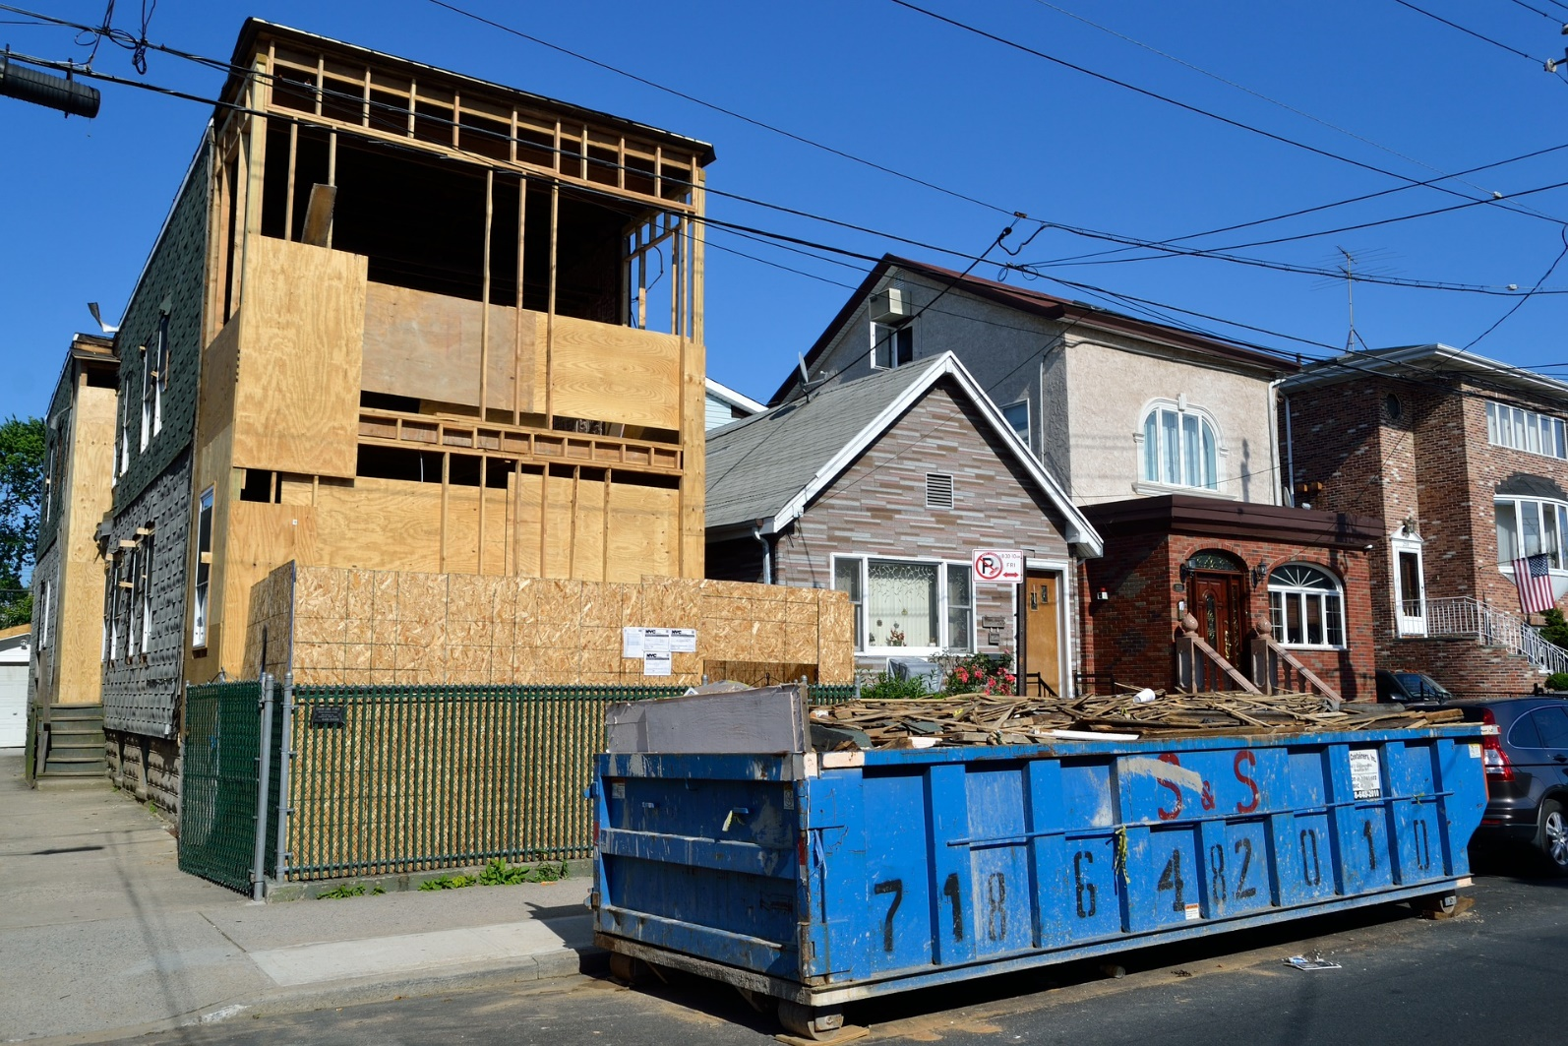
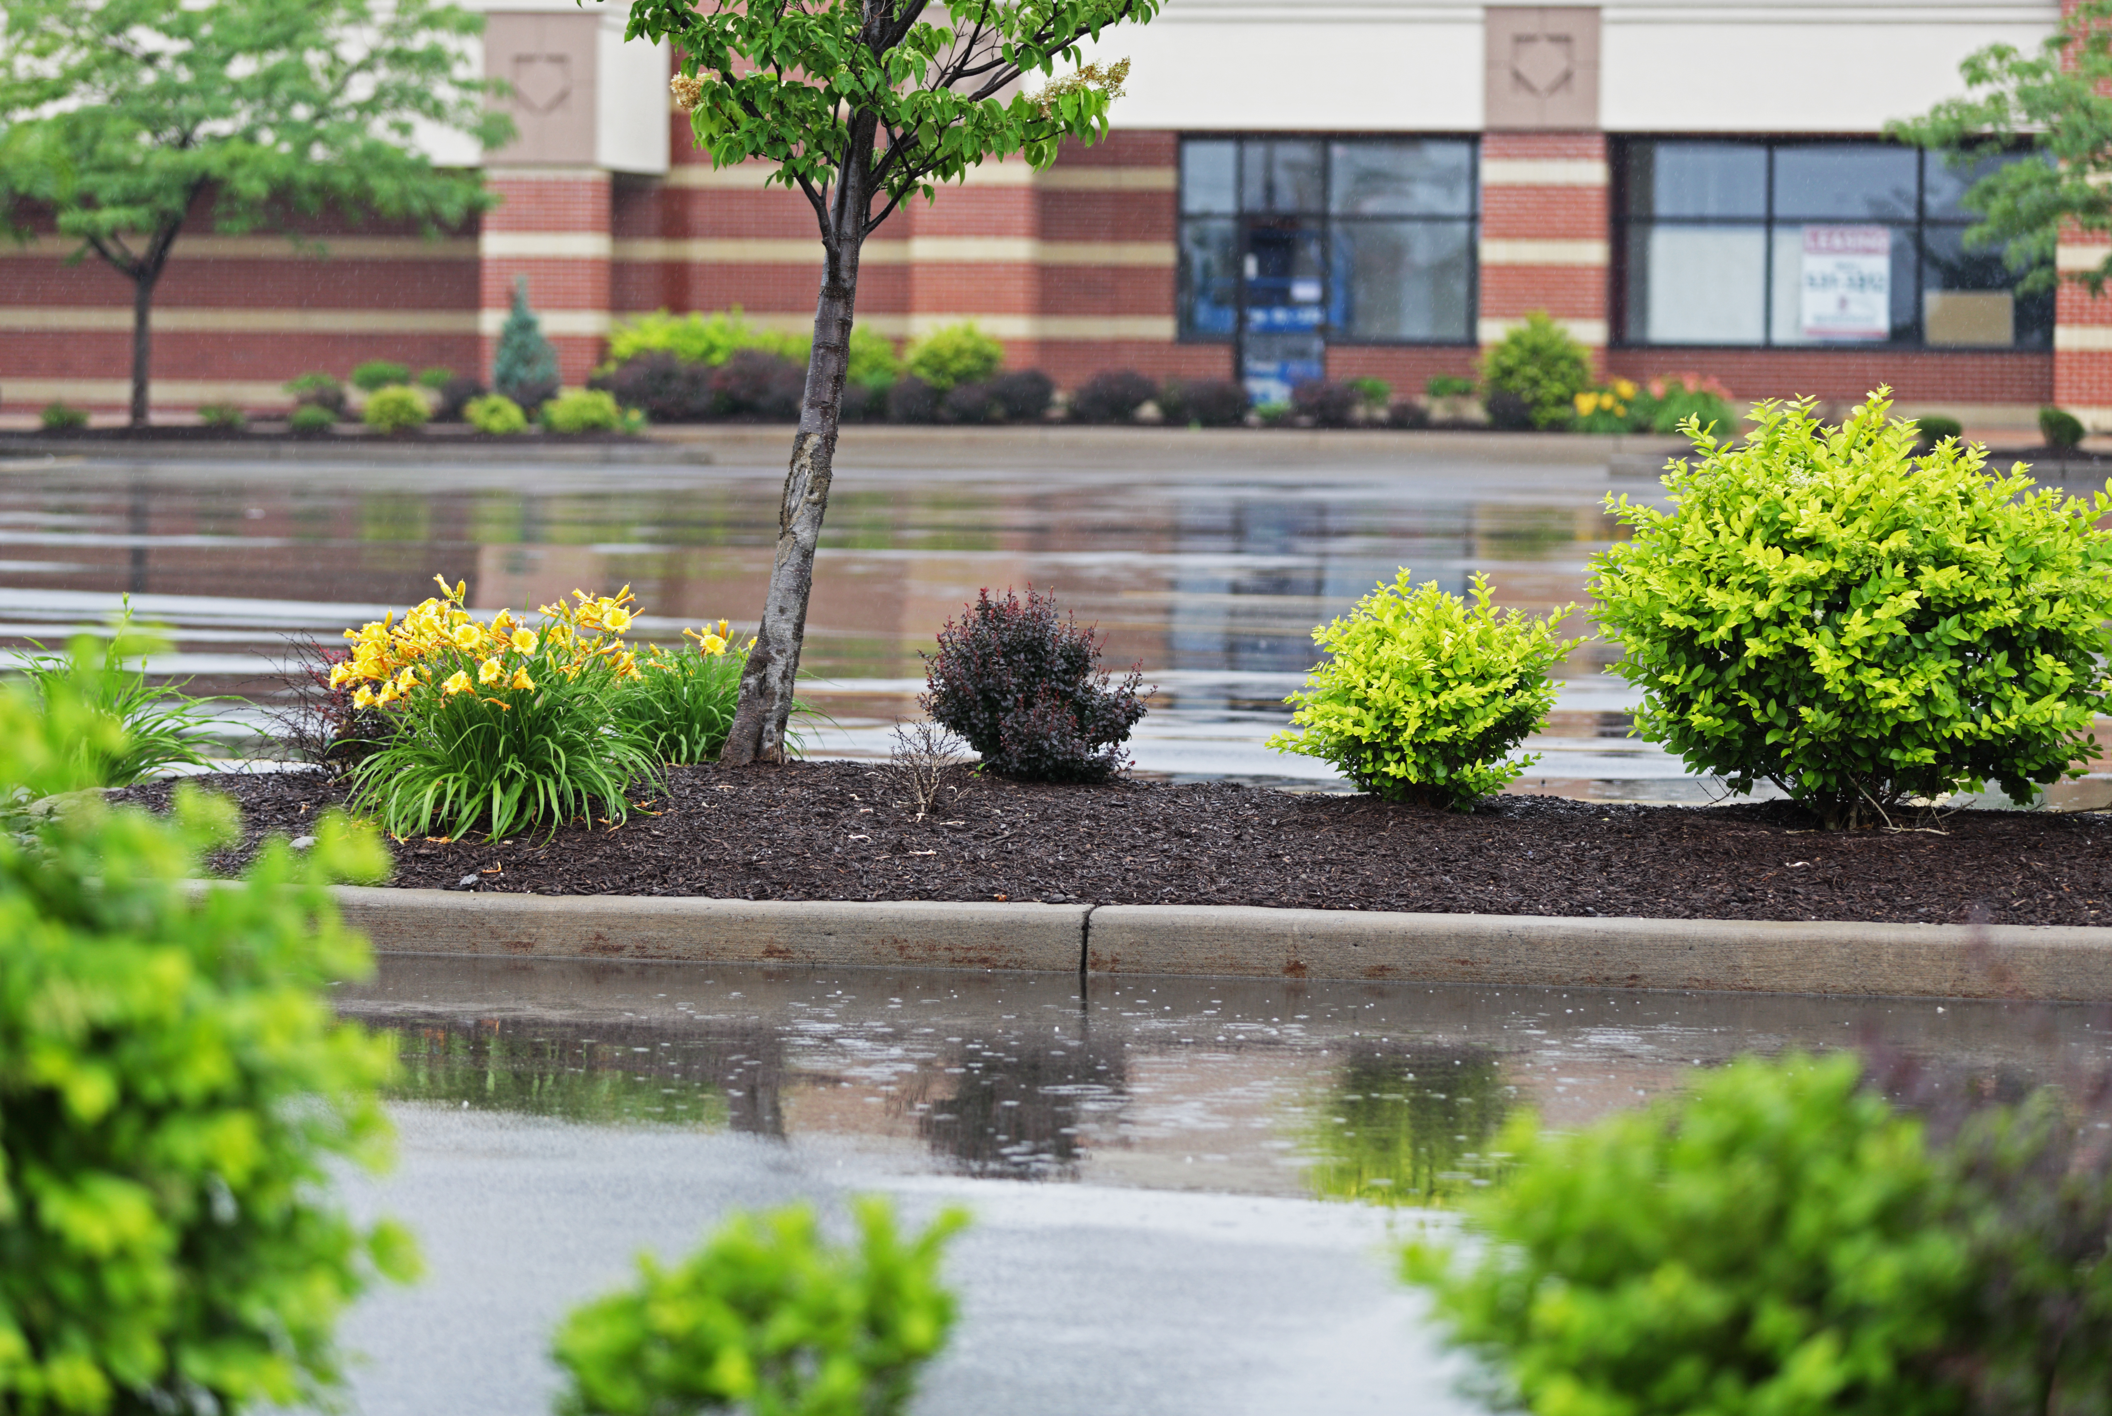
Construction & Landscaping Requirements
Model Water Efficient Landscape Ordinance (MWELO) requirements for compost and mulch application.
Recycling organic waste commingled with C&D debris, to meet CalGreen 65% requirement for C&D recycling in both residential and non-residential projects
Notes:
(Note to presenter: If your Jurisdiction already enforces CalGreen and MWELO, then you would address that this would not be a new requirement. Use this an opportunity to promote your efforts of success.)
Jurisdictions will have to adopt an ordinance or other enforceable requirement that requires compliance with CalGreen and Water Efficient Landscape Ordinance requirements (California Code of Regulations Title 24, Part 11):
Providing readily accessible areas for recycling containers in commercial and multi-family units
Recycling organic waste commingled with C&D debris, to meet CalGreen 65% requirement for C&D recycling in both residential and non-residential projects
Require new construction and landscaping projects to meet Water Efficient Landscape requirements for compost and mulch application.

Slide 14
Waste Sector Outlook
Notes:
Here we can see both the available and needed Compost, AD, and chip and grind capacity needed to meet 75% reduction in disposal by 2025 goal set by SB 1383.
There are a number of activities, such as source reduction, recycling, composting, in-vessel digestion, community composting, food recovery, biomass, rendering, and animal feed, that constitute a reduction in landfill disposal under SB 1383.
The regulations do not dictate which alternatives to landfill disposal must be utilized and jurisdictions have the flexibility to design their programs to utilize landfill alternatives that work best for their community.
Jurisdictions throughout the state are currently assessing their organics recycling capacity and planning for additional capacity when needed.

Slide 15
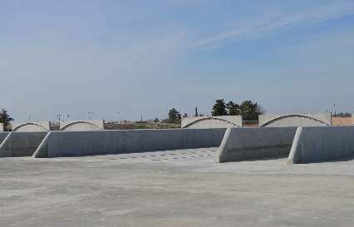
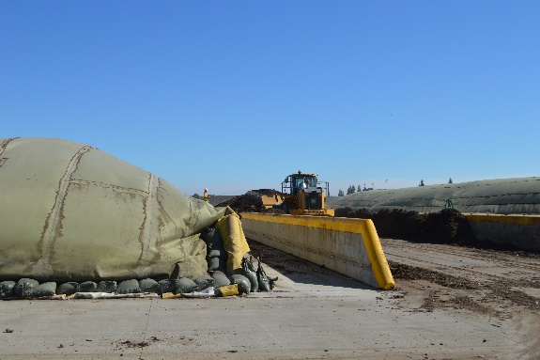

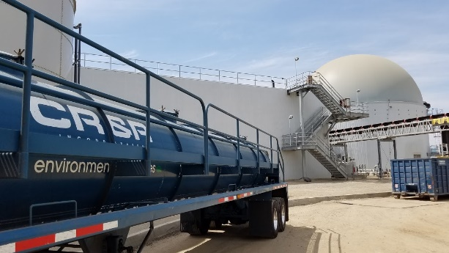
SB 1383 in Action
Infrastructure Requirements
Evaluating Current Infrastructure and Planning
New Compost and AD Facilities and Edible Food Recovery
Notes:
Each jurisdiction must plan for adequate capacity for recycling organic waste and for edible food recovery
Each county will lead this effort by coordinating with the cities, regional agencies, and special districts that provide solid waste collection services in the county to estimate existing, new and/or expanded capacity.
Each jurisdiction must demonstrate that it has access to capacity through contracts, franchise agreements, or other documented arrangements.
There are requirements for each jurisdiction to consult with specified entities to determine organic waste recycling capacity, such as the Local Enforcement Agency, Local Task Force, owners/operators of facilities, community composting operations, and from citizens, such as disadvantaged communities, i.e., to discuss the benefits and impacts associated with expansions/new facilities.
For edible food recovery the county and city must contact edible food recovery organizations and food recovery services that serve the jurisdiction to determine how much existing, new and/or planned capacity is available.
If capacity is lacking, each jurisdiction within the county that lacks capacity must submit an implementation schedule to CalRecycle that includes specified timelines and milestones, including funding for the necessary recycling or edible food recovery facilities.
The County must collect data from the jurisdictions on a specified schedule and report to CalRecycle. Jurisdictions are required to provide the required data to the County within 120 days.
The first report is due Aug. 1, 2022 – that report must cover 2022-2024.
Subsequent reports will be due every 5 years, and will plan for a 10-year horizon

Slide 16


SB 1383 in Action
Inspection and Enforcement Requirements
Jurisdiction Requirements
Compliance Monitoring & Education
2022-2024
Compliance Monitoring & Enforcement
2024
Ordinance
2022
Adopt an Ordinance (Enforceable Mechanism)
Including Enforcement
Annual Compliance Reviews, Route Reviews, Inspections
Educate Violators
Annual Compliance Reviews
Route Reviews, Inspections,
Notice of Violations,
Penalties for Violators
Monitor Compliance and Conduct Enforcement
Notes:
By January 1, 2022, jurisdictions are required to have:
An enforcement mechanism or ordinance in place
They are not required to enforce until 2024.
Between Jan 2022 and Dec 2023, jurisdictions need to:
Identify regulated entities in violation and provide educational material as required by Section 18995.1(a)(4)
The focus during the first 2 years is on educating entities.
With the goal of ensuring every entity has an opportunity to comply before mandatory jurisdiction enforcement comes into effect in 2024.
Starting January 2024, jurisdictions must take enforcement against entities that are not in compliance.
Section 18995.4(a)(1) allows for notification to the generator and provides 60 days for the generator to comply before penalties are required to be issued by the jurisdiction.
The jurisdiction has the flexibility to develop its own enforcement process within these parameters.
Section 18997.2 of the regulations set the following penalty ranges:
Between $50-$100 base penalty for the first violation,
Between $100-$200 base penalty for the second violation of the same nature within a year of the first penalty, and
Between $250--$500 base penalty for the third or subsequent violation of the same nature occurring within a year of penalty for the most recent violation.
An early robust education program will minimize the amount of future enforcement action needed.

Slide 17
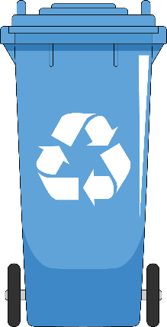
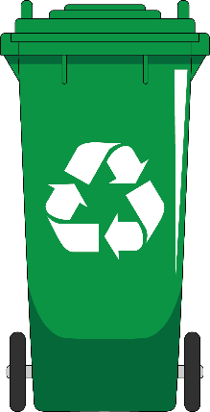
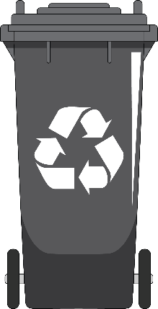
Jurisdiction Enforcement Requirements
Must Have Enforcement and Inspection Program that Includes:
Annual Compliance Review
  Commercial Businesses that Generate > 2 Cubic Yards/week
  Verify Businesses are:
    Subscribed to Service or Self-hauling
2 or 3 Container Collection Service: Route Reviews of Commercial/Residential Areas to Verify Service and Inspect for Contamination OR Waste Evaluations to Determine Percent Contamination in Loads at the Facility
Single Unsegregated Collection Service: Verify Businesses are subscribed to a service that is Transporting Contents to a High Diversion Organic Waste Processing Facility
Requirements Harmonize with AB 1826 and Don’t Establish a Minimum Quantity of Physical Inspections
Notes:
(Note to Presenter: If needed, customize the next couple of slides to fit the type of collection service that your City has/will have for residential and commercial. You may have residential on 3-container, multifamily on single or 2-container and businesses having all three depending on the business.)
If a Jurisdiction is using a 3- or 2-bin organic waste collection service they are required to do:
Annual compliance review of commercial businesses just as we should be doing now with AB 1826 Mandatory Commercial Organics Recycling
Commercial businesses that generate 2 CY or more per week of solid waste (trash, recycling, organics),
Note: commercial businesses include multi-family dwellings of five units or more
This is a desk audit to verify that service is provided or that they are complying through self-hauling or backhauling
3+, 3 or 2 container collection service:
Route reviews: We are supposed to conduct route reviews of commercial businesses and residential areas. The route reviews check randomly selected containers, must be done on all collection routes annually, is a visual inspections (bags do not have to be opened), and education is provided if there is an issue
OR
A jurisdiction has the option of conducting waste evaluations every six months to identify if there are prohibited container contaminants. If there is more than 25 percent prohibited container contaminants, then additional education must be provided
There are numerous activities that can be delegated to our haulers, such as the Route Reviews.
Single Unsegregated Collection Service:
We will need to verify with our hauler(s) that the contents are transported to a high diversion organic waste processing facility and that the facility is meeting the requirements of the organic content recovery rate
Note: The department will be identifying in the future what facilities are high diversion organic waste processing facilities as the facilities will be reporting to CalRecycle.
There are no route reviews required

Slide 18
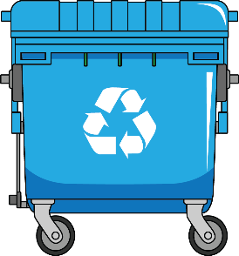
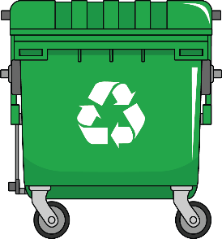
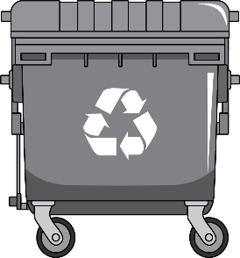
Jurisdiction Enforcement Requirements
On Commercial
Food Generators
Must Have Enforcement and Inspection Program that Includes:
Inspections to verify:
  Edible food Recovery arrangements
Tier 1 Commercial Edible Food Generators by 2022
Food Recovery Organizations and Services by 2022
Tier 2 Commercial Edible Food Generators by 2024
Commercial Edible Food Generator Inspections Can Be Combined with Existing Mandatory Inspections
Notes:
(Note to Presenter: If your jurisdiction is already implementing an edible food recovery program and conducting inspections, such as through the Health Department you will want to revise the talking points.)
Edible Food Recovery Program inspections (Sections 18991.1 and 18995.1)
These types of inspections will be new for our jurisdiction.
We will need to plan resources to conduct these inspections.
We might consider partnering with Health Inspectors that are already visiting food generators.
Inspections on Tier One edible food generators in 2022 and Tier Two in 2024
Verify they have written arrangements with a food recovery organization or food recovery service
Verify they are maintaining required records
Verify that the food generators are recovering the maximum amount of edible food and not intentionally spoiling food
Inspections on food recovery organizations and food recovery services in 2022
Verify they are maintaining required records

Slide 19





SB 1383 in Action
Jurisdiction Requirements
Recordkeeping Requirements:
Organic Collection Services
Hauler Program
Contamination Minimization
Waivers
Education & Outreach
Maintain Records and Report to CalRecycle
Edible Food Recovery Program
Recycled Organic Waste Procurement
Recycled Paper Procurement
Commercial Edible Food Generators
Jurisdiction Inspection & Enforcement
Notes:
Our jurisdiction will have to maintain all information in an Implementation Record.
This graphic is a snapshot of items to be kept in the Implementation Record.
Each section requires a minimum level of recordkeeping such as “ordinances, contracts, and franchise agreements”.
CalRecycle reviews the implementation record as part of a compliance evaluation of our program.
The Implementation Record needs to be stored in one central location
It can be kept as a physical or electronic record
It needs to be accessible to CalRecycle staff within ten business days
It needs to be retained for five years

Slide 20

State Enforcement
CalRecycle Oversight (Begins in 2022)
Oversee and Monitor for Compliance
Jurisdictions
State Agencies and Facilities
Local Education Agencies
Review Reports, Records and Authorize Waivers
Annual Reports
Implementation Record
Low Population Waivers
Rural Area Waivers
Emergency Circumstances Notifications
If Violations
Issue Notices of Violation
Approve Corrective Action Plan
Allows up to 24 months to address barriers outside of a jurisdiction’s control
May be subject to penalties
Notes:
CalRecycle will be overseeing and monitoring Jurisdictions, State Agencies and facilities, and Local Education Agencies Compliance. These efforts can include verifying:
That organic waste generators have service
Jurisdictions are providing education
That Notices of Violation are issued within the correct timeframe
SB 1383 is a Statewide target and not a jurisdiction organic waste diversion target.
Unlike with AB 939 where there was a specified target for each jurisdiction, SB 1383 prohibits a jurisdiction target. Due to this structure:
The regulations establish state minimum standards.
Jurisdictions and the regulated community have to demonstrate compliance with each of the standards
Under the SB 1383 regulations if CalRecycle determines a jurisdiction is violating one or more of the requirements,
A jurisdiction will be issued a Notice of Violation and will be provided up to 90 days to correct the violation(s).
For cases where the jurisdiction may need additional time, CalRecyle may provide an extension for up to 90 days.
For violations that are due to barriers outside the jurisdiction‘s control and may take more time to correct, the regulations allow for the jurisdiction to be placed on a Corrective Action Plan (CAP). The CAP can allow up to 24 months to comply. In these cases, the jurisdiction needs to show it has taken substantial effort to comply but cannot be due to extenuating circumstances.
A CAP issued due to inadequate organic waste recovery capacity may be extended for a period of up to 12 months if the jurisdiction meets the requirements and has demonstrated substantial effort to CalRecycle.
Failure to effectively implement SB 1383 could result in penalties of up to $10,000 per day.
Regarding eligibility for a CAP failure of a governing body to adopt an ordinance, adequately fund the programs, or not identifying resource to implement the requirements of the law IS NOT considered substantial effort or an Extenuating Circumstance and will not allow a violation to be subject to a Corrective Action Plan.

Slide 21

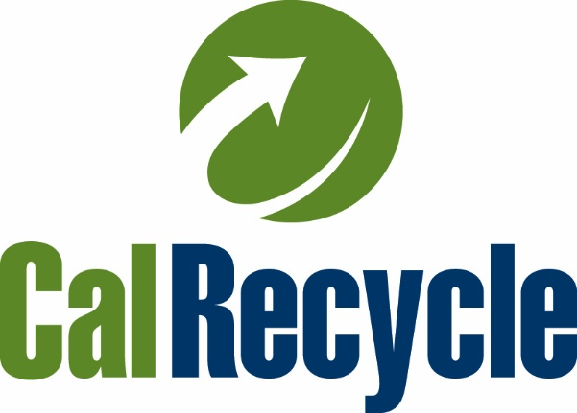


Stay
Engaged
https://www2.calrecycle.ca.gov/Listservs/
Subscribe/152
https://www.calrecycle.ca.gov/organics/slcp
Presenter’s Contact Info
Notes:
(Note to presenter: If you have been participating in the regulatory workshops you might customize this slide. If you haven’t been participating you might consider using this slide to discuss next steps with your elected officials and executive management.)

