Slide 1
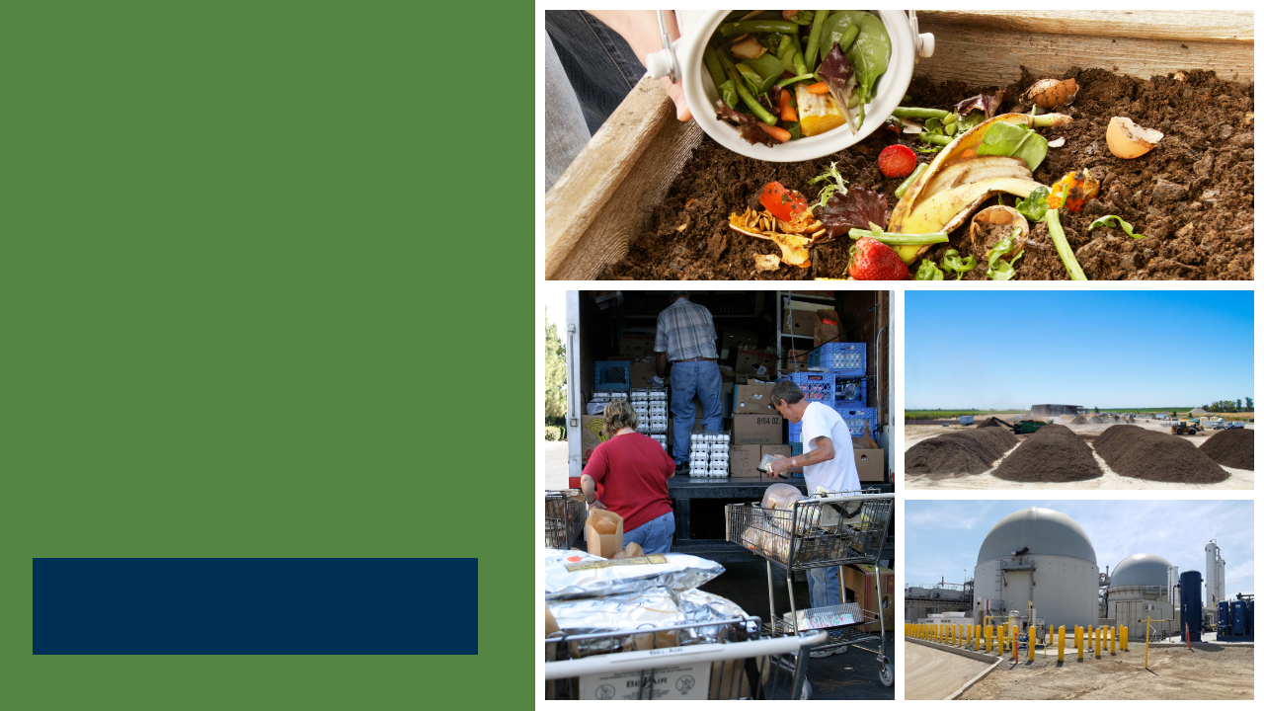
SB 1383
Model Franchise Agreement
CalRecycle Statewide Webinar
Presented by HF&H Consultants and CalRecycle
October 27, 2020
Notes:
Presentation Introduction
SB 1383 (Lara, Chapter 395, Statutes of 2016) is the most significant waste reduction mandate to be adopted in California in the last 30 years.
The legislation has significant policy and legal implications for state and local governments.
To assist jurisdictions with the implementation of SB 1383, HF&H Consultants, in collaboration with Diversion Strategies and Debra Kaufman Consulting, worked with CalRecycle to develop four Model Tools:
Model franchise agreement;
Model mandatory organics disposal reduction ordinance;
Model organic waste product procurement policy; and,
Model edible food recovery agreement.
This presentation will focus on the Model Franchise Agreement Tool, which has been developed to provide jurisdictions and haulers with contract language to support jurisdictions’ compliance with SB 1383 requirements for collection, processing, contamination monitoring, education, record keeping, and more.

Slide 2
Disclaimer
This Model Tool is for informational and example purposes only. It should not merely be duplicated without consideration of an individual jurisdiction’s particular needs or circumstances. It is not intended to cover each and every situation, nor can it anticipate specific needs.
In developing the Model Tool, CalRecycle and its consultant (HF&H Consultants) have attempted to ensure that the language herein aligns with the SB 1383 regulations; however, in the event of any conflict, the language in the regulations shall prevail over language in the Model Tool and determination of regulatory intent and interpretation should be appropriately guided by the regulatory language and the official rulemaking record of which this Model Tool is not a component.
CalRecycle and its consultant make no representation that use of this Model Tool will ensure compliance with regulatory requirements.
The Model Tool does not constitute legal advice. Jurisdictions are encouraged to seek legal counsel appropriate to their particular circumstances regarding compliance with regulatory requirements.
Notes:
Disclaimer
Before we go any further, we do have to go over the fine print.
The Model Tools are for example purposes only. They should not merely be duplicated without consideration of an individual jurisdiction’s particular needs or circumstances. It is not intended to cover each and every situation, nor can it anticipate specific needs.
We’ve done our best to align the language in the Model with the regulations. However, in the event of any conflict, the language in the regulations shall prevail over language in the Model Tool.
In such cases, the SB 1383 reg language and the official rulemaking record should guide determining regulatory intent and interpretation.
It is also important to note that each jurisdiction is ultimately responsible for its compliance with the regulations, and is advised to seek legal counsel in development or modification of its agreement(s).

Slide 3

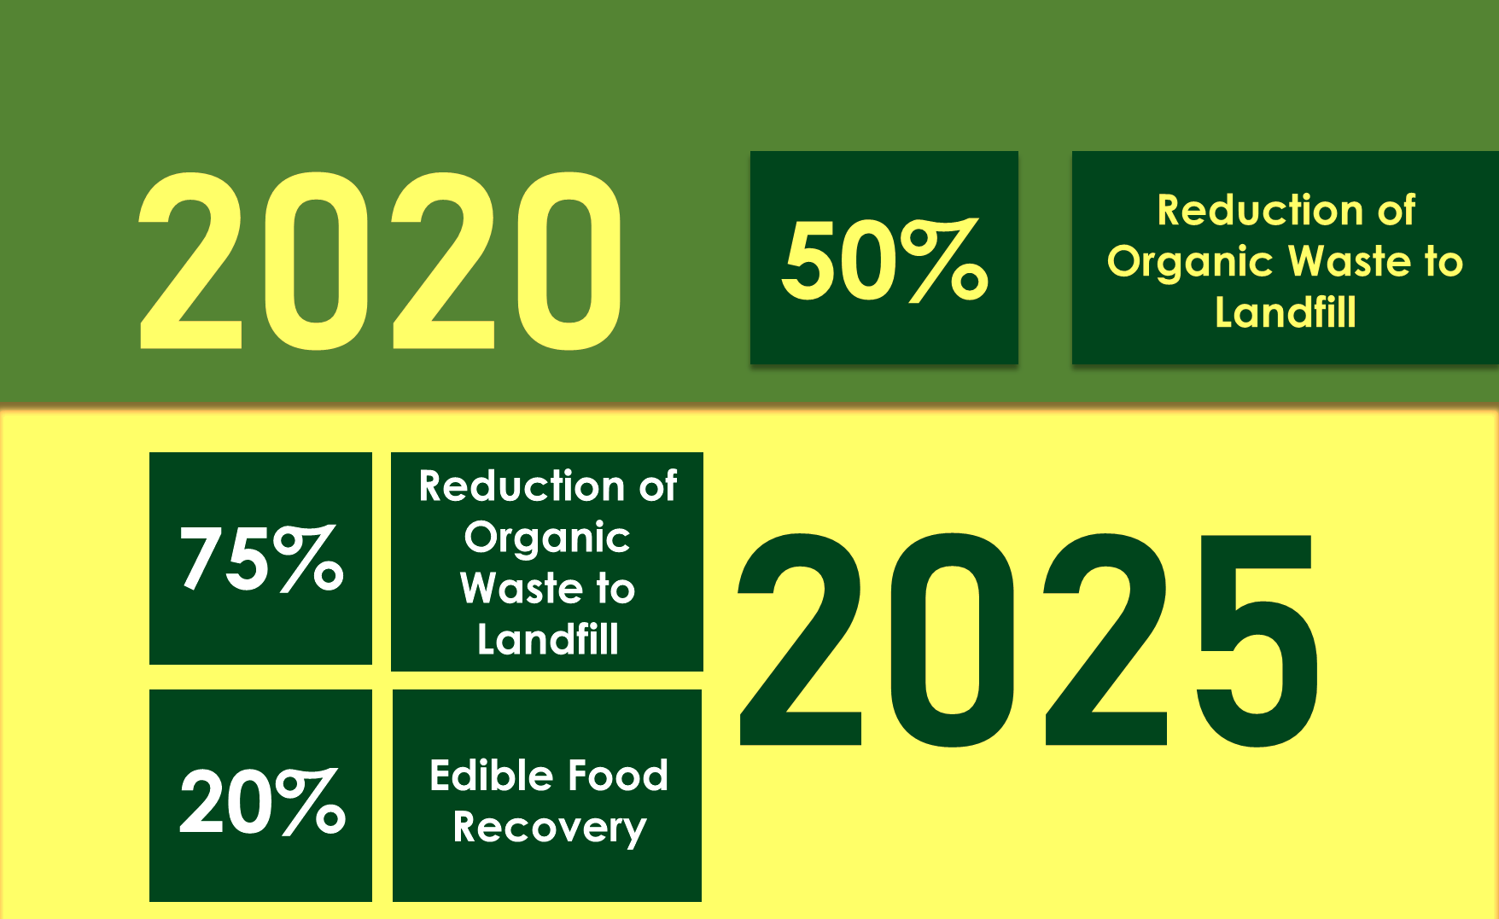
Outline
SB 1383 overview
Model objectives
Model structure and considerations
Model highlights
Q & A
Notes:
Presentation Outline
We will begin with an overview of SB 1383, highlighting specific requirements, target dates, and local government roles and responsibilities.
We will then discuss objectives of the Model Franchise Agreement Tool, reviewing how it was developed, how it is structured, and items to consider while using the Model Tool.
Next, we’ll go through the Model Franchise Agreement, article by article. We will cover the focus of each article as well as guidance notes and customizations options that are provided in the Model Tool.
We expect the presentation to be about 40 minutes.
NOTE TO PRESENTER: AMEND THIS STATEMENT IF YOU PLAN TO STOP ALONG THE WAY FOR QUESTIONS.
To manage our time, I ask that you hold questions until the end of the presentation. We will have about 20 minutes for questions and answers.

Slide 4
SB 1383 Requirements
2020
50% Reduction in Landfilled Organic Waste
(11.5 Million Tons Allowed Organic Waste Disposal)
2022
Regulations Take Effect
2025
75% Reduction in Landfilled Organic Waste
(5.7 Million Tons Allowed Organic Waste Disposal)
2025
20% Recovery of Currently Disposed Edible Food for Human Consumption
Notes:
SB 1383 establishes organic waste reduction targets.
It builds upon Mandatory Commercial Organics Recycling law. California Jurisdictions have been implementing this law since 2016.
SB 1383 sets a goal for Californians to reduce disposal of organic waste 50% by 2020 and 75% by 2025.
These targets use the 2014 Waste Characterization Study measurements when 23 million tons of organic waste were disposed in California.
These disposal reductions will reduce at least 8 million metric tons of greenhouse gas emissions annually by 2030.
SB 1383 establishes an additional goal to recover 20% of currently disposed edible food for human consumption by 2025, as directed by Legislature as a part of the disposal reduction targets.
The SB 1383 definition of organic waste covers many materials, such as food, paper, cardboard, greenwaste, and woodwaste, etc.
The regulations take effect in 2022.

Slide 5






SB 1383 Key Jurisdiction Dates
2022
2024
Provide Organics Collection Service to All Residents and Businesses
Take Enforcement Action Starting January 1, 2024 Against Non-Complaint Entities
Establish Edible Food Recovery Program
Conduct Education and Outreach
Procure Recovered Organic Waste Products
Plan for Capacity
Notes:
In SB 1383 terms, a jurisdiction is defined in the regulations to include cities, counties, cities and counties, and special districts that provide solid waste handling services.
To meet the regulatory deadline of January 1, 2022, CalRecycle expects that jurisdictions will be planning and making programmatic and budgetary decisions regarding the requirements now.
By 2022, Jurisdictions are required to:
Have an ordinance (we will be discussing that later in the presentation.)
Have organics collection services for all residents and businesses up-and-running. Organic waste collection services are to be automatically provided to all residents and businesses if they generate organic waste;
Implement edible food recovery programs established for Tier 1 generators by Jan. 1, 2022 and for Tier 2 generators by Jan. 1, 2024;
Conduct compliant education and outreach efforts;
Procure recovered organic waste products and paper/paper products; and,
Assess and plan for organic processing and edible food recovery capacity.
In addition, jurisdictions are to conduct desk audits, route reviews, and inspections of Tier 1 generators.
In the first two years, jurisdictions must provide education and outreach to non-compliant generators.
Note that CalRecycle can begin enforcement actions on jurisdictions and other entities starting on Jan. 1, 2022.
In 2024, Jurisdictions will be required to take enforcement against noncompliant entities.
Note that Jurisdictions are not required to impose penalties on generators found in violation of prohibited container contaminant requirements.
CalRecycle has some funding available through competitive grant programs, as well as loan programs, for establishing the infrastructure for recycling organic waste and recovering edible food. However, for the programmatic activities, such as enforcement, inspections, education, and collection service, Jurisdictions will need to plan for budgetary and staffing changes to address these requirements.
The big takeaway here: is that jurisdictions need to start planning now to have the programmatic, staffing, and budgetary changes in place by January 1, 2022.
The Model Franchise Agreement is a tool that can significantly help jurisdictions comply with SB 1383 requirements by contracting with their hauler or haulers for provision of organics collection services to all generators as well as provision contamination monitoring, education, and reporting.

Slide 6




SB 1383 in Action
Jurisdiction Requirements
Organic Waste Collection Services
Three-Container “Source Separated” Collection Service
Organics prohibited from black container
All organic waste segregated for collection and recycling
Two-Container Collection Service
One container for collection of segregated
organic waste
One container for collection of mixed waste (subject to 75% organic content recovery standard)
One-Container Collection Service
One container for collection of mixed waste (subject to 75% organic content recovery standard)
Provide organics collection service to all residents and businesses
Minimum contamination monitoring and reduction requirements
Collection waivers authorized for certain documented circumstances
Notes:
The most basic element of the regulation is that jurisdictions are required to automatically provide an organic waste collection service to each of their residents and businesses.
Organic waste collection services is not just the “green container”.
This slide depicts the different types of organic waste collection options that are available under SB 1383 regulations.
The regulations also require all residents and businesses to use an organic waste recycling service that meets the regulatory requirements.
Jurisdictions must regulate and have enforceable requirements for its haulers that collect organic waste in the jurisdiction, and also for commercial and residential generators and self-haulers.
There is a lot of detail in the SB 1383 regulations regarding the types of allowable collection programs (several pages of regulatory text dedicated just to this). At a high level, they require the following.
Each resident and business must be provided and subscribe to an organic waste collection service where the generator “source separates” the waste (e.g. separate bins), or where the service provider transports all unsegregated waste to a facility that recovers a certain percentage of the organic content collected from the system.
The regulations allow for a menu of collection options. Jurisdictions may also use a combination of these services. For example, residents may have a three-container system and businesses may have a two-container system.
For three-container systems, the gray container can be used for landfill-bound material; the blue container for recyclables including organic recyclables, and a green containers for food and yard trimming. In this program, organic waste is required to be source separated where paper and cardboard is placed in the blue container, food and yard in green containers). No required recovery rate is required for processing.
The three-can option also allows additional separation. For example, some jurisdictions provided separate containers or split containers for yard waste and food waste so these materials can be managed separately
If using a two-container system, at least one of the containers (whichever does not contain source separated materials) must be transported to a high diversion organics processing facility
Lastly, a one-container system is an option. In this scenario, the jurisdiction will be responsible for ensuring that all contents are transported to a high diversion organic waste processing facility that recovers the prescribed amount of organic content.
The same rules will apply to entities not subject to the local jurisdiction’s control. In these cases, CalRecycle will oversee State Agencies, UCs, CSUs, Community Colleges, K-12 schools, and other entities not subject to local oversight.
The Model Franchise Agreement addresses the various types of collection services and provides options that can be customized.

Slide 7
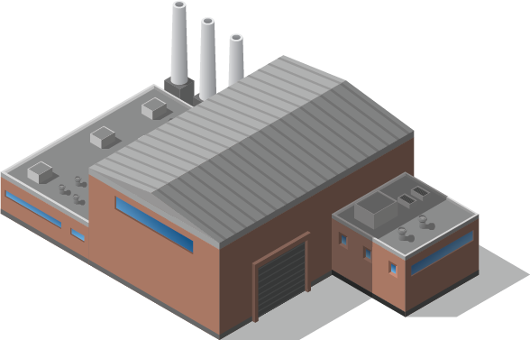







SB 1383 in Action
Other Requirements
Processing
Requirements tied to collection system and compliance approach
Contamination
Monitoring
Reporting
Notes:
Jurisdictions must also ensure certain processing requirements are met.
They will also need to conduct contamination monitoring and report on how they are implementing these requirements.
We’ll review how the Model Franchise Agreement provides provisions for all of these requirements.
Keep in mind that most of these requirements are tied to the jurisdiction’s collection system and compliance approach.
The Model Franchise agreement provides example language for a number of different approaches.

Slide 8


Model Franchise Agreement
Notes:
NOTE FOR PRESENTER: At this point, you may choose to pause and ask for questions on the SB 1383 regulatory overview. This is an option to be used if the presenter wants to break up the presentation and engage the audience.
This wraps up the overview of the key SB 1383 regulations related to franchise agreements. I will now shift gears to present the Model Franchise Agreement.

Slide 9

Objectives of the Model
Franchise Agreement
Support jurisdictions with planning,
implementation, and compliance with SB 1383
Provide resources and guidance
Increase understanding of regulations and compliance strategies
Note that franchise agreements are not required under SB 1383
  Model language may be adapted for contracts, and/or hauler permits/licenses
Notes:
Objectives of the Model Franchise Agreement
The objective of the Model Franchise Agreement is to provide jurisdictions, their contractors, and third parties with a tool to support their compliance with SB 1383.
Since franchise agreements are commonly used by jurisdictions throughout the state, this Model Agreement was prepared to support jurisdictions with planning, implementation, and compliance efforts.
A franchise agreement is not the only way to accomplish these arrangements, the regulations allow this to happen through a franchise, a license, or a permit system.
Regardless of the vehicle used, the Model Franchise will be a good tool to borrow language from to make sure you are covering key SB 1383 regulatory requirements.
Throughout the Model Franchise Tool, guidance notes are provided to help users understand the regulations and compliance strategies.
I want to emphasize that having a franchise agreement in place is not a specific requirement under SB 1383.

Slide 10



Model Franchise Agreement
Typical agreement framework
  Use of actual franchise provisions in many cases
  Use of new provisions when real world examples didn’t exist
  Organization with main body (general requirements) and exhibits (detailed specifications)
  Omission of some boiler-plate and non-SB 1383 related sections
Optional provisions address different conditions
  Contract arrangement
  Service options
  Compliance approaches
Notes:
Model Franchise Agreement
Now, we would like to briefly discuss how the Model Franchise Agreement was developed and what you can expect.
First, we started with a typical agreement framework.
We then built the provisions of the agreement out by using actual franchise provisions in many cases. We drew on nearly two dozen franchise agreements that include SB 1383-related provisions. In cases where no example language could be found, we drafted new provisions to fill the gaps. That language was sent to a resource group and additional refinements were made to the Model Agreement based on resource group member feedback.
The Model Franchise Agreement is organized into two main documents: the main body, which provides general requirements, and the exhibits, which provide detailed specifications.
Keep in mind that we have omitted some boiler-plate language and non-SB 1383 related sections, such as rate-setting provisions and performance standards. Those are things that should be dealt with at the local level and may be informed by existing practice or the negotiation that you will have with your contractor.
We designed the Model Franchise Agreement to be flexible for use by a wide range of communities with different contracting conditions, different service needs, and different compliance approaches.
We built optionality throughout the Model, so that there is a lot of “choose your own adventure” built into the Model. Options are offered by including multiple example provisions into dozens of sections throughout of the Agreement.
These options will allow users to pick and choose the language that most closely fits their circumstances and desired compliance approach. Because of the optionality, there is a lot of language that you ultimately will not select and you will need to remove from the Model as you work with it.

Slide 11
Important Considerations
Create a new agreement or amend the existing agreement, subject to review and revision
Review SB 1383 requirements while using Model
  Each jurisdiction is responsible for achieving compliance
Involve jurisdiction’s legal counsel for review
Engage with affected parties to streamline implementation
Recognize the Model provides example language ONLY
  Customization and modification is expected
Notes:
Important Considerations
We would like to note some important considerations to think about as you use the Model Franchise Agreement.
New Agreement or Amendment of Existing Agreement
The Model Franchise Agreement can be used by jurisdictions drafting new agreements and those amending existing agreements. It is recommended that users consider use of existing provisions, subject to review and revision as needed, or are advised to use provisions resulting from negotiations.
For new franchise agreements, the Model Franchise Agreement may be used as a starting point, noting, as discussed, that it does not contain example language for all provisions in a typical franchise agreement.
For amendments to existing agreement(s), example provisions in the Model can be integrated into the jurisdiction’s existing agreement.
In either case, we strongly recommend that you look at the detailed language and not just accept what the Model says. Think about how it will work in your community and edit the provisions as needed.
We have provided this tool as a Model to work for all jurisdictions in the state, which means all users will need to make refinements to meet the specifics of their jurisdiction.
SB 1383 Requirements
Each jurisdiction is responsible for understanding and complying with SB 1383.
Use of the Model Franchise Agreement does not mean that a jurisdiction is compliant. Those using the Model will need to make sure that specific provisions deal with the needs of your SB 1383 compliance strategy and that you have thought through other requirements of SB 1383 that may not be covered through the Model Franchise Agreement.
Not all SB 1383 requirements can be fulfilled through delegation to the collection companies. Jurisdictions will be required to fulfill SB 1383 requirements that the collection contractor cannot, so it is important to understand where those gaps are and where you will need to fill in.
Involve Legal Counsel
Any agreement that results from use of the Model Franchise Agreement should not be considered to have undergone legal counsel review. Each jurisdiction is responsible for involving its legal counsel to perform legal review and approval processes typically required by the jurisdiction for approval of such agreements.
Engage with Contractor(s)
When amending an existing franchise agreement(s), it is advised that the amendment process involves engagement with the involved contractor(s) and negotiation of final terms and conditions suitable for all parties. This process will include the hauler(s) and may include transfer and processing contractors, when those services are handled through separate contract(s). This is a two-party agreement, and both parties need to be involved in the negotiation of the terms.
Example Language Only
Lastly, I want to mention that the provisions in the Model Franchise Agreement are examples only. Jurisdictions are not required to use this language nor include similar provisions in its franchise agreement(s). The Model Agreement is provided as a tool. If a jurisdiction has a unique way of dealing with requirements, that is okay.

Slide 12

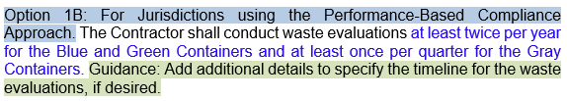
Guidance, Customization, and
SB 1383 Content
General guidance notes
Specific customization notes
SB 1383-specific content
Notes:
General Guidance, Optionality, and SB 1383-specific Content
The Model Franchise Agreement is a colorful document. There are green and blue highlights and there is blue text, and all of those things have significance.
Guidance notes, highlighted in green, are integrated into the Model Franchise Agreement to explain how specific sections and provisions of the Model can be customized for a particular user’s needs.
These guidance notes clearly identify what SB 1383 requires and what is optional for consideration by the users of the Model.
Notes in blue identify various options or areas where specific information is to be inserted or selected.
SB 1383-specific content is shown in blue font.
Franchise language not specific to SB 1383 is shown in black font, but may be supportive of SB 1383 and may provide additional parameters that are not in the regulations but are necessary to have in the franchise agreement to make the language operative.
In most cases, the black font relates to SB 1383 requirements and we have tried not to get into areas that are not related to SB 1383, but are more business deals.
The examples shown on this slide present optional provisions for Standard or Performance-Based Compliance
SB 1383 regulations define:
(i) a standard compliance approach for organics collection (documented in Article 3); and,
(ii) a performance-based approach (documented in Article 17).
Throughout the Model Franchise we have included option language for each approach and guidance notes when certain provisions should be included or excluded depending on which compliance approach the jurisdiction is using.

Slide 13







Collection, Processing, and Disposal
Consider current collection system and compliance
Consider necessary provisions and number of contracts
  Integrate collection/processing/disposal or separate contracts
Present general guidance and options
Notes:
Collection, Processing, and Disposal
The manner in which a jurisdiction contracts for collection, processing, and disposal services will impact the necessary provisions of the franchise agreement.
In a system that integrates collection, processing, and disposal services under one contract, the user of the Model will need to include all provisions that cover those services.
In systems where collection is handled under a separate contract from processing, transfer, or disposal, the example processing, transfer, and/or disposal provisions in the Model can be omitted.
General guidance and optional franchise provisions are presented in the Model Agreement to give users insight on which provisions to select and adapt for their contract conditions.

Slide 14


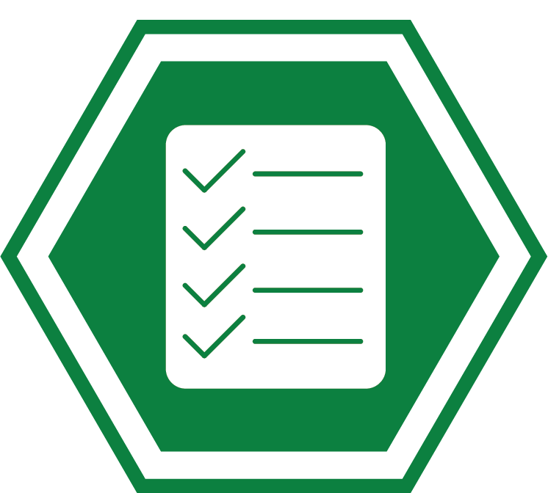
Delegation of Responsibilities
Jurisdiction, franchised hauler, or third party
Options presented in Model for delegation scenarios
Notes:
Delegation of Responsibilities
As noted in the SB 1383 regulations, some SB 1383 obligations can be delegated by jurisdictions to others, others cannot. Guidance notes explain these various scenarios.
For responsibilities that can be delegated to contractors, users of the Model Agreement are advised to consider which requirements of SB 1383 will remain the responsibility of the jurisdiction or which will be delegated to the franchise contractor or another party (or a combination).
For example, some jurisdictions may require their franchised hauler(s) to perform contamination monitoring and other jurisdictions may conduct the monitoring themselves or through a third party.
Numerous options are presented throughout the Model to address different assignments of responsibility. The options are in blue highlights, with guidance notes in green highlights.

Slide 15
Organization of the
Model Franchise Agreement
1 Definitions
2 Representations and Warranties
3 Terms of Agreement
4 General Agreement
5 Collection Services
6 Other Services
7 Standards of Performance
8 Record Keeping and Reporting
9 Jurisdiction Fees
10 Compensation and Rate Regulation
11 Indemnity, Insurance, Performance Bond
12 Default and Remedies
13 Other Agreements of the Parties
14 Miscellaneous Agreements
Notes:
Model Franchise Agreement Structure
This table lists each Article provided in the Model Franchise Agreement.
There are also 7 Exhibits that provide details on collection and processing services, LDs, and reporting requirements.
We will go through each of these sections to give you a sense of the content and how to use them.

Slide 16

Article 1: Definitions
Focus
Reflects SB 1383 definitions (not comprehensive) and other definitions from example franchise agreements
Includes some key terms based on container color and material type
Guidance and Customization
Review, modify, and integrate definitions carefully for unique collection program and contractual arrangements
Tailor definitions that contain individual customization options, highlighted in green or blue
Amend and align jurisdiction's municipal code definitions, as needed
Notes:
Definitions
Focus
This Article includes defined terms used in the Model Agreement.
Some have been obtained from SB 1383 definitions, which are noted in blue text; many others are from example franchises.
Some of the key terms are based on container color and material type; we will see some example on the next slide.
Guidance and Customization
The nuances of various defined terms and their relationship to one another can have a significant impact on the meaning and intent of the franchise agreement.
For this reason, users are advised to carefully and deliberately review the definitions of their existing agreement(s), compare them to similar terms in the Model, modify existing definitions, and integrate new ones where needed.
While the user may modify or create their own definitions, the jurisdiction must ensure that all SB 1383 requirements are met.
For example, material streams can be defined, renamed, or further subdivided; however the agreement must assure that all organic waste specified in SB 1383 for collection is collected in a compliant manner.
Definitions contain customization options, which are highlighted in green or blue.
Additionally, the Model refers to containers by their colors (gray, green, blue, and brown) as done in the SB 1383 regulations.
You may want to tweak those definitions, but ultimately make sure they comply with the regulations.
Finally, jurisdictions will likely need to amend the definitions in their municipal/county code to align with updated definitions in the franchise agreement.
We often find that definitions in the ordinances are out of date with the franchise agreements, so this may be an opportunity to align those definitions.

Slide 17
Article 1: Definitions (Continued)
Source separated recyclable materials
Non-organic recyclables - glass, metal, plastic, etc.
Source separated blue container organic waste (SSBCOW) – organic recyclables such as fibers and cardboard
Source separated green container organic waste (SSGCOW)
Gray container waste (3-container system only)
Mixed waste (2-container and 1-container systems)
Note: Organic waste is an umbrella term. It includes SSBCOW, SSGCOW, textiles, carpet, etc. Organic wastes are collected in a combination of containers depending on the collection program and therefore not separately identified above.
Notes:
Definitions Continued
This slide contains key defined terms that are used in the Model Franchise Agreement; they provide important context for using the document.
You’ll notice that the defined terms for recyclables, organics, and solid waste align closely with definitions provided in SB 1383.
We refer to the containers by color.
Key Defined Terms
For materials that have traditionally gone in the recyclables container, there are three key definitions:
“Source separated recyclable materials”, analogous to the “Recyclable Materials” definition used in many franchise agreements; this term is an umbrella term that covers both terms listed below it.
“Non-organic recyclables” refers to materials like glass, metal, and plastic that are not organic but can be recycled; and,
“Source separated blue container organic waste” refers to organic materials, such as paper and cardboard, that are typically collected in a recyclable stream.
For materials that have traditionally gone in the organics container, there is one key definition:
“Source separated green container organic waste” which refers to organic, non-fiber materials, such as yard trimmings and food waste, both of which are also defined terms.
Note, that source separated green container organic waste is a subset of the definition “organic waste”, an umbrella term that includes both blue and green container organics and other organic materials that are not necessarily designated for separation.
For materials that have traditionally gone in the solid waste container, there are two key definitions:
For a 3-container system, the solid waste is referred to as gray container waste.
For 2-container and 1-container systems, the Mixed Waste is the term used.
These terms are the terms used in SB 1383.
You may be wondering why organic waste is not listed as a material stream collected in the blue, green, or gray container. Organic waste is an umbrella term. It includes SSBCOW, SSGCOW, textiles, carpet, and other regulated materials.
Again, be careful with these defined terms, they are used in very precise ways. As you modify them, make sure that you continue to use them in precise ways.

Slide 18

Article 2: Representations and Warranties of Contractor
Focus
Includes legal franchise agreement provisions that should be tailored for each jurisdiction based on advice of counsel
Includes information not specific to SB 1383 requirements
Guidance and Customization
Headings in Model demonstrate structure and content
  Examples ONLY; modify as desired
Jurisdictions should use provisions of current agreement or amend current provisions to align with Model
Notes:
Focus
The Model does not include sample language in the Representations and Warranties Section because the provisions do not have a relationship to SB 1383. Instead, placeholder section headings are provided for corporate status, corporate authorization, and no litigation to signal the type of content likely to be included by jurisdictions in this section.
This section should be viewed as a placeholder for the user to incorporate its boiler-plate language or language that is advised by your counsel, which may necessitate changes to the placeholder headings and inclusion of additional sections.

Slide 19

Article 3: Terms of Agreement
Focus
Includes foundational franchise agreement provisions that should be tailored for each jurisdiction
Provides SB 1383-specific customization based on the jurisdiction’s edible food recovery program in Limitations of Scope section
Guidance and Customization
Customize for exclusive or non-exclusive franchise agreement
Use current provisions; review and revise as needed
Notes:
Focus
Article 3 of the Model Agreement includes placeholder sections for provisions that grant the exclusive or non-exclusive rights to the hauler and describe the limitations to the scope of those exclusive or non-exclusive rights.
Typically, the Limitations of Scope provisions of a franchise agreement have very nuanced elements that are unique to each jurisdiction and are also described in the jurisdiction’s municipal code.
For this reason, it is recommended that each user consider using the Limitations of Scope section from their current franchise agreement (subject to their review and revision as needed) with the exception that jurisdictions may want to include a few new items related to organic waste.
Model language has been provided for consideration to address three items jurisdictions may choose to exclude from its exclusive or non-exclusive scope of the franchise. The first is edible food recovered for human consumption. The second is food waste used as animal feed; and, the third is organic waste composted at a community composting sites.
Section 3 also includes a few other placeholder sections to be tailored by the users of the Model.
Most notably a placeholder section is included for jurisdictions to describe the term of their agreement, including the initial duration and any extension provides.

Slide 20
Article 4: General Agreements
Focus
Includes provisions for jurisdictions that own and operate processing facility(ies) or separately contracts with one or more facilities
Uses defined terms (e.g., “Designated Disposal Facility”) with SB 1383-specific requirements, dependent on the type of collection system and compliance approach for each jurisdiction
Guidance and Customization
Allows for direct use of facility or right to use at later date
Exclude if contractor selects transfer/processing/disposal facilities
Notes:
Focus
Article 4 covers the General Agreements of the contract and of the parties.
A key item to consider when crafting Section 4 is how the facilities will be selected and designated in the agreement. In other words, who is choosing the facilities.
Example language is provided for scenarios in which the hauler provides the facilities, and for scenarios in which the jurisdiction provides the facilities or separately contracts for facility services. An option is also included for jurisdictions to reserve the right to direct use of jurisdiction-selected facilities in the future.
Section 4 also includes placeholder sections for subcontracting arrangements and change in scope with guidance notes for users of the Model to rely on their existing contract language, subject to review and revision or negotiated changes.

Slide 21
Article 5: Collection Services
Focus
Provides framework for SB 1383-compliant collection system
  3,- 3+-, 2-, or 1-container systems; split containers, plastic bags
  Uncontainerized yard trimming, C&D, bulky items, special events
Includes overview of services; details in Exhibits A through D
Guidance and Customization
Amend based on collection system type
Use separate sections if different collection systems exist for single family, multi family, and commercial sectors
Amend if containers provided by jurisdiction
Modify based on exclusive or non-exclusive franchise system
Adapt based on standard or performance-based compliance
Notes:
Focus
Article 5 provides the framework for SB 1383-compliant collection systems.
Jurisdictions can choose language that aligns with their chosen collection systems: including use of 3-, 2-, 1-, or more containers; split containers, and/or plastic bags.
A note about the use of plastic bags: they can be used in any type of collection system, however, there are different requirements based on the type of collection system the jurisdiction decides to use. We have provided language for use of plastic bags in a 2- or 3-container system.
There are a lot of specific guidance notes and optionality highlighted in this section around those different options.
Guidance and Customization
As I previously described, SB 1383 focuses on three types of compliant collection systems, based on level of source separation or processing. Use the language based on your collection system, and delete the irrelevant sections.
Users may rely on different approaches for different sectors. For example, a 3-contatiner system may be provided for Single-Family customers and/or 2-container system for Multi-Family, and/or Commercial customers.
If this approach is taken, make sure to include the appropriate language for both types of collection systems and reference the appropriate customer sectors.
The provisions in this Article assume the contractor’s provision of Collection Containers. If the jurisdiction provides or will provide the Containers, the language will need to be modified accordingly.
We have also provided language for exclusive and non-exclusive franchise systems, and for performance-based compliance and for standard-based compliance approaches. These options are flagged with guidance and option notes in green and blue highlighting.
If the jurisdiction chooses to comply using the Performance-Based Compliance Approach pursuant to Article 17 of SB 1383, the jurisdiction must provide a three-Container Collection system to at least ninety percent (90%) of Single-Family Generators and ninety percent (90%) of total Commercial and Multi-Family Generators.

Slide 22
Article 6: Other Services
Focus
Transfer, processing, and disposal facilities; subcontractors; capacity guarantee
Contamination monitoring methodology and frequency
Education and outreach; food recovery; waiver program; inspections; complaints; procurement of recovered organic waste products
Sections not specific to SB 1383: billing; abandoned materials; emergency services
Guidance and Customization
6.1: Transfer, processing, and disposal reflect collection system
  Hauler-selected (approved facilities) or jurisdiction-selected (designated facilities)
  Container system (e.g., if using 3-container system, not required to send ‘gray’ container to a high diversion organic waste processing facility)
Notes:
Focus
Article 6 covers Other Services and is includes SB 1383-specific requirements.
This Article is focused on transfer, processing, and disposal facilities; subcontractors; and discarded materials capacity guarantee.
This Article also provides language for contamination monitoring, including the methodology and frequency of such efforts.
All of these provisions should be tailored based on negotiated deal between the jurisdiction and their contractor.
Sections not specific to SB 1383 that are included in this Article include: billing; abandoned materials; and emergency services.
Guidance:
The Model recognizes that jurisdictions secure transfer, processing, and disposal services using different approaches that impact the requirements of the Contractor. The jurisdiction may designate certain facilities to be used, and the hauler may designate other facilities to be used.
Within these broader options are more discrete options that are based on the collection system type.
For example, if a jurisdiction is using a 3-container system, they are not required to send ‘gray’ container waste to a high diversion organic waste processing facility (unless organics are permitted in the gray containers); but if the jurisdiction is using a 1- or 2-container system, they are required to use that type of facility.
Since multiple facilities could be used to meet the Transfer, Processing, and Disposal needs, users of the Model Tool will most likely use a combination of these approaches. Users will need to customize the language to fit their specific circumstances.

Slide 23
Article 6: Other Services (Continued)
Guidance and Customization Continued
6.2: Contamination monitoring - Route reviews or waste evaluations; contractor-lead or jurisdiction lead
6.3: Education and outreach - Options based on level of Contractor involvement
6.5: Edible food recovery – Options based on level of Contractor involvement
6.9: Inspections and enforcement - Compliance reviews for commercial generators; collection compliance; and, food recovery
6.10: Service complaints
6.11: Recovered organic waste procurement - renewable natural gas covered in Section 7.4
All sections: Options for Standard or Performance-based Compliance Approach
Notes:
Guidance and Customization Continued
Section 6.2 provides detailed language on contamination monitoring requirements. Options are provided for utilization of route reviews or waste evaluations, as required under the performance-based compliance approach.
Section 6.3 provides language for Contractor responsibilities for education and outreach and provides optionality based on whether educational requirements are primarily fulfilled by the jurisdiction (or a third party), or whether educational requirements are fulfilled by the Contractor.
Section 6.5 provides language for Contractor responsibilities for edible food recovery. It covers three options:
Contractor cooperation and non-interference with food recovery efforts performed by others;
Contractor facilitation of food recovery between generators and food recovery organizations; and,
The last option provides for annual funding that can be directed to the jurisdiction, to food recovery organizations and services, or that can be used as grant funding support.
Jurisdictions may use some combination of these options as well.
Article 6 also includes provisions describing the contractor’s engagement with and responsibilities related to inspections, enforcement, and handling of SB 1383 complaints, including a range of options to allow for customization.
Section 6.11 provides options for the Contractor to provide bulk compost and/or bulk mulch to the jurisdiction to help meet recovered organic waste procurement targets as required under SB 1383.
Contractor’s use of renewable natural gas for collection vehicles is provided in Section 7.4 under Collection Vehicle Requirements.

Slide 24

Article 7: Standards of Performance
Focus
Container requirements (colors and labels)
Vehicle requirements (if requiring use of renewable natural gas)
All other sections: subject to review and revision
  Hours and schedule, collection standards, vehicle requirements, personnel, hazardous waste, diversion requirements
Guidance and Customization
Collection system type and color preferences (lid or body)
Container replacements – containers already compliant; containers replaced upon commencement; containers replaced during term of agreement
Labeling – label existing containers; imprints or in-molds for new containers; combination of labels and in-molds
Notes:
Focus
Article 7 covers Standards of Performance and provides two SB 1383-specific sections.
The main one is Section 7.5, which includes SB 1383 container color and labeling requirements.
The language in this section assumes the Contractor’s provision of Collection Containers. If the jurisdiction provides or will provide the Containers, the provisions will need to be amended accordingly.
This section provides several options for addressing achievement of compliance with the SB 1383 blue, green, and gray container color requirements, if the containers are not presently compliant.
Container labeling requirements are also provided in Section 7.5. Optionality is built-in as to whether jurisdictions will require Contractor to label existing containers, provide imprints or in-molds for new containers, or some combination of the two.
Guidance notes advise users on how to amend the container section to align with current and/or desired compliance approach.
The other SB 1383-specific content is provided in Section 7.4 for Collection Vehicle. This applies to jurisdictions that are requiring their Contractor(s) to use renewable natural gas to help meet their recovered organic waste procurement targets.
Place holder sections are provided for many sections such as operating hours and standards, personnel, hazardous waste, diversion requirements, and more as these sections do not relate directly to SB 1383. It is recommended that users consider use of their existing contract provisions, subject to review and revision as needed, or are advised to use provisions resulting from negotiations.

Slide 25
Article 8: Record Keeping and Reporting
Focus
References Exhibit G (includes guidance and customization notes)
  Provides example record keeping and reporting language
  Allows for jurisdiction to use current provisions and add/negotiate new provisions
Notes:
Focus
There are a lot of record keeping and reporting requirements included under SB 1383, particularly for the standard-based compliance approach.
Article 8 references Exhibit G where these requirements are outlined in detail.

Slide 26

Article 9: Jurisdiction Fees
Focus
Use franchise fee and/or other fee provisions from existing agreement(s), subject to review and revision
Consider new fees to fund SB 1383 programs
  Not required under SB 1383; example language only
Guidance and Customization
Note that new fees will require methodology to set and adjust fees; may warrant performance of a nexus study (review with counsel)
Determine SB 1383 Fee and/or food recovery payment frequency
Notes:
Focus
Article 9 covers Jurisdiction Fees.
Some placeholder headings are provided here for jurisdiction’s franchise fees and others fees, because the fees are specific to each jurisdiction and its negotiation with its contractor.
However, the Model Agreement does include two example fees that jurisdictions may consider including to fund SB 1383 programs.
There is model language for an SB 1383 fee and an edible food recovery program contribution.
Note that these provisions are not required under SB 1383 and are provided as example provisions only.
Guidance and Customization
Subject to legal review, users will need to determine if the want to included an SB 1383 and/or a food recovery payment and, if so, how to set and periodically adjust such fees.
Users will also need to determine if a nexus fee study is warranted to support the fee amounts. There are some recent case law decisions related to fees and the legal approach in different jurisdictions is highly contextual.

Slide 27

Article 10: Compensation and
Rate Regulation
Focus
Use compensation and adjustment provisions from existing agreement(s) or modify current provisions, subject to review and revision
Guidance
Consider provision(s) that distinguish SB 1383-related costs
Understand SB 1383-related costs distinct from other market dynamics when communicating potential rate impacts to elected officials and the public
Notes:
Focus
Given the complexity around compensation and rate setting, the range of options available and jurisdiction specific considerations, the Model does not include example provisions in Article 10.
Jurisdictions are advised to add compensation and rate adjustment provisions to Article 10 based on their negotiated agreement or prior practice with their contractor or to modify their current provisions as needed.

Slide 28
Article 11: Indemnity, Insurance, and Performance Bond
Focus
Use existing provisions for indemnity, insurance requirements, and performance bond, subject to review and revision
Guidance
Consider inclusion of SB 1383 indemnification provision
Notes:
Focus
Like other “boiler-plate sections”, the Model does not include sample language for Article 11, because the provisions do not have a relationship to SB 1383 requirements.
Risk managers and legal counsel can develop this Article using existing provision subject to review, revision, and negotiations.
Guidance
There is one exception in that example language is provided for an SB 1383 indemnification provision.
This is noted as an optional provision for jurisdictions to consider as it is not required by SB 1383.

Slide 29

Article 12: Default and Remedies
Focus
Use existing provisions subject to review and revision
Guidance and Customization
12.1: Jurisdictions may adapt current defaults to make SB 1383 specific or may add SB 1383-related defaults provided in the Model
12.7: Jurisdictions may customize liquidated damages noticing procedures and Contractor payment requirements (e.g., cure within ten business days of performance failure notice)
Notes:
Focus
Like Article 11, Article 12 primarily consists of placeholder section headings and guidance for jurisdictions to add default and remedy provisions from their existing agreement(s) or to amend them at their option.
Guidance and Customization
Some example language has been provided in Section 12.1 of the Model to illustrate how jurisdictions may adapt current provisions to make them SB 1383 specific or may add SB 1383-related defaults, as listed on this slide.
Note, default provisions are not required under SB 1383.
With respect to liquidated damages, Section 12.7 provides example performance standard and liquidated damages language that has built-in customization options.
Exhibit F presents specific Liquated Damages for consideration.
Note, the performance standard and liquidated damages language is not required under SB 1383 and is provided as an example only.

Slide 30

Article 13 and 14:
Other Agreements of the Parties and Miscellaneous Agreements
Focus
Use existing provisions, subject to review and revision, for relationship of parties, compliance with law, governing law, binding on successors, parties of interest, severability, acknowledgement of California public records act, counterparts, etc.
Guidance
Obtain legal counsel input to determine which of these important legal provisions are required
Notes:
Focus
No content is provided for Articles 13 and 14.
Jurisdictions are advised to add existing provisions related to other agreements.

Slide 31
Organization of the Model Franchise Agreement Exhibits
A Single-Family Services 3, 2-, and 1-Container System Exhibits Uncontainerized Yard Trimmings Collection Exhibit Supplemental Single-Family Programs Exhibit
B Multi-Family and Commercial Services 3-,2-, 1- Container System Exhibits Supplemental Multi-Family Programs
C Jurisdiction Services
D C&D Services
E Processing, Transfer, and Disposal Services and Facility Standard
F Liquidated Damages
G Record Keeping and Reporting
Notes:
Scripting for Long-Form Presentation
NOTE FOR PRESENTER: At this point, you may choose to pause and ask for questions on the main portion of the Model Franchise Agreement. This is an option to be used if the presenter wants to break up the presentation and engage the audience.
That wraps up the overview of the main body of the franchise agreement. I will now move on to discussing the seven exhibits included with the Model Agreement.
Scripting for Short-Form Presentation
NOTE TO PRESENTER: Use this script if you plan to skip over presenting each Exhibit slide separately.
Exhibits A and B detail collection services to be provided by the Contractor to single family, multi-family, and commercial customers.
Various SB 1383-compliant collection-system scenarios are provided including separate exhibits for use of a 3, 2, and/or 1-container system.
If the jurisdiction chooses to comply with SB 1383 using the Performance-Based Compliance Approach pursuant to Article 17, jurisdiction must provide a three-Container Collection system to at least 90% of all Single-Family, and 90% of all Multi-Family, and Commercial Customers. As a result, these jurisdictions must use the Exhibits that reflect three-container collection system scenarios.
Exhibit C presents sample language detailing the collection services that the contractor may provide to a jurisdiction.
Exhibit D – Construction and Demolition Services – provides detailed language regarding C&D collection services to be provided by the Contractor to customers. It is important to recognize that organic waste from C&D need to be recovered.
Exhibit E – Processing, Transfer, and Disposal Services and Facility Standards – details facility requirements for collected discarded materials.
This exhibit is necessary for agreements that require the Contractor to provide or arrange facilities for transfer, processing, and disposal services, and includes SB 1383 processing facility performance and monitoring requirements.
Exhibit F provides example performance standards and liquidated damages language related to SB 1383 program, monitoring, and reporting requirements.
This Exhibit incorporates penalty amounts identified in Article 16 of SB 1383.
Exhibit G provides example record keeping and reporting language to help users meet SB 1383 requirements.

Slide 32

Exhibit A:
Single Family Services
Focus
Details collection services to be provided to single family customers
Provides various collection-system scenarios
Guidance and Customization
Offers optional exhibits: Uncontainerized Yard Trimming Collection (A.4)
Supplemental Single Family Programs (A.5)
Includes performance-based compliance exhibits (Exhibits A.1 and B.1) and low-population and high-elevation waiver exceptions
Takes account of exclusive and non-exclusive franchise language (rates) and approved/designated transfer facility(ies)
Notes:
Focus
Exhibit A presents collection services to be provided by the Contractor to single family customers.
Guidance and Customization
Exhibits A.1 to A.3 describe options for the implementation of a three-, two-, or one-Container Collection system for Single-Family Customers.
Jurisdictions should pick only one of these Exhibits, unless you are offering a different system to different single-family customers.
Exhibit A.4 is an optional exhibit that describes the implementation of an uncontainerized collection system for yard trimmings, commonly called loose-in-the-street collection.
Exhibit A.5 describes Supplemental Single-Family programs for used oil, bulky collection, and holiday tree collections programs. While these programs are not required by SB 1383, it is important to note that any organics collected in bulky item programs and holiday tree programs must be diverted from landfill disposal in a manner consistent with SB 1383.
Performance-Based Compliance Approach
If the jurisdiction chooses to comply with SB 1383 using the Performance-Based Compliance Approach, jurisdiction must provide a three-Container Collection system to at least 90% of all Single-Family, and 90% of all Multi-Family, and Commercial Customers. As a result, these jurisdictions must use the Exhibits that reflect three-container collection system scenarios.
Low-Population and High-Elevation Waivers
Jurisdictions granted a low-population waiver by CalRecycle, are not required to implement some or all of the requirements described in Article 3.
The low-population waiver will specify which requirements will apply and which requirements will not apply, so jurisdictions will need to be careful about which requirements will be included.
Note, Jurisdictions are still subject to implementing AB 341 and AB 1826 in the low population waiver areas even though these areas have SB 1383 waivers.
If a jurisdiction is granted a High-Elevation Area waiver by CalRecycle, jurisdictions are not required to collect food scraps or food-soiled paper to specified generators (residential, multifamily, and businesses with less than 2 cy of solid waste/week). but must provide a collection program for Yard Trimmings and all other Organic Waste including blue container organic materials for papers and cardboard.
Exclusive and Non-Exclusive Agreements
In many instances, the Exhibits reference the Contractor charging for service “at a Rate approved by the Jurisdiction” or “Jurisdiction-approved Rate”. This language is applicable for exclusive franchise agreements. If the jurisdiction has a non-exclusive franchise agreement, where rates are unregulated, these references can be revised to read: “at Rates agreed upon by Customer(s) and Contractor”.
Approved/Designated Transfer Facility.
Users will need to amend references to Facilities in Exhibits A and B to include and describe, if applicable, Transporting Discarded Materials to the Approved/Designated Transfer Facility and then to the appropriate Approved/Designated Facility for Processing or Disposal.
Guidance notes are provided throughout to help users adapt these exhibits.

Slide 33

Exhibit B: Multi Family and Commercial Services
Focus
Details collection services
Provides various collection-system options for customization
Guidance and Customization
Offers optional exhibits: Uncontainerized Yard Trimming Collection (A.4) – modify for multi-family
Supplementary Multi Family Programs (B.4)
Includes performance-based compliance exhibit (option B.1; 3-container system) and low population and high elevation waiver exceptions
Takes account of exclusive and non-exclusive franchise language (rates) and approved/designated transfer facility(ies)
Allows for multiple collection systems
Notes:
Focus
Exhibit B details Multi Family and Commercial collection services.
This Exhibit provides much of the same optionality we reviewed in Exhibit A to give users the ability to choose language that aligns with their collection system.
Multiple Collection Systems
We do want to point out that jurisdictions may offer their Multi-Family and/or Commercial Customers different types of Collection systems (e.g., offer both three- and two-Container systems). In such case, the jurisdiction will want to include more than one of the Collection exhibits provided in Exhibits B.1, B.2, and B.3.

Slide 34

Exhibit C: Jurisdiction Services
Focus
Details collection services that may be offered to jurisdiction
  Jurisdiction facilities, public litter containers, special events
Guidance and Customization
Provides optional programs, not specifically required under
SB 1383
Includes customizable language for alignment with current or desired collection system
Exclude Exhibit C if non-exclusive franchise
Notes:
Focus
Exhibit C presents sample language detailing the collection services that the contractor may be provided to a jurisdiction including services for:
The jurisdiction’s facilities;
Parks,
Public litter containers; and,
Special events
Note, that providing these services to parks and at public litter containers is not required under SB 1383.
Guidance and Customization
The programs contemplated in Exhibit C are optional. Not all jurisdictions will choose to include them in its franchise agreement, particularly in non-exclusive franchise agreements as these jurisdictions typically contract for their services separately.

Slide 35

Exhibit D: Construction and Demolition Services
Focus
Details C&D collection services
  Acceptable materials
  Transport, processing, and disposal
  Container types
  Recycling requirements; education; record keeping and reporting
Guidance and Customization
Provides flexibility for exclusive and non-exclusive franchise language (rates)
Allows for approved and designated facilities language modifications
Permits diversion requirement and container signage customization
Notes:
Focus
Exhibit D on Construction and Demolition Services provides detailed language regarding C&D collection services to be provided by the Contractor to customers.
Contract language in this Exhibit is provided as an example only.
Jurisdictions are advised to think carefully about how its system is structured for C&D services and what the interface is like with hauler.
In some cases, C&D may not be part of the franchise and this exhibit should be omitted.
Jurisdictions may prefer to use provisions of their current Agreement, add provisions to those provided below, or negotiate new provisions.
Note, SB 1383 requires jurisdictions to adopt a C&D ordinance or other enforceable mechanism for compliance with specific CALGreen Building Codes specific to organic materials generated from C&D. Example language is provided in the Model Ordinance.

Slide 36
Exhibit E: Processing, Transfer, and Disposal Services and Facility Standards
Focus
Details facility requirements for collected discarded materials
Provides language necessary for agreements that require Contractor to provide or arrange facilities for transfer, processing, and disposal services
  Exclude if jurisdiction provides all facilities or contracts with facility operators
Guidance and Customization
Allows for amendment based on collection system type and compliance approach
Contains language provisions in cases where Contractor is owner of facility or Contractor uses subcontractor (E.1)
Includes marketing of recyclables provisions (E.2)
Offers performance-based compliance language (facility requirements and waste evaluations) (E.6)
Notes:
Focus
Exhibit E covers Processing, Transfer, and Disposal Services and Facility Standards presenting facility requirements for handling discarded materials.
This exhibit is necessary for agreements that require the Contractor to provide or arrange facilities for transfer, processing, and disposal services.
Guidance
Jurisdictions should revise this Exhibit to reflect the types of processing facilities needed for their 3-, 2-, or 1-collection systems and SB 1383-compliant approach. Options are presented for many facility scenarios with guidance notes explaining scenarios in which various options are to be used.
There is a lot of content provided in Exhibit E, which I do not have time to address in detail. I want to note that there are important SB 1383 facility requirements imbedded in this Exhibit such as gray-container evaluations, organic recovery efficient rates targets to be achieved and measurement methods, incompatible material limits and measurement methods, and more.

Slide 37
Exhibit F: Liquidated Damages
Focus
Provides example performance standards and liquidated damages
Incorporates penalty amounts identified in Article 16 and penalties that may be assessed by CalRecycle against the jurisdiction
Guidance and Customization
Includes guidance on liquidated damages
  Amounts should be carefully reviewed by counsel;
  Items not delegated to Contractor should be removed
Permits jurisdictions amend existing liquidated damages or integrate new items, subject to review and revision
Allows for customizable penalty amounts
  Provided as a range – Jurisdictions must meet minimum amounts
Notes:
Focus
Exhibit F provides example performance standards and liquidated damages language.
This Exhibit incorporates penalty amounts identified in Article 16 of SB 1383.
The SB 1383 regulation includes different ranges of penalty amounts for 1st, 2nd, and 3rd and subsequent offenses for the penalties assessed by the jurisdictions on haulers.
Jurisdictions may modify the penalty amounts provided they meet the levels under SB 1383.
If liquidated damages are included in the agreements, items that have not been delegated to the Contractor should be removed. For example, if a jurisdiction plans to conduct route reviews, the associated liquidated damage should be removed.
The final list of liquidated damages and penalty amounts should be negotiated by the parties entering the agreement, and should be reviewed by jurisdiction’s legal counsel to ensure they meet all legal standards for enforceability.
Guidance
It is important to note, that liquidated damages are not specifically required by SB 1383, and are completely optional.

Slide 38

Exhibit G:
Record Keeping and Reporting
Focus
Provides example record keeping and reporting language
Allows jurisdiction to use current provisions and add/negotiate new provisions
Guidance and Customization
Includes guidance on performance-based compliance exemptions including education and outreach, and enforcement (except edible food)
Offers language for format and timeframe requirements
Provides language for contamination reporting (route reviews or waste evaluations) and facility reporting (approved or designated facilities)
Notes:
Focus
Exhibit G provides example record keeping and reporting language to help users meet SB 1383 requirements.
A jurisdiction may prefer to use current provisions or add and negotiate new provisions.
Guidance notes explain when various reporting sections are relevant to standard compliance or performance-based compliance approaches and when sections are applicable to 3-, 2-, or 1-container systems.
Guidance and Customization
Jurisdictions using the Performance-Based Compliance Approach per Article 17 of SB 1383 are exempt from certain recordkeeping and reporting requirements, which are noted in the guidance and customization notes throughout this Exhibit.
It is important to note that if a jurisdiction initially enters an agreement under the performance-based approach and then has to shift to a standard compliance approach, the jurisdiction will need access to a lot of records/reports not required under the performance-based approach.
In this case, jurisdictions may want to reserve the right to include the expanded reporting requirements in case it shifts to the standard compliance approach.

Slide 39
Customization Tips
Modify language, particularly defined terms
Blend existing provisions with Model provisions, subject to review and revision
Align language to reflect jurisdiction’s collection system and compliance approach
Delete guidance notes and unused options
Style and design are customizable
Seek legal counsel
Review the Model Franchise Agreement case studies
  City of San Ramon
  City of Stockton
www.calrecycle.ca.gov/organics/slcp/education
Notes:
That wraps up my presentation of the Model Franchise Agreement provisions. My last slide focuses on providing some overall tips on how to use the Model Franchise Agreement.
Overall Tips
The Model Franchise Agreement provides example language and tries to address a wide range of options for customization purposes.
Given the diversity of situations, the Model language will need to be customized. We recognize that it will not be a perfect fit for each jurisdiction, but it will provide a solid foundation to prepare a new agreement or amend a current agreement to integrate these SB 1383 requirements.
Modify Language
Adjust the Model language to fit the user’s specific needs. For example, customize the agreement based on a 3-, 2-, or 1-container system as appropriate and reflect what role your contractor will play in contamination monitoring, education, and other requirements.
Blend Existing Provisions with Model Provisions
Blend provisions from both the Model Franchise Agreement and the jurisdictions existing agreement(s) to create an agreement that best suits your needs and requirements. When using existing provisions be advised to review and revise them as needed to reflect current conditions and regulations, or use provisions resulting from negotiations.
Align Language
When customizing the Model Franchise Agreement to align with the jurisdiction’s collection system and compliance approach, review definitions carefully.
Delete Guidance Notes and Unused Options
Delete highlighted guidance notes in the Model when preparing the final agreement. In cases where the Model offers multiple options, optional provisions that are not selected are to be deleted and section numbers must be modified accordingly.
Style and Design
The use of multiple font colors and highlighting to differentiate content in the Model Franchise Agreement, as described above, is not required in any final document produced. The Model Franchise Agreement has been designed in accordance with CalRecycle’s accessibility guidelines. SB 1383 does not require specific styles or design to be used for ordinances, and the final document style is at each jurisdiction’s discretion.
Seek Legal Counsel
As we noted at the beginning of this presentation, each jurisdiction is ultimately responsible for its compliance with the regulations, and is advised to seek legal counsel in development or modification of its agreement(s).
Case Studies
Lastly, I want to mention that CalRecycle, in conjunction with HF&H Consultants, developed a series of case studies that spotlight how jurisdictions and entities are implementing some aspects of SB 1383. We have created two case studies for each of the Model Tools. For the Model Franchise Agreement, we are showcasing the recently adopted, SB 1383-compliant franchise agreements in the cities of San Ramon and Stockton. You can read about their implementation process and lessons learned by following the links provided on this slide.

Slide 40


Thank You!
Link to Model Tools www.calrecycle.ca.gov/organics/slcp/education
Contact
Rob Hilton
HF&H Consultants
rchilton@hfh-consultants.com
(925) 977-6959
Tracy Swanborn
HF&H Consultants
tswanborn@hfh-consultants.com
(707) 246-4803
CalRecycle
slcp.organics@calrecycle.ca.gov
Notes:
Thank you very much for listening.
We will use the remaining time to respond to questions and receive comments.

