Slide 1
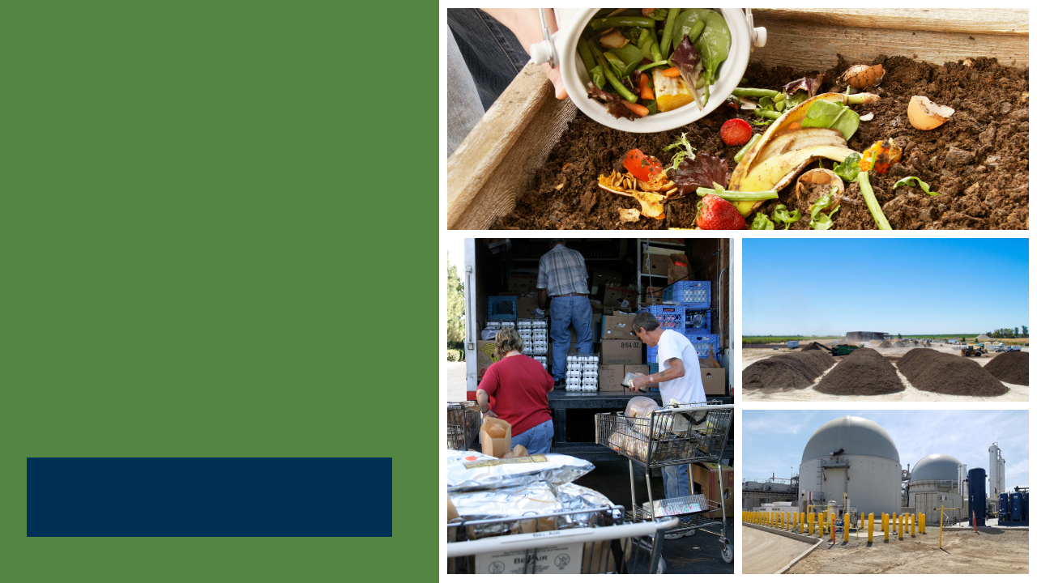
SB 1383
Model Mandatory Organics Disposal Reduction Ordinance
CalRecycle Statewide Webinar
Presented by HF&H Consultants, Debra Kaufman Consulting, and CalRecycle
October 27, 2020
Notes:
Presentation Introduction
SB 1383 is the most significant waste reduction mandate to be adopted in California in the last 30 years.
The legislation has significant policy and legal implications for state and local governments.
To assist jurisdictions with the implementation of SB 1383, the consulting team worked with CalRecycle to develop four Model Tools:
Model franchise agreement;
Model mandatory organics disposal reduction ordinance;
Model organic waste product procurement policy; and,
Model edible food recovery agreement.
This presentation will focus on the Model Mandatory Organics Disposal Reduction Ordinance Tool, which was developed to provide jurisdictions with language to supplement and expand their current municipal code to enforce compliance with SB 1383.

Slide 2
Disclaimer
This Model Tool is for informational and example purposes only. It should not merely be duplicated without consideration of an individual jurisdiction’s particular needs or circumstances. It is not intended to cover each and every situation, nor can it anticipate specific needs.
This Model Tool was developed by CalRecycle and its consultants (HF&H Consultants in conjunction with Debra Kaufman Consulting). They have attempted to ensure that the language herein aligns with the SB 1383 regulations; however, in the event of any conflict, the language in the regulations shall prevail over language in the Model Tool and determination of regulatory intent and interpretation should be appropriately guided by the regulatory language and the official rulemaking record of which this Model Tool is not a component.
CalRecycle and its consultants make no representations that use of the Model Tool will ensure compliance with regulatory requirements.
This Model Tool does not constitute legal advice. Jurisdictions are encouraged to seek legal counsel appropriate to their particular circumstances regarding compliance with regulatory requirements.
Notes:
Disclaimer
Before we go any further, we have to go over the fine print.
The Model Mandatory Organics Disposal Reduction Ordinance is for example purposes only. It shouldn’t be duplicated without considering an individual jurisdiction’s particular needs or circumstances. It’s not intended to cover each and every situation, or anticipate specific needs.
We’ve done our best to align the language in the Model with the regulations. However, in the event of any conflict, the language in the regulations and in the official rulemaking record shall prevail over language in the Model Tool.
It’s also important to note that each jurisdiction is ultimately responsible for its own compliance with the regulations, and is advised to seek legal counsel in developing or modifying an ordinance.

Slide 3

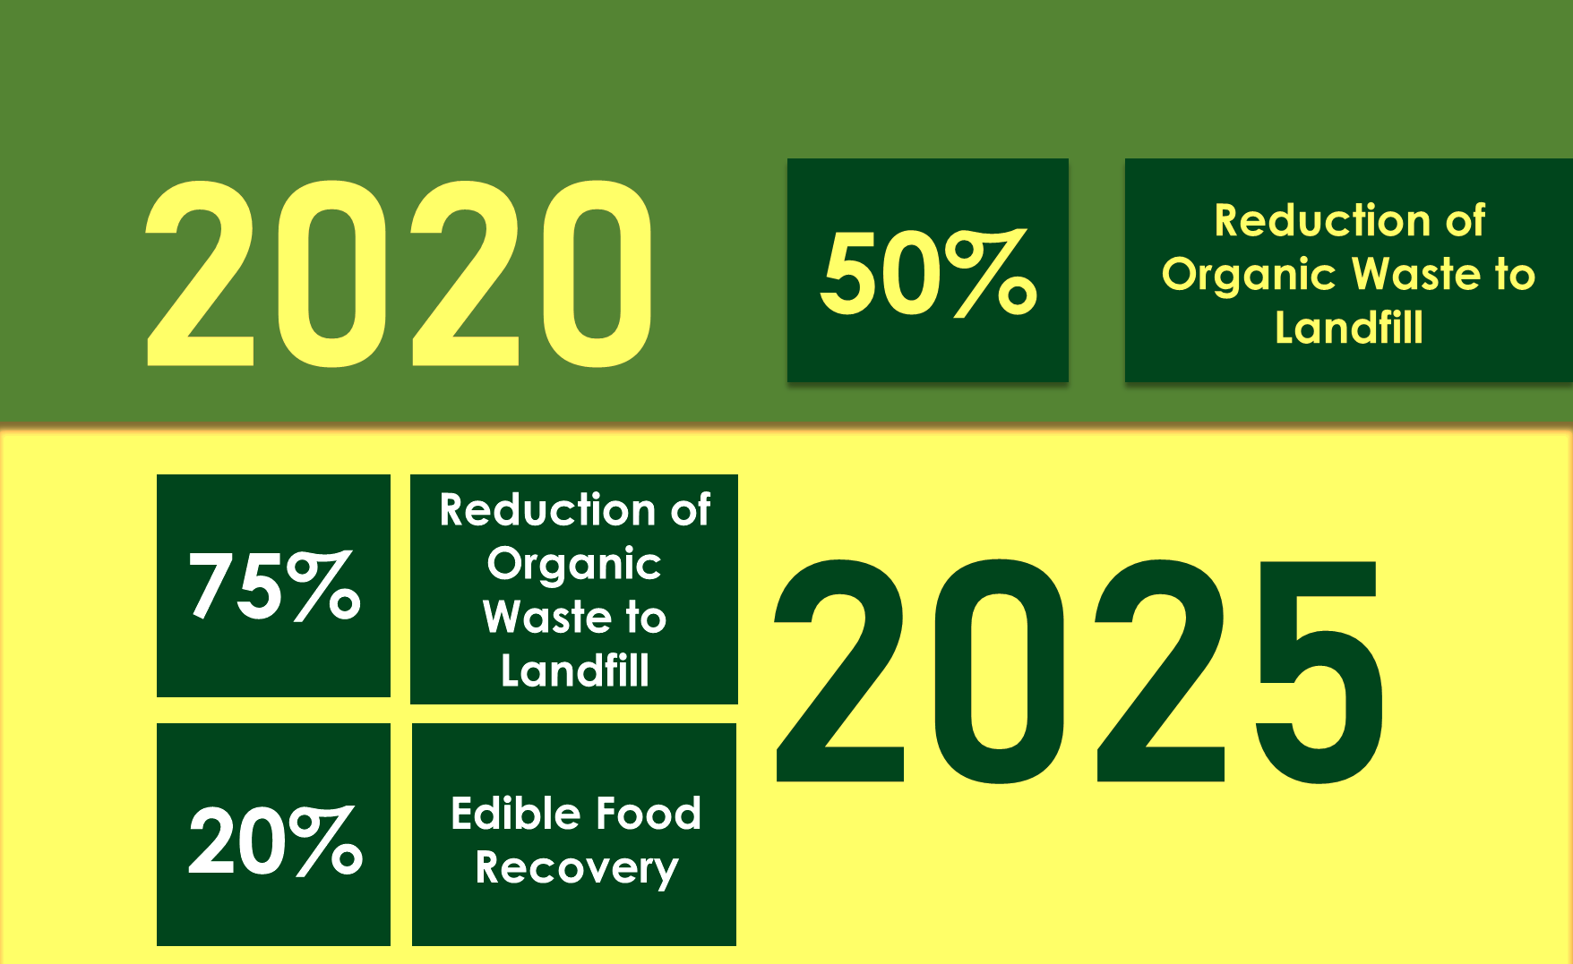
Outline
SB 1383 Overview
Model Objectives
Model Structure and Considerations
Model Highlights
Q & A
Notes:
Presentation Outline
I’ll begin with an overview of SB 1383, highlighting specific requirements, target dates, and local government roles and responsibilities (first 11 slides)
I will then discuss objectives of the Model Mandatory Organics Disposal Reduction Ordinance, reviewing how it was developed, how it is structured, and items to consider while using this Model Tool.
Next, I’ll go through the Ordinance, section by section, covering the focus of each section as well as pointing out guidance notes and customizations options that are included.
the presentation is expected to be about 40 minutes.
Then we will have about 20 minutes for questions and answers.

Slide 4
SB 1383 Requirements
2020
50% Reduction in Landfilled Organic Waste
(11.5 Million Tons Allowed Organic Waste Disposal)
2022
Regulations Take Effect
2025
75% Reduction in Landfilled Organic Waste
(5.7 Million Tons Allowed Organic Waste Disposal)
2025
20% Recovery of Currently Disposed Edible Food for Human Consumption
Notes:
First, as an Overview of SB 1383:
Sb 1383 Establishes organic waste reduction targets.
It Builds upon the existing Mandatory Commercial Organics Recycling law which California Jurisdictions have been implementing since 2016.
It Sets a goal for Californians to reduce disposal of organic waste 50% by 2020 and 75% by 2025.
These targets use the 2014 Waste Characterization Study measurements when 23 million tons of organic waste were disposed in California.
These disposal reductions will reduce at least 8 million metric tons of greenhouse gas emissions annually by 2030.
It Establishes a target to recover 20% of currently disposed edible food for human consumption by 2025, as directed by Legislature as a part of the disposal reduction targets.
And Organic waste covers several materials, including food, paper, cardboard, greenwaste, and woodwaste, etc.
The regulations take effect in 2022.

Slide 5






SB 1383 Key jurisdiction Dates
2022
2024
Provide Organics Collection Service to All Residents and Businesses
Take enforcement action against non-compliant entities starting January 1, 2024
Establish Edible Food Recovery Program
Conduct Education and Outreach
Procure Recovered Organic Waste Products
Plan for Capacity
Notes:
To meet the regulatory deadline of January 1, 2022, CalRecycle expects that jurisdictions will be planning and making programmatic and budgetary decisions regarding the requirements now.
SB 1383 regulations define a jurisdiction as a city, county, or city and county, and also special districts that provide solid waste handling services.
By 2022 Jurisdictions are required to:
Have an ordinance (which is the primary focus of this presentation).
Have organics collection services for all residents and businesses up-and-running. Services are to be automatically provided to all residents and businesses if they generate organic waste
Implement edible food recovery programs established for Tier 1 generators by Jan. 1, 2022 and for Tier 2 generators by Jan. 1, 2024
Conduct compliant education and outreach efforts
Procure recovered organic waste products and paper/paper products
Assess and plan for organic processing and edible food recovery capacity.
Conduct desk audits, route reviews, and inspections of commercial edible food generators.
In the first two years, jurisdictions must provide education and outreach to non-compliant generators.
CalRecycle can begin enforcement actions on jurisdictions and other entities starting on Jan. 1, 2022.
Jurisdictions will be required to take enforcement against noncompliant entities in 2024.
CalRecycle has some funding through competitive grant programs, as well as a loan programs, for establishing the infrastructure for recycling organic waste and recovering edible food. However, for the programmatic activities, such as enforcement, inspections, education, and collection service, Jurisdictions will need to plan for budgetary and staffing changes to address these requirements.
The Big takeaway here is to start planning now to have the programmatic, staffing, and budgetary changes in place by January 1, 2022.

Slide 6










SB 1383 in Action
Local Government Roles and Responsibilities
City Council
Board of
Supervisors
City Manager
CAO
Finance
Legal
Environmental Health
Public
Works
SB 1383 doesn’t just apply to waste management and recycling departments.
Every local department plays a role in SB 1383 implementation.
Public
Transportation
Fleets
Purchasing
Public Parks
Notes:
Getting started now on SB 1383 planning is important because ordinance adoption and program implementation extends beyond waste management and recycling operations staff.
Let’s look at how this plays out in adopting and implementing the Model Ordinance.
City Councils and Boards of Supervisors will need to pass an ordinance by January 1, 2022, requiring all residents and businesses to subscribe to these services.
Finance and Legal staff will also be involved in the ordinance process, playing a role in establishing new collection fees related to a new or amended Franchise Agreements, contracts, or permits for haulers of organic waste.
City Managers and Chief Administrative Officers will be involved in developing and directing staff to implement the ordinance.
Environmental health departments may assist in the implementation of the edible food program
Public parks, transportation fleets and purchasing may all play a role in implementing organic procurement requirements
So several departments may play a role in planning for and implementing this law.

Slide 7
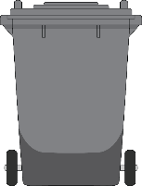



SB 1383 in Action
Jurisdiction Requirements
Organic Waste Collection Services
Three-Container “source separated” Collection Service
Organics prohibited from black container
All organic waste segregated for collection and recycling
Two-Container Collection Service
One container for collection of segregated
organic waste
One container for collection of mixed waste (subject to 75% organic content recovery standard)
One-Container Collection Service
One container for collection of mixed waste (subject to 75% organic content recovery standard)
Provide organics collection service to all residents and businesses
Minimum contamination monitoring and reduction requirements
Collection waivers authorized for certain documented circumstances
Notes:
The most basic element of the regulation is that jurisdictions are required to automatically provide an organic waste collection service to each of their residents and businesses.
The regulations also require all residents and businesses to use an organic waste recycling service that meets the regulatory requirements.
There’s a lot of detail regarding the types of allowable collection programs (several pages of regulatory text dedicated just to this) but at a high level, they require:
Each resident and business to be provided with the appropriate number of containers and subscribed to an organic waste collection service which can be either a source separated program where generators separate materials into designated bins or a one bin program where the service provider transports all unsegregated waste to a facility that recovers 50% of organic content collected by 2022, and 75% by 2025.
The regulations allow for a menu of collection options. Jurisdictions, for example may have a combination of these services where, residents might have a three-container system and businesses might have a two-container system).
In A one-container system – the jurisdiction will be responsible for ensuring that all contents are transported to a facility that recovers the prescribed amount of organic content
In a two-container system – at least one of the containers (whichever is not source separated) must be transported to a facility that recovers 75% of organic content
In A three-container system – organic waste is required to be source separated (paper/cardboard in blue, food and yard in green). There is No required recovery rate for a three container system.
The three-can option also allows additional separation at the jurisdiction/hauler’s discretion. For example, some jurisdictions may want to provide separate containers for different organics streams such as a green cart for plant debris and a brown cart for food waste so they can be managed separately
These same rules will apply to entities not subject to local control, which CalRecycle will oversee including State Agencies, UCs, CSUs, Community Colleges, K-12 schools and other entities not subject to local oversight.
Jurisdictions must regulate and have enforceable requirements for the haulers that collect organic waste in their jurisdiction, and also for commercial and residential generators and self-haulers.
The Model tool recognizes that different jurisdictions may be using different collection configurations and as such, contains language in various sections to address this, with guidance and customization notes noted in shaded colors to allow for jurisdictions to modify the Model Ordinance to address the collections system they select.

Slide 8


SB 1383 in Action
Inspection and Enforcement Requirements
Jurisdiction Requirements
Compliance Monitoring & Education
2022-2024
Compliance Monitoring & Enforcement
2024
Ordinance
2022
Adopt an Ordinance (Enforceable Mechanism)
Including Enforcement
Annual Compliance Reviews, Route Reviews, Inspections
Educate Violators
Annual Compliance Reviews
Route Reviews, Inspections,
Notice of Violations,
Penalties for Violators
Monitor Compliance and Conduct Enforcement
Notes:
By January 1, 2022, jurisdictions are required to have:
An enforcement mechanism or ordinance in place, but they are not required to enforce until 2024.
Between Jan 2022 and Dec 2023, jurisdictions need to:
Identify businesses in violation and provide educational material to those generators
The focus during the first 2 years is on educating generators.
The goal is to make sure every generator has an opportunity to comply before mandatory jurisdiction enforcement comes into effect in 2024.
After January 2024, jurisdictions take progressive enforcement against organic waste generators that are not in compliance.
The progressive approach allows for notification to the generator and provides ample time for the generator to comply before penalties are required to be issued by the jurisdiction.
Note, that Jurisdictions are not required to impose penalties on generators found in violation of prohibited container contaminant requirements.
CalRecycle sets a maximum timeframe that a jurisdiction has to issue a Notice of Violation and issue penalties to a generator.
The jurisdiction has the flexibility to develop its own enforcement process within these parameters.
When a jurisdiction determines a violation occurred the jurisdiction is required to, at a minimum:
Issue a Notice of Violation requiring compliance within 60 days of the issuance of that notice.
If the generator still has not complied within 60 days from the issuance of the Notice of Violation, then the jurisdiction is responsible to issue penalties
The regulations set a minimum penalty amount of at least $50 for the first violation within one year and can go up to $500 a day for multiple violations occurring within one year.
An early robust education program will minimize the amount of future enforcement action needed

Slide 9


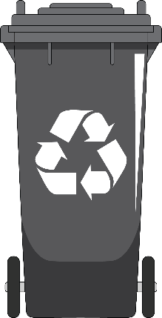
Jurisdiction Enforcement Requirements
Must Have Enforcement and Inspection Program that Includes:
Annual Compliance Review
  Perform for commercial businesses that generate > 2 cubic yards/week
  Verify businesses are subscribed to service or self-hauling
2- or 3-Container Collection Service: Conduct route reviews of commercial/residential areas to verify service and inspect for contamination, or waste evaluation studies
Single Unsegregated Collection Service: Verify businesses are subscribed to a service that is transporting contents to a high diversion organic waste processing facility
Requirements Harmonize with AB 1826 and Do not Establish a Minimum Quantity of Physical Inspections
Notes:
SB 1383 Article 14 lays out the enforcement requirements for jurisdictions, which include compliance reviews, route reviews, and inspections.
Annual compliance reviews of commercial businesses are required for jurisdictions using 3- and 2-container organic waste collection services. These annual compliance reviews of commercial businesses are like the reviews jurisdictions should be doing now to verify compliance with AB 1826 Mandatory Organics Recycling
The requirement is to perform the review for commercial businesses that generate 2 CY or more per week of solid waste (trash, recycling, organics),
Note that under SB 1383, commercial businesses include multi-family dwellings of five units or more.
The compliance review can be a desk audit that involves review of reports from haulers to verify that service is provided or that the businesses are complying.
For contamination management in the 2- or 3-container collection service, there are two options:
Route reviews are one strategy: Jurisdictions are supposed to conduct route reviews of commercial businesses and residential areas. The route reviews are used to:
Verify generators subscription to required collection service (validating the desk review)
This entails seeing that the business has the appropriate external containers.
If a business does not use the hauler’s service, it would involve verifying the business is self-hauling properly.
Note: This random inspection of routes does not require going inside a business to verify that the business has appropriate containers/labels inside of the business.
Waste evaluation studies are a second strategy for verifying generator compliance. This process involves sampling materials from routes and assessing contamination levels.
These Route Reviews or waste composition studies may be delegated to the hauler(s).
Jurisdictions with a single, one-container, Unsegregated Collection Service:
Need to verify with its hauler(s) that the contents of the gray containers are transported to a high diversion organic waste processing facility and that the facility is meeting the SB 1383 organic content recovery rate requirements.
Note that CalRecycle will be identifying in the future which facilities are high diversion organic waste processing facilities as the facilities will be reporting to CalRecycle.
There are no route reviews required for jurisdictions with one-container systems.
Model Tool
The Model Ordinance provides language that gives jurisdictions authority to inspect containers, records, and facilities, as well as enforce compliance on generators, haulers, and processors.
This language is included in Section 16 and 17 in the Model. I will review these sections in more detail a little later in the presentation.

Slide 10
Jurisdiction Enforcement Requirements
On Commercial Edible
Food Generators
Must Have Enforcement and Inspection Programs that Include:
Inspections to verify edible food recovery contracts and written agreements
Tier 1 commercial edible food generators by 2022
Tier 2 commercial edible food generators by 2024
Commercial Edible Food Generator Inspections Can Be Combined with Existing Mandatory Inspections
Notes:
Edible Food Recovery Program:
Jurisdictions must also have an enforcement inspection program for commercial edible food generators
These types of inspections will be new for jurisdictions.
Jurisdictions will need to plan resources to conduct these inspections.
Consider partnering with Health Inspectors that are already visiting food generators.
Inspections on Tier One commercial edible food generators begin jan 1 2022 and Tier Two beginning jan 1 2024
Verify they have contracts for written agreements with a food recovery organization and food recovery service.
Verify that they have arranged to have their edible food recovered that would otherwise be disposed.
Verify that they are complying with the commercial edible food generator recordkeeping requirements.
Verify that they are not intentionally spoiling food that can be recovered.
If a jurisdiction is already implementing an edible food recovery program and conducting inspections, such as through the Health Department, the Model Ordinance may need to be modified to reflect those practices, if the ordinance does not already allow for that.
Enforcement requirements on other generators and haulers will be discussed later in the presentation.

Slide 11
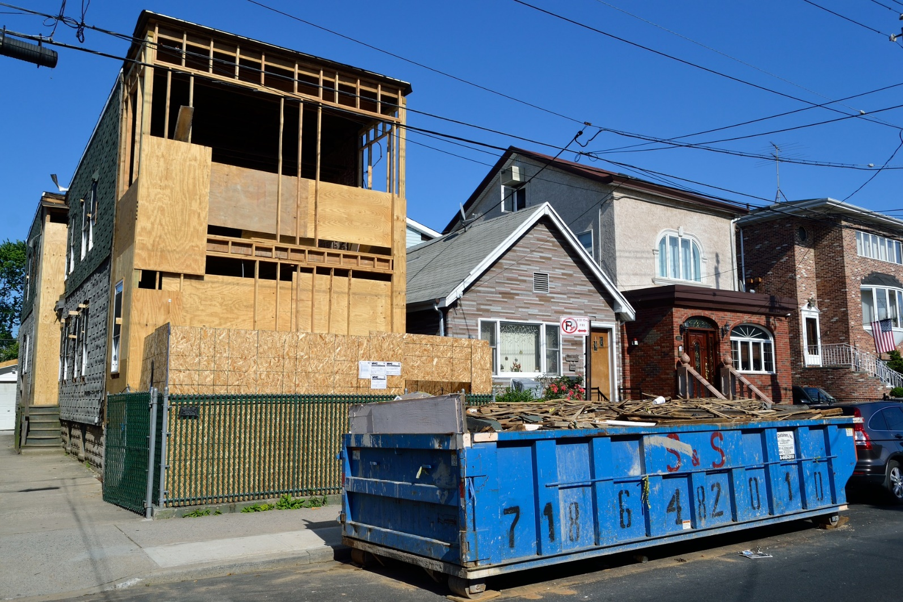
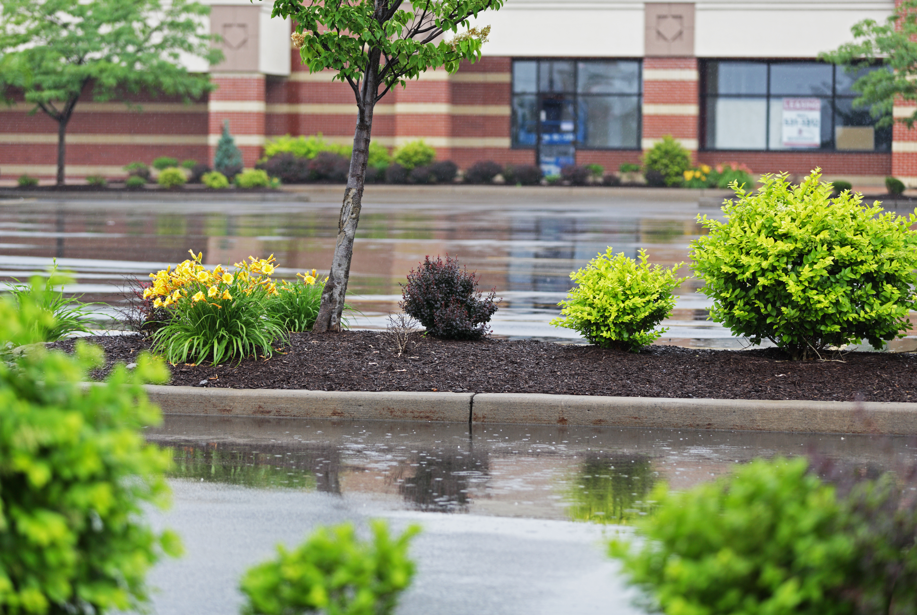
Construction & Landscaping Requirements
Model Water Efficient Landscape Ordinance (MWELO) requirements for compost and mulch application.
Recycling organic waste commingled with C&D debris, to meet CALGreen 65% requirement for C&D recycling in both residential and non-residential projects
Notes:
Jurisdictions will have to adopt an ordinance or other enforceable requirement that requires compliance with specified CALGreen and Water Efficient Landscape Ordinance requirements (California Code of Regulations Title 24, Part 11), unless they already have such an ordinance or enforceable mechanism to address these requirements. The requirements include
Providing readily accessible areas for recycling containers in commercial and multi-family units.
Recycling organic waste commingled with C&D debris, to meet CALGreen 65% requirement for C&D recycling in both residential and non-residential projects.
Requiring new construction and landscaping projects to meet Water Efficient Landscape requirements for compost and mulch application.
Sections13 and 14 in the Model Ordinance specifically address these requirements, and provide further guidance and suggested modification if necessary.

Slide 12

Model Mandatory Organics Disposal Reduction Ordinance
Notes:
Note to Presenter: At your option, consider pausing to answer questions before continuing to the Model Tool.
This wraps up the overview of the key SB 1383 regulations related to the mandatory ordinance. I will now shift gears to present an overview and details of the Model Mandatory Organics Disposal Reduction Ordinance, which is designed for use by jurisdictions, starting with objectives and the structure of the model.

Slide 13


Objectives of the Model
Support jurisdictions with planning, implementation, and compliance with SB 1383
Provide resources and guidance
Increase understanding of regulations and compliance strategies
Present an example ordinance that allows for customization unique to each jurisdiction
Notes:
Objectives of the Model Mandatory Organics Disposal Reduction Ordinance
The objective of the Model Mandatory Organics Disposal Reduction Ordinance is to provide jurisdictions with a tool to support their compliance with SB 1383.
Jurisdictions are required to have an enforceable ordinance or other enforceable mechanism to address the regulatory requirements that jurisdictions need to enforce on entities under their authority.
Not all jurisdictional requirements are addressed through the model ordinance—the focus is on the entities under the jurisdiction’s authority. There are other sb 1383 requirements on jurisdictions not intended to be addressed in this model, such as certain recordkeeping, contamination monitoring and outreach and reporting requirements. These other requirements may need to be addressed separately in other policies, program implementation, municipal code, franchise agreements or other planning documents.
The Model Tool has been designed to serve as a resource for jurisdictions that are either creating a new ordinance, or amending existing municipal code.
We anticipate that jurisdictions will pick and choose elements of the Model Tool that are relevant to them.
We also anticipate jurisdictions may integrate the Model Tool into their current municipal code
Throughout the Model Tool, guidance notes are provided to help users understand the regulations and compliance strategies.
I want to emphasize that having an ordinance in place is not a specific requirement under SB1383.
SB 1383 requires that jurisdictions have enforceable ordinances or similarly enforceable mechanism to support compliance with SB 1383, but allows for this to occur through different mechanisms other than just an ordinance.
Regardless of the mechanism, the language provided in the model should prove useful.
The next six slides will cover the structure of the ordinance and discuss how best to use it for varying circumstances.

Slide 14
Model Ordinance
Ordinance and policies can stand-alone
  Jurisdictions may amend their existing language and use Model provisions
Regulatory language reflected
Resource Group expertise integrated
Guidance notes
  Explanation of provisions
  Highlight applicability to different conditions
Optional provisions
  Address different conditions
Notes:
Model Mandatory Organics Disposal Reduction Ordinance
Now, I would like to briefly discuss how the Model Ordinance was developed and what you can expect.
The Model was designed to be customizable for a diverse range of jurisdictions, while providing flexibility for each unique condition that may exist.
Upon revision, it can be used a stand-alone document, or it can be used to amend existing policies.
The Model is reflective of regulatory language.
Guidance notes are directly embedded throughout each of the Model Tools to provide context for provisions, guide users on strategies for tailoring language, and to highlight relevant SB 1383 regulations.

Slide 15
Important Considerations
Create a new section or amend the existing section, subject to review and revision
Review SB 1383 requirements while using Model
  Each jurisdiction is responsible for achieving compliance
Involve legal counsel for review
Engage with affected parties to streamline implementation
Recognize the Model provides example language ONLY
  Customization and modification is expected
Notes:
Important Considerations
We would like to note some important considerations to think about as you use the Model Ordinance:
New Section or Amendment of Existing Section
The Model Ordinance can be used by jurisdictions drafting a complete overhaul of their current municipal code, and those amending existing sections. It is recommended that users consider use of existing sections, subject to review and revision as needed.
For amendments to existing sections, example language in the Model can be integrated into the jurisdiction’s existing municipal code. But be careful of defined terms!
If a jurisdiction is merging language from existing documents, it must ensure that there are no inconsistencies with the way terms are used.
SB 1383 Requirements
Each jurisdiction is responsible for understanding and complying with SB 1383.
Use of the Model Ordinance does not exempt a jurisdiction from complying with all SB 1383 requirements.
Not all jurisdictional requirements are addressed through the model ordinance—the primary focus of the ordinance is to address the sb 1383 regulatory requirements that jurisdictions need to enforce on other entities. There are other sb 1383 requirements on jurisdictions not intended to be addressed in this model such as certain recordkeeping, contamination monitoring and outreach and reporting requirements. These other requirements may need to be addressed separately in other policies, program implementation, municipal code, franchise agreements or other planning documents.
Not all requirements can be fulfilled through delegation.
It is advised that jurisdictions thoroughly review the SB 1383 regulations and take necessary actions to ensure full compliance.
Involve Legal Counsel
Any ordinance that results from use of the Model Ordinance should not be considered to have undergone legal counsel review. Each jurisdiction is responsible for involving its legal counsel to perform legal review in relation to local legal issues.
Engage with Affected Parties
It is advised that the amendment process involves engagement with the involved parties. This process will include the generators, hauler(s), and may include transfer and processing contractors when those services are handled through separate contract(s).
Example Language Only
The language in the Model Ordinance are examples only. Jurisdictions are not required to use this language. All language should be considered in the context of the jurisdiction’s unique conditions. Customization and modification is expected to reflect each jurisdiction’s unique circumstances and programs.

Slide 16
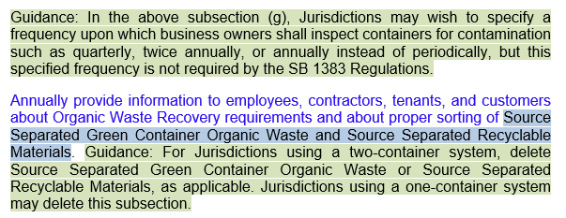
General Guidance, Optionality, and
SB 1383-specific Content
General guidance notes
SB 1383-specific content
Specific customization notes
Notes:
General Guidance, Optionality, and SB 1383-specific Content
The Model Mandatory Organics Disposal Reduction Ordinance is a colorful document. Text highlights and colors, as displayed in this screenshot, provide guidance and optionality.
Guidance notes, highlighted in green, are integrated into the Model to explain how specific sections and provisions of the Model can be customized for a jurisdiction’s needs. Additional information on SB 1383 regulations is imbedded in many of these guidance notes.
SB 1383-specific regulatory content is shown in blue font.
Customization notes are highlighted in blue and identify various options or areas where specific information is to be inserted or selected.
Language not specific to SB 1383 is shown in black font.

Slide 17
SB 1383 Standard or Performance-Based Compliance Approach
Language available for:
Standard Compliance Approach
Performance-based Compliance Approach
NOTE: If a section does not specify Performance-based Compliance Approach (per SB 1383 Article 17) or Standard Compliance Approach (per SB 1383 Article 3), then section applies to either type of compliance system
Notes:
Standard or Performance-Based Compliance
SB 1383 regulations define two compliance options for jurisdictions:
(i) a standard compliance approach (described in SB 1383 Article 3), which provides jurisdictions more flexibility in their compliance approach; and,
(ii) a performance-based compliance approach (described in SB 1383 Article 17), which requires a three-container system, 90% participation by both commercial and residential sectors and use of facilities that meet specific performance standards. Use of this approach waives some requirements of SB 1383.
The compliance approach chosen will affect the provisions and structure of a jurisdiction’s ordinance. If a jurisdiction chooses the performance-based compliance approach but doesn’t achieve it, the jurisdiction may need to add provisions to be comply with the standard compliance approach.
Standard or Performance-Based Compliance Continued
Ordinance language that differs for the standard-compliance approach and performance-based compliance approach are identified in the section headings and the guidance notes.
If there isn’t a guidance note or a customization note distinguishing the section for either a standard or performance-based compliance approach, then the section is applicable to jurisdictions regardless of the type of compliance system chosen.

Slide 18

Type of Jurisdiction
City vs. county vs. regional agency vs. special district that provides solid waste handling services
Guidance notes are in green shading.
NOTE: Regional agencies and special districts that provide solid waste handling services will need to make further modification for member agencies
Notes:
Type of Jurisdiction
Some SB 1383 requirements differ based on the type of jurisdiction (e.g., city, county, city and county or special district providing solid waste collection services). Jurisdiction is defined in the regulations. If the definition is not specifically used, then the specific type of jurisdiction, such as city, is being referred to.
Jurisdictions should choose the customization options that best match the requirements of their jurisdiction type (for example, there are different requirements for a county and a jurisdiction could delete those county requirements).
Ordinance provisions that differ based on the jurisdiction type will be identified in the guidance notes of the Model Ordinance.
Note that the Model does not address the full framework that a regional agency or special district providing solid waste handling services will need to capture for its relationship with its member agencies.
These types of jurisdictions will need to make modifications to the ordinance depending on their specific requirements.

Slide 19
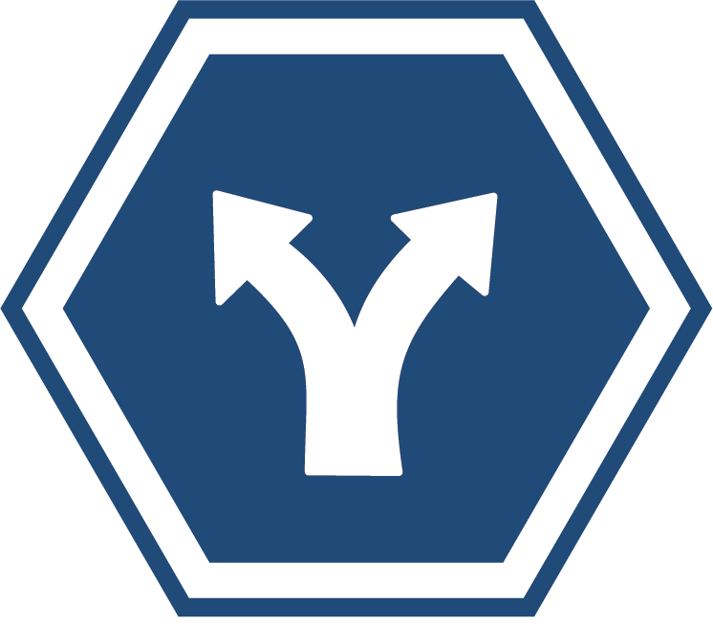
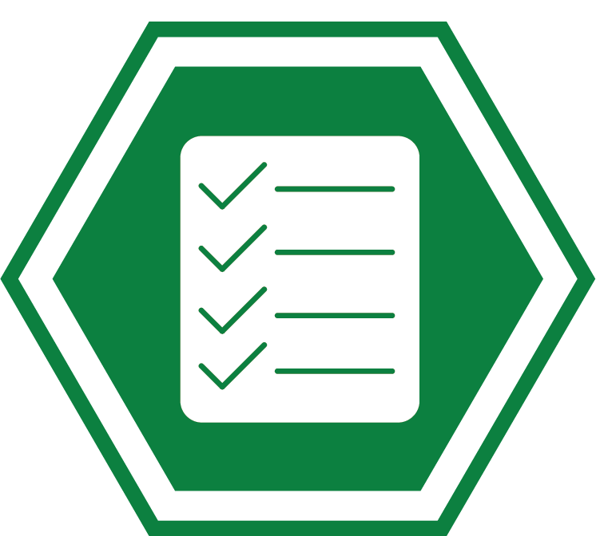
Delegation of Responsibilities
Enforcement by jurisdiction or another public agency
Penalties for non-enforcement
Notes:
Delegation of Responsibilities
Users of the Model Ordinance are also advised to consider which requirements of SB 1383 will remain the responsibility of the jurisdiction or which will be delegated to other parties, like the hauler(s), other contractors or a regional agency.
For example, some jurisdictions may have an agreement with their regional agency to perform the compliance monitoring and inspections and others may do it themselves.
Options are presented in the Model Ordinance that address different delegation scenarios.
REMEMBER: It should be kept in mind that not all activities can be delegated to private entities, (e.g., Impose civil penalties and waivers cannot be delegated to a private entity).
It is important to note that regardless of how a jurisdiction chooses to handle enforcement; the jurisdiction itself could be subject to penalties based on non-enforcement. This will depend on the nature of the arrangement between the jurisdiction and the entity providing enforcement.
The remainder of my presentation will focus on reviewing the specific sections of the model ordinance and highlighting their contents.

Slide 20
Organization of the
Model Ordinance
1 Purpose and Findings
2 Title of Ordinance
3 Definitions
4/5 Single Family/Multi-Family-Standard & Performance
6/7 Commercial Businesses-Standard & Performance
8 Waivers
9 Commercial edible Food Generators
10 Food Recovery Organizations/Services
11/12 Haulers-Standard and Self-Haulers (If Applicable)
13 Compliance with CALGreen
14 Model Water Efficient Landscaping
15 Procurement Requirements
16 Inspections
17 Enforcement
18 Effective Date
Notes:
Model Mandatory Organics Disposal Reduction Ordinance Structure
This is a list of each Section provided in the Model Ordinance.
I will go through each section, noting highlights, including guidance notes and customization options.

Slide 21
Section 1: Purpose and Findings
Focus
Purpose, highlights applicable laws (AB 939; AB 341; AB1826; and, SB 1383)
Ordinance is broadly stated; not limited to SB 1383 requirements
Guidance and Customization
Rural jurisdictions exempt from AB 1826 may remove language related to AB 1826
Any jurisdiction may customize language based on compliance approach, jurisdiction-specific diversion goals and/or policies (e.g., performance-based compliance, zero waste goals, greenhouse gas reduction policies)
Notes:
Focus
Section 1 – Purpose and Findings – states the general purpose of the ordinance and highlights applicable laws such as AB 939; AB 341; AB 1826; and, of course, SB 1383.
Other laws are broadly stated; and as such, the ordinance is not limited to SB 1383 requirements
Except for the findings and purpose section, however, all aspects of the Model Ordinance are intended to be specific to SB 1383 requirements, unless otherwise indicated in a guidance note for optional language.
Guidance and Customization
Rural jurisdictions exempt from AB 1826 may remove language related to AB 1826.
Jurisdictions should customize language based on their compliance approach, jurisdiction-specific diversion goals, and/or other policies.

Slide 22

Section 2: Title of Ordinance
Focus
Ordinance title provided: “Mandatory Organics Disposal Reduction Ordinance”
Ordinance title not specific to SB 1383 requirements
Guidance and Customization
Title may be chosen by jurisdiction
Notes:
Focus
This Section provides a suggested title of the ordinance, Mandatory Organics Disposal Reduction Ordinance- MODRO—the title is not a specific requirement of SB 1383, and may be modified by jurisdiction

Slide 23

Section 3: Definitions
Focus
Reflective of SB 1383 definitions; not comprehensive
  Key terms based on container color and material type (examples on next slide)
  Commercial businesses include multi-family dwellings with 5+ units
Intentionally broad to allow for customization
Guidance and Customization
Tailor based on collection system and franchise agreement provisions, including enforcement responsibilities
Amend non-local entities definition
Notes:
Focus
Section 3 – Definitions – provides defined terms for the Model Ordinance.
You will notice that most are reflective of the definitions used in SB 1383, but they do not cover all definitions provided in the regulations.
Note, that commercial businesses include multi-family residential dwellings with five or more units.
It is recommended that jurisdictions review all defined terms in the SB 1383 regulations.
Other definitions provided are from example ordinances and franchise agreements.
Key terms, which we’ll review on the next slide, are based on container color and material type.
Where we could, we intentionally kept some of the definitions broad to allow for customization by jurisdictions.
Guidance and Customization
Jurisdictions should tailor the definitions so that they align with their collection system and franchise agreement provisions, including how enforcement responsibilities have been allocated between the City, the hauler, and/or a third party.
Jurisdictions should customize the definitions provided for Non-Local Entities to ensure they accurately represent the non-local entities, such as Special Districts and Military installations that may or may not be located within the jurisdiction.

Slide 24
Section 3: Definitions (Continued)
Source separated recyclable materials
Non-organic recyclables – glass, metal, plastic, etc.
Source separated blue container organic waste (SSBCOW) – organic recyclables such as fibers and cardboard
Source separated green container organic waste (SSGCOW)
Gray container waste (3-container system only that do not allow for collection of Organic Waste)
Mixed waste (2-container or 1-container systems and 3-container systems that allow for collection of Organic Waste)
Note: Organic waste = all organics including SSBCOW, SSGCOW, textiles, carpet, etc.
Notes:
To orient you to the Model Ordinance, I want to first walk through some of the key definitions to provide you important context for reviewing the document.
CalRecycle wanted to use defined terms in the Model Ordinance for recyclables, organics, and solid waste that align as closely as possible with definitions in SB 1383 regulations. This slide summarizes the approach and umbrella terms.
[Walk through definitions.]
We refer to the containers by color throughout the document. Some jurisdictions will need to change color terminology to match their colors (until uniform container colors are implemented by jan 1 2036.
Umbrella term for Recyclables
Source Separated Recyclable Materials is the broadest of the terms, and is inclusive of both non-organic recyclables and organic recyclables.
Non-organic Recyclables means non-putrescible and non-hazardous recyclable wastes such as glass, metal and plastic, and is only used in jurisdictions with a two- or three-container system,
Organic recyclables is called SSBCOW on this slide which stands for Source Separated Blue Container Organic Waste and is intended to reflect recyclable materials that are organic in nature, such as paper product and writing paper, and are also required to be collected in the blue recyclable container for jurisdictions using a two- or three-container approach, so non organic and organic recyclables in the blue container
Umbrella term for Organic Waste. Important to remember that in the context of SB 1383, Organic Waste includes organic recyclables (such as fibers, textiles, and cardboard). As a result, OW includes the blue and green container organics – Source Separated Blue Container Organic Waste and Source Separated Green Container Organic Waste.
For a 3-container system, the solid waste is referred to as Gray Container Waste. Per SB 1383, this definition is limited to waste in a 3-container system.
For 2-container or 1-container systems, where waste is processed through a high diversion facility, Mixed Waste is the term used.

Slide 25
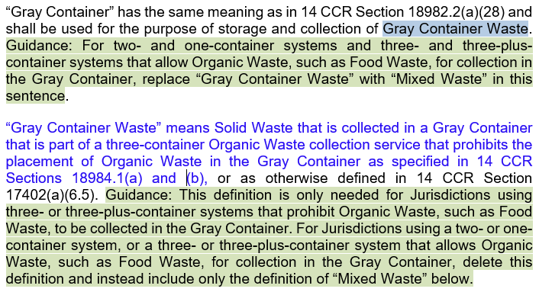
Section 3: Definitions (Continued).
Notes:
Focus
This slide presents a visual representation of what the definitions look like and how you can customize them to reflect your jurisdiction’s collection system.
Here we see the “gray container” and “gray container waste” definitions.
Under the “gray container” definition, a guidance note, highlighted in green, notifies the user that this definition should be changed to “mixed waste” if the jurisdiction is using two-container or one-container collection system.
Under the “gray container waste” definitions, a guidance note, highlighted in green, notifies the user that this definition is only needed for jurisdictions using a three-container or three-plus container systems.

Slide 26

Section 4: Single Family
Standard Compliance Approach
Focus
Framework for compliant collection system
Jurisdictions provide service to residents
Source separation requirements based on collection system type
Guidance and Customization
Modify based on collection system (3, 3+, 2, and 1 containers)
Modify based on allowance of organic material self-hauling
Modify based on sector-specific collection services
Modify based on allowance of waivers
(low population; rural; and, high elevation)
Notes:
Focus
Section 4 –- provides the framework for a collection system under the standard compliance approach, specifically for single-family generators.
Jurisdictions are required to provide a compliant collection system to all single family generators.
While the word “auto-enroll” was struck from the regulations, the intent of the regulations is that jurisdictions provide service to all generators in some way.
This automatic provision of service is required under both the standard and performance-based compliance approaches.
Single family generators are required to properly source separate their discarded materials, based on the collection system offered by their jurisdiction.
Guidance and Focus
Jurisdictions should modify this section based on their collection system, which dictates which containers are used for specific material types.
We have provided language for a three-container, two-container, and one-container system.
We have also provided some language in this Section for jurisdictions that allow self-hauling of organic materials.
The language points users to Section 12, which provides more detailed information on self-hauling requirements for jurisdictions that allow it.
Jurisdictions should also modify this section based on potential sector-specific activities.
For example, if a two-container system is provided for multi-family and commercial customers, and a three-container system is provided to single-family residences, the ordinance will need to be amended to reflect this approach.
And lastly, jurisdictions that receive low population, rural, and/or high elevation From CalRecycle, will need to amend this section based on those waivers granted by CalRecycle.
for each waiver, some SB 1383 requirements are still applicable and AB 341 and AB 1826 are still applicable. I’ll be talking more about waivers in a few minutes.

Slide 27






Section 5: Single Family
Performance-Based Compliance Approach
Focus
Framework for compliant performance-based compliance collection system
Jurisdictions provide 3-container service to residents
90% of all residents must have service
Guidance and Customization
Performance-based compliance regulation exemptions
Container specifications for single family vs. multi-family
Modify based on allowance of organic material self-hauling
Notes:
Focus
Section 5 – focuses on requirements for Single Family generators in a jurisdiction using the performance based compliance approach
Note, this section also applies to multi-family premises with less than five units. You may choose to have a special section discretely for multi-family, rather than combined with single family.
Under the performance based compliance approach, Jurisdictions are required to provide 3-container service to all residents.
As with the Standard-Compliance Approach, the intent of the regulations is that service is provided to all generators in some type of automatic or universal way.
Under the performance based compliance approach, at least 90% of all residential generators must be provided a three-container system.
Guidance and Focus
Under this compliance approach, jurisdictions are exempt from a number of SB 1383 requirements. Such requirements related to the ordinance include:
Regulation of haulers and self-haulers;
Waivers and exemptions requirements; and,
Enforcement provisions with the exception of enforcement related to edible food generators and food recovery organizations and services.
There are other regulatory requirements that a jurisdiction using the performance based compliance approach would also be exempt from (e.g., certain recordkeeping, education, container labeling by jurisdiction, outreach and reporting requirements) that are not intended to be addressed by this ordinance.
The ordinance also provides language that gives jurisdictions the ability to specify the number, size, and location of containers provided to generators, which may be useful for jurisdictions with large multi-family complexes.
Optional language is also provided for jurisdictions that allow organic material self-hauling.

Slide 28
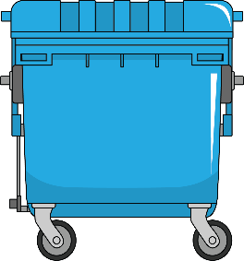
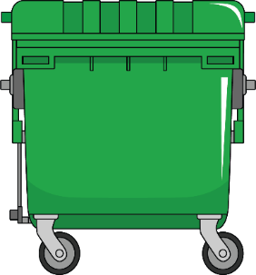
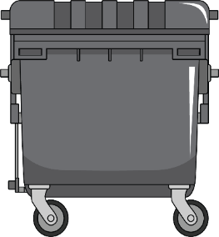

Section 6: Commercial Businesses– Standard Compliance Approach
Focus
Framework for compliant commercial businesses, including multi-family (five or more units) collection system
Jurisdictions provide service to commercial businesses
Guidance and Customization
Modify based on collection system (3, 3+, 2, and 1 containers)
Modify based on frequency of inspections
Delete unused options
Modify based on allowance of waivers
(low population; rural; and, high elevation)
Notes:
Focus
Section 6 – Commercial Standard Compliance - provides the framework for a compliant collection system under the standard compliance approach, specifically for commercial businesses, which includes multi-family residential dwellings with five or more units.
Jurisdictions are required to provide organic collection container service to all commercial businesses using some type of automatic or universal provision of service.
Such generators are required to properly source separate their discarded materials, based on the collection system offered by their jurisdiction.
Guidance and Focus
Jurisdictions should modify this section based on their collection system.
We have provided some language in this Section for jurisdictions that allow self-hauling of organic materials.
The language points users to Section 12 for more detail on self hauling requirements.
Jurisdictions should also modify this section based on potential generator sector-specific collection differences.
For example, if a two-container system is provided for multi-family and commercial customers, and a three-container system is provided to single-family residences, the ordinance will need to be amended to reflect this approach.
And lastly, jurisdictions that receive low population, rural, and/or high elevation waivers from CalRecycle will need to amend this section based on those waivers granted by CalRecycle.
The structure of the Model is very similar between commercial and residential.

Slide 29
Section 7: Commercial Businesses– Performance-Based Compliance Approach
Focus
Framework for compliant performance-based compliance collection system
Jurisdictions provide 3-container service to commercial businesses
90% of all commercial businesses must have service
Guidance and Customization
Provide performance-based compliance regulation exemptions
Modify based on container sizes
Modify based on frequency of inspections
Modify if allowing self-haul to designated facility
Notes:
Focus
Section 7 –- provides the framework for a compliant collection system for commercial businesses under the performance-based compliance approach, which includes multi-family residential dwellings with five or more units.
Jurisdictions are required to provide 3-container service to all commercial businesses using some type of automatic or universal provision of service, including multi-family.
Under the performance-based compliance approach, at least 90% of all commercial generators must be provided a 3-container system.
Guidance and Focus
Under the performance-based compliance approach, jurisdictions are not required to fulfill a number of SB 1383 requirements. Such requirements related to the ordinance include:
Regulation of haulers and self-haulers;
Waivers and exemptions requirements; and,
Enforcement provisions with the exception of enforcement related to edible food generators and food recovery organizations and services.
The ordinance also allows for language modification surrounding the minimum required service levels which jurisdiction could change over time.
Optional language is also provided for jurisdictions that allow organic material self-hauling to a designated facility.

Slide 30

Section 8: Waivers
Jurisdictional Waivers
Generator Waivers - OPTIONAL
Granted by CalRecycle
  Low population
    AB 1826 exception
  Rural area
  High elevation
Granted by jurisdiction
De minimis volumes
  Commercial businesses
Physical space constraints
  Commercial businesses
Collection frequency
  All generators under 2- or 3-container system
  Blue and grey containers
Notes:
Section 8 of the model covers waivers
SB 1383 regulations allow for both jurisdictional and generator waivers, but section 8 of the Model ordinance only contains language for generator waivers, as the jurisdictional waivers are granted by CalRecycle, and would not be governed by a jurisdiction’s ordinance. That said, I will cover some of the jurisdictional waivers that may be available in a few slides, as it is relevant to what requirements a jurisdiction with a waiver would include in their ordinance.
Generator Waivers
SB 1383 allows jurisdictions to grant waivers to some generators for de minimis volumes, physical space limitations, and less than weekly collection frequency, although none of these waivers are required.
The Model Ordinance includes sample language should a jurisdiction decide to include de minimis, physical space, and/or less than weekly collection frequency waivers for generators that meet specified requirements.
De minimis volumes: Must provide documentation every 5 years that the commercial business’s total solid waste collection service is below a certain number of gallons per week of organic waste, which includes all 3 streams of material.
Physical Space Constraints: Provide documentation every 5 years that the premises lack adequate space for organic waste containers
Collection Frequency may be changed to every 14 days for Blue and grey containers in a 2 or 3 container system under specified conditions and with approval from local enforcement agency.

Slide 31
Section 8: Generator Waivers
Focus
Offer applicable collection waivers, as stated in SB 1383
Guidance and Customization
Document waivers for the standard compliance approach
Note generator waivers are optional; not required by SB 1383
Jurisdictions can “mix and match” which, if any, generator waivers will be offered
Waiver verification must be retained in writing for reporting
Notes:
Focus
Section 8 provides model language for the optional generator waivers that I just described.
Guidance and Customization
If generator waivers are used, the jurisdiction’s implementation record required by SB 1383, must include documentation of businesses that applied for waivers, if the jurisdiction is using the standard compliance approach.
A jurisdiction can also choose to ‘mix and match’ which, if any, waivers are offered to businesses. In such a case, the jurisdiction should remove language related to waivers that will not be offered

Slide 32




Section 8: Jurisdiction Waivers
Low Population
Disposed of <5,000 tons of solid waste in 2014
Total population <7,500 people
OR
Census tracts with population density <75 people per square mile
High Elevation
Located over 4,500 ft.
Rural Jurisdiction
<70,000 people in a county
Exemption: Food waste collection and food soiled paper for residents, multifamily, and businesses less than 2cy/week solid waste
Exemption: Some or all of the requirements in Art.3 and delayed procurement requirement and capacity planning
Exemption: Some or all of the requirements in Art. 3
?
Notes:
Jurisdictional Waivers
Jurisdictions may also apply for waivers to Calrecycle if they meet certain criteria.
If a jurisdiction meets the low population, rural area, or high elevation criteria, they can apply for specified waivers.
Jurisdictions may need to modify the provisions of their ordinance depending upon whether they plan to apply for (and are granted) these specific waivers from CalRecycle.
Jurisdictions that are eligible for, apply for, and receive low population, rural or high elevation waivers may exempt some or all organic waste generators from some or all generator requirements as specified in the waiver.
But Jurisdictions that receive an Sb 1383 low-population waiver are still subject to implementing AB 341 and AB 1826 in those low population areas.
Waivers are valid for up to 5 years for low populations and until December 31, 2026, or 5 years after CalRecycle’s approval, whichever is later, for rural jurisdictions.
The regulations do not place an expiration or time limit on high elevation waivers.

Slide 33

Section 9: Commercial Edible Food Generators
Focus
Define and provide enforceable mechanism for requiring commercial edible food generators to use food recovery programs
Guidance and Customization
Consider record submission by generators (not required by SB 1383)
Consider reporting on edible food not accepted (not required by SB 1383)
Remember that SB 1383 is not in conflict with California Good Samaritan Food Donation Act of 2017
Notes:
Focus
Section 9 – Commercial Edible Food Generators– defines the requirements for commercial edible food generators to use a food recovery program for diverting edible food.
It lists the required records that a commercial edible food generator must retain, such as name of the food organization it will be using, the types of food collected, and copies of written agreements.
Additionally, this section includes language to allow jurisdictions access to the premises to review records.
Guidance and Customization
Record-keeping by Commercial Edible Food Generators is required by SB 1383, but record submission is not.
Jurisdictions could consider adding language that generators submit their records to the jurisdiction annually or on another basis to reduce the need for on-site inspection to verify/look at records.
Jurisdictions may also want to receive records on the amount and type of food that are rejected by the food recovery organization, either to ensure proper delivery standards are maintained to ensure food safety, or to follow-up with why the food was rejected.
However, neither is required by SB 1383 regulations.
Just as a Reminder: Food donated to Food Recovery Organizations/Services is protected under the California Good Samaritan Food Donation Act of 2017, which expands the liability protection for businesses that donate food.

Slide 34

Section 10: Food Recovery Organizations/Services
Focus
Provide guidelines for record keeping of food recovery organizations/services activities
Guidance and Customization
Consider the following, which are not required by SB 1383:
  Expanding education and outreach about Good Samaritan Food Donation Act of 2017
  Reporting to jurisdiction on edible food not accepted for follow-up action
  Adding optional language for food recovery organizations/services to support capacity planning within 60 days of inquiry
Notes:
Focus
Section 10 – Food Recovery Organizations/Services – Defines the requirements for food recovery organizations/services to retain documentation of the commercial edible food generators it services, and the quantity in pounds of food collected and transported.
Guidance and Customization
The Model Ordinance includes language that the organization/service shall educate edible food generators about the Good Samaritan Food Act, although this is not required by SB 1383.
There is optional language that would require the food recovery organization/service to report the amount and type of edible food not accepted by the organization/service for follow-up action to be taken. However, this is also not required by SB 1383.
Finally, there is optional language that would require organizations/services to provide information and consultation to the jurisdiction to support edible food recovery capacity planning assessments, or other studies conducted by the jurisdiction.
If the entity is contacted by the jurisdiction, it shall respond within 60 days regarding available and potential new or expanded capacity, per the regulations.
For added emphasis, none of the customization options noted in Section 10 are required by SB 1383, but are included for consideration by the jurisdiction.

Slide 35
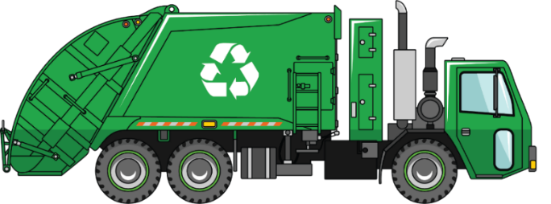
Section 11: Haulers
Focus
Address specific regulatory requirements that jurisdiction must enforce on haulers to be SB 1383 compliant
Guidance and Customization
Exclude if using performance-based compliance approach
Address some requirements in the franchise agreement rather than the ordinance
Cross-reference requirements in ordinance to other hauler documents
Modify the language for exclusive, nonexclusive, and permitted haulers
Notes:
Focus
Section 11 – Haulers – addresses the regulatory requirements that must be placed on haulers for SB 1383 compliance.
Guidance and Customization
If a jurisdiction uses the performance-based compliance approach, they are not required to impose these requirements on haulers however, they are required to approve the hauler and require the hauler to transport the source separated organic waste collection stream to a designated source separated organic waste recycling facility.
Jurisdictions can adopt some of the requirements in the event that they do not meet the performance-based compliance approach.
Regardless of which compliance method the jurisdiction chooses, the hauler is still responsible for meeting the hauler requirements of SB 1383.
Some of the requirements stated in the Model Ordinance are better suited to being addressed in a franchise agreement, or may be included in both.
These requirements can include items such as container colors, educational outreach plans, or contamination monitoring.
We recommend cross-referencing these requirements with franchise agreements and other hauler documents to ensure compliance and congruence between documents.
Within the model are options for exclusive, non-exclusive, and permitted haulers. The language will need to be modified to match the jurisdiction’s collection arrangement.

Slide 36
Section 12:
Self-Hauler – If Applicable
Focus
Address self-hauler regulations for SB 1383 compliance
Guidance and Customization
Require commercial self-haulers recordkeeping
Note residential organic self-hauler recordkeeping and reporting is not required by SB 1383
Notes:
Focus
Section 12 – Self-Haulers – addresses the regulatory requirements that must be placed on self-haulers to be SB 1383 compliant, if self-hauling is allowable within the jurisdiction.
Guidance and Customization
Commercial self-haulers must keep a record of the amount of organic waste delivered to each facility that processes or recovers organic waste.
This record is subject to inspection by the jurisdiction.
Record includes delivery receipts, weight tickets, and amount of material in cubic yards or tons transported.
If the self-hauler delivers to a facility that does not have a scale, the self-hauler is not required to keep a record of the weight, but must keep a record of the volume.
Residential organic self-haulers are not required to record or report information per SB 1383, including residential landscaping activities.

Slide 37

Section 13: Compliance with CALGreen
Focus
Require a jurisdiction to have an enforceable mechanism to comply with select CALGreen standards
Guidance and Customization
Exclude if the jurisdiction has an existing CALGreen ordinance
Refer to jurisdiction’s building and/or planning code for complete compliance with CALGreen
Incorporate CALGreen updates (optional) in different municipal code section
Modify language based on the collection system
Notes:
Focus
Section 13 – addresses the requirement for a jurisdiction to have an ordinance or similarly enforceable mechanism to require organic waste commingled with C&D, to be recycled per the CALGreen standards as well as the requirement for provision of adequate space for recycling for new or renovated mf and commercial construction of a certain size.
Guidance and Customization
If the jurisdiction already has an ordinance or other enforceable mechanism requiring compliance with CALGreen, then this language can be removed from the Model Ordinance.
It should be noted that the complete CALGreen requirements are not included in the Model Ordinance, and project applicants should be referred to a jurisdictions building or planning code for other CalGreen requirements.
Keep in mind that the CALGreen updates may be included in a different section of the municipal code than the rest of the Model Ordinance.
the Model Ordinance contains customizable sections to adapt the language for storage and collection of organics and recyclables based on the current collection system, whether that is 2-, 3-, or 1-container collection systems-

Slide 38

Section 14: Model Water Efficient Landscape Ordinance (MWELO)
Focus
Require jurisdiction to meet or exceed select MWELO standards for SB 1383 compliance
Guidance and Customization
Address MWELO standards (broadly) related to SB 1383
Incorporate MWELO standards into the building or planning municipal code section, if required
Notes:
Focus
Section 14 – Model Water Efficient Landscape Ordinance – addresses the requirement for a jurisdiction to meet or exceed the MWELO standards
Guidance and Customization
The Model Ordinance does not broadly address all requirements of the MWELO; only those set by the SB 1383 baseline requirements.
Similar to the CALGreen updates, the MWELO updates may need to be incorporated in a different section of the municipal code than the rest of the ordinance.
If the jurisdiction adopts an ordinance that allows for an ‘auto’ update of the MWELO standards, they must ensure that the MWELO standards set by SB 1383 are still met. If MWELO requirements are reduced, the SB 1383 requirements will still stand.
If a jurisdiction already has an existing MWELO ordinance or similarly enforceable mechanism, they may omit this provision, but should be aware of auto-updating provisions.

Slide 39

Section 15: Recovered Organic Waste Product Procurement
Focus
Assist jurisdictions in meeting the procurement requirements contained in SB 1383 regulations
Specify jurisdiction’s departments to comply with procurement policy
Establish recycled-content paper procurement vendor requirements
Guidance and Customization
Include requirements in jurisdiction’s separate procurement policy
  Separate procurement policy is not required by SB 1383
Choose general language with further customization in the policy
Modify paper purchasing with price preference criteria
Notes:
Focus
Section 15 – Recovered Organic Waste Product Procurement – assists cities, counties, or city and county in meeting the recovered organic waste product procurement requirements.
It anticipates that city/county will adopt a procurement policy to address purchase of organic waste products, such as compost, mulch, renewable natural gas, and electricity from biomass to meet their annual SB 1383 target.
It includes a sample provision that the city or county’s departments will comply with the organic waste product procurement policy, should the jurisdiction choose to adopt one.
Note: Rural jurisdictions that have an exemption from organic waste collection requirements have delayed implementation of this requirement.
It then focuses on defining recycled-content paper procurement requirements for vendors to support the jurisdictions compliance with these SB 1383 requirements. Reminder that all cities, counties, and community service districts that provide solid waste handling services are subject to the recycled-content paper procurement requirements starting Jan. 1, 2022.
Guidance and Customization
Adopting a procurement policy is not required by SB 1383, but may help in achieving the designated procurement target.
If the jurisdiction currently has (or decides to adopt) a procurement policy, then less-specific language may be used in the ordinance and further detail may be described in the procurement policy. So, a jurisdiction has options on how to address these requirements—they may choose to include a more streamlined procurement section in the ordinance and have a separate procurement policy with more detail or they may address these requirements only in a separate procurement or other policy, or only in this ordinance.

Slide 40

Section 16: Inspections by Jurisdiction Representatives
Focus
Provide enforceable mechanism to perform inspections, as required by SB 1383
Guidance and Customization
Develop administrative and tracking process to accept and follow-up on anonymous complaints (jurisdiction recommended requirement)
Consider options for visual inspections or remote monitoring
Notes:
Focus
Section 16 – Inspections – presents an approach to establishing the right to inspect or investigate.
Guidance and Customization
Some jurisdictions may want to expand on this section to include more specifically who has the authority to inspect, what entities may be inspected or investigated, and the protocols for such inspections and investigations.
Basic language has been included to direct jurisdictions to receive and follow-up on anonymous complaints, and that they be made in writing with specified information. However, the actual application of this is up to the jurisdiction’s discretion for what that process looks like and how the jurisdiction will handle those complaints.
To comply with contamination monitoring and the other inspection requirements of SB 1383, options are included around performing visual inspections of containers or remote monitoring using cameras mounted in containers.

Slide 41
Section 17: Enforcement
Focus
Provide enforceable mechanism to enact penalties for non-compliance
Guidance and Customization
Establish penalties that meet at least the SB 1383 penalty levels
  Note enforcement table with penalty amounts in Model is optional
Consider whom will have enforcement responsibilities
  City manager or designee, regional or county agency enforcement official
Provide education to non-compliant entities in 2022 and 2023
Assess civil penalties no later than January 1, 2024
Acknowledge jurisdiction is ultimately responsible for enforcement
Modify specifics of enforcement to align with jurisdiction practices
Notes:
Focus
Section 17 of the Model Ordinance addresses SB 1383’s requirement to adopt an enforceable ordinance or similarly enforceable mechanism.
Guidance and Customization
It includes language related to establishing penalty amounts that must, at a minimum, meet the penalty levels specified in SB 1383 Article 16, which range from $50 to $500 per violation. It also indicates that such penalties have to be consistent with specified sections of the Government Code.
The penalty amounts in the regulations are presented as a range for the violation. For example, the penalty for the first violation is $50 to $100. Jurisdictions may choose a single penalty amount (rather than use a range) for each violation type. In such case, the amount may not be lower than the lowest value on the range for violations subject to the requirements of SB 1383.
Penalty levels are required per the regulations, and amounts must be clearly stated.
the enforcement table included in the Model Ordinance is not required by SB 1383. A jurisdiction may choose to include or delete items from the table depending on the specifics of their final ordinance and their enforcement program, if they include such a table in their Ordinance.
If a jurisdiction chooses to delegate some enforcement responsibilities, it needs to consider to whom it is going to delegate, and at what level.
Remember: a jurisdiction is ultimately responsible for enforcement, even if the jurisdiction delegates some activities to another entity.
For the first two years, from January 1, 2022 through December 31, 2023, jurisdictions are required to identify non-compliant entities and provide education to them.
Enforcement actions, including civil penalties must begin no later than January 1, 2024, but a jurisdiction may consider having penalties start earlier.
The Model Ordinance allows for date adjustment, so jurisdictions could choose to adopt the Model Ordinance sooner than is required Note that Jurisdictions are not affirmatively required to impose penalties on generators found in violation of prohibited container contaminant requirements.
Jurisdictions will need to modify the enforcement language in their ordinance so that it conforms with their current and desired enforcement procedures.
Jurisdictions may want to provide enforcement requirements stricter than those specified by SB 1383.
Many municipal codes have enforcement in a general section of the code, so these provisions may need to be moved to a different code section.

Slide 42

Section 18: Effective Date
Focus
Defines effective date of the ordinance
Guidance and Customization
Make ordinance effective no later than January 1, 2022
Include option for earlier effective date to allow more time for implementation and compliance
Notes:
Focus
Section 18 – Effective Date – addresses SB 1383’s requirement that an ordinance or other enforceable mechanism be in place no later than January 1, 2022
Guidance and Customization
Jurisdictions can choose to make the ordinance effective prior to January 1, 2022, to allow entities more time to come into compliance through outreach and educational efforts prior to the implementation of penalties.

Slide 43
Customization Tips
Modify language, particularly defined terms
Blend existing provisions with the Model provisions, subject to review and revision
Align language to reflect jurisdiction’s collection system and compliance approach
Delete guidance notes and unused options
Seek legal counsel
Review Model Mandatory Organics Ordinance case studies
  Alameda County
  City and County of San Francisco
www.calrecycle.ca.gov/organics/slcp/education
Notes:
Overall Tips
The Model Ordinance provides example language and tries to address a wide range of options for customization purposes. Given the diversity of situations, the Model Ordinance language will need to be highly customized to fit the jurisdiction’s needs and situation.
it provides a great baseline and it may not be perfect fit for each jurisdiction, but will provide a solid foundation for each jurisdiction to amend its current municipal code to integrate these SB 1383 requirements. As we wrap up this presentation, we’d like to review some overall tips on how to use the Model Ordinance.
Modify Language
Adjust the Model language to fit the user’s specific needs. For example, “jurisdiction” is used throughout the document, and will need to be changed to City, County, Agency, etc., as applicable.
Blend Existing Provisions with Model Provisions
When using the Model Ordinance, users may want to select provisions from both the current municipal code and the Model to create an ordinance that best suits its needs and requirements. It is recommended that users consider modifying existing provisions as appropriate, however they should be carefully reviewed to ensure alignment with compliant programs and collection approaches.
Align Language
Customize the Model Ordinance so that it aligns with your jurisdiction’s collection system, compliance approach, and franchise agreement.
Delete Guidance Notes and Unused Options
Highlighted guidance notes are presented in the Model Ordinance for reference only, and are to be removed by the user when preparing its final Ordinance. In cases where the Model Ordinance offers multiple options, optional provisions that are not selected are to be deleted and section numbers must be modified accordingly.
Seek Legal Counsel
As we noted at the beginning of this presentation, each jurisdiction is ultimately responsible for its compliance with the regulations, and is advised to seek legal counsel in development or modification of its agreement(s) and ordinance.
Case Studies
CalRecycle, in conjunction with HF&H Consultants, has developed a series of case studies that spotlight how jurisdictions and entities are implementing some aspects of SB 1383. We have created two case studies for each of the Model Tools. For the Model Mandatory Organics Disposal Reduction Ordinance, we are showcasing enforcement ordinances from the County of Alameda and the City of San Francisco. You can read about their implementation process and lessons learned by following the links provided on this slide.

Slide 44


Thank You!
Link to Model Tools
www.calrecycle.ca.gov/organics/slcp/education
Contact
Rob Hilton
HF&H Consultants
rchilton@hfh-consultants.com
(925) 977-6959
Debra Kaufman
Debra Kaufman Consulting
dkaufmanconsulting@gmail.com
(415) 519-5507
CalRecycle
slcp.organics@calrecycle.ca.gov
DKC
Notes:
Thank you very much for listening.
We will use the remaining time to respond to questions and receive comments.

