Slide 1
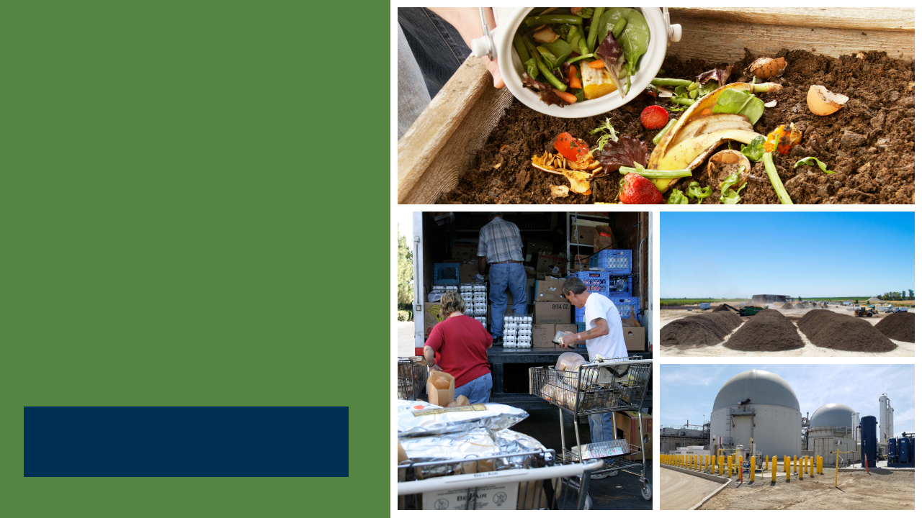
SB 1383
Model Procurement Policy for Recovered Organic Waste Products
CalRecycle State-Wide Webinar
Presented by HF&H Consultants, Debra Kaufman Consulting, and CalRecycle
October 28, 2020
Notes:
Presentation Introduction
SB 1383 is the most significant waste reduction mandate to be adopted in California in the last 30 years.
The legislation has significant policy and legal implications for the state and local governments.
To assist jurisdictions with the implementation of SB 1383, we have worked with CalRecycle to develop four Model Tools:
Model franchise agreement;
Model mandatory organics disposal reduction ordinance;
Model organic waste product procurement policy; and,
Model edible food recovery agreement.
Today I am pleased to be presenting the SB 1383 overview and introducing the Model Procurement Policy. The purpose of the Model Procurement Policy is to provide example language that Jurisdictions can use to create a new organic waste product procurement policy or to amend its existing procurement policies to support its compliance with SB 1383 organic waste product procurement and recycled-content paper requirements.

Slide 2
Disclaimer
This Model Tool is for informational and example purposes only. It should not merely be duplicated without consideration of an individual jurisdiction’s particular needs or circumstances. It is not intended to cover each and every situation, nor can it anticipate specific needs.
In developing this Model Tool, CalRecycle and its consultants (HF&H Consultants in conjunction with Debra Kaufman Consulting) have attempted to ensure that the language herein aligns with the SB 1383 regulations; however, in the event of any conflict, the language in the regulations shall prevail over language in the Model Tool and determination of regulatory intent and interpretation should be appropriately guided by the regulatory language and the official rulemaking record of which this Model Tool is not a component.
CalRecycle and its consultants make no representation that use of this Model Tool will ensure compliance with regulatory requirements.
This Model Tool does not constitute legal advice. Jurisdictions are encouraged to seek legal counsel appropriate to their particular circumstances regarding compliance with regulatory requirements.
Notes:
Disclaimer
Before we go any further, I have to go over the fine print.
The Model Procurement Policy is for example purposes only. It should not merely be duplicated without consideration of an individual jurisdiction’s particular needs or circumstances. It is not intended to cover each and every situation, nor can it anticipate specific needs.
We’ve done our best to align the language in the Model with the regulations. However, in the event of any conflict, the language in the regulations shall prevail over language in the Model Tool.
In the event of any language discrepancy, the SB 1383 reg language and the official rulemaking record should guide determining regulatory intent and interpretation.
It is also important to note that each jurisdiction is ultimately responsible for its compliance with the regulations, and is advised to seek legal counsel in development or modification of its policy.

Slide 3

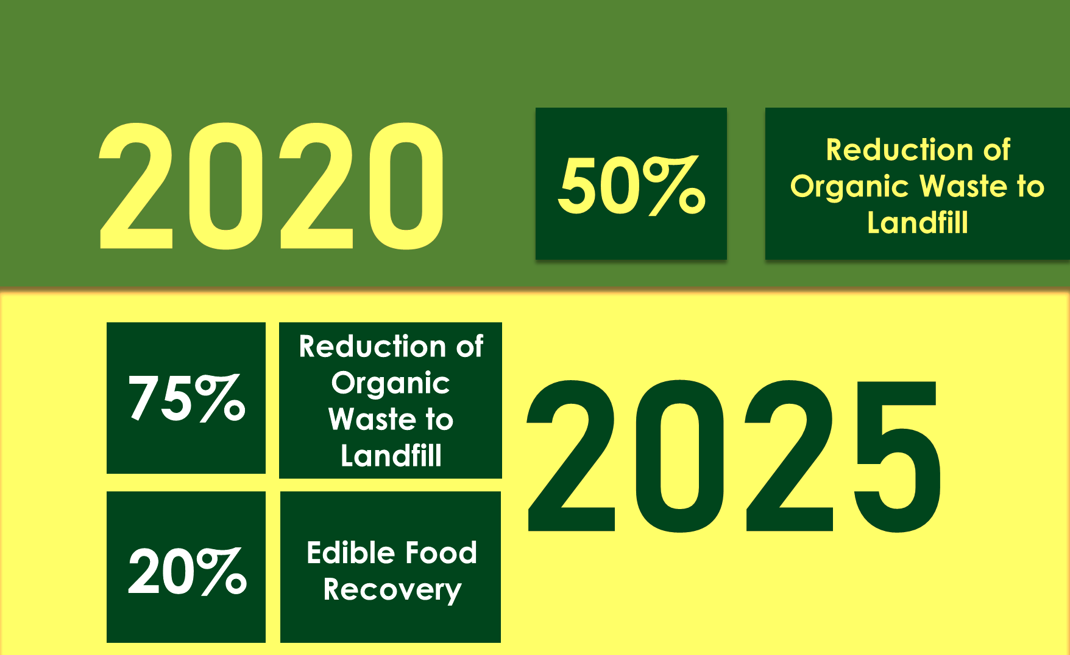
Outline
SB 1383 Overview
Model Objectives
Model Structure and Considerations
Model Highlights
Q & A
Notes:
Presentation Outline
I will provide an overview of SB 1383, highlighting specific requirements, target dates, and local government roles and responsibilities.
I will then turn it over to Debra Kaufman to discuss objectives of the Model Procurement Policy Tool, review how it was developed, how it is structured, and items to consider while using the Model Tool.
She will go through the Model, section by section, covering the focus of each section as well as guidance notes and customization options that are provided in the Model Tool.
We expect the presentation to be about 35 minutes.
We will have about 20 minutes for questions and answers.

Slide 4
SB 1383 Requirements
2020
50% Reduction in Landfilled Organic Waste
(11.5 Million Tons Allowed Organic Waste Disposal)
2022
Regulations Take Effect
2025
75% Reduction in Landfilled Organic Waste
(5.7 Million Tons Allowed Organic Waste Disposal)
2025
20% Recovery of Currently Disposed Edible Food for Human Consumption
Notes:
SB 1383 establishes organic waste reduction targets.
It builds upon the Mandatory Commercial Organics Recycling law, which California Jurisdictions have been implementing since 2016.
SB 1383 sets a goal for Californians to reduce disposal of organic waste 50% by 2020 and 75% by 2025.
These targets use the 2014 Waste Characterization Study measurements when 23 million tons of organic waste were disposed in California.
These disposal reductions will reduce at least 8 million metric tons of greenhouse gas emissions annually by 2030.
SB 1383 establishes an additional goal to recover 20% of currently disposed edible food for human consumption by 2025, as directed by Legislature as a part of the disposal reduction targets.
The SB 1383 definition of organic waste covers many materials, such as food, paper, cardboard, greenwaste, and woodwaste, etc.
The regulations take effect in 2022.

Slide 5






SB 1383 Key Jurisdiction Dates
2022
2024
Provide Organics Collection Service to All Residents and Businesses
Take enforcement action against non-complaint entities starting January 1, 2024.
Establish Edible Food Recovery Program
Conduct Education and Outreach
Procure Recovered Organic Waste Products
Plan for Capacity
Notes:
In SB 1383 terms, a jurisdiction is defined in the regulations to include a city, county, city and county, and special districts that provide solid waste handling services.
To meet the regulatory deadline of January 1, 2022, CalRecycle expects that jurisdictions will be planning and making programmatic and budgetary decisions regarding the requirements now.
By 2022 Jurisdictions are required to:
Have an ordinance.
Have organics collection services for all residents and businesses up-and-running. Services are to be automatically provided to all residents and businesses if they generate organic waste;
Implement edible food recovery programs established for Tier 1 generators by Jan. 1, 2022 and for Tier 2 generators by Jan. 1, 2024;
Conduct compliant education and outreach efforts;
Procure recovered organic waste products and recycled content paper/paper products;
Assess and plan for organic processing and edible food recovery capacity.
Conduct desk audits, route reviews, and inspections of Tier 1 generators.
In the first two years, jurisdictions must provide education and outreach to non-compliant generators.
Note that CalRecycle can begin enforcement actions on jurisdictions and other entities starting on Jan. 1, 2022.
In 2024, Jurisdictions will be required to take enforcement against noncompliant entities.
Note that Jurisdictions are not affirmatively required to impose penalties on generators found in violation of prohibited container contaminant requirements.
CalRecycle has some funding through competitive grant programs, as well as a loan programs, for establishing the infrastructure for recycling organic waste and recovering edible food. However, for the programmatic activities, such as enforcement, inspections, education, and collection service, Jurisdictions will need to plan for budgetary and staffing changes to address these requirements.
Big takeaway here: start planning now to have the programmatic, staffing, and budgetary changes in place by January 1, 2022.

Slide 6
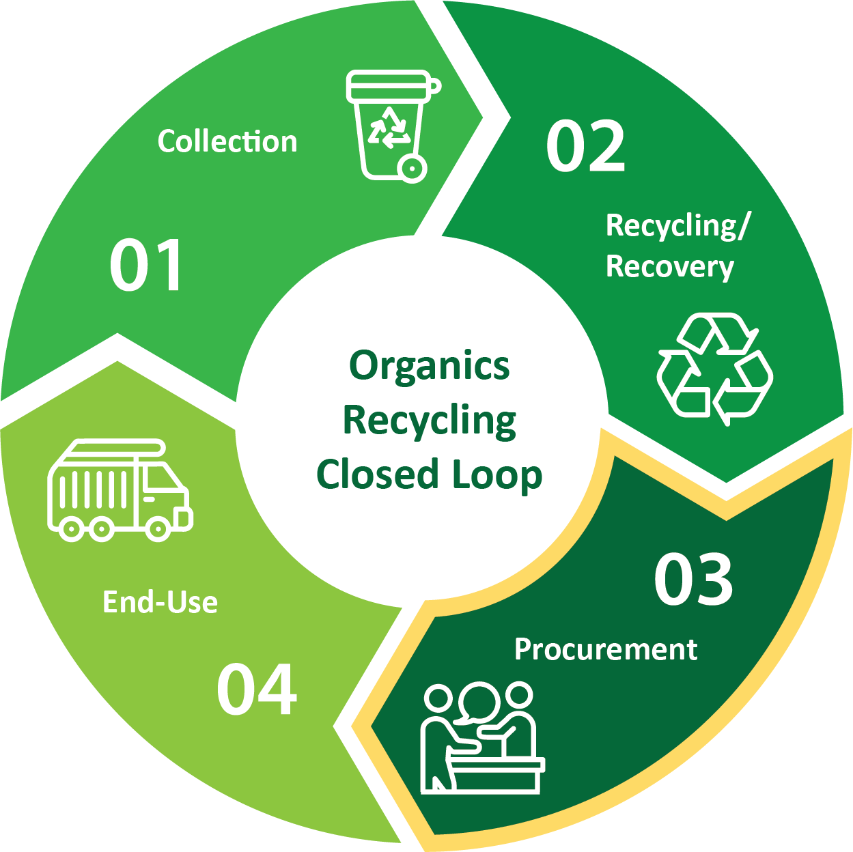
SB 1383 in Action
Procurement Requirements
Jurisdiction Requirements
RECOVERED ORGANIC WASTE PRODUCT PROCUREMENT
Compost
Renewable gas for fuel, electricity, and heating
Electricity from biomass conversion
Mulch from specified solid waste facilities
Close the Loop
RECYCLED-CONTENT PAPER PROCUREMENT
Recycled content
Recyclability
Notes:
Note scripting provided by CalRecycle with modification by HF&H to shorten length:
Our goal is to make sure jurisdictions understand what the requirements are for local jurisdictions related to the SB 1383 procurement requirements.
Beginning Jan 1, 2022, jurisdictions are required to annually procure a quantity of recovered organic waste product
CalRecycle will notify jurisdictions of their minimum procurement target prior to January 1, 2022. Target linked to population.
However, the regulations contain all the information needed for a Jurisdiction to calculate its target at any time.
The jurisdiction can decide what mix of compost, mulch, biomass-derived electricity, or renewable gas they want to use to meet their target.
CalRecycle will provide a calculator with the conversion factors for a jurisdiction to calculate progress.
Procurement doesn’t necessarily mean purchase.
A jurisdiction that produces its own compost, mulch, renewable gas, or electricity from biomass conversion can use that toward the procurement target. Same goes for the jurisdiction’s direct service providers (for example, its haulers).
A jurisdiction can use compost or mulch for many purposes (e.g., erosion control, soil amendment, soil cover, parks/open spaces, giveaways).
A jurisdiction or hauler can use renewable gas for transportation fuels, electricity, or heating applications.
SB 1383 also requires that jurisdictions procure recycled-content paper when it is available at the same price or less then virgin material.
Finally, procured paper products must meet Federal Trade Commission recyclability guidelines (essentially products we purchase must be recyclable).

Slide 7










SB 1383 in Action
Local Government Roles and Responsibilities
City Council
Board of
Supervisors
City Manager
CAO
Finance
Legal
Environmental Health
Public
Works
SB 1383 doesn’t just apply to waste management and recycling departments.
Every local department plays a role in SB 1383 implementation.
Public
Transportation
Fleets
Purchasing
Public Parks
Notes:
Getting started now on SB 1383 planning is really important because this law extends beyond waste management and recycling operations staff.
Let’s look at how this plays out in the context of using the Model Procurement Policy.
Purchasing staff will be central to implementing the procurement policy.
Public Parks staff may be involved with using recycled-content products, such as assessing the need for local compost application to parks and city landscaped areas.
Public Transportation and Fleet departments could be involved in procuring renewable natural gas for city and county owned vehicles.
City Managers and Chief Administrative Officers will be involved in assigning staff to implement procurement of recycled organic waste products, and establishing edible food recovery programs – which touch the Model Franchise Agreement, Procurement Policy, and Food Recovery Agreement.
Environmental health departments may assist in the implementation of the edible food program
Public parks, transportation fleets and purchasing may all play a role in implementing organic procurement requirements
So several departments may play a role in planning for and implementing this law.

Slide 8


Jurisdictions that Must Comply
Cities, counties, and city/counties are responsible for compliance with the organic waste products procurement target and requirements
  Other entities (regional agencies, special districts, etc.) have populations that are already covered under the city or county
All jurisdictions must comply with the recycled-content paper procurement requirements
Notes:
Type of Jurisdiction
Organic Waste Products Procurement:
SB 1383 regulations clarify that only jurisdictions that are a city, a county, or a city and county are subject to the organic waste product procurement target.
Other types of jurisdictions covered in the SB 1383 definition of 'jurisdiction', such as regional agencies and special districts, have populations that are already counted under a city or county and therefore are not directly responsible for compliance with procurement target requirements for recovered organic waste products.
Jurisdictions should choose the customization options that best match the requirements of their jurisdiction type (a city, a county or a city and county).
Recycled-content Paper Procurement:
Note that all jurisdictions must comply with the recycled-content paper procurement requirements.
Rural Jurisdictions
rural cities and counties are exempt from the recovered organic waste product procurement requirements until January 1, 2027.
However, they are still responsible for the recycled content paper procurement requirements starting in 2022 because those requirements are not based on population, unlike the recovered organic waste product procurement target.
Now I would like to turn it over to Debra Kaufman to go through the objectives, structure and sections of the model policy.

Slide 9
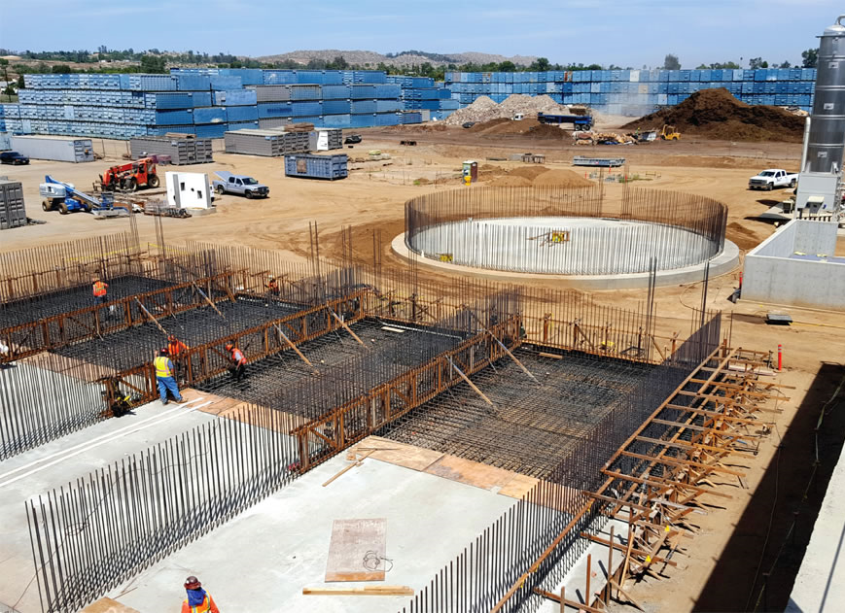
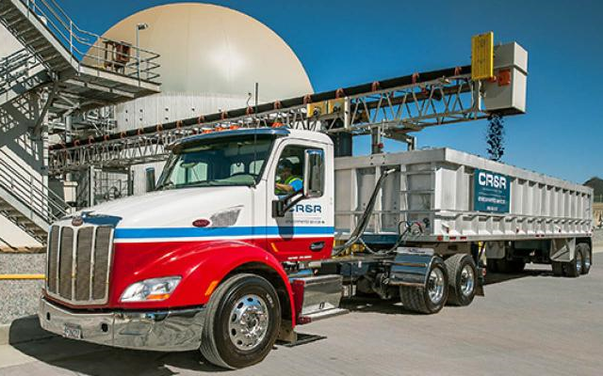
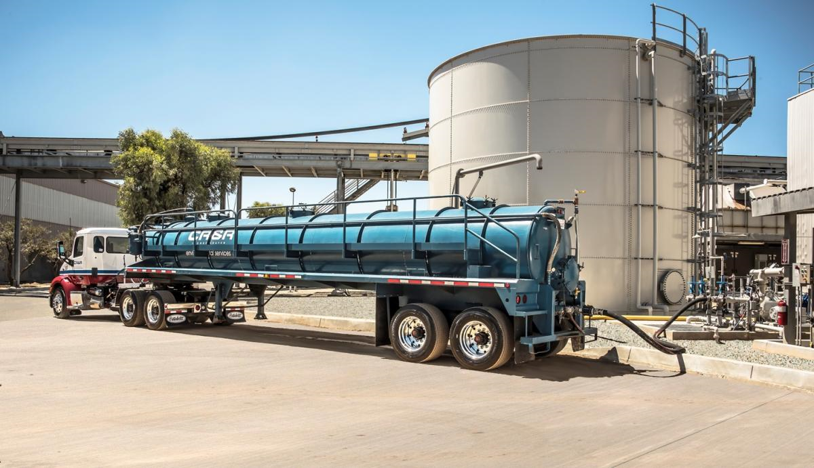
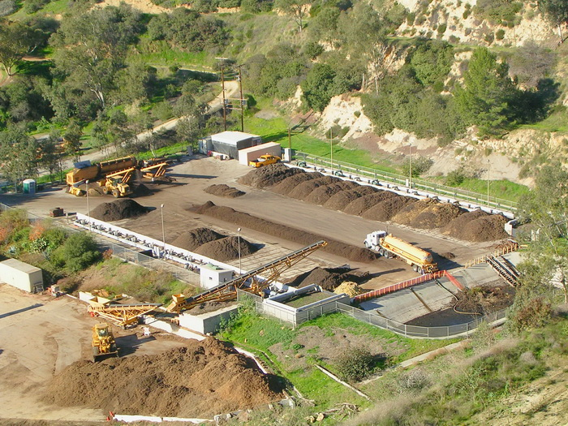
Model Recovered Organic Waste Procurement Policy
Notes:
Thank you for the overview of the key SB 1383 regulations and the summary of organic product procurement requirements. I will now shift gears to present the Model Recovered Organic Waste Product Procurement Policy, which is designed for use by jurisdictions.

Slide 10


Objectives of the Model
Support jurisdictions with planning, implementation, and compliance with SB 1383
Provide resources and guidance
Increase understanding of regulations and compliance strategies
Present example procurement policy provisions
Notes:
The Model Procurement Policy’s main objective is to support Jurisdictions with planning, implementation and compliance with SB 1383’s procurement of recovered organic waste products and recycled-content paper.
Includes example procurement provisions - many of which reflect specific SB 1383 requirements.
Can be used to create a new procurement policy
Can be used to amend current policies to become compliant
The Model contains guidance notes in order to help the user maintain compliance while adapting and customizing the Model for a jurisdiction’s specific purposes.

Slide 11



Model Procurement Policy
Stand-alone policy
  Jurisdictions may use Model provisions to amend their existing policy
Reflective of regulatory language
Provision of guidance notes
  Explanation of provisions
  Highlight applicability to different conditions
Provision of options
  Address different conditions
Notes:
Model Procurement Policy
Now, I would like to briefly discuss how the Model Procurement Policy was developed and what you can expect.
The Model Policy was designed to be customizable for a diverse range of jurisdictions, while providing flexibility for each.
As I mentioned, Upon revision, it can be used a stand-alone document, or it can be used to amend existing policies.
The Model reflects regulatory language.
Guidance notes are directly embedded throughout the Models to provide context for provisions, guide jurisdictions on strategies for tailoring language, and to highlight relevant SB 1383 regulations.
While we’ve provided a wide range of options and guidance, we anticipate jurisdictions will need to customize the example language to fit their needs and are likely to integrate these provisions into the framework of their existing policies. However, it is important to understand what were the requirements of 1383, and how they were was it adapted for the policy.
In a few minutes, I will review key provisions of the Model PP.
**Note that the scope of the Model Policy generally does not extend beyond the elements required by SB 1383, unless otherwise noted in the Model as additional provision options. Other purchasing requirements unrelated to SB 1383 will need to be brought into the final policy that is adopted **

Slide 12
Important Considerations
Create a new policy or amend an existing policy
Review SB 1383 requirements while using Model
  Each jurisdiction is responsible for achieving compliance
Involve jurisdiction’s legal counsel for standard legal provisions and review
Engage with affected parties to streamline implementation
Recognize the Model provides example language ONLY
  Customization and modification is expected
Notes:
Important Considerations
I would like to note some important considerations to think about as you use the Model Procurement Policy.
New Policy or Amendment of Existing Policy
The Model is designed to be customizable for jurisdictions, providing options to address a range of procurement choices.
The Model Policy is focused on the SB 1383 procurement requirements for organic waste products as well as purchase of recycled-content paper and paper products. Jurisdictions may want to expand their policy to cover non-organic recycled-content products and products with other environmentally preferable traits.
SB 1383 Requirements
Jurisdictions are responsible for SB 1383 compliance.
Model Policy usage does not exempt a jurisdiction from complying with all SB 1383 requirements.
Model Policy includes example language that supports SB 1383 compliance.
Specifically, Article 12 (Procurement of Recovered Organic Waste Products) and Article 13 (Reporting) requirements should be reviewed.
It’s important to Involve Legal Counsel
Model Policy usage shall not replace legal counsel review.
Each jurisdiction is responsible for involving its legal counsel to perform legal review and approval processes typically required by the jurisdiction for approval of such policies.
Engage with Affected Parties
When adopting a new or amended policy, it is advised that the review and adoption process involve engagement with the affected parties.
The model contains Example Language Only
The provisions in the Model Policy are examples of how the SB 1383 requirements may be integrated and worked into a jurisdictions’ policy. Jurisdictions are not required to use this exact language. All language should be considered in the context of the specific requirements contained in the SB 1383 regulations and adapted to the jurisdictions’ unique conditions.

Slide 13
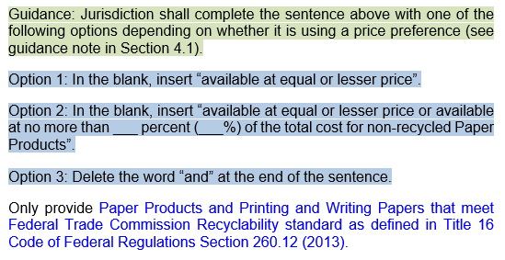
Guidance, Options, and SB 1383 Content
General guidance notes
Specific customization notes
SB 1383-specific content
Notes:
General Guidance, Optionality, and SB 1383-specific Content
The Model Procurement Policy is a colorful document. Text highlights and colors, as displayed in this screenshot, provide guidance and optionality.
Guidance notes, highlighted in green, are integrated into the Model Procurement Policy to explain how specific sections and provisions of the Model can be customized for a jurisdiction’s needs.
Notes highlighted in blue identify various options or areas where specific information is to be inserted or selected.
SB 1383-specific content is shown in blue font. Policy language not specific to SB 1383 is shown in black font.
The SB 1383-specific content follows closely with SB 1383 regulatory language.
In most cases, the black font relates to SB 1383 requirements and is included to provide context to how SB 1383-related provisions can be integrated into a procurement policy.

Slide 14
Organization of the
Model
1 Purpose
2 Definitions
3 Recovered Organic Waste Product Procurement
4 Recycled-Content Paper Procurement
5 Recordkeeping Responsibilities
6 Effective Date
Notes:
Structure of the Model Procurement Policy
The Model PP is organized into six sections listed here.
During the remainder of this presentation, I will provide a high-level overview of each section’s focus in relation to compliance with SB 1383.
I will also identify some of the relevant guidance or customization notes.
A Jurisdiction’s current PP, if one exists, may be structured differently than the Model, and may exceed the minimum standards in 1383 related to the purchasing requirements.

Slide 15

Section 1: Purpose
Focus
Provides policy purpose
Explains policy is not required by SB 1383
Guidance and Customization
Expand purpose as necessary to address climate action plans or other local goals/policies
Add additional benefits related to the jurisdiction’s goals/policies
Notes:
As (Tracy or Rob described), SB 1383 Regulations require a city, county, or city and county, as of January 1, 2022, to annually procure a quantity of recovered organic waste products.
While SB 1383 does not require jurisdictions to adopt an organics waste product procurement policy, jurisdictions may find adopting such a policy will support its obligation to comply with the SB 1383 organic waste product procurement requirements, across departments.)
The Focus of section 1 is to
Provide overarching detail on why the policy exists and the environmental and regulatory goals in adopting the PP.
It Explains that “Purpose” isn’t required by the regulations, and doesn’t need to be added if it is currently omitted from a PP, but is included in the Model to provide further clarity on why the Model exists.
Guidance and Customization
A jurisdiction could Add additional environmental and regulatory objectives such as addressing climate action plans, waste prevention goals, and reduced toxicity goals for example,
A j might also Add additional benefits that will result from the adoption of the PP, such as reduction of expenses (if applicable) or alignment with other environmental initiatives adopted.

Slide 16

Section 2: Definitions
Focus
Reflects SB 1383 definitions
Allows for customization because not comprehensive
Guidance and Customization
Review definitions carefully in existing ordinances, franchise, and municipal code
Modify, delete, and integrate new definitions
Consider requiring compost of a particular specification
Consider designee for recordkeeping
Delete unused definitions
Notes:
Section 2 covers definitions and
Nearly all of the definitions included in Section 2 are reflective of the definitions provided in SB 1383 regulations.
Several terms such as “Mulch”, “Compost”, “Renewable Natural Gas”, “Recycled-Content Paper”, and others are nuanced in their definition and include important qualifiers or criteria that must be understood by jurisdictions as they drive SB 1383 procurement compliance obligations. For example, mulch that qualifies to meet the procurement target is limited to mulch produced at a composting facility, transfer or processing facility, or landfill; and renewable natural gas must be generated from organic waste that has been diverted from a landfill and processed at an in-vessel digestion facility. If just the term “Renewable Natural Gas” or “Mulch” is used in the policy without the SB 1383 specifications, the policy may not be in compliance with SB 1383.
The definitions are also not comprehensive of all definitions that a jurisdiction may want to include in its PP; thereby allowing for customization.
Definitions are intentionally broad to allow jurisdictions customization, flexibility, and to match current programs or practices and specific in other cases to comply with the law.
Guidance and Customization
Definitions should be compared to existing ordinances, franchise agreements, and the existing municipal code for consistency and accuracy.
Guidance is provided related to compost specifications, specifically OMRI Certified or part of the USCC Seal of Testing Assurance Program, but this is not required by the regulations and is only presented for consideration.
If the jurisdiction decides to appoint a recordkeeping designee, there is an example definition. Amend or remove as necessary to match jurisdiction tracking strategy.
As mentioned above, any unused definitions should be removed.

Slide 17
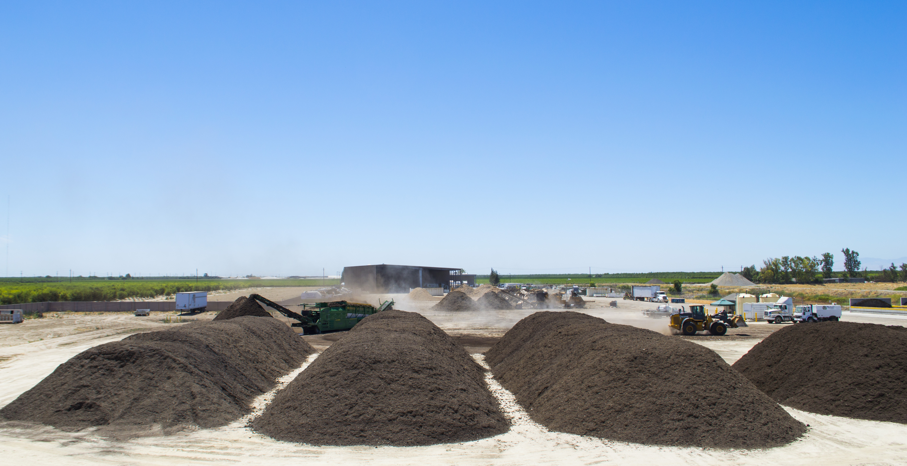
Section 3: Recovered Organic Waste Product Procurement
3.1 Procurement Targets
3.2 Requirements for Jurisdiction Departments
3.3 Requirements for Direct Service Providers
Notes:
Section 3 provides example language for organic waste product procurement requirements related to mulch, compost, renewable natural gas, and electricity from biomass for different entities doing the procurement.
It includes three subsections as noted here—procurement targets, requirements for jurisdictional departments and requirements for direct service providers— and I will address each of these.

Slide 18

Section 3.1: Procurement Target
Focus
Requires specified jurisdictions to procure organic waste products to meet or exceed its SB 1383 target
Guidance and Customization
Specifies that targets are only applicable if the jurisdiction is a city, county, or city and county
Identifies that rural cities and counties are exempt until January 1, 2027
Notes:
(SB 1383 requires cities, counties, or a city and county to annually procure a quantity of recovered organic waste products that meets or exceeds its current annual recovered organic waste product procurement target.
A procurement target is calculated by multiplying the per-capita procurement target of 0.08 tons per resident per year by the city or county population.
Annually, CalRecycle will provide notice to each jurisdiction by posting such information on the CalRecycle’s website and providing written notice directly to each city, county, or city and county (San Francisco).
While CalRecycle will post the annual target, this shouldn’t stop jurisdictions from calculating their own target at anytime.
A city, county, or city and county shall comply with the regulations by one or both of the following:
directly procuring recovered organic waste products for their use or giveaway or
requiring, through a written contract or agreement, that a direct service provider to the jurisdiction procure organic waste products and provide written documentation of such procurement.)
Focus
subsection 3.1 of The Model policy specifically states the types of Recovered Organic Waste Products eligible for SB 1383 compliance, including Eligible Compost, Eligible Mulch, Renewable Gas (in the form of vehicle fuel, electricity or heat), and Electricity Procured from Biomass Conversion.
Note that rural cities and counties do not have to comply with the organic waste procurement requirements until January 1, 2027.

Slide 19

Section 3.2: Requirements for Departments
Focus
Details requirements surrounding procurement and recordkeeping
Guidance and Customization
Suggests record submission upon project completion or subject to recordkeeping designee’s timeline
Identifies mulch from chipping/grinding operations does not count
Highlights need for ordinance/enforceable mechanism for mulch specifications
Describes electricity from biomass conversion eligible only if it receives feedstock from specified solid waste facilities
Notes:
SB 1383 states that procurement of 4 types of recovered organic waste products comply with SB 1383 regulations:
Compost produced at a permitted compost materials handling operation or facility, a large volume permitted in-vessel digestion facility [NOTE: Digestate is not an eligible recovered organic waste product];
Renewable gas used for fuel for transportation, electricity or heating appliances [procured from a POTW with specific disposal restrictions];
Electricity from biomass conversion [using specific feedstock]; and,
Mulch [subject to physical contamination, maximum metal concentration, and pathogen density standards].
Focus
This Section focuses on a jurisdiction’s procurement of organic products for its own use. It delves into the type of recovered organic products that a jurisdiction may choose to procure, and describes the specifications such products shall meet, if used to partially or fully meet the city’s procurement target. It also prescribes required or recommended procurement records to be maintained.
Guidance and Customization
Includes Language surrounding what records should be submitted to the recordkeeping designee, if there is one assigned, and provides flexibility on when records should be submitted internally.
The inclusion of recordkeeping requirements in the Model is intended to help jurisdictions meet the SB 1383 procurement recordkeeping requirements
SB 1383 regulations require that cities, counties, or city and county have an ordinance or similarly enforceable mechanism that requires that Mulch used to comply with a jurisdiction’s organic procurement target, meet specific standards.
This Section includes language that could serve as the jurisdiction’s enforceable mechanism for compliance with this requirement when engaging with a Direct Service Provider for mulch. This language addresses the physical contamination, maximum metal concentration and pathogen density standards for mulch to be eligible for land application.
Electricity procured from a biomass conversion facility must be from a facility that uses feedstock from a composting facility, transfer facility, or a solid waste landfill to count toward the organic waste procurement target.

Slide 20

Section 3.3: Requirements for
Direct Service Providers
Focus
Includes Model Water Efficient Landscaping Ordinance (MWELO) requirements
Presents recovered organic waste product standards
Details renewable natural gas procurement by direct service providers
Guidance Notes
Acknowledges list is not inclusive of all MWELO – includes compost / mulch components only
Considers haulers/processors providing compost / mulch to jurisdiction and customers
Considers bid preference for renewable gas transportation services
Notes:
Section 3.3 focuses on requirements that a jurisdiction might choose to place on its direct service providers to help it meet its organic product procurement target and also to comply with the MWELO components of SB 1383.
This section outlines MWELO requirements for landscape service providers which can help a jurisdiction comply with the requirement that they establish an enforceable mechanism to require compliance with certain sections of the MWELO.
This section also includes sample language if a jurisdiction chooses to rely on a direct service provider to help it achieve its organic waste procurement target.
SB 1383 does not require that a Direct Service Provider of organic waste collection services give away recovered organic waste products, nor does it require a Direct Service Provider to use renewable gas for transporting solid waste, organic material and/or recyclable materials.
However, if the Jurisdiction chooses to rely on a Direct Service Provider to support its organic product procurement compliance, the jurisdiction must specify the products to be acquired by the Direct Service Providers.
This Section does that by specifying standards for each of the eligible products.
In addition, this Section specifies obligations for Direct Service Providers to maintain and provide records stating the name, physical location, and contact information or entity, operation, or facility from whom the recovered organic waste products were received.
Focus
This Section outlines a Direct Service Provider’s responsibilities to abide by MWELO standards and utilize recovered organic waste products.
Guidance and Customization
Model Water Efficient Landscape Ordinance (MWELO) requirements contained in the policy are related to Compost and mulch use only, and are excerpted from the MWELO; this does not constitute an inclusive list of MWELO or WELO requirements.
If the city or county requires its franchised hauler(s) or processor(s) to provide a specified quantity of Compost or SB 1383 Eligible Mulch to the city or county and its customers at no charge via its franchise agreement(s) or processing agreement(s), there is model language for that.
As I mentioned, Direct Service Provider giveaway of Recovered Organic Waste Products is not a regulatory requirement and as such, is an optional element of this Policy.
The city or county may be able to partially or fully achieve its PP target by incorporating minimum Renewable Gas procurement requirements in contracts for transportation services. The city or county shall decide whether it wants to provide a bid preference for vendors providing transportation services that use Renewable Gas or mandate that a specified amount or minimum percent of fuel purchases by the contractor are Renewable Gas.
Procurement of Renewable Gas by vendors is not a regulatory requirement and as such this is also an optional provision.

Slide 21

Section 4: Recycled-Content Paper Procurement
4.1 Requirements for Jurisdiction
4.2 Requirements for Vendors
Notes:
SB 1383 requires jurisdictional compliance with recycled-content paper procurement requirements for two categories of materials:
Printing and writing paper, and
Paper products, which is defined by SB 1383 regulations to include items such as paper janitorial supplies, cartons, wrapping, packaging, file folders, hanging files, corrugated boxes, tissue, and toweling.
Section 4 provides example language to assist jurisdiction in preparing its policies for recycled-content paper procurement requirements that comply with SB 1383.
It includes two subsections, one for jurisdictions and one for vendors.

Slide 22

Section 4.1: Paper Procurement for Jurisdiction Departments
Focus
Requires jurisdictions to obtain recycled-content paper products
Options for procurement at no greater cost or within a price differential
Enables jurisdiction to collect records for compliance
Guidance and Customization
Identifies that SB 1383 does not prohibit price preferences or flat requirement for recycled-content paper products
Includes procurement pricing options
  Price comparable or more favorable
  Price preference (% above virgin products)
  No price preference (require recycled-content regardless of price)
Notes:
SB 1383 Regulations require all Jurisdictions to procure paper products and printing and writing paper consistent with the requirements of the Public Contact Code, starting Jan 1, 2022.
This requires all jurisdictions, including rural jurisdictions, to purchase recycled products instead of non-recycled products whenever recycled products are available at the same or lesser total cost than non-recycled items, if fitness and quality are equal.
They must also provide that the paper products offered or sold are eligible to be labeled with an unqualified recyclable label.
The Regulations do not prohibit Jurisdictions from either using a price preference for Recycled-Content Paper products or requiring Recycled-Content Paper products regardless of price.
The Regulations defines Recycled-Content Paper to consist of at least 30% by fiber weight, postconsumer fiber.
All jurisdictions, meaning cities, counties, city and county, community service districts that provide solid waste handling services must comply
Focus
These requirements reiterate pre-existing requirements on paper products and printing and writing paper to contain recycled content.
Model language helps to put these pre-existing requirements into practice and enables the jurisdiction to collect records they will need to show compliance with SB 1383.
Guidance and Customization
Jurisdictions are not prohibited from either using a price preference (usually 5 to 10 percent) for Recycled-Content Paper Products or requiring Recycled-Content Paper Products regardless of price.
Options are highlighted in blue around 3 different approaches:
Comparable or more favorable pricing, a price preference, or no price preference.

Slide 23
Section 4.2: Paper Procurement for Vendors
Focus
Specifies paper vendor procurement policy
Guidance and Customization
Allows for pricing preferences, if any, for recycled-content paper products
Considers requiring extra detail in purchasing records
Acknowledges that printing vendors must already use recycled-content paper per Public Contracts Code
Notes:
SB 1383 Regulations require all businesses from whom a Jurisdiction purchases paper products and printing and writing paper to certify in writing the minimum percentage, if not the exact percentage, of postconsumer material in the paper products.
They must also provide that the paper products offered or sold are eligible to be labeled with an unqualified recyclable label.
SB 1383 Regulations do not require vendors providing printing services to local governments to use Recycled-Content printing and writing paper, but Public Contract Code Section 22153 does.
Guidance and Customization
Customization options exist in the model to coordinate the level of price preference, if any, or requirement to purchase recycled-content paper.
Jurisdiction may want to consider adding additional details in the requirements above and beyond what is required by SB 1383. For example, a jurisdiction may choose to add that the vendor records should include “dollars spent for each type of product”.

Slide 24
Section 5: Responsibilities for Tracking Procurement
Focus
Assigns responsibility for recording jurisdiction’s procurement and compiling the annual report
Guidance and Customization
Designates department responsible for recordkeeping
Identifies with whom the reports shall be shared
Notes:
SB 1383 requires jurisdictions to maintain records to show they have met their organic waste procurement target and that they have purchased paper meeting the specified recycled content standard.
Jurisdictions shall include copies of invoices, receipts or other proof of purchase.
SB 1383 does not specify that a department or person be assigned the sole responsibility of collecting and maintaining documents needed to support and demonstrate compliance.
However, we think it makes sense to identify staff responsible for record-keeping.
Focus
This Section assigns the responsibility of recordkeeping to a specified designee in a specified department, and lists the duties assigned to the designee.
Guidance and Customization
This section can be modified or removed completely to align with the recordkeeping strategy that the jurisdiction employs. If an electronic recordkeeping system is used for some, or all, of the documentation, the language can be adjusted to reflect the jurisdiction’s activities. As long as all the required information is gathered and reported, any number of strategies could be specified here.
However, For larger agencies, it may make more sense to identify a responsible party.

Slide 25

Section 6: Effective Date
Focus
Allows jurisdictions to enact the policy before or just in time for regulatory compliance
Guidance and Customization
Specifies no later than January 1, 2022 for all except rural jurisdictions
Identifies rural jurisdiction organic waste products procurement exemption valid until December 31, 2026
  Indicates compliance with recycled-content paper procurement by January 1, 2022
Notes:
SB 1383 states that jurisdictions shall annually procure their calculated quantity commencing January 1, 2022, with the exception of Rural jurisdictions who are not required to comply with the organic waste procurement requirements until December 31, 2026 (covered below)
This section covers the effective date for the policy.
Guidance and Customization
The guidance provided, notes that if the policy is not going into immediate effect, the jurisdiction can reword the example language to include a later date for effective date, but no later than January 1, 2022, per SB 1383 regulatory requirements.
Rural counties and jurisdictions located within rural counties are exempt from organic waste products procurement requirements until January 1, 2027.
But jurisdictions must comply with recycled-content paper procurement by January 1, 2022.

Slide 26
Customization Tips
Modify language to fit jurisdiction’s needs
Delete guidance notes and unused options upon completion
Blend existing requirements with the Model requirements
Customize style and design
Seek legal counsel
Review organic waste product procurement case studies
  City of Manteca waste-to-fuel program
  Hitachi Zosen Inova energy-from-waste facility
www.calrecycle.ca.gov/organics/slcp/education
Notes:
Overall Tips
The Model Procurement Policy provides an example language. Given the diversity of jurisdictions and their approaches to procurement, the Model language will need to be customized. We recognize that it will not be a perfect fit for each jurisdiction, but it will provide a solid foundation for each jurisdiction to create its policy or to amend its existing procurement policies to integrate these SB 1383 requirements. I will wrap up this presentation with a few tips to keep in mind as you use the Model PP.
Modify Language
Adjust the Model language to fit the jurisdiction’s specific needs. For example, “jurisdiction” is used throughout the document, and will need to be changed to city or county, as applicable.
Delete Guidance Notes and Unused Options
Highlighted guidance notes are presented in the Model for reference only, and are to be removed by the jurisdiction when preparing its policy. In cases where the Model offers multiple options, optional provisions that are not selected are to be deleted and section numbers must be modified accordingly.
Blend Existing Requirements with Model Requirements
When using the Model Policy, jurisdictions may want to blend requirements from both the Model Policy and existing Policy(s) or Administrative Guidelines on Procurement to create a policy that best suits their needs and requirements. Be thoughtful of defined terms.
Style and Design
The use of multiple font colors and highlighting to differentiate content in the Model Policy, as described above, is not required in any final document produced, and the colors should be eliminated or made consistent with the jurisdiction’s standard document styles. The Model Policy and this Guidance Document have been designed in accordance with CalRecycle’s accessibility guidelines. SB 1383 does not require specific styles or design to be used for policies, and the final document style is at each jurisdiction’s discretion.
Seek Legal Counsel
As we noted at the beginning of this presentation, each jurisdiction is ultimately responsible for its compliance with the regulations, and is advised to seek legal counsel in development or modification of its agreement(s).
Case Studies
CalRecycle, in conjunction with HF&H Consultants, has developed a series of case studies that spotlight how jurisdictions and entities are implementing some aspect of SB 1383. We have created two case studies for each of the Model Tools. For the Model PP, we are showcasing the City of Manteca waste-to-fuel program and the Hitachi Zosen Inova Facility in San Luis Obispo County. You can read about their implementation process and lessons learned by following the links provided on this slide.

Slide 27


Thank You!
Link to Model Tools
www.calrecycle.ca.gov/organics/slcp/education
Contact
Rob Hilton
HF&H Consultants
rchilton@hfh-consultants.com
(925) 977-6959
Debra Kaufman
Debra Kaufman Consulting
dkaufmanconsulting@gmail.com
(415) 519-5507
CalRecycle
slcp.organics@calrecycle.ca.gov
DKC
Notes:
Thank you very much for listening.
We will use the remaining time to respond to questions and receive comments.

