Slide 1

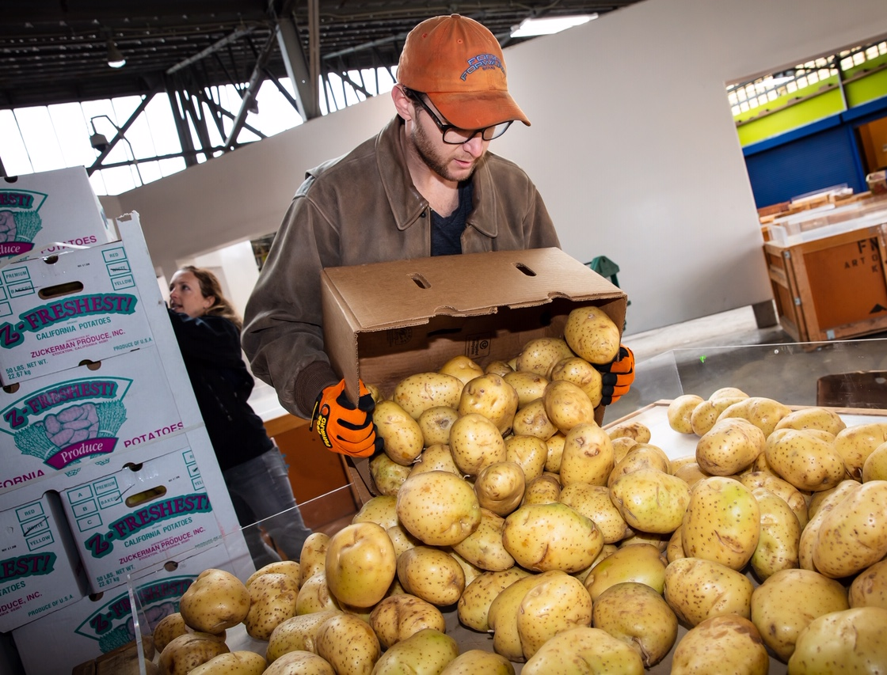
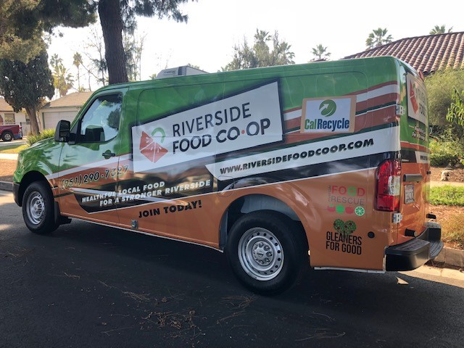
SB 1383
Model Food Recovery Agreement
CalRecycle Statewide Webinar
Presented by HF&H Consultants, Diversion Strategies, and CalRecycle
October 28, 2020
Notes:
Presentation Introduction
SB 1383 (Lara, Chapter 395, Statutes of 2016) is the most significant waste reduction mandate to be adopted in California in the last 30 years.
The legislation has significant policy and legal implications for state and local entities, regulated generators, food recovery services and organizations throughout the state.
To assist regulated entities with the implementation of SB 1383, CalRecycle, with assistance from HF&H Consultants, has developed four Model Tools:
Model franchise agreement;
Model mandatory organics disposal reduction ordinance;
Model organic waste product procurement policy
Model edible food recovery agreement
Today we are pleased to be presenting the Model Food Recovery Agreement. This Model was developed by HF&H Consultants and Diversion Strategies. The purpose of the Model Food Recovery Agreement is to provide an example agreement for customization by commercial edible food generators and the food recovery organizations and food recovery services they contract with.
SB 1383 requires that Tier 1 and Tier 2 commercial edible food generators enter into a contract or written agreement with a food recovery organization or food recovery service and this Model provides an example framework to support their compliance.

Slide 2
Disclaimer
This Model Tool is for informational and example purposes only. It should not merely be duplicated without consideration of an individual food recovery organization’s or service’s or edible food generator’s particular needs or circumstances. It is not intended to cover each and every situation, nor can it anticipate specific needs.
In developing this Model Tool, CalRecycle and its consultants (HF&H Consultants in conjunction with Diversion Strategies) have attempted to ensure that the language herein aligns with the SB 1383 regulations; however, in the event of any conflict, the language in the regulations shall prevail over language in the Model Tool and determination of regulatory intent and interpretation should be appropriately guided by the regulatory language and the official rulemaking record of which this Model Tool is not a component.
CalRecycle and its consultants make no representation that use of this Model Tool will ensure compliance with regulatory requirements.
This Model Tool does not constitute legal advice. Parties entering into food recovery agreements are encouraged to seek legal counsel appropriate to their particular circumstances regarding compliance with regulatory requirements.
Notes:
Before we go any further, I have to review the fine print.
The Model Food Recovery Agreement is for example purposes only. It should not merely be duplicated without consideration of an individual user’s particular needs or circumstances. It is not intended to cover each and every situation, nor can it anticipate specific needs.
We’ve done our best to align the language in the Model with the regulations. However, in the event of any conflict, the language in the regulations shall prevail over language in the Model Tool.
In such cases, the SB 1383 regulatory language and the official rulemaking record should guide the determining regulatory intent and interpretation.
It is also important to note that each Tier 1 and Tier 2 commercial edible food generator and food recovery organization’s or service’s are ultimately responsible for its compliance with the regulations, and is advised to seek legal counsel in development or modification of its agreement(s).

Slide 3
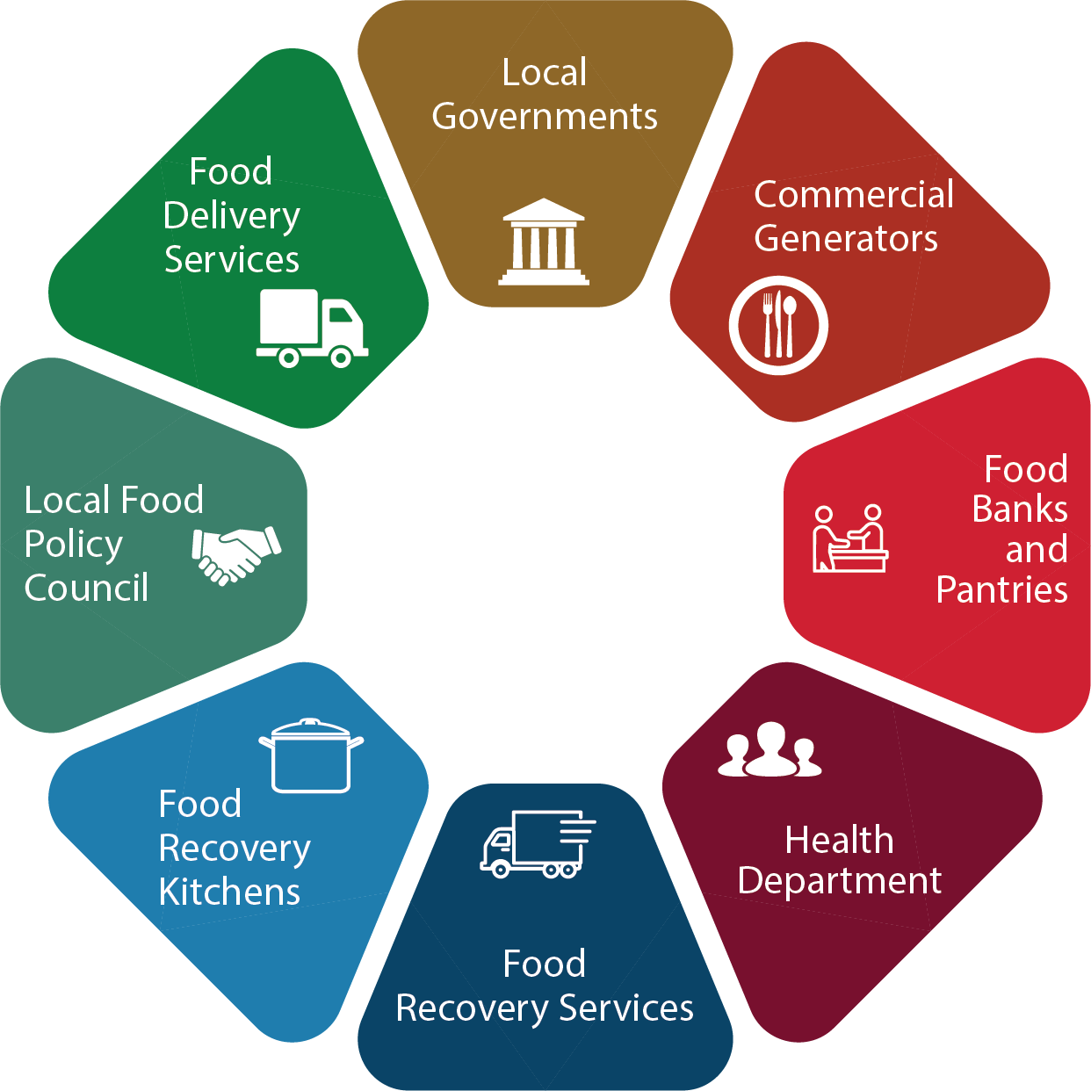
Outline
SB 1383 overview
  Key edible food recovery dates
  Food recovery requirements
    Commercial edible food generators
    Food recovery organizations/services
    Jurisdictions
Model objectives
Model structure and considerations
Model highlights
Q & A
Notes:
Presentation Outline
We will begin with an overview of SB 1383, highlighting key edible food recovery dates and specific roles and requirements for each regulated entity.
Next, we will review the objectives of the model and provide an overview for the model’s structure and use.
We will then walk through the main highlights of each section of the agreement.
Finally, we will wrap up the presentation with a Q&A session.
As we start discussing the Model Food Recovery Agreement, it is important to remember that multiple actors are involved in shaping a thriving and successful food recovery network. We hope this presentation and the Model Food Recovery Agreement will be a starting point for at least one piece of the puzzle that keeps this wheel spinning.

Slide 4
SB 1383 Requirements
2020
50% Reduction in Landfilled Organic Waste
(11.5 Million Tons Allowed Organic Waste Disposal)
2022
Regulations Take Effect
2025
75% Reduction in Landfilled Organic Waste
(5.7 Million Tons Allowed Organic Waste Disposal)
2025
20% Recovery of Currently Disposed Edible Food for Human Consumption
Notes:
SB 1383 establishes organic waste reduction targets.
It builds upon the Mandatory Commercial Organics Recycling law, which California Jurisdictions have been implementing since 2016.
SB 1383 sets a goal for Californians to reduce disposal of organic waste 50% by 2020 and 75% by 2025.
These targets use the 2014 Waste Characterization Study measurements when 23 million tons of organic waste were disposed in California.
These disposal reductions will reduce at least 8 million metric tons of greenhouse gas emissions annually by 2030.
SB 1383 establishes an additional goal to recover 20% of currently disposed edible food for human consumption by 2025, as directed by Legislature as a part of the disposal reduction targets.
The SB 1383 definition of organic waste covers many materials, such as food, paper, cardboard, greenwaste, and woodwaste, etc.
The regulations take effect in 2022.

Slide 5
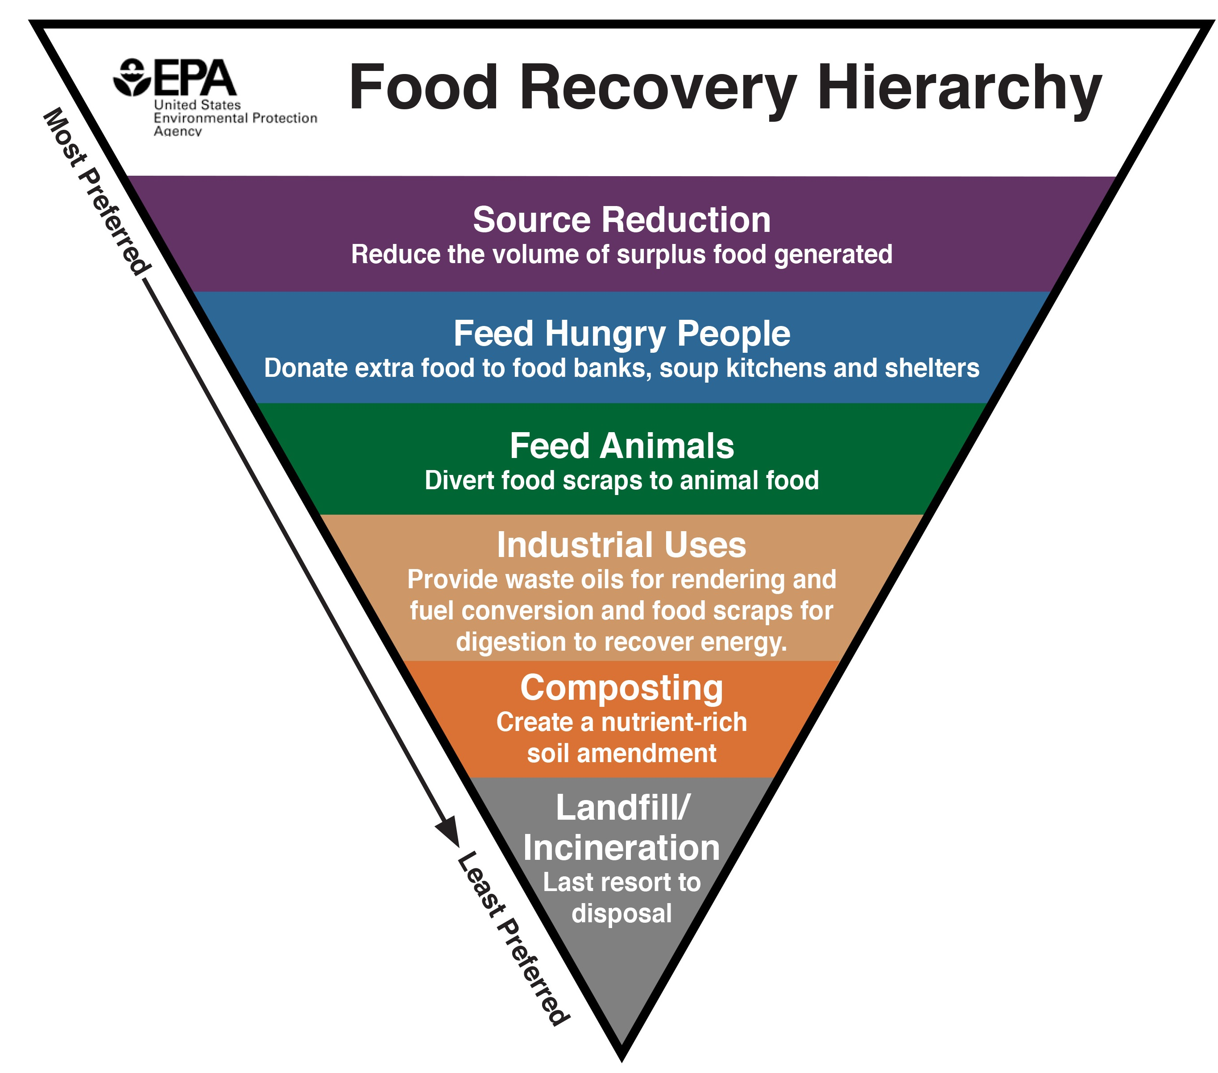
Food Recovery Hierarchy
Focus of SB 1383’s 20% edible food recovery goal
Focus of Model Food Recovery Agreement
Notes:
Food Recovery Hierarchy/Context
Many of you have probably seen this image before. (or ask “how many of you have seen this image before?” and have them raise hands)
This is the food recovery hierarchy created by the EPA, which prioritizes different options for addressing the issue of wasted food, from most to least preferred.
Note that source reduction - reducing the amount of surplus food generated - is the top method in the hierarchy. Jurisdictions are required by SB 1383 to provide annual food recovery education, which includes information on actions that commercial edible food generators can take to prevent the creation of food waste.
The second most preferred method, feeding hungry people, is our primary focus today. This is the focus of SB 1383’s 20% edible food recovery goal, and the Model Food Recovery Agreement is a tool that aims to support this process.
If you’re looking for support with downstream options, our Model Franchise Agreement and Ordinance may be useful, but today we’re going to talk about food recovery.

Slide 6






SB 1383 Key Edible Food Recovery Dates
2022
2024
Jurisdictions establish edible food recovery program
Tier 2 commercial edible food generators must be compliant
Tier 1 commercial edible food generators must be compliant
Jurisdictions begin inspections of Tier 2 commercial edible food generators
Jurisdictions take enforcement action for non-compliant entities
Jurisdictions begin food recovery capacity planning
Jurisdictions begin food recovery education (annually)
Jurisdictions begin inspections of Tier 1 generators and food recovery orgs/services
Notes:
Key Food Recovery Dates:
In order to meet the 20% edible food recovery goal, SB 1383 establishes a variety of specific programmatic requirements. This slide demonstrates the timeline for some of those requirements.
By January 1, 2022.
Jurisdictions must establish edible food recovery programs, conduct capacity planning, provide education, and begin inspections of Tier 1 commercial edible food generators and food recovery organizations and services. CalRecycle is developing a food recovery capacity planning tool that will be available in 2021.
Tier 1 commercial edible food generators must comply with edible food recovery requirements.
By 2024:
Tier 2 commercial edible food generators must comply;
Jurisdictions begin inspections of Tier 2 commercial edible food generators; and,
Jurisdictions are to take enforcement actions for non-compliant entities (including commercial edible food generators, and food recovery organizations and services).
As you’ll notice, the main difference in the edible food recovery timeline is between Tier 1 and Tier 2 generators. In a few more slides, we will discuss the difference between these two types of generators.

Slide 7



Jurisdiction Edible Food Recovery Requirements
Establish Edible Food Recovery Program
Plan for Capacity
and Expansion (if needed)
Enforceable Mechanisms and Monitor Compliance
Ensure Generators Have Access to Organizations/ Services
Provide Education
Report Program Information
Notes:
*Jurisdiction Script:
SB 1383 requires that jurisdictions strengthen their existing infrastructure for edible food recovery by implementing edible food recovery programs. This involves a number of specific requirements.
Even in communities where infrastructure already exists, there are new requirements, such as recordkeeping and inspections, that will need to be implemented.
These requirements include:
Establishing an edible food recovery program
Support expansion of food recovery capacity, if needed
Providing education and outreach
Passing enforceable mechanism and inspecting commercial edible food generators for compliance
Reporting program information to CalRecycle
We will highlight some of these requirements in more detail on the following slides.
CEFG/FRO Script:
SB 1383 requires strengthening the existing infrastructure for edible food recovery. Jurisdictions have specific requirements to achieve these goals. Even in communities where edible food recovery infrastructure already exists, there are new jurisdictional implementation requirements, such as recordkeeping and inspections.
Jurisdictions are tasked with implementing successful edible food recovery programs in their communities. They must ensure that generators have access to food recovery organizations and services and that food recovery organizations and services are set up for success.
The steps to establish these programs will first be informed by the Jurisdiction’s edible food recovery capacity planning.
Jurisdictions are responsible for:
Estimating the amount of edible food that will be disposed by commercial edible food generators;
Identifying existing, new or proposed food recovery capacity; and,
Identifying whether additional capacity is needed.
If results show that the jurisdiction does not have adequate food recovery capacity, the jurisdiction is responsible for creating and implementing a plan to increase that capacity.
An important component is that jurisdictions will be required to consult with Food Recovery Organizations and Services in this capacity planning effort. So for all of the representatives from food recovery organizations and services out there, you will likely be engaged in the capacity planning process with your local jurisdiction and must respond to requests for information within 60 days.
Jurisdictions are also responsible for providing annual education to commercial edible food generators; including information on:
The jurisdiction’s edible food recovery program
The generator’s requirements under the program;
And how the generators can source reduce edible food wasted.
Another resource jurisdictions will be responsible for is compiling a list of food recovery organizations and services operating in the jurisdiction; which will be published on the jurisdiction’s website, and updated annually.
In order to ensure the program is effective, jurisdictions are required to pass “enforceable mechanisms” for compliance with the program (which for many jurisdictions will take the form of ordinances and updates to Municipal or County Codes)
The model mandatory organics reduction disposal ordinance tool we have created supports this step. Jurisdictions will also be responsible for compliance monitoring through inspections.
Last but not least, Jurisdictions will need to maintain records and report information to CalRecycle on the results of the program, education, and compliance monitoring results.

Slide 8


Food Recovery Capacity Planning
Estimate amount of edible food disposed
Identify existing food recovery capacity and
proposed or potential new or expanded capacity
Consult with food recovery organizations and services
Create a plan to expand capacity, if needed
Notes:
This slide focuses on capacity planning. Counties, in coordination with jurisdictions and regional agencies within the county, are required to:
Estimate the amount of edible food that will be disposed by tier one and tier two commercial edible food generators within the county;
Identify existing capacity at food recovery organizations to recover that food;
Identify proposed, new, or expanded food recovery organizations and services;
Identify the amount of new or expanded capacity necessary to recover the amount of edible food estimated to be disposed; and,
Consult with food recovery organizations and food recovery services regarding capacity that could be accessed by the jurisdiction and its commercial edible food generators.
If results determine that additional capacity is needed, each jurisdiction will submit an implementation schedule for how it will ensure adequate capacity, including funding.
Note that the model agreement does not address capacity planning, but it is important to be aware of this requirement.

Slide 9


SB 1383 in Action
Food Recovery
Education, Outreach, and Resources
Jurisdiction Requirements
Develop List of Food Recovery Orgs. & Services
Educate Commercial Edible Food Generators
Perform
Other Requirements
Maintain on website and update annually
Include name, address, contact, collection service area, and types of food accepted for each
Information on:
Food recovery program
Generator requirements
Food recovery orgs. and services in jurisdiction
Actions to prevent creation of food waste
Language requirements
Maintain copies of materials
Frequency of material distribution
Format options
Notes:
Jurisdictions will be responsible for developing a list of food recovery organizations and services that operate in their jurisdiction. This list is required to be published on the jurisdiction’s website and updated annually. CalRecycle is looking for the list to include the organizations and services that are playing a meaningful role in food recovery and have a proven track record of recovering food safely.
Jurisdictions are also responsible for providing annual education to commercial edible food generators. Jurisdictions must provide information on:
The jurisdiction’s food recovery program;
The generator’s requirements to recover edible food under the jurisdiction’s program;
Food recovery organizations and services operating within the jurisdiction. This includes providing information about the jurisdiction’s online food recovery list; and,
Actions that commercial edible food generators can take to prevent the creation of food waste.
Other educational requirements include:
Providing education materials in any language spoken by a substantial population group;
Maintaining copies of materials provided; and,
Distributing materials at the proper frequency and format
Jurisdiction may provide the educational material through print or electronic media, and may additionally conduct direct outreach through workshops, meetings, or site visits.
This information may be provided by including it with regularly scheduled notices, such as inserts in mailed invoices.
Note that education and outreach is not covered in the model agreement, but it is important to be aware of this requirement.
NOTE TO SPEAKER: Update the following sentence to reflect the status of education and outreach tools developed by CalRecycle.
CalRecycle will be developing SB 1383 education and outreach materials in the future.

Slide 10


SB 1383 in Action
Edible Food Recovery Reporting
Jurisdiction recordkeeping and reporting Requirements
Edible Food Recovery Program
Education & Outreach
Commercial Edible Food Generators
Jurisdiction Inspection & Enforcement
Notes:
Jurisdictions are also required to maintain records as well as report to CalRecycle. This slide shows the various areas that jurisdictions are responsible for reporting.
Jurisdictions are required to maintain certain records, including:
A list of commercial edible food generators in the jurisdiction that have a contract or written agreement with food recovery organizations or services (this model provides that agreement);
A list of food recovery organizations and food recovery services in the jurisdiction and their edible food recovery capacity; and,
Documentation of the actions the jurisdiction has taken to increase edible food recovery capacity.
Edible food recovery reporting requirements for jurisdictions include:
The number of commercial edible food generators located within the jurisdiction;
The number of food recovery services and organizations located and operating within the jurisdiction that contract with or have written agreements with commercial edible food generators for food recovery;
Total pounds of edible food recovered;
Edible food recovery capacity planning activities;
For education requirements, report the number of edible food generators that received information and the type of education and outreach provided; and,
Information on inspections conducted, including inspections of commercial edible food generators and food recovery organizations and services.
The Model Edible Food Recovery Agreement addresses recordkeeping/reporting between the generators and food recovery organizations/services.

Slide 11
Commercial Edible Food Generator Tiers
Tier 1
By January 1, 2022
Supermarket
Grocery store (10,000+ sq. ft.)
Food service provider
Food distributor
Wholesale food vendor
Tier 2
By January 1, 2024
Restaurant (≥ 250 seats or 5,000 sq. ft.)
Hotel with onsite food facility & ≥ 200 rooms
Health facility with onsite food facility & ≥ 100 beds
Large events and venues
State agency with cafeteria (≥ 250 seats or 5,000 sq. ft.)
Local education agency with on-site food facility
Notes:
Commercial Edible Food Generator Tiers:
SB 1383 breaks commercial edible food generators into two categories: Tier 1 and Tier 2.
Tier 1 Generators include your typically larger volume generators that already have food donation practices in place such as:
Supermarkets;
Large Grocery stores;
Food service providers;
Food distributors; and,
Wholesale food vendors
These Tier 1 generators must comply by January 2022.
Tier 2 Generators include those tending to have more prepared food available for food recovery, and many of these generators do not have any food donation practices in place such as:
Larger restaurants (250+ seats, 5,000+ sq. ft.)
Hotel with onsite food facility and 200+ rooms
Health facility with onsite food facility and 100+ beds
Large events and venues
State agency with cafeteria with 250+ seats or a total cafeteria facility size of 5,000+ square feet.
Local education agency with on-site food facility
The Tier 2 generators must comply by January 2024.
The Model agreement includes the definitions for each generator.

Slide 12

SB 1383 in Action
Commercial Edible Food Generators
Recover maximum amount of edible food that would otherwise be disposed
Purpose of Model Agreement
Arrange food recovery through a contract or written agreement with:
Food recovery organizations or services that will collect edible food for food recovery
Food recovery organizations that will accept food that the generator self hauls
Notes:
Commercial Edible Food Generator Requirements:
Commercial edible food generators are required to arrange to recover the maximum amount of their edible food that would otherwise be disposed.
They must do this through a contract or written agreement, one or both of the following:
(1) Food recovery organizations or services that will collect their edible food for food recovery; or,
(2) Food recovery organizations that will accept food that is self-hauled by the generator to the food recovery organization during the delivery/drop off times specified in the contract or written agreement.
This requirement to have a contract or written agreement is the reason the Model Food Recovery Agreement was created. The Model serves as a template and starting point for creating such contracts and written agreements. This will support generators’ compliance with these requirements. The Model will also help set food recovery organizations and services up for success in the process. Further objectives and details on the model agreement will be discussed later in the presentation.

Slide 13

SB 1383 in Action
Commercial Edible Food Generators
Maintain records related to edible food recovery
List of each food recovery organization or service that collect or receives the generator’s food
Copies of contracts and written agreements
List the following information for each organization or service:
  Name, address, and contact information
  Types of food collected or self-hauled
  Established frequency of food collected or self-hauled
  Quantity of food recovered (pounds per month)
Notes:
Commercial Edible Food Generator Requirements:
Commercial edible food generators are also required to maintain records related to these edible food recovery activities.
This recordkeeping includes maintaining:
A list of each food recovery service or organization that collects or receives its edible;
A copy of contracts or written agreements between the commercial edible food generator and food recovery service or organization; and,
A record for each food recovery organization or service that the generator has a contract or agreement with, including the:
Name, address, and contact information;
Types of food collected or self-hauled;
Established frequency for food collection or self-hauled; and,
Quantity of food collected or self-hauled, measured in pounds recovered per month.

Slide 14

SB 1383 in Action
Food Recovery Organizations and Services
Maintain records related to edible
food recovery
Name, address, and contact information of involved parties (commercial edible food generators, food recovery services, and/or food recovery organizations)
Quantity of food collected, transported, and/or received per month (in pounds)
Report quantities of food recovered to jurisdictions annually
Cooperate with capacity planning efforts
Notes:
Food Recovery Organizations And Services Requirements:
Food recovery organizations and services that contract with or have written agreements with commercial edible food generators pursuant to SB 1383, are required by SB 1383’s regulations to maintain records related to edible food recovery activities with the commercial edible food generators they work with. Many of these record keeping requirements are already being tracked by well-established food recovery organizations.
Food recovery services must maintain records of:
The name, address and contact information for each commercial edible food generator that the service collects edible food from;
The quantity in pounds of edible food collected from each commercial edible food generator per month;
The quantity in pounds of edible food transported to each food recovery organization per month; and,
The name, address and contact information for each food recovery organization that the service transports edible food to.
Food recovery organizations must maintain records of:
The name, address and contact information for each commercial edible food generator that the organization receives edible food from;
The quantity in pounds of edible food received from each commercial edible food generator per month; and,
The name, address and contact information for each food recovery service that the organization receives edible food from for food recovery.
Food recovery organizations and services have one reporting requirement which is to annually report to the jurisdiction that their primary address is physically located in, the total pounds of food recovered from tier one and tier two commercial edible food generators in the previous calendar year. This requirement applies only to Food recovery organizations and services that have contracts or written agreements with commercial generators pursuant to SB 1383.
Finally, jurisdictions are responsible for edible food recovery capacity planning, which includes a requirement to consult with food recovery organizations and services. Food recovery organizations and services that are contacted for capacity planning information must respond to the jurisdiction within 60 days regarding available and potential new or expanded capacity.

Slide 15
Model Food Recovery Agreement
Notes:
NOTE FOR PRESENTER: AT THIS POINT, YOU MAY CHOOSE TO PAUSE AND ASK FOR QUESTIONS ON THE SB 1383 REGULATORY OVERVIEW. THIS IS AN OPTION TO BE USED IF THE PRESENTER WANTS TO BREAK UP THE PRESENTATION AND ENGAGE THE AUDIENCE.
This wraps up my overview of the SB 1383 edible food recovery regulations. I will now shift gears to present the Model Food Recovery Agreement, which is designed for edible food generators and food recovery organizations and services.

Slide 16

Model Food Recovery Agreement
Objectives of the model
Assist commercial edible food generators with compliance
Ensure edible food is recovered in a safe and effective manner
Protect food recovery organizations and services from “donation dumping”
Identify potential food recovery arrangements and cost models
Support jurisdictions with developing food recovery programs
Increase understanding of regulations and compliance strategies
Provide resources and guidance to regulated entities
Present example food recovery agreement provisions
Notes:
So, how do we make all of these requirements a reality? The Model Food Recovery Agreement aims to support some steps in the process. Key objectives of the model are listed on this slide.
The main objective of this Model Agreement is to provide commercial edible food generators with a tool to support their compliance with SB 1383, which requires them to enter into a contract or written agreement with a food recovery organization or service.
The Model also addresses key contract issues to guide safe food handling, to prohibit commercial businesses from donation dumping, and present a range of structures for commercial business compensation arrangements to the food recovery organizations and service providers.
Another key objective of the Model is to support jurisdictions with development of their edible food recovery programs.

Slide 17
Model Food Recovery Agreement
Overview
of the Model
General agreement framework
  Provide base of example resources
  Develop provisions with options to customize
  Include main body and exhibits
Optional provisions address different conditions and arrangements
Guidance notes
  Embedded within document
Highlight key sections
Notes:
Let’s start with how the Model Food Recovery Agreement was developed and what you can expect when using it.
We started by researching and compiling examples of existing food recovery resources used by organizations around the state. This gave us a better understanding of various approaches and where customization of the model may be needed.
We then built out the structure of the agreement, including identifying areas where options are needed.
Ultimately, the agreement is organized using a main body agreement, as well as attachments for further details, which we will discuss later in the presentation.
We designed the Model Food Recovery Agreement to be flexible and adaptable for use by different food recovery organizations, food recovery services, and commercial edible food generators across the state; we recognize there is a wide variety of options and approaches around the state and we have attempted (as best we could) to reflect those in the model.
As we noted at the beginning of the presentation, this Model Tool does not constitute legal advice. Parties entering into food recovery agreements are encouraged to seek legal counsel appropriate to their particular circumstances regarding compliance with regulatory requirements.

Slide 18
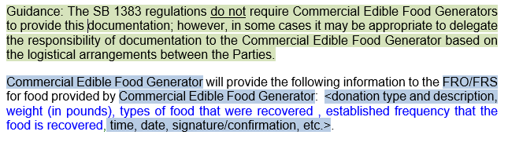

Guidance, Customization, and SB 1383 Content
General guidance notes
Specific customization notes
SB 1383-specific content
Notes:
As mentioned, guidance notes are integrated into the Model Food Recovery Agreement to explain how specific sections and provisions of the Model can be adapted to your needs.
General guidance notes are highlighted green and are included to help users understand how to make those decisions.
Blue shading identifies situations where you are expected to fill in the blanks or edit language to meet your needs.
Language that is specific to SB 1383 is shown in green blue font (mostly in the definitions section) and language not directly from SB 1383, but relevant for a food recovery agreement, is shown in black font.

Slide 19

Adaptability of the Model
Provisions within the Model are intended to apply and be adapted to multiple programs
  Collection vs. self hauled delivery
  Donation vs. fee for service vs. other payment type
Sample provisions may be modified or deleted based on the agreed upon arrangement
Not a “one size fits all” approach
Notes:
Adaptability of the Model
Provisions within the Model are intended to apply to a variety of program and arrangement types for food recovery operations. We know each one has unique relationships and unique organizational and regional circumstances that will impact how they use of the agreement.
In response, we have included a variety of options and pathways throughout the model. This allows users to “choose their own adventure” and create a document that will be most effective for their program and unique conditions.
Different conditions will necessitate different options to be chosen. Examples include:
Determining whether edible food will be collected or delivered. A service may come and pick up or the generator may be expected to self-haul. This includes identifying which party is responsible for which task.
Identifying the business model and whether a fee will be charged for the service or whether the service is donation-based or has no fee;
Keep in mind that there is not a “one size fits all” approach. We recognize that the different organizations, services, and generators will have different ideas about how the model works and we need to have the customization available to accommodate this.
The Model Food Recovery Agreement addresses a variety of commonly-used or potential programs and service options; however, we couldn’t possibly get into the details of modeling each specific business model, therefore sections will need to be modified, added, or removed to meet your specific needs.

Slide 20

Agreement Structure Streamlining
Two options are available for handling contract details
  Details inserted into the Agreement itself
  Details incorporated by reference as an attachment
Options are indicated in guidance notes where applicable
Structure preferences are up to both parties’ discretion
Notes:
Agreement Structure Streamlining
Our hope was to make the body of the agreement have the generic terms used for most situations and the attachments could be used to be more flexible. You could also insert all the details into the body of the agreement itself, but it would make the agreement less flexible over time and we will discuss more on this later. The model is intended to allow you to make your agreement as simple or as complex as you’d like. Your agreement may be longer or shorter than the Model depending on your preferences. Such optionality is indicated and discussed in the guidance notes.
For the purpose of simplifying the amount of repeated information in the model tool, many sections of the model use the attachment approach rather than the body; but again, this is entirely up to the parties of the agreement.

Slide 21
Organization of the
Model Food Recovery Agreement
1 Allowable Foods
2 Food Safety Requirements and Protocols
3 Collection, Transportation, and Storage
4 Equipment Protocols
5 Documentation and Reporting
6 Commercial Edible Food Generator Service Fees or Financial Donations
* Attachments
Notes:
Structure of the Model Agreement
Let’s take a look at the Model’s structure. This outline shows the contents for each section of the agreement. We will review all of them. We have not listed all of the attachments on this slide, but there are five of them, and we will go over them. Note, that three attachments (A through C) are only to be used if details within those Exhibits are not embedded in the body of the agreement.
Alternative scripting for use when presenting to jurisdictions and/or in instances when wanting to keep the presentation short. In this case, Slides 22 through 35 would be deleted.
The Model Food Recovery Agreement outline is shown here. The Model is structured to provide key content in the main portion of the document, supported with details in the Attachments.
Section 1 identifies the allowable foods as well as non-allowable foods so that the commercial edible food generators understand the specific types of edible food the FRO or FRS will take. The allowable and non-allowable foods can be customized and an attachment may be used to present detailed lists of food types.
Section 2 specifies the importance of compliance with federal, state, and local food safety regulations and indicates that specific requirements may be included in an attachment.
Section 3 includes optional language for scenarios in which the FRO or FRS collects the edible food from the commercial businesses, and for scenarios in which the businesses deliver food to the FROs. It also has a donation dumping provision that documents that the commercial businesses shall not knowingly provide unusable or unsuitable food to the FRO or FRS. It also documents that the commercial business shall not force Food Recovery after FRO capacity has been reached, and shall not intentionally deliver food outside of the specified collection/Food Recovery windows.
Section 4 provides optional and customizable language related to the provision of equipment by either party such food transport containers, coolers, thermal blankets, etc. It identifies which party provides the equipment and specifies the type of equipment, protocols for maintenance and return of equipment, and sanitation practices of the equipment, if applicable.
Options are included in Section 5 for recordkeeping and reporting by either the commercial business or FRO or FRS. It lists the types of records to be maintained and any reporting obligations.
Lastly, Section 6 presents Model language related to the FRO’s or FRS’s fees for service or financial donations or in-lieu payments to be provided by commercial edible food generators. A significant amount of customization options are presented here recognizing the FROs and FRSs structure the provision of service in different ways. For example, the fee for service section includes three options covering fees charged per pick-up, fees charged per pound, and flat rate fees charged every month or at a different defined frequency.
The Model Food Recovery Agreement is structured with many guidance notes to explain how the Model can be adapted to different contracting arrangements and includes optional provisions for such purpose.

Slide 22

Section 1: Allowable Foods
1.1 Foods Accepted and/or Preferred for Donation or Collection
1.2 Foods Not Accepted for Donation or Collection
Focus
Details the non-perishable and perishable foods accepted and/or preferred and foods not accepted between the generator and the food recovery organization
  Specify food types, goods, conditions, or conditional acceptance guidelines
Guidance and Customization
Provides agreement detail options:
  List acceptable, preferred, and/or not acceptable foods in body text of agreement; or list in Attachment A of agreement
Notes:
Section 1: Allowable Foods
Section 1.1 details the specific food types accepted and/or preferred by the food recovery organization or service.
Some examples of details include:
Food type – listed by types of non-perishable, perishable, and prepared foods;
Examples of food; and,
Packaging and labeling requirements.
Examples of “preferred” goods may be items that are in high demand amongst the population that the food recovery organization serves, such as items of high nutritional value.
Section 1.2 details the opposite. This is where the user of the tool would specify items not acceptable for donation or collection. This may be for a variety of reasons that are specific to the organizations, such as food type, food quality, nutritional value of the item, and more.

Slide 23


Section 1: Allowable Foods
1.3 Conditions for Donation Refusal
Focus
Specifies the food recovery organization/food recovery service’s right to refuse donations; and, if desired, outline notification procedures
Guidance and Customization
Specify criteria for donation refusal (e.g., food safety, improper storage, lack of storage or transportation capacity, etc.)
Outline notification procedures (if desired)
  Notify donating party of rejection
  Provide reason for rejection
  Explain how to handle rejected food
Notes:
Section 1: Allowable Foods
Section 1.3 Conditions for Donation Refusal
This section reinforces the food recovery organization or service’s right to refuse donations.
Some examples of reasons a donation might be rejected include:
Food safety;
Improper storage;
Item not agreed upon for donation; or on the unacceptable foods list;
Lack of transportation or storage space; and,
Items not currently needed by recipient
Note that SB 1383 prohibits commercial edible food generators from intentionally spoiling food that is capable of being recovered by a food recovery organization or service.
This section may also be used to outline any notification specifications that the parties to the agreement wish to include for these situations.
These specifications might include:
Requirement to notify the donating party that the donation has been rejected;
Including the reason for rejection; and,
Outline how rejected food shall be handled.
Parties can should include documentation of the refusal process. This documentation is not a requirement under SB 1383, but may be included if both parties wish to have more detailed records or work towards a continuous improvement strategy for more recovery.
Parties to the Agreement may also want to include a provision on employing best practices to minimize any ongoing donation rejections. This could include best practices
such as inspecting the donation before leaving the Commercial Edible Food Generator’s site, prompt notification and communication between the parties, and other practices that would help minimize rejected donations and the costs and liability incurred as a result of such rejections.

Slide 24

Section 2: Food Safety Requirements and Protocols
Focus
Highlights important standards are met that ensure safe and effective food recovery processes (not required by SB 1383)
Guidance and Customization
Requires food recovery organization and generators to be in compliance with all federal, state, and local regulations
Allows parties to specify additional protocols
Includes references to food safety resources and guidelines in guidance notes
Notes:
Section 2: Food Safety Requirement and Protocols
While not specifically detailed in SB 1383, food safety is of paramount importance for food recovery and is a critical consideration for all parties involved.
This section requires food recovery organizations and services, and generators, to be in compliance with all federal, state, and local regulations regarding food safety. Some details mentioned include permits and recall processes.
This section in the Model Agreement intentionally avoids being overly prescriptive. It does not detail the federal, state, and local food safety regulations. This approach was taken because SB 1383 requirements do not supersede local, federal, and state regs or DEH directives and out of concern for providing information that might inadvertently conflict with other regulations. Instead, the Model Food Safety provision directs users of the model to insert the level of food safety information desired, and to lean on expert food safety resources to do so. Links to food safety resources and guidelines are embedded in the guidance notes in the beginning of the Model. A key note is that this Model is customizable and parties may integrate specific food safety requirements at their option.

Slide 25
Section 3: Collection, Transportation, and Storage
3.1 Transportation
Focus
Establishes responsibility between parties
Provides instructions for transportation and collection
Guidance and Customization
Determine the party or parties responsible for the transportation of food
Outline specific instructions or protocols for transportation
Notes:
Section 3.1 Transportation
Focus
This section outlines in detail how the transportation of edible food will happen and establishes the party responsible for transportation and collection.
Guidance and Customization
The party or parties responsible for the transportation of food may include a:
Food recovery organization;
Generator;
Third party; or,
A hybrid option.
This section also details specific instructions for transportation. For example, details for this section may include:
Pick-up and delivery addresses
Acceptable days and time windows for pick-ups or deliveries
Other special instructions such as:
How donations are compiled;
Designated check-in and communication protocols;
Inspection of donations;
and more.
For purposes of streamlining the agreement and ease of amending the document, some of the detail on transportation, collection, and staging has been incorporated as an attachment.

Slide 26
Section 3: Collection, Transportation, and Storage
3.2 Missed or Delayed Pick-Ups
Focus
Establishes protocol for responding to missed or delayed pick-ups/deliveries
Guidance and Customization
Determine party responsible for retaining possession of food for missed or delayed pick-ups
Establish notification process in the event of a pick-up or delivery change
Include associate charges, if desired
Clarify potential for termination of agreement for multiple instances
Notes:
3.2. Missed or delayed pick-ups
Focus
This section establishes protocols in the event of missed or delayed pick-ups or deliveries.
Guidance and Customization
Some issues covered include:
Who retains possession of the food in the event of a delay. The model agreement provides example language that allows a commercial edible food generator to retain possession if a delay cannot be accommodated (for example, if the delay results in delivery after hours)
Notification processes, in the event of changes, are also contemplated in this section. Examples of changes include donations not being available on the scheduled day, holidays, or other closures that may affect transportation.
Parties may choose to include charges for missed or delayed pick-ups, or may even include a provision for termination of the agreement for consistent instances of missed or delayed pick-ups.

Slide 27
Section 3: Collection, Transportation and Storage
3.3 Donation Dumping
Focus
Specifies clearly that donation dumping is prohibited
Guidance and Customization
Requires generator to not knowingly donate unusable or unsuitable food; force donation after capacity; or deliver outside of agreed time windows
Allows for compensation to food recovery organization for costs incurred
Permits potential reporting to local jurisdiction and/or termination of agreement
Notes:
3.3. Donation Dumping
SB 1383 specifically prohibits the practice of donation dumping and delivering a donation to a food recovery organization without its consent.
Donation dumping is the act of donating food to a food recovery organization that does not accept that type of food; or, the donated food is not recoverable for human consumption.
This section clearly outlines that this practice is prohibited, and that generators will not knowingly donate unusable or unsuitable food; force donation after capacity; or, deliver outside of agreed upon time windows.
The agreement includes some examples of penalty options that can be used in the in the event of donation dumping. For instance:
Commercial edible food generator must compensate the food recovery organization for any cost incurred as a result of donation dumping;
Notification that this action may result in immediate termination of the agreement; and
Notification that the Commercial edible food generator may be reported to the local jurisdiction.

Slide 28
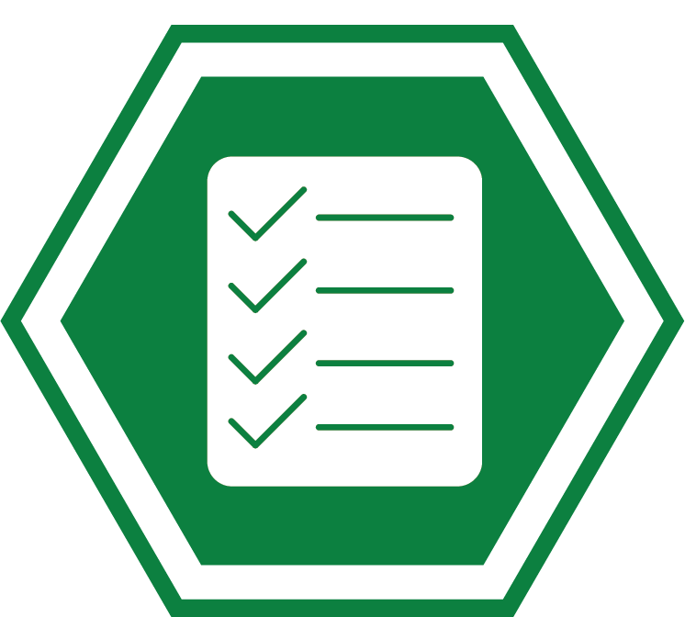
Section 4: Equipment Protocols
Focus
Provides standards regarding loaned equipment, if applicable (not required by SB 1383)
Guidance and Customization
Establishes protocols for use, maintenance, storage, sanitization, and return of equipment borrowed between parties
Includes list of equipment and details in Attachment C (optional)
Notes:
Section 4: Equipment Protocols
This section is to be used for scenarios in which either party is using equipment provided by the other Party. This could include food containers, coolers, or thermal blankets. This section should specify the type of equipment, protocol for maintenance and return of equipment, and sanitation of the equipment, if applicable. Language can be amended to accommodate the specific equipment, use protocols, and return protocols.
The list of specific equipment borrowed by either or both parties can be included as an attachment and that could be updated on a periodic basis.

Slide 29

Section 5: Documentation and Reporting
Focus
Ensure clear delineation of documentation responsibilities, if any; which may assist with meeting SB 1383 recordkeeping and reporting requirements.
Guidance and Customization
Provides options for documentation by generator and/or food recovery organization
Offers document information examples
  Donation type and description
  Donation time
  Donation weight
  Signature or confirmation of donation
Includes frequency that information must be provided
Specifies format of documentation and duration of record retention.
Notes:
Section 5: Documentation and Reporting
Focus
This section outlines documentation needs between the Parties.
This can be documentation required internally, for tax purposes, and/or for regulatory reporting.
As mentioned in our SB 1383 overview, both commercial edible food generators as well as food recovery organizations and services have recordkeeping requirements. This section of the agreement outlines who will responsible for record keeping and reporting and who needs to provide what to who.
Guidance and Customization
Options are presented in this section for commercial edible food generators providing documentation to the food recovery organization or service, and vice versa. Depending on the logistical arrangements between the parties, it may be appropriate to delegate the responsibility of certain documentation actions to one party.
Examples of documented information may include:
Donation type & description;
Donation time;
Donation weight; and
Signature or other confirmation by each party at the time of pick-up and/or delivery.
If desired, the parties may specify the format and submittal requirements of the required information. For format requirements, the parties can determine paper or electronic submittals; they can also establish time periods for which records are to be retained.

Slide 30

Section 6: Service Fees or Financial Donations
Focus
Provides funding structure for the required edible food recovery programs
Guidance and Customization
Select fee structure, if any, depending on financial model of food recovery organization or service
  Fee for service (fee per pick up, fee per pound, flat fee per time interval (e.g., week, month, etc.))
  Donation by generator
  Other financial donation by generator to organization, in-lieu or in-kind payment, etc.
Specify if payment through other mechanisms (franchise agreement, third party, etc.)
Notes:
Section 6: Commercial Edible Food Generator Service Fees or Financial Donations
This section provides language that includes different fee structures that are dependent on the financial model of the food recovery organization or service. Since fee structures can vary greatly, the language should be amended and tailored to the users specific financial model.
Users can select from a range of generator payment options included in the Model
Example language is provided for fee-for-service models. These options include variations such as:
Fees paid by generator per pick-up;
Fees paid per pound of food collected;
Flat rate payment by generator per month or at another other frequency; or,
Or a hybrid of these options or tiered payment structure.
In addition, options are provided in which fees are not collected. These options included:
Generation provision of financial donations to the organization; or,
Generator provision of in-lieu or in-kind payments. For example, generators may donate vehicles, refrigeration equipment, or storage space, or engage in other cost sharing models.
The Model also provides options that contemplate payment being provided externally, such as through another funding mechanism such as third party funding, tip fees, franchise fees, or other mechanisms.

Slide 31
Section 7: Terms and Conditions
Focus
Define various terms and conditions for execution of agreement (not required by SB 1383)
Guidance and Customization
Determine amendment and approval processes
Determine effective date, term, and termination options
  Effective until terminated
  Extend with fulfillment of terms and conditions
  Renew automatically with notice of termination, or
  Defined term
Provide a contact for administration of the agreement
Insert non-performance criteria
Include additional liability language
Notes:
Section 7: Terms and Conditions
This section enumerates various terms and conditions for the execution of the agreement. These terms and conditions determine:
The amendment and approval processes;
The effective date, term, and termination options.
Other conditions documented in this section include requirements for the parties to:
Provide a contact for administration of the agreement; and,
Insert non-performance criteria.
This section also provides additional liability language that you would want to have reviewed by your legal counsel.

Slide 32
Customization Option: Attachments
Attachment A: Acceptable and/or Preferred Foods,
Unacceptable Foods, and Packaging and Labeling Requirements
  Expanded details to support Section 1
Attachment B: Collection, Transportation, and Storage
  Expanded details to support Section 3
Attachment C: Equipment Use and Storage
  Expanded details to support Section 4
Attachment D: Definitions
Attachment E: Contacts for Agreement
Notes:
We are now going to discuss the attachments.
As noted, attachments A through C are only to be used if details within those attachments are not embedded directly in Sections 1, 3, and 4 of the agreement.
For that reason, we are going to spend a little more time reviewing attachment D (Definitions) and Attachment E (Contacts for Agreement).

Slide 33
Attachment D: Definitions
Focus
Includes variety of definitions (including SB 1383 regulatory definitions and other example definitions)
Guidance and Customization
Review carefully definitions in existing programs and SB 1383 definitions for consistency
Modify and/or integrate new definitions based on current conditions, programs, and contractual arrangements
Notes:
Attachment D: Defined Terms
Some of the defined terms were obtained directly from SB 1383 definitions. Others are from example food recovery programs.
The nuances of defined terms and their relationship to one another can have a significant impact on the meaning of the provisions of the food recovery agreement.
For this reason, parties to the agreement are advised to carefully review the definitions of the Model Agreement and SB 1383, as well as any definitions contained in existing agreement(s), if applicable.
Users should modify existing definitions and/or integrate new ones where needed. It is likely that some of the definitions in the Model can be used without modification, while others will need to be tailored to the parties’ unique conditions, program, and contractual arrangements. Make sure you are still compliant with SB 1383.
Note that not all of the terms in the definitions section have been used within the Model Agreement. Additional definitions have been provided as a reference for other definitions that may be included in a Food Recovery Agreement. Users of the Model Agreement should add or delete definitions as applicable based on the terms selected for their Agreement.

Slide 34
Attachment E: Contacts for Agreement
Focus
Provides point of contact for each party for future communication
Guidance and Customization
List the person who will interact most with donations and collections (optional)
List legal or management person in addition to the day-to-day contact (optional)
Notes:
This Attachment allows the user of the Model to assign contacts. Including this as an attachment is beneficial because if a contact changes, only the attachment will need to be updated, rather than the entire agreement.
In this section, it is best to list the person who will interact most with donations or collections on a “day-to-day” basis. However, additional contacts, such as legal representatives or management, may also be listed in addition to the day-to-day contact.

Slide 35
Customization Tips
Modify language, particularly defined terms
Delete guidance notes and unused options upon completion
Blend existing provisions with the Model provisions
Customize style and design
Seek legal counsel
Review food recovery case studies
  Fresno Metro Ministry
  France’s Edible Food Law
www.calrecycle.ca.gov/organics/slcp/education
Notes:
That wraps up the content of each of the sections of the Model Agreement. The Model Food Recovery Agreement provides example language. Given the diversity of approaches to edible food recovery, the Model language will need to be customized. We recognize that it will not be a perfect fit for each situation, but it will provide a solid foundation for each agreement that will need to be entered into. Depending on the preferences of the contracting parties, uses of the Model may choose to include more comprehensive or detailed provisions within the framework we’ve provided or users may choose to simplify the Model provisions.
Now here are a few more tips and tricks for customizing and finalizing the document.
Modify Language. Adjust the Model language to fit the user’s specific needs. For example, customize the list of foods accepted and prohibits and select the fee payment arrangements. Customize the level of detail included. The actual agreement may be shorter than the Model or longer depending on the preference of the parties involved.
Delete Guidance Notes and Unused Options. Highlighted guidance notes are presented in the Model for reference only, and are to be removed by the user when preparing its final food recovery agreement. In cases where the Model offers multiple options, optional provisions that are not selected are to be deleted and section numbers must be modified accordingly.
Blend Existing Provisions with Model Provisions. Users that have existing food recovery agreements may want to select provisions from both the Model Agreement and their existing agreement to blend together an agreement that best suits their needs.
Style and Design. We have used multiple colors and highlighting to differentiate content to make it easier for the users. We’ve also used styles that meet the accessibility guidelines for CalRecycle. You do not have to do that in the use of your agreement and your agreement may and should adapt to your style.
Seek Legal Counsel
While the regulations specify that commercial edible food generators must enter into an agreement, the regulations do not specify the content of the Food Recovery Agreements so commercial businesses and the food recovery organizations and service providers have latitude on the content. It is advised to seek legal counsel in development or modification of its agreement(s) to capture provisions deemed essential by the parties.
Case Studies:
CalRecycle, in conjunction with HF&H Consultants, has developed a series of case studies that spotlight how jurisdictions and entities are implementing some aspect of SB 1383. We have created two case studies for each of the Model Tools. With respect to edible food recovery, we are showcasing Fresno Metro Ministry’s edible food recovery program, and France’s Edible Food Law. You can read these case studies by following the links provided on this slide.

Slide 36



Thank You
Link to Model Tools
www.calrecycle.ca.gov/organics/slcp/education
Contacts
Diversion Strategies
Erin Merrill
erin@diversionstrategies.com
(916) 396-3907
Rachel Oster
rachel@diversionstrategies.com
(916) 261-0952
HF&H Consultants
Rob Hilton
rchilton@hfh-consultants.com
(925) 977-6959
CalRecycle
slcp.organics@calrecycle.ca.gov
Notes:
Thank you very much for listening. You will find the Model Food Recovery Agreement, as well as the other three Model Tools [Model Ordinance, Model Franchise Agreement, and Model Procurement Policy] at the link shown on this slide.
We will use the remaining time to respond to questions and receive comments.

