Slide 1
Disclaimer
This guidance tool was developed by CalRecycle as a courtesy for informational and example purposes only. Use of this tool is optional and is not a regulatory requirement. In the event of any conflict with this guidance tool or information herein, applicable statutory and regulatory provisions shall control. This tool and information herein are based on known facts and legal authority as understood by CalRecycle at the time of release. Any analysis, guidance, or other information herein may be subject to change based on changed facts or legal authority, actual or understood, subsequent to the time of this communication. The provision of this guidance tool and any analysis, guidance, or other information herein shall not be construed as a waiver of any rights or remedies available to CalRecycle. Recipients of this communication are encouraged to seek the assistance of legal counsel to comply with applicable state law based on their pertinent facts and circumstances. CalRecycle makes no representation that use of this tool will ensure compliance with regulatory requirements. The user assumes all risk and CalRecycle accepts no responsibility or liability to any person because of the use of, or reliance upon, this tool or the information herein.

Slide 2
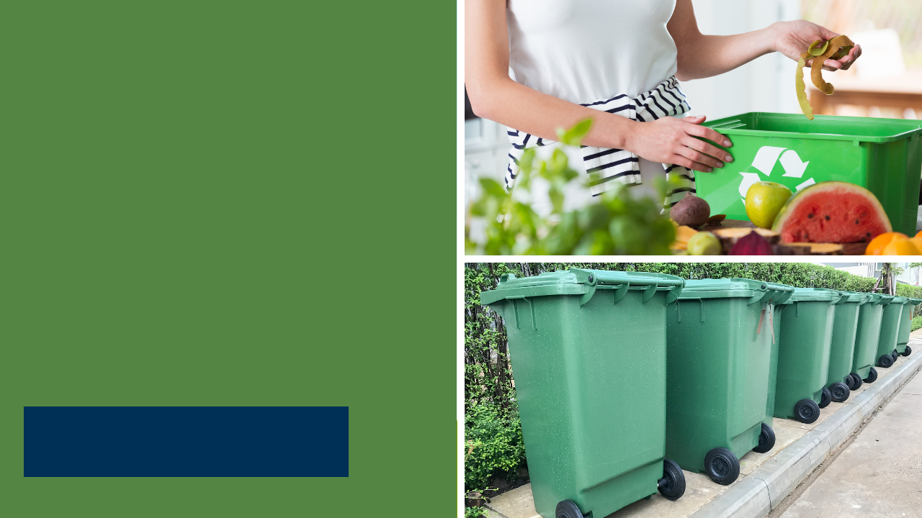
SB 1383 for
Non Local Entities
Statewide Webinar
April 28, 2021
9:00 – 10:00 AM PST

Slide 3
Overview
Jurisdiction Responsibilities and Definitions
Requirements
Waivers
Enforcement
Mandated Food Donors
Questions
Notes:
Here’s an overview of what I’ll be covering for today:

Slide 4
Jurisdiction Responsibilities
Provide education and outreach to all organic waste generators located within the jurisdiction.
Determine if regulated businesses, are subscribing to collection service or self-hauling
Include in their capacity planning efforts all organic waste and edible food tonnage generated by commercial edible food generators
Require haulers providing organic waste collection services to meet the regulations as a condition of approval of a contract, agreement, or other authorization to collect organic waste. (Section 18988.1)
Notes:
Before I go over the Non Local Entity and Organic Waste Definitions, I’d like to point out a few things:
Jurisdictions are required to provide education and outreach to all organic waste generators, including Non local entities located within the jurisdiction.
Jurisdictions also need to determine if regulated businesses, including non local entities, are subscribing to collection service or self-hauling (this is what jurisdictions are currently doing under AB 341 and AB 1826 and will continue to do)
Jurisdictions are to include in their capacity planning efforts all organic waste and edible food tonnage generated by commercial edible food generators
Jurisdictions are responsible for requiring haulers providing residential, commercial, or industrial organic waste collection services to generators within its boundaries to meet the requirements and standards of the regulations as a condition of approval of a contract, agreement, or other authorization to collect organic waste. (Section 18988.1)
So if a Non Local Entity is contracting with a hauler for its collection services (trash, recycling, organics) then that hauler should be adhering to the regulatory requirements

Slide 5
Definitions
Non Local Entity | Organic Waste
An entity that is an organic waste generator but is not subject to the control of a jurisdiction’s regulations related to solid waste. These entities may include, but are not limited to, special districts, federal facilities, prisons, facilities operated by the state parks system, public universities, including community colleges, county fairgrounds, and state agencies. | Solid wastes containing material originated from living organisms and their metabolic waste products including, but not limited to, food, green material, landscape and pruning waste, organic textiles and carpets, lumber, wood, paper products, printing and writing paper, manure, biosolids, digestate, and sludges.
Notes:
Now, lets look at the Non Local Entity Definition:
Non Local Entities are “An entity that is an organic waste generator but is not subject to the control of a jurisdiction’s regulations related to solid waste. These entities may include, but are not limited to, special districts, federal facilities, prisons, facilities operated by the state parks system, public universities, including community colleges, county fairgrounds, and state agencies.”
A “special district” as a non local entity are special districts that do not provide solid waste collection services and also produce organic waste.
Note: The “Jurisdiction” definition includes special districts that provide solid waste collection services. These types of special districts have to adhere to any “jurisdiction” responsibilities in the regulations.
“Federal Facilities” are also non local entities: Some examples of federal facilities are federal office buildings, federal parks and campgrounds, and military bases.
For non-local entities, we must make a paradigm shift from how state agencies were defined in AB 75.
For AB 75, “State Agency” means every state office, department, division, board, commission, or other agency of the state, including Community Colleges and California State Universities. (UCs were not considered state agencies, but were encouraged to implement programs)
As you can see in the non-local entity definition (Section 18982(a)(42)) , entity types such as prisons, facilities operated by the state parks system, public universities, community colleges, and county fairgrounds are identified separately from “state agencies” even though these entity types are what we consider as “state agencies” under AB 75.
The reason why I’m making this distinction, and it’s important for you to understand is because parts of SB 1383 are specific to “State Agencies”, so I want to be clear on what those are. This will come into play when we cover enforcement and mandated food donors. In those cases, it’s important that we know the differences between state agency and non local entity.
Here’s the organic waste definition:
“Organic waste” means solid wastes containing material originated from living organisms and their metabolic waste products including, but not limited to, food, green material, landscape and pruning waste, organic textiles and carpets, lumber, wood, paper products, printing and writing paper, manure, biosolids, digestate, and sludges.

Slide 6
Non-Local Entity Organic Waste Requirements
Subscribe to an organic waste collection service, or self-haul organic waste to a recovery facility
Provide containers for the collection of organic waste and non-organic recyclables in all areas where disposal containers are located
Prohibit employees from placing organic waste in a container not designated for organic waste
Periodic inspections of containers for contamination and inform employees if containers are contaminated
Provide information to employees on methods for prevention of organic waste generation
Notes:
Let’s cover the requirements for non-local entities:
1. Non-local entities must either subscribe to collection service or self-haul organic waste.
This requirement ensures that non-local entities that generate organic waste are accountable for the organic waste they generate and manage the organic waste material in compliance with the requirements.
They could have a 3, 2, or single unsegregated collection service and the service must comply with the requirements in Article 3. If they have a single unsegregated collection service or use a 2 container system, then the material in the gray container must go to a high diversion organic waste processing facility.
If that facility does not meet the performance requirements, then the non-local entity has options: For example, the facility comes into compliance, or the material is taken to another high diversion organic waste processing facility, or the non-local entity uses a 3-container collection service.
Keep in mind that if they are subscribing to the jurisdiction’s collection service, then the jurisdiction would be addressing this issue.
If self-haul is practiced it must be done in a manner that complies with the requirements of Article 7, Section 18988.3. If they self-haul part of their materials, they would need to subscribe to a service for the other organic waste materials.
2. Non Local Entities need to provide containers for collection. Typically, the service provider will provide the external collection containers for trash, organics, and recycling and so the agency would focus on the internal containers:
The internal container must have a body or lid that conforms with the container colors provided through the organic waste collection service provided by the jurisdiction OR must have container labels on new containers that comply with the labeling requirements (Section 18984.8.)
Non-local entities are not required to replace functional containers, including containers purchased prior to January 1, 2022, that do not comply with the requirements of this article prior to the end of the useful life of those containers, or prior to January 1, 2036, whichever comes first.
Non-Local entities must ensure new containers are properly labeled by:
(1) Placing labels on containers that include language or graphic images, or both that indicate the primary materials accepted and the primary materials prohibited in that container; or
(2) Providing containers with imprinted text or graphic images that indicate the primary materials accepted and the primary materials prohibited in that container.
(c) Labels shall clearly indicate primary items that are prohibited container contaminants for each container.
(d) Non-local entities may comply by using model labeling provided by the Department.
So to explain this further here is an example: if the collection service is 3 container system, then you need to have a green, blue, and gray internal container or the 3 internal containers need to be labeled appropriately.
The container color and material specifications are intended to standardize the colors and minimum levels of acceptable materials for collection containers provided across the state. This standardized approach helps employees, visitors, and contractors, know what container to use, and ensure that organic wastes are transported to appropriate facilities for recovery.
It is important to point out that if a non-local entity does not generate any of the materials that would be collected in one type of container, then the entity does not have to provide that particular container in all areas where disposal containers are provided.
Again as a part of the collection service, the hauler would be providing the external collection containers that meet the requirements in Article 3.
A non-local entity should coordinate with its hauler regarding education
For example, if food waste is not currently being collected, then it could work with the hauler on implementing the program, such as education, monitoring for contamination, etc.
Typically the hauler will be doing the monitoring of external containers by conducting route reviews and providing education if there is contamination. You can confirm that the hauler is doing this.
3. Prohibit employees from placing organic waste in a container not designated for organic waste.
Non-local entities are accountable for organic waste handled by their employees.
This will help minimize contamination and ensure that the maximum amount of organic waste is recovered from non-local entities.
4. Non-local entities must periodically inspect organic waste containers for contamination and, if the containers are contaminated, inform employees of the requirement to only use those containers for organic waste.
It is important to ensure that employees are not putting organic waste in the trash container and are not contaminating the recycling and organics container. (Remember when we talk about organics we are talking about the definition that includes paper, cardboard, food, and greenwaste, etc., so that is why I mentioned recycling and organics containers or the blue and green containers)
This ensures that non-local entities are accountable for their organic waste by maintaining awareness of the contents of their organic waste collection container, communicating to employees when containers are contaminated, and when needed, educating employees about the proper use of organic waste containers.
IF Asked: How often is “periodically”? It is up to the local education agency to determine the frequency. Here’s an example: In the beginning, they start out weekly. If there is not a lot of contamination, they back off to every two weeks, or if there is a lot of contamination, they inspect daily. The key is they inspect as often as needed to reduce as much contamination as possible.
5. Non-local entities must provide information to employees on methods for the prevention of organic waste generation
Also, nothing prohibits a non-local entity from preventing waste generation, managing organic waste on-site, or using a community composting site.
These are additional options available to prevent the creation of, as well as to recycle, organic waste beyond subscribing to an organic waste collection service or self-hauling to a facility that processes the organic waste for recycling.

Slide 7
Waivers for Non-Local Entities
(Section 18986.3)
De Minimis:
  Solid waste is 2 cy or more per week and organic waste is less than 20 gallons per week per container (blue/green)
  Solid waste is less than 2 cy per week and organic waste is less than 10 gallons per week per container (blue/green)
Physical space: Inadequate space for organic containers
Non-local entity is located within a jurisdiction or census tract that has been granted a waiver by the Department pursuant to 14 CCR Section 18984.12.
Notes:
CalRecycle can issue a waiver if a non-local entity provides documentation that any of the following apply:
The first waiver for collection service can be issued if a non-local entity generates a de minimis amount of material in the blue and/or green container. De minimis amounts of waste are either of the following:
Solid waste is 2 cy or more and organic waste is less than 20 gallons per week
Solid waste is less than 2 cy and organic waste is less than 10 gallons per week
For example: In a three container collection service, if there is no organic waste stream present (material that would go in the green container) , then a green container collection service is not necessary. However, a blue recycling container collection service would still need to be provided for the collection of other organic waste, such as paper products and cardboard.
If there is a de minimis waiver for collection, then the associated internal container would not be necessary.
In the example above if you have no material for the green container, such as an office building that does not generate food or greenwaste, then the office building would not need to have internal containers for food.
A space waiver may be granted for a non-local entity if it provides documentation that a hauler, licensed architect, licensed engineer, or a similarly qualified entity has determined there is inadequate space for separate organic waste containers.
This waiver is only applicable in limited scenarios and should decrease in use over the years.
There are few instances in which an existing waste collection space could not accommodate an additional organic waste recycling container if the existing containers were downsized.
If a jurisdiction that a non-local entity is located in is granted a waiver pursuant to Section 18984.12, then the non-local entity will not have to comply with the requirements in Article 5. The non-local entity will need to submit a request to CalRecycle.
This was done because if the jurisdictions in these areas do not have to comply with Article 3 then there will not be collection services available for non-local entities to utilize.
CalRecycle will be publishing on its website the jurisdictions and census tracts (for unincorporated areas) that meet the thresholds for a waiver. This will be published after the 2020 Census data is available. Non-local entities will be able to review this information to determine if they are in a jurisdiction or census tract that is waived. We will also have guidance on the website for non-local entities to request a waiver this should be on the website in May/June and we will hold a statewide webinar to explain the process.
References:
Low Population:
(1) A jurisdiction may apply to the Department for a waiver for the jurisdiction and some or all its generators from some or all of the requirements of this article if the following apply:
(A) The jurisdiction disposed of less than 5,000 tons of solid waste in 2014 as reported in the Disposal Reporting System.
(B) The jurisdiction has a total population of less than 7,500 people.
(2) A jurisdiction may apply to the Department for a waiver from some or all of the requirements of this article for census tracts that have a population density of less than 75 people per square mile that are served by the jurisdiction and are located in unincorporated portions of a county.
Rural exemption:
The Department shall grant an exemption from complying with the organic waste collection requirements specified in this article for rural jurisdictions that meet the definition of a “Rural Jurisdiction” in Section 42649.8 of the Public Resources Code (MORe), if the governing body of the jurisdiction adopts a resolution that includes a finding as to the purpose of and need for the exemption.
Elevation

Slide 8
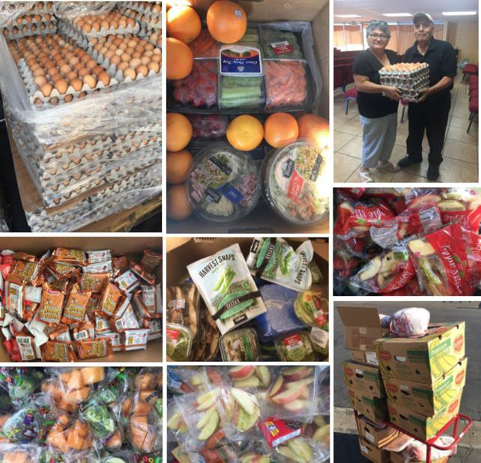
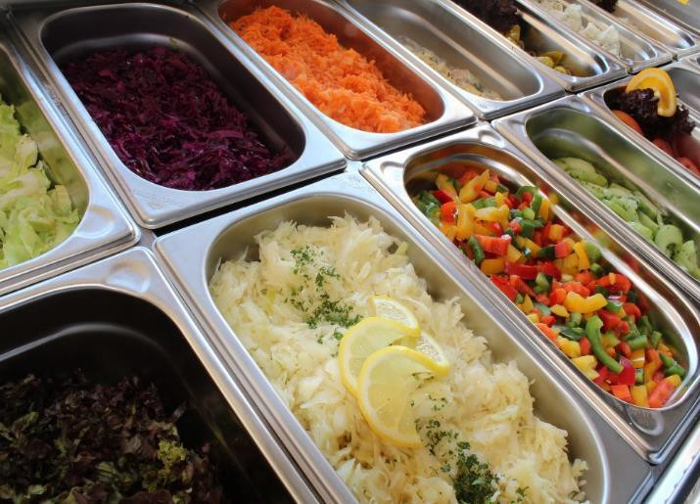

WHAT DOES “EDIBLE FOOD” MEAN?
All Food Donations Must Be in Compliance with the California Retail Food Code
“Edible food” means food intended for human consumption.
“Edible food” is not solid waste if it is recovered and not discarded.
Nothing in this chapter requires or authorizes the recovery of edible food that does not meet the food safety requirements of the California Retail Food Code.
Notes:
Let’s now discuss the edible food recovery requirements.
So what does edible food mean? It means food intended for human consumption
We also specify in the regulations that nothing requires that edible food be recovered if it does not meet the food safety requirements of the California Retail Food Code
So just because the food is intended for human consumption does not mean it is safe to recover.
It must be intended for human consumption and also meet all of the food safety requirements that are specified in California’s Retail Food Code
We also specified in the definition of edible food that it is not solid waste if it is recovered and not discarded
This is really important.
This is material that is before the trash container. This is food and not waste!
The photos on the left were taken from one of CalRecycle’s waste prevention and rescue grant recipients.
These are some of the recoveries that they have been doing in K-12 schools and school kitchens.
So showing a contrast. The food pictured on the right is from an unsupervised open buffet line where customers serve themselves.
Most county health departments would not allow that food to be donated.

Slide 9









Mandated Food Donors (Article 10)
(Sections 18991.3 – 18991.5)
Tier 1
Tier 2
Starts 2022
Starts 2024
Wholesale Food Vendors
Restaurants
Facilities ≥ with 250 or more seats or 5,000 sq. ft.
Large Venues and Events
Food Service Providers &
Food Distributors
State Agencies
Federal Facilities
Hotels
with cafeterias ≥ with 250 or more seats or 5,000 sq. ft.
with on-site food
facility and ≥ 200 rooms
Grocery Stores
Facilities ≥ 10,000 sq. ft.
Local Education
Agencies
H
Health Facilities
Supermarkets
with ≥ 100 beds and
on-site food facility
with on-site food facility
Notes:
There are two Tiers for Mandated Food Donors (also known as a commercial edible food generator):
Tier 1 Mandated Food Donors begin implementation January 1, 2022.
Tier 2 Mandated Food Donors begin implementation January 1, 2024.
When looking at non-local entities to assess if they are subject to the edible food requirements, we must first determine if they fit into either tier 1 or 2 definitions:
We are not aware of any situations where a non-local entity would fit in the Tier 1 definition.
I am going to focus on these specific types of non-local entities: state agencies, prisons, facilities operated by the state parks system, public universities, including community colleges, and county fairgrounds
For state agencies, that are not identified separately in the non local entity definition, the state agency is a tier 2 generator if they have a cafeteria with 250 or more seats or a total cafeteria facility size equal to or greater than 5,000 square feet. Some examples are: CalPERS, CalSTRS, Franchise Tax Board or National Guard.
While there is a specific definition for state agency as a mandated food donor, a state agency may also meet the definitions of a restaurant, hotel, health facility, large venue, or large event. For example, a state hospital may not have cafeteria that meets the state agency tier 2 generator definition, but meets the health facility definition.
Now let’s look at how prisons, facilities operated by the state parks system, public universities, including community colleges, and county fairgrounds might fit in one of the Tier 2 definitions.
First off is Restaurants with 250 or more seats, or a total facility size equal to or greater than 5,000 square feet. These would be restaurants that meet the definition and is located in a state park or a public university, if the restaurant is owned by the non-local entity. An example of this is Crocker Dining Hall at Asilomar State Beach.
For reference: “Restaurant” means an establishment primarily engaged in the retail sale of food and drinks for on-premises or immediate consumption.
If the restaurant meets the threshold and is not owned by the non-local entity it is located in, then it is the restaurant that is required to comply.
If the non local entity is operating on property they do not own, such as federal property, they are subject to the mandated food donor requirements. An example of this would be state parks operating a concession stand, or museum on federal property.
Hotel with an on-site food facility and 200 or more rooms. We are not aware of any that meet this definition.
Health facility with an on-site food facility and 100 or more beds. (Some examples could be: California Medical Facility, or Salinas Valley State Prison. )
Large venue - means a permanent venue facility that annually seats or serves an average of more than 2,000 individuals within the grounds of the facility per day of operation of the venue facility. A venue facility includes, but is not limited to, a public, nonprofit, or privately owned or operated stadium, amphitheater, arena, hall, amusement park, conference or civic center, zoo, aquarium, airport, racetrack, horse track, performing arts center, fairground, museum, theater, or other public attraction facility. A facility or site owned by one entity that includes individual businesses located on the site is considered a single large venue. Some examples are: Cal Expo, Mondovi Performing Arts Center, public university stadiums that meets the large venue threshold)
Large event -means an event, including, but not limited to, a sporting event or a flea market, that charges an admission price, or is operated by a local agency, and serves an average of more than 2,000 individuals per day of operation of the event, at a location that includes, but is not limited to, a public, nonprofit, or privately owned park, parking lot, golf course, street system, or other open space when being used for an event. An example of a Large event is the state fair.
Things to note:
If a prison that has a “food service provider,” then the food service provider is the tier 1 entity and not the prison.
Federal facilities are not subject to SB 1383’s mandated food donor requirements.
Also, a non-local entity is allowed to recover edible food and provide to its employees, students. For example, many public universities have edible food collection and then redistribute the edible food to students.

Slide 10

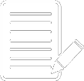

SB 1383 IN ACTION
Recover maximum amount of edible food that would otherwise be disposed
Required to keep records, no reporting requirements
MANDATED
FOOD DONORS
Arrange food recovery through a contract or written agreement with:
Food recovery organizations or services that will collect edible food for food recovery
Food recovery organizations that will accept food that the generator self hauls
Notes:
The key requirements for commercial edible food generators is to:
Arrange to have the maximum amount of their edible food that would otherwise be disposed be recovered for human consumption through a contract or written agreement either with:
A food recovery organization or service that will collect their surplus edible food OR
Self haul to a food recovery organization that will accept their edible food.
Let’s talk about self-haul:
We added this into the regulations based upon feedback from the California Association of Food Banks
It is very expensive for the organizations and services to recover this edible food
They are often dependent on philanthropic or government funding and grants and many do not have sustainable funding
So it would help them if generators are self-hauling; however, the self-hauling has to be included in that contract or written agreement
Under no circumstances should a commercial edible food generator self-haul edible food without permission from the food recovery organization or service.
That is absolutely critical to protect them from donation dumping
There is also nothing in the regulations that prohibits a food recovery organization or service from charging a fee for the services that they are providing to the food donor
There are record keeping requirements for mandated food donors, and no reporting requirements. Note: This does not affect the current annual reporting requirements for state agencies for State Agency Recycling and State Agency Buy Recycled Campaign
Mandated Food Donor records must be kept up regularly and must be maintained for five years.
Records may be kept electronically or hard copy.
These requirements include keeping the following:
(1) A list of each food recovery service or organization that collects or receives its edible food pursuant to a contract or written agreement established under Section 18991.3(b).
(2) A copy of contracts or written agreements between the mandated food donor and a food recovery service or organization.
(3) A record of the following for each food recovery organization or service that the mandated food donor has a contract or written agreement with:
(A) The name, address and contact information of the service or organization.
(B) The types of food that will be collected by or self-hauled to the service or organization.
(C) The established frequency that food will be collected or self-hauled.
(D) The quantity of food collected or self-hauled to a service or organization for food recovery. The quantity shall be measured in pounds recovered per month.
To help mandated food donors to comply, CalRecycle with HF&H Consultants developed a model food recovery agreement
The tool is highly customizable and is intended to help the mandated food donors to comply
The regulations are silent on what needs to be included in the contract or written agreement
So although we provide this as a model and it is customizable it does not have to be used but it can be used
Non-local entities can check with the food recovery organizations/services that they partner with to see if they already have a written agreement/contract that is provided to donors. If they do not, then the non-local entity that is a mandated food donor will need to have a written agreement or contract and keep it in their records.

Slide 11
CalRecycle Enforcement
FEDERAL FACILITIES | STATE AGENCIES
Issue a Notice of Violation requiring compliance within 90 days Can grant up to an additional 90 days extension Shall be listed on the Organic Waste Recovery Noncompliance Inventory on CalRecycle’s website | Issue a Notice of Violation requiring compliance within 90 days Can grant up to an additional 90 days extension Shall be listed on the Organic Waste Recovery Noncompliance Inventory on CalRecycle’s website Notify the Governor Notify the Legislature
Notes:
Under the SB 1383 regulations, Jurisdictions are not required to enforce local education agencies. CalRecycle will conduct enforcement for non local entities related to organic waste
Enforcement applies to organic waste recycling and mandated food donor requirements (except Federal Facilities are not subject to edible food requirements).
The enforcement process is a progressive process that consists of the following;
Issuance of a Notice of Violation (NOV) that can include additional time.
If the issue is not corrected the entity is placed on the organic waste recovery non-compliance inventory list on CalRecycle’s website.
If an entity is placed on the inventory list, they come off of the list when they correct the deficiency—Refer to Section 18997.4. Organic Waste Recovery Noncompliance Inventory.
If the Department finds that a state agency or federal facility has failed to meet the final deadline in a NOV issued, the Department shall send a notice stating that the Department has placed the respondent on the Organic Waste Recovery Noncompliance Inventory listed on its website.
The Department may remove the respondent from the Organic Waste Recovery Noncompliance Inventory upon a finding, based on available evidence, that the respondent is no longer in violation.
While the regulations become effective Jan. 1, 2022, the enforcement process is an escalating process and the timelines are not triggered until a Notice of Violation, or NOV, is issued.
CalRecycle will consider the totality of circumstances surrounding non-local entity’s compliance prior to issuing an NOV.
Once CalRecycle determines a non-local entity is violating Article 5 or Article 10 and enforcement action is necessary, CalRecycle will implement the process outlined in the SB 1383 regulations.
The SB 1383 enforcement structure allows CalRecycle to focus on compliance assistance first and dedicate enforcement efforts to serious offenders. Regulations allow for flexibility and deadline extensions, in some instances, when there are extenuating circumstances causing compliance issues.
Ref: Section 18996.7 covers enforcement action regarding federal facilities.
And Section 18996.6 covers enforcement action regarding state agencies (notice here state agencies were identified separately).

Slide 12
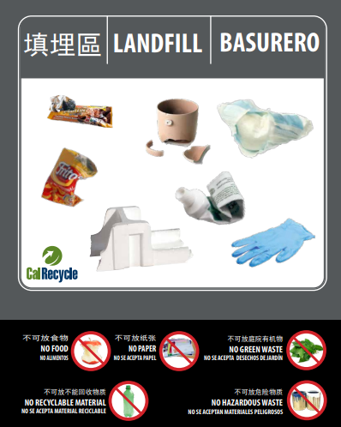
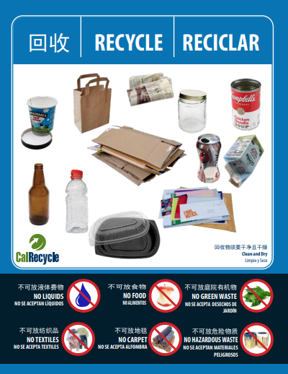
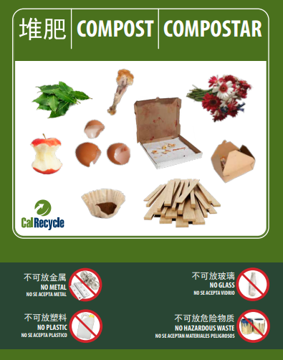
Resources
SB 1383 Home Page:
https://www.calrecycle.ca.gov/organics/slcp
Outreach, Education and Signage: https://www.calrecycle.ca.gov/stateagency/assistance/organics
Sign up for CalRecycle’s Short-Lived Climate Pollutants (SLCP) listserv: https://www2.calrecycle.ca.gov/Listservs/
LAMD Contact: https://www.calrecycle.ca.gov/LGCentral/Contacts/
SB 1383 Non Local Entity webpage is coming soon!
Notes:
For resources, visit our website that outlines the requirements for SB1383. The webpage for non-local entities is not yet published but is coming soon.
CalRecycle developed the SB 1383 compliant model labels, signage, brochures for non local entities to utilize. This information is available on our website.
The new signage is available for three-, two-, and single unsegregated collection services in English, Spanish, Mandarin, Punjabi, Russian, and Korean.
The materials are designed to include the most widely acceptable and prohibited items.
Each sign is fully customizable using Adobe Acrobat Pro. Users can add and/delete the material(s) they collect in their program.
To stay up to date, you can sign up for the SLCP listserv
If you need future assistance, we encourage you to work with your local jurisdiction or you can contact the Local Assistance liaison that is assigned to the jurisdiction that your Non Local entity is located in. The webpage to access to find out who your contact is listed on this slide. (https://www.calrecycle.ca.gov/LGCentral/Contacts/)
Before we turn to audience questions we wanted to share a brief update about CalRecycle’s Commercial Generator-Based Edible Food Waste Characterization Study. I will turn it over to the study project manager to give you some more information…

Slide 13
Participants Wanted! Commercial Generator-Based Edible Food Waste Characterization Study
A statewide study to gather accurate, representative data to measure edible food discarded in California
Collecting samples directly from generators in industry groups known to discard food
Participating generators will receive their composition summary upon study completion
Sampling will begin in late 2021 (tentative)
Data will only be used for study, and participant data will remain confidential
Recommendations desired for:
K-12 schools
Full-Service restaurants
Limited-Service restaurants
Hotels (except casino hotels) and motels
Caterers/ Food Production Facility
Cafeterias, Grill Buffets and Buffets
wastechar@calrecycle.ca.gov
Notes:
CalRecycle’s Commercial Generator-Based Edible Food Waste Characterization Study is currently underway!
The study will help track progress toward established targets set forth by SB 1383 (Lara, Chapter 395, Statutes of 2016), to achieve reductions in the level of the statewide disposal of organic waste, with special requirements for edible food waste reduction.
Our contractor is beginning to recruit businesses in selected industry groups to participate in the study.
Participation involves filling out a survey on their food waste management practices and allowing the sampling team to take a sample from their trash and organics bins, of at least 200lb, as well as a peek into the recycling bin to visually assess if there is any food waste
The team will be sorting the samples into 11 categories: 8 food categories and 3 non-food categories.
Participating businesses will receive a composition report card of what was in their trash and organics samples.
Some of the industry groups we expect to me more difficult to recruit are (listed above). If you have any recommendations on businesses that fall within one of these groups and may be interested in participating and getting a composition report of their organics and trash bin, please let us know.
Email us at wastechar@calrecycle.ca.gov with suggestions or any questions!

