Slide 1
Disclaimer
This guidance tool was developed by CalRecycle as a courtesy for informational and example purposes only. Use of this tool is optional and is not a regulatory requirement. In the event of any conflict with this guidance tool or information herein, applicable statutory and regulatory provisions shall control. This tool and information herein are based on known facts and legal authority as understood by CalRecycle at the time of release. Any analysis, guidance, or other information herein may be subject to change based on changed facts or legal authority, actual or understood, subsequent to the time of this communication. The provision of this guidance tool and any analysis, guidance, or other information herein shall not be construed as a waiver of any rights or remedies available to CalRecycle. Recipients of this communication are encouraged to seek the assistance of legal counsel to comply with applicable state law based on their pertinent facts and circumstances. CalRecycle makes no representation that use of this tool will ensure compliance with regulatory requirements. The user assumes all risk and CalRecycle accepts no responsibility or liability to any person because of the use of, or reliance upon, this tool or the information herein.

Slide 2
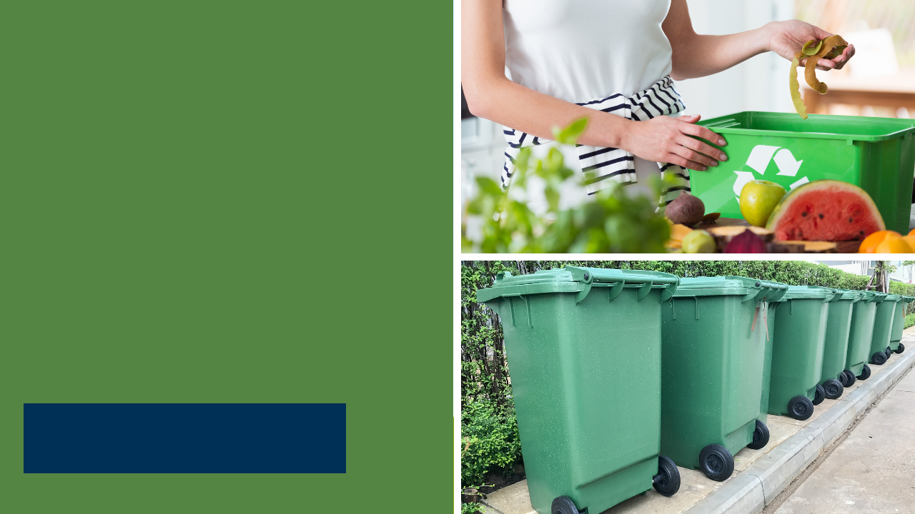
SB 1383 for
Local Education Agencies
Statewide Webinar
April 28, 2021
10:30 – 11:30 AM PST

Slide 3
Overview
Review of Solid Waste Laws
Definitions
Requirements
Edible Food Recovery
Waivers
Enforcement
Notes:
Here is an overview of what we will be covering today
A quick timeline of solid waste and recycling laws impacting local education agencies.
Definitions under SB 1383
Requirements
(Reference: Article 5 – Generators of Organic Waste, Section18986.1 Non Local Entities, Section 18986.2 Local Education Agencies)
Edible Food Recovery
Waivers
(Reference: Section 18986.3)
And Enforcement for Local Education Agencies
(Reference: Section 18996.6. Enforcement Action Regarding State Agencies, Section 18996.7. Enforcement Action Regarding Local Education Agencies and Federal Facilities, and Section 18996.9. Department Enforcement Actions Against Entities.)

Slide 4
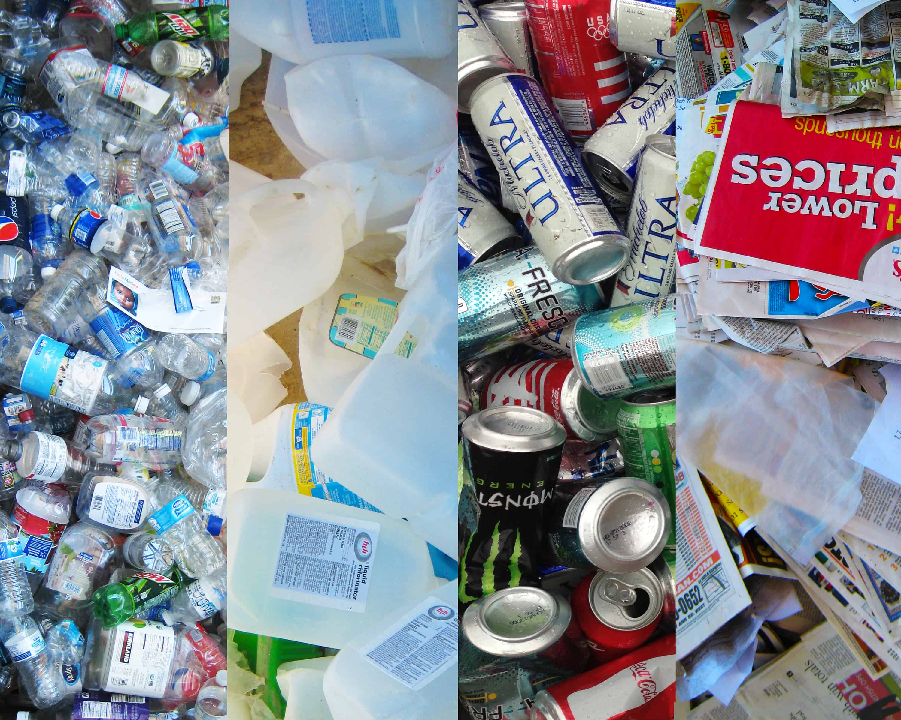

Current Solid Waste Laws
AB 32 California Global Warming Solutions Act (2006): The first comprehensive program of regulatory and market mechanisms to achieve real, quantifiable reductions of greenhouse gases (GHG).
AB 341 Mandatory Commercial Recycling (2012): Requires public entities that generate four cubic yards of solid waste per week to reuse, recycle, compost, or otherwise divert solid waste from disposal.
AB 1826 Mandatory Commercial Organics Recycling (2016): requires public entities that generate two cubic yards of solid waste (total of trash, recycling, and organics) per week to implement an organic waste recycling program.
Notes:
In 2006 AB 32- “California Global Warming Solutions Act” became the first comprehensive program of regulatory and market mechanisms to achieve real, quantifiable, cost-effective reductions of greenhouse gases (GHGs).
Many individuals monitor school waste, including school district administrators concerned about increases in solid waste disposal costs, recycling-conscious teachers and students, and city/county recycling coordinators working with a local school districts.
Other Current laws include:
Mandatory Commercial Recycling, impacting schools that generate at least 4 cubic yards of municipal solid waste per week.
Mandatory Commercial Organics Recycling, impacting schools that generate 2 cubic yards of solid waste per week, that is 2 cubic yards of trash, recycling, and organics total.

Slide 5

Current Solid Waste Laws
AB 827 (2020): Builds off AB 341 and AB 1826. Public entities must make recycling and organic recycling containers available. These containers must be placed adjacent to trash containers and be visible, easily accessible, and clearly marked.
SB 1383 Short-Lived Climate Pollutants: Organic Waste Methane Emissions Reduction (2022): Schools and local education agencies will be required to prevent, reduce the generation of, and recycle organic waste. Additionally, in 2024, schools and local education agencies with an on-site food facility will be required to recover edible food.
Notes:
AB 827- Collection container requirements, impacting schools in areas where recycling and organics is generated. Schools must provide an appropriate container adjacent to the solid waste container to collect and divert recycling and organic waste.
In September 2016, Governor Brown set methane emissions reduction targets for California, SB 1383, in a statewide effort to reduce emissions of short-lived climate pollutants by reducing organic waste disposal by 50% by 2020 and 75% by 2025.
As part of California’s larger strategy to combat climate change Senate Bill 1383 established an edible food recovery goal
No less than 20 percent of currently disposed edible food must be recovered for human consumption by 2025
I would like to clarify that these goals are not for individual jurisdictions, local education agencies, or for individual food facilities
Rather it is a statewide goal that Californians must collectively achieve
Why is this statewide goal so important? We need to address our climate crisis now!
Also we see many examples of wasted food rather than feeding people that are hungry
Since COVID the number of people that don’t have enough food to eat has doubled
This is another reason these regulations are so critical!
This law was designed to reduce the global warming super pollutants like methane, which is up to 84 times more potent than carbon dioxide.
Recycling organic waste and recovering edible food is a fast track to combating climate change.
It is critical that we address climate change now
Californians are resilient
We have to work together to achieve these goals and CalRecycle is your partner

Slide 6
Jurisdiction Requirements
Provide education and outreach to all organic waste generators, including local education agencies
Determine if regulated businesses, including local education agencies, are subscribing to collection service or self-hauling
Include in their capacity planning efforts all organic waste and edible food tonnage generated by mandated food donors
Responsible for requiring haulers providing residential, commercial, or industrial organic waste collection services to generators
Notes:
Before we go over the Local Education Agency and Organic Waste Definitions, I’d like to point out a few things:
Jurisdictions are required to provide education and outreach to all organic waste generators, including local education agencies located within the jurisdiction.
Jurisdictions also need to determine if regulated businesses, including local education agencies, are subscribing to collection service or self-hauling. This is what jurisdictions are currently doing under AB 341 and AB 1826 and will continue to do so.
Jurisdictions are to include in their capacity planning efforts all organic waste and edible food tonnage generated by mandated food donors
Jurisdictions are responsible for requiring haulers providing residential, commercial, or industrial organic waste collection services to generators within its boundaries to meet the requirements and standards of the regulations as a condition of approval of a contract, agreement, or other authorization to collect organic waste. (Section 18988.1)
So if a local education agency is contracting with a hauler for its collection services (trash, recycling, organics) then that hauler should be adhering to the regulatory requirements
So let’s dive into SB 1383 for local education agencies

Slide 7
Definitions
Local Education Agency: a school district, charter school, or county office of education that is not subject to the control of city or county regulations related to solid waste.
Organic Waste: Solid wastes containing material originated from living organisms and their metabolic waste products including, but not limited to, food, green material, landscape and pruning waste, organic textiles and carpets, lumber, wood, paper products, printing and writing paper, manure, biosolids, digestate, and sludges.
Notes:
SB 1383 defines a Local Education Agency as a school district, charter school, or county office of education that is not subject to the control of city or county regulations related to solid waste.
Examples include all public school sites and other facilities such as a district office, central kitchen, and maintenance and operations locations.
Organic waste is defined as solid wastes containing material originated from living organisms and their metabolic waste products including, but not limited to, food, green material, landscape and pruning waste, organic textiles and carpets, lumber, wood, paper products, printing and writing paper, manure, biosolids, digestate, and sludges.

Slide 8
SB 1383 Organic Waste Requirements
Article 5. Generators of Organic Waste (Section 18986.1 & 18986.2)
  Subscribe to an organic waste collection service, or self-haul organic waste to a recovery facility
  Need to provide containers for the collection of organic waste and non-organic recyclables in all areas where disposal containers are located, except restrooms
  Prohibit employees from placing organic waste in a container not designated for organic waste
  Periodic inspections of containers for contamination and inform employees if containers are contaminated
  Provide information to employees and students on methods for prevention of organic waste generation
Notes:
The requirements for local education agencies related to organic waste are in Article 5.
The requirements for these entities also connect with Article 3, such as what local education agencies have to do for containers, which I’ll cover in a moment.
Let’s look at each of the organic waste recycling requirements:
The first is
Local education agencies must either subscribe to collection service or self-haul organic waste.
They may recycle their organic waste by subscribing to and complying with the requirements of an organic waste collection service that meets the requirements of Article 3.
This ensures that local education agencies that generate organic waste are accountable for the organic waste they generate and to allow CalRecycle to verify that they are recycling it.
Local education agencies can have a 3, 2, or single unsegregated collection service but the service must comply with the requirements in Article 3.
If they have a single unsegregated collection service or use a 2 container system, then material in the gray container must go to a high diversion organic waste processing facility.
If that facility does not meet the performance requirements, then the local education agency has options, for example: the facility comes into compliance, or the material is taken to another high diversion organic waste processing facility, or the local education agency uses a 3-container collection service.
Keep in mind that if the local education agency is subscribing to the jurisdiction’s collection service, then the jurisdiction would be addressing this issue.
If self-haul is practiced it must be done in a manner that complies with the requirements of Article 7, Section 18988.3. If they self-haul part of their materials, they would need to subscribe to a service for the other organic waste materials.
Next requirement,
Local education agencies need to provide containers for collection. Typically, the service provider will provide the external collection containers for trash, organics, and recycling and so the agency would focus on the internal containers.
Like businesses, in Section 18984.9, local education agencies need to provide internal containers for the collection of organic waste and non-organic recyclables in all areas where disposal containers are located, except restrooms.
The internal container must have a body or lid that conforms with the container colors provided through the organic waste collection service provided by the jurisdiction OR must have container labels on new containers that comply with the labeling requirements (Section 18984.8.)
Local education agencies are not required to replace functional containers, including containers purchased prior to January 1, 2022, that do not comply with the requirement of this article prior to the end of the useful life of those containers, or prior to January 1, 2036, whichever comes first.
Local education agencies must ensure new containers are properly labeled by:
(1) Placing labels on containers that include language or graphic images, or both that indicate the primary materials accepted and the primary materials prohibited in that container; or
(2) Providing containers with imprinted text or graphic images that indicate the primary materials accepted and the primary materials prohibited in that container.
(c) Labels shall clearly indicate primary items that are prohibited container contaminants for each container.
(d) Local education agencies may comply with this section by using model labeling available on the CalRecycle website.
So to explain this further here is an example: if the collection service is 3 container system, then you need to have a green, blue, and gray internal container or the 3 internal containers need to be labeled appropriately.
The container color and material specifications are intended to standardize the colors and minimum levels of acceptable materials for collection containers provided across the state. This standardized approach helps employees, visitors, and students, know what container to use, and ensure that organic waste are transported to appropriate facilities for recovery.
It is important to point out that if a local education agency does not generate any of the materials that would be collected in one type of container, then the entity does not have to provide that particular container in all areas where disposal containers are provided. Arlene will talk about de minimis waivers in the next slide.
The next requirement:
Prohibit their employees from placing organic waste in a container not designated for organic waste.
This makes them accountable for organic waste handled by their employees by requiring the employees to safely reduce the disposal of organic waste.
It also helps to minimize contamination and ensure that the maximum amount of organic waste is recovered.
Next requirement:
Local education agencies must periodically inspect organic waste containers for contamination and, if the containers are contaminated, inform employees of the requirement to only use those containers for organic waste.
It is important to ensure that employees are not putting organic waste in the trash container and are not contaminating the recycling and organics container. (Remember when we talk about organics we are talking about the definition that includes paper, cardboard, food, and greenwaste, etc., so that is why I mentioned recycling and organics containers or the blue and green containers)
This ensures that local education agencies are accountable for their organic waste by maintaining awareness of the contents of their organic waste collection container, communicating to employees when containers are contaminated, and when needed, educating employees about the proper use of organic waste containers.
IF Asked: How often is “periodically”? It is up to the local education agency to determine the frequency. Here’s an example: In the beginning, they start out weekly. If there is not a lot of contamination, they back off to every two weeks, or if there is a lot of contamination, they inspect daily. The key is they inspect as often as needed to reduce as much contamination as possible.
The last requirement on this slide:
Provide information to employees and students on methods for the prevention of organic waste generation
Also, nothing prohibits a local education agency from preventing waste generation, managing organic waste on-site, or using a community composting site.
These are additional options available to prevent the creation of, as well as to recycle, organic waste beyond subscribing to an organic waste collection service or self-hauling to a facility that processes the organic waste for recycling.

Slide 9
Waivers
Article 5. Generators of Organic Waste (Section 18986.3)
  De Minimis:
    Solid waste is 2 cu. yd or more and organic waste is less than 20 gallons per week
    Solid waste is less than 2 cu. yd and organic waste is less than 10 gallons per week
  Space Constraints: no adequate space for organic containers must be determined by a hauler, licensed architect or engineer
  The entity is located within a jurisdiction or census tract that has been granted a waiver by the Department pursuant to Section 18984.12.
Notes:
CalRecycle shall waive a local education agency’s obligation to comply with some or all of the organic waste collection requirements if the local education agency provides documentation demonstrating that any of the following situations applies:
If a local education agency generates a de minimis amount of material in the blue and/or green container, it can be issued a waiver. De minimis amounts are either of the following:
Solid waste is 2 cy or more and organic waste is less than 20 gallons per week
Solid waste is less than 2 cy and organic waste is less than 10 gallons per week
For example: In a three container collection service, if there is no organic waste stream present or material that would go in the green container, then a green container collection service is not necessary. However, a blue recycling container collection service would still need to be provided for the collection of other organic waste, such as paper products and cardboard.
If there is a de minimis waiver for collection, then the associated internal container would not be necessary.
In the previous example, if you have no material for the green container, such as an office building that does not generate food or greenwaste, then the office building would not need to have internal containers for food.
A space waiver may be granted for a local education agency if it provides documentation that a hauler, licensed architect, licensed engineer, or a similarly qualified entity has determined there is inadequate space for separate organic waste containers.
This waiver is only applicable in limited scenarios and should decrease in use over the years.
There are few instances in which an existing waste collection space could not accommodate an additional organic waste recycling container if the existing containers were downsized.
If a jurisdiction that a local education agency is located in is granted a waiver pursuant to Section 18984.12, then the local education agency will not have to comply with the requirements in Article 5. The local education agency will need to submit a request to CalRecycle.
This was done because if the jurisdictions in these areas do not have to comply with Article 3 then there will not be collection services available for local education agencies to utilize.
We will be publishing on the CalRecycle website the jurisdictions and census tracts (for unincorporated areas) that meet the thresholds for a waiver.
This will be published on our website after the 2020 Census data is available. Local education agencies will be able to review this information to determine if they are in a jurisdiction or census tract that is waived.
CalRecycle is developing instructions and will have guidance on the website for local education agencies to request a waiver. We anticipate this information being available in May or June and we will hold a statewide webinar to explain the process.
I would like to note that a school site may want to coordinate with the school district to determine if the entire school district is eligible or just certain sites and then determine if the school district will submit the waiver requests. This coordination could be helpful since it is the district that typically maintains the collection service contract for all of the sites in the school district.
References:
Low Population:
(1) A jurisdiction may apply to the Department for a waiver for the jurisdiction and some or all its generators from some or all of the requirements of this article if the following apply:
(A) The jurisdiction disposed of less than 5,000 tons of solid waste in 2014 as reported in the Disposal Reporting System.
(B) The jurisdiction has a total population of less than 7,500 people.
(2) A jurisdiction may apply to the Department for a waiver from some or all of the requirements of this article for census tracts that have a population density of less than 75 people per square mile that are served by the jurisdiction and are located in unincorporated portions of a county.
Rural exemption:
The Department shall grant an exemption from complying with the organic waste collection requirements specified in this article for rural jurisdictions that meet the definition of a “Rural Jurisdiction” in Section 42649.8 of the Public Resources Code (MORe), if the governing body of the jurisdiction adopts a resolution that includes a finding as to the purpose of and need for the exemption.
Elevation

Slide 10
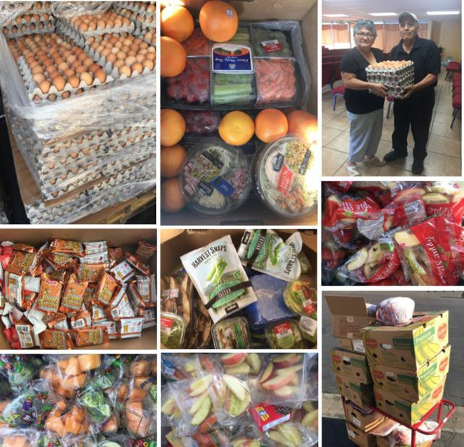


WHAT DOES “EDIBLE FOOD” MEAN?
All Food Donations Must Be in Compliance with the California Retail Food Code
“Edible food” means food intended for human consumption.
“Edible food” is not solid waste if it is recovered and not discarded.
Nothing in this chapter requires or authorizes the recovery of edible food that does not meet the food safety requirements of the California Retail Food Code.
Notes:
Let’s now discuss the edible food recovery requirements.
So what does edible food mean? It means food intended for human consumption
We also specify in the regulations that nothing requires that edible food be recovered if it does not meet the food safety requirements of the California Retail Food Code
So just because the food is intended for human consumption does not mean it is safe to recover.
It must be intended for human consumption and also meet all of the food safety requirements that are specified in California’s Retail Food Code
We also specified in the definition of edible food that it is not solid waste if it is recovered and not discarded
This is really important. This is material that is before the trash container. This is food and not waste!
The photos on the left were taken from one of CalRecycle’s waste prevention and rescue grant recipients.
These are some of the recoveries that they have been doing in K-12 schools and school kitchens
So showing a contrast. The food on the left is from an unsupervised open buffet line where customers serve themselves.
Most county health departments would not allow that food to be donated.

Slide 11









Mandated Food Donors (Article 10)
(Sections 18991.3 – 18991.5)
Tier 1
Tier 2
Starts 2022
Starts 2024
Wholesale Food Vendors
Restaurants
Facilities ≥ with 250 or more seats or 5,000 sq. ft.
Large Venues and Events
Food Service Providers &
Food Distributors
Hotels
State Agencies
with on-site food
facility and ≥ 200 rooms
with cafeterias ≥ with 250 or more seats or 5,000 sq. ft.
Grocery Stores
Facilities ≥ 10,000 sq. ft.
Local Education
Agencies
H
Health Facilities
Supermarkets
with ≥ 100 beds and
on-site food facility
with on-site food facility
Notes:
There are two categories for Mandated Food Donors (which is also known as a commercial edible food generator) :
Tier 1 Mandated Food Donors begin implementation January 1, 2022.
Tier 2 Mandated Food Donors begin implementation January 1, 2024.
Local education agencies with an on-site food facility are commercial edible food generators and must recover the maximum amount of edible food starting January 1, 2024.
If they use a food service provider, then the food service provider has requirements to help recover the excess edible food that it generates and that begins in January 1, 2022.
(… if asked… For reference: “Food service provider” means an entity primarily engaged in providing food services to institutional, governmental, commercial, or industrial locations of others based on contractual arrangements with these types of organizations.)

Slide 12

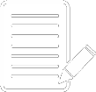

SB 1383 IN ACTION
Recover maximum amount of edible food that would otherwise be disposed
Required to keep records, no reporting requirements
MANDATED
FOOD DONORS
Arrange food recovery through a contract or written agreement with:
Food recovery organizations or services that will collect edible food for food recovery
Food recovery organizations that will accept food that the generator self hauls
Notes:
The key requirements for commercial edible food generators is to:
Arrange to have the maximum amount of their edible food that would otherwise be disposed be recovered for human consumption through a contract or written agreement either with:
A food recovery organization or service that will collect their surplus edible food OR
Self haul to a food recovery organization that will accept their edible food.
Also, a local education agency is allowed to recover edible food and provide it to its employees and students. For example, many schools have sharing tables to redistribute the edible food to students.
Let’s talk about self-haul
We added this into the regulations based upon feedback from the California Association of Food Banks
It is very expensive for the organizations and services to recover this edible food
They are often dependent on philanthropic or government funding and grants and many do not have sustainable funding
So it would help them if generators are self-hauling; however, the self-hauling has to be included in that contract or written agreement
Under no circumstances should a commercial edible food generator self-haul edible food without permission from the food recovery organization or service.
That is absolutely critical to protect them from donation dumping
There is also nothing in the regulations that prohibits a food recovery organization or service from charging a fee for the services that they are providing to the food donor
There are record keeping requirements for mandated food donors, and no reporting requirements.
Keep in mind that each local education agency that has an onsite food facility will need to maintain its records on site.
Records can be maintained electronically or hard copy. So a school district might have an electronic system so all of the records for each site can be maintained.
Saving records electronically allows the site to have access to its records in the event that CalRecycle conducts an inspection.
Records must be kept up regularly and must be maintained for five years.
These record-keeping requirements include keeping the following:
(1) A list of each food recovery service or organization that collects or receives its edible food pursuant to a contract or written agreement established under Section 18991.3(b).
(2) A copy of contracts or written agreements between the mandated food donor and a food recovery service or organization.
(3) A record of the following for each food recovery organization or service that the mandated food donor has a contract or written agreement with pursuant to Section 18991.3(b):
(A) The name, address and contact information of the service or organization.
(B) The types of food that will be collected by or self-hauled to the service or organization.
(C) The established frequency that food will be collected or self-hauled.
(D) The quantity of food collected or self-hauled to a service or organization for food recovery. The quantity shall be measured in pounds recovered per month.
To help mandated food donors to comply - CalRecycle with HF&H Consultants developed a model food recovery agreement
The tool is highly customizable and is intended to help mandated food donors comply
The regulations are silent on what needs to be included in the contract or written agreement
So although we provide this as a model and it is customizable it does not have to be used but it can be used

Slide 13
Enforcement
Enforcement process for Local Education Agencies (Section 18996.7)
Issue a Notice of Violation (NOV) requiring compliance within 90 days
Can grant up to an additional 90 days extension
Shall be listed on the Organic Waste Recovery Noncompliance Inventory on CalRecycle’s website
Notes:
Section 18996.7 covers the enforcement process for local education agencies. Enforcement applies to organic waste recycling and edible food requirements.
Jurisdictions are not required to enforce local education agencies. CalRecycle will conduct enforcement.
While the regulations become effective Jan. 1, 2022, the enforcement process is an escalating process and the timelines are not triggered until a Notice of Violation, or NOV, is issued.
CalRecycle will consider the totality of circumstances surrounding a local education agency’s compliance prior to issuing an NOV.
Once CalRecycle determines a Local Education Agency is violating Article 5 or Article 10 and enforcement action is necessary, CalRecycle will implement the process outlined in the SB 1383 regulations.
If the Department finds that a local education agency has failed to meet the final deadline in an NOV issued, CalRecycle shall send a notice stating that it has placed the respondent on the Organic Waste Recovery Noncompliance Inventory listed on CalRecycle’s website.
CalRecycle may remove the respondent from the list upon a finding, based on available evidence, that the respondent is no longer in violation of this chapter.
You can also refer to Section 18997.4. Organic Waste Recovery Noncompliance Inventory.
The SB 1383 enforcement structure allows CalRecycle to focus on compliance assistance first and dedicate enforcement efforts to serious offenders. Regulations allow for flexibility and deadline extensions, in some instances, when there are extenuating circumstances causing compliance issues.

Slide 14
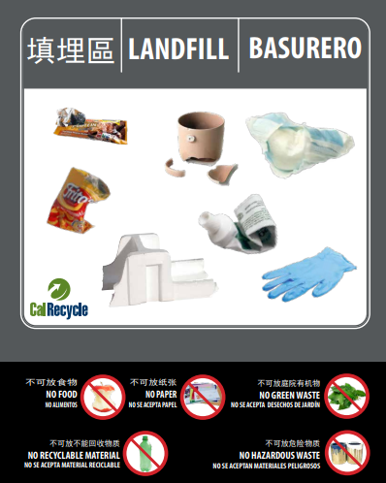
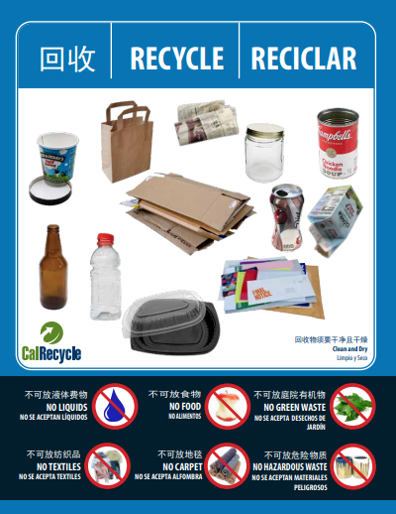
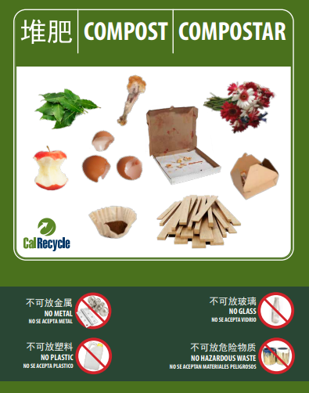
Resources
SB 1383 Home Page: https://www.calrecycle.ca.gov/organics/slcp
Outreach, Education and Signage: https://www.calrecycle.ca.gov/recycle/commercial/organics/prtoolkit
To stay up to date, sign up for CalRecycle’s Schools and Short-Lived Climate Pollutants (SLCP) listservs: https://www2.calrecycle.ca.gov/Listservs/
SLCP In-Box: slcp.organics@calrecycle.ca.gov
School In-Box: schools@calrecycle.ca.gov
School Waste Reduction Programs: https://www.calrecycle.ca.gov/recycle/schools
SB 1383 Local Education Agency webpage is coming soon!
Notes:
Visit our SLCP webpages for updates and requirements on SB 1383. The webpage for local education agencies is not yet published but is coming soon.
CalRecycle developed and posted on our website SB 1383 compliant model labels, signage, and brochures for local education agencies to utilize.
The signage is available for three-, two-, and single unsegregated collection services in English, Spanish, Mandarin, Punjabi, Russian, and Korean.
The materials are designed to include the most widely acceptable and prohibited items.
Each sign is fully customizable using Adobe Acrobat Pro. Users can add and delete the material(s) they collect in their program.
We will continue to develop and share best management practices for local education agencies. To stay up to date, you can sign up for the SLCP and Schools listserv or visit our Schools webpages for updated tools and resources
Before we turn to audience questions we wanted to share a brief update about CalRecycle’s Commercial Generator-Based Edible Food Waste Characterization Study. I will turn it over to the study project manager to give you some more information…

Slide 15
Participants Wanted! Commercial Generator-Based Edible Food Waste Characterization Study
A statewide study to gather accurate, representative data to measure edible food discarded in California
Collecting samples directly from generators in industry groups known to discard food
Participating generators will receive their composition summary upon study completion
Sampling will begin in late 2021 (tentative)
Data will only be used for study, and participant data will remain confidential
Recommendations desired for:
K-12 schools
Full-Service restaurants
Limited-Service restaurants
Hotels (except casino hotels) and motels
Caterers/ Food Production Facility
Cafeterias, Grill Buffets and Buffets
wastechar@calrecycle.ca.gov
Notes:
CalRecycle’s Commercial Generator-Based Edible Food Waste Characterization Study is currently underway!
The study will help track progress toward established targets set forth by SB 1383 (Lara, Chapter 395, Statutes of 2016), to achieve reductions in the level of the statewide disposal of organic waste, with special requirements for edible food waste reduction.
Our contractor is beginning to recruit businesses in selected industry groups to participate in the study.
Participation involves filling out a survey on their food waste management practices and allowing the sampling team to take a sample from their trash and organics bins, of at least 200lb, as well as a peek into the recycling bin to visually assess if there is any food waste
The team will be sorting the samples into 11 categories: 8 food categories and 3 non-food categories.
Participating businesses will receive a composition report card of what was in their trash and organics samples.
Some of the industry groups we expect to me more difficult to recruit are (listed above). If you have any recommendations on businesses that fall within one of these groups and may be interested in participating and getting a composition report of their organics and trash bin, please let us know.
Email us at wastechar@calrecycle.ca.gov with suggestions or any questions!

