Slide 1

Organic Waste Recycling Capacity Planning
SB 1383 Requirements Overview
Notes:
Today I am going to go over the Organic Waste Recycling Capacity Planning requirements and tie-in how cities and counties might use our Organics Capacity Planning Calculator to meet some of those requirements. Then Chris Brea will walk us through a tutorial of the calculator. We will then follow-up with Q&A. Feel free to submit questions into the comment box so that we can address them after the presentations.

Slide 2
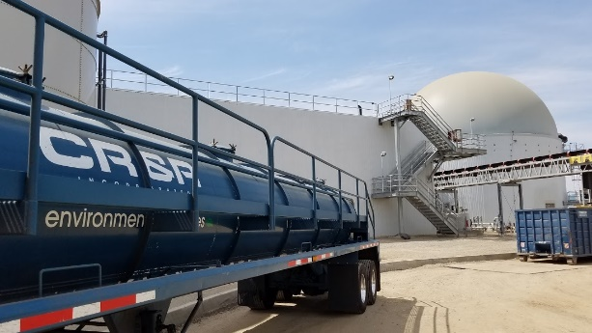
Organic Waste Recycling Capacity Planning Requirements Overview (Section 18992.1)
Notes:
Each jurisdiction, meaning each county, city, Regional Agency, and special district that provides solid waste collection services within the county, must plan for adequate capacity for recycling organic waste.
•Each county will lead this effort by coordinating with the jurisdictions located within the county.
It is important to note that when there is a CalRecycle approved Regional Agency that has all of the jurisdictions as members, that the Regional Agency/JPA can perform the main coordinating role instead of the county. However, the Joint Powers Authority (JPA) for the regional agency can be revised to incorporate 1383 responsibilities or a designation can be made through "agreements" such as MOU's. (Section 18981.2[b])
Each County is responsible for:
Establishing a collaborative approach to this planning, including setting a timeline, identifying tasks, and determining what each jurisdiction tasks are;
Collecting the organic waste recycling capacity planning information from each jurisdiction;
Submitting the organic waste recycling capacity report to CalRecycle;
Identifying any jurisdiction, including itself, that does not have enough organic waste recycling capacity; and
Informing that applicable individual jurisdiction that does not have capacity about the timeline for submitting the implementation schedule which is within 120 days from when the County submits the report to CalRecycle.
Counties are not responsible for ensuring and enforcing each of the cities located within the county conduct the organic waste recycling capacity planning that is required.
This coordination might be done in different ways depending on what the needs are, and what the availability for resources are.
For example:
The County might lay out each of the tasks that need to be accomplished by each jurisdiction and the timelines.
The County might check in with each of the jurisdictions to check on the status so they know what will be submitted in time for the County to complete the report to CalRecycle.
The County might set up a process so that each jurisdiction can submit the data to the County, e.g., using Google Docs or some other system to submit the needed information.
The County might identify some tasks that it will complete for each jurisdiction:
For example, the County might take the lead on coordinating with some of the required entities, e.g., the County might reach out to the local enforcement agency (LEA) for information about all proposed projects that the LEA is aware of in the jurisdictions.

Slide 3
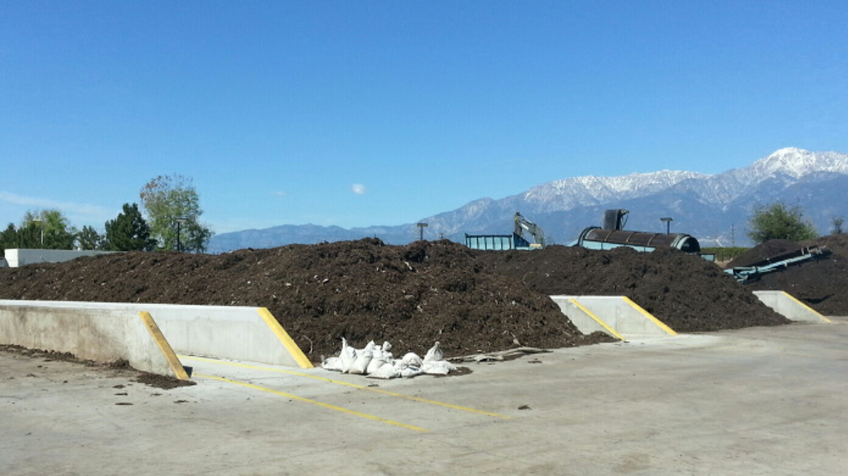
Counties, in coordination with cities, special districts that provide solid waste collection services, and regional agencies located within the county, are required to:
Estimate the amount of organic waste that will be disposed
Identify available verifiable existing organic waste recycling infrastructure capacity (inside and outside of the county)
Notes:
Each jurisdiction is responsible for conducting the requirements shown on this slide and the next slide.
The purpose of this planning is for each jurisdiction to determine how much organic waste will be disposed and how much existing, planned, or new organic waste recycling capacity is needed for the organic waste material that is collected from the collection program.
CalRecycle developed an extensive online calculator to assist you in this part of the process.
As this information is collected the online calculator tool can be utilized to record and calculate disposal and projected disposal by material type, as well as, existing capacity by facility type, new or expanded capacity by facility type, and any shortfall in capacity.
The capacity planning requirements do not require estimates to be exact or absent of any error or uncertainty. Rather it requires that each estimate is conducted in compliance with the requirements of this section.
The County is the coordinating entity for all of the capacity planning tasks because the County is responsible for submitting a report on capacity planning to CalRecycle.
However, each of these tasks is expected to be done by each individual jurisdiction.
Capacity planning efforts will be crucial to the state achieving SB 1383’s targets and the capacity planning requirements were intended to be a cooperative and communicative effort throughout the entities in the county.
1. Each jurisdiction must estimate the amount of all organic waste in tons that will be disposed by each of the jurisdictions within the county.
2. Each jurisdiction must identify the amount in tons of existing organic waste recycling infrastructure capacity, located in the county and outside of the county, that is verifiably available to each of the jurisdictions located in the county:
Each jurisdiction can demonstrate the capacity is verifiably available through a contract, franchise, or other documentation of existing, new, or expanded capacity at a facility, activity, operation or property that recovers organic waste that will be available to the county or its jurisdiction prior to the end of the reporting period.

Slide 4
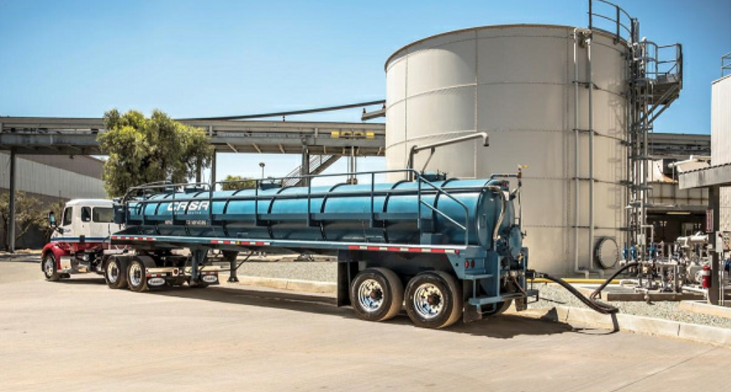
Counties, in coordination with cities, special districts that provide solid waste collection services, and regional agencies located within the county, are required to:
Estimate the amount of new or expanded organic waste recycling facility capacity needed
Notes:
Each jurisdiction must estimate the amount of new or expanded organic waste recycling facility capacity that will be needed to process the organic waste estimated to be disposed.
This requirement provides jurisdictions with the ability to identify how much additional capacity they will need at new or existing facilities that are inside or outside of its boundaries, and assist in identifying capacity at facilities that may become oversubscribed if other jurisdictions identify the same facilities.
Because this effort requires regional coordination, each of the cities that are contacted by County staff must respond to the request for information within 120 days.
If this timeline is not met, the county does not need to include estimates for that jurisdiction that provides solid waste collection services in its report to CalRecycle.
However, the county must include in its report any jurisdictions that did not provide the necessary information to comply with the requirements.
This is needed because the county can be penalized financially for failing to estimate organic waste capacity, and this clarifies that the County is not liable if the cities located in the county fail to respond within the given time frame.

Slide 5
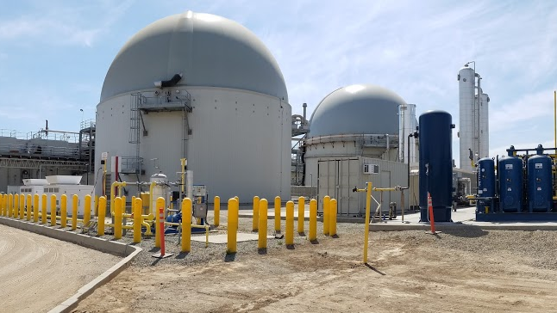
Planning includes consultation with the following:
The Enforcement Agency and the local task force
Haulers and owners of facilities, operations, and activities that recover organic waste
Community composting operators
Notes:
In complying with this section the, County in coordination with each jurisdiction is required to engage with important entities that play a role in organic waste recycling capacity planning efforts.
Such engagement will provide more accuracy in determining the organic waste capacity needed to meet the reduction in organic waste disposal goals required by statute.
Each jurisdiction should determine who will contact the following important entities: the local enforcement agency (LEA), local task force, haulers, facility owners, and community composting operations.
Jurisdictions that host facilities that generate digestate (e.g., in-vessel digester) and biosolids (waste water treatment plants) are required to plan for the recycling capacity for these materials.
Any of the entities contacted by a jurisdiction must respond within 60 days and include information about throughput and permitted capacity necessary for planning purposes to ensure the capacity planning requirements can be met in a timely manner.
Consult with community composting operations is required to provide an opportunity to consult with small-scale community composting operators that may be able to recycle additional organic waste outside of conventional organic waste processing infrastructure that may be available.
This collaboration will provide CalRecycle with the ability to ensure that jurisdictions are involving local communities in their capacity planning efforts.

Slide 6
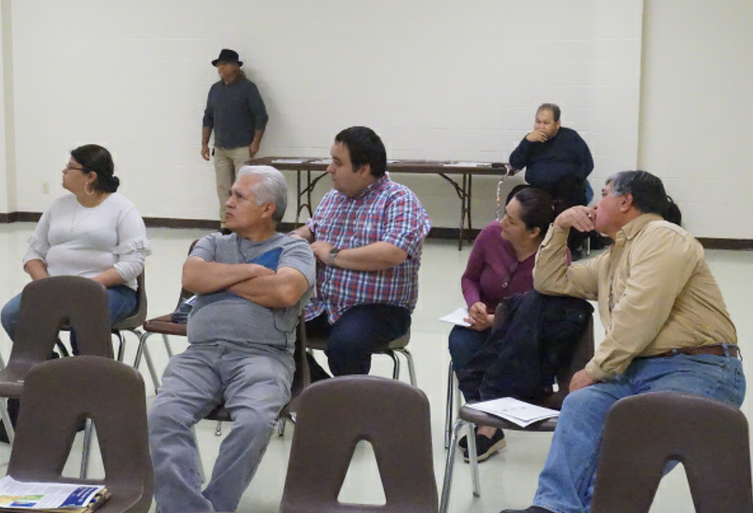
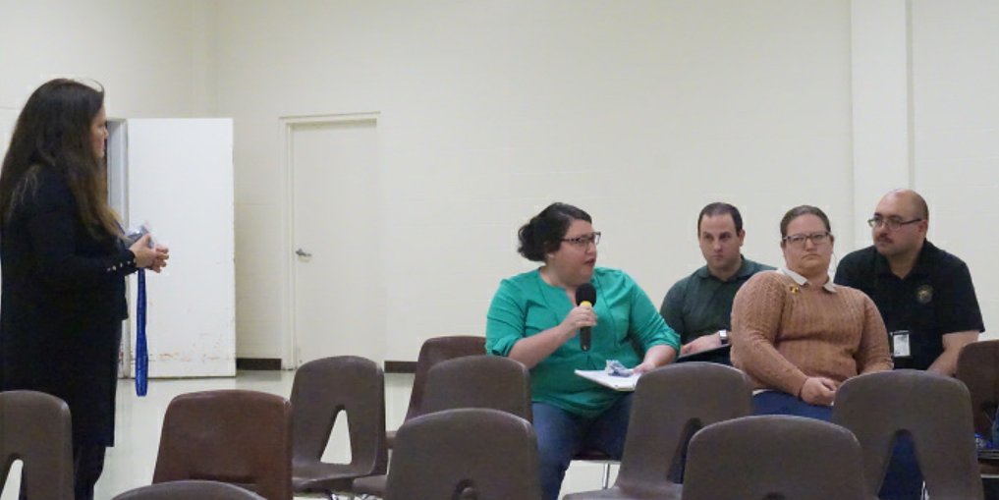
Planning also includes community outreach for planned new or expanding facilities
Notes:
Each jurisdiction is required to conduct community outreach regarding locations being considered for new or expanded facilities, operations, or activities to seek feedback on the benefits and impacts that may be associated with new or expanded facilities, operations, or activities.
The intent for the community outreach is that it would be conducted by the jurisdiction in which the expanded or new facility, operation, and activity is located.
With that said, as with the other consultations, the County and the jurisdictions should decide how and by whom community outreach will be handled if there is a new or expanded facility, operation, or activity.
However, nothing precludes jurisdictions from providing outreach on their own.
This outreach requirement was included in the regulations to facilitate feedback from the community during the planning process.
The community outreach must meet certain specifications to ensure thorough and authentic engagement on this requirement.

Slide 7
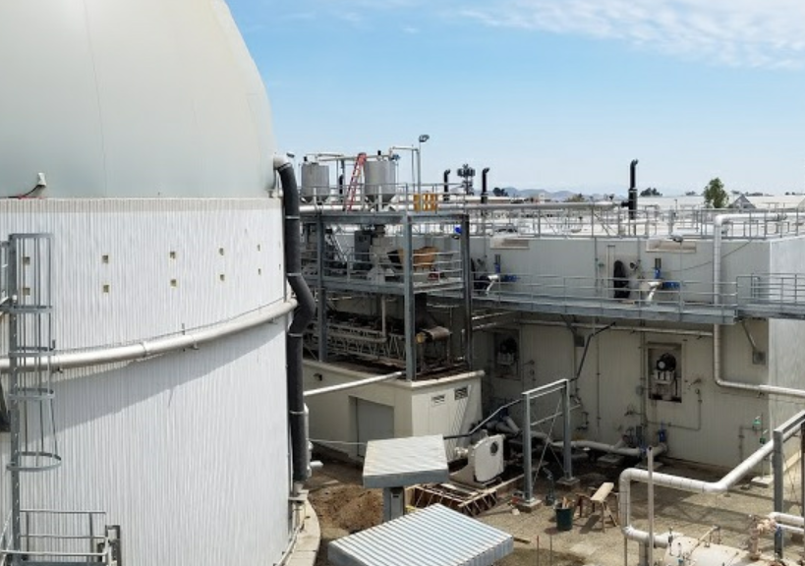
If the county determines that organic waste recycling capacity is needed, the county must notify any jurisdiction that lacks capacity that it is required to:
Submit an implementation schedule to CalRecycle
Identify proposed new or expanded organic waste recycling facilities that will be used to process the organic waste
Notes:
If a jurisdiction’s data determines that organic recycling capacity is needed, the County is required to notify each jurisdiction that lacks sufficient capacity that the jurisdiction is required to:
Submit an implementation schedule to CalRecycle that demonstrates how the jurisdiction will ensure available capacity to recover the organic waste disposed by generators within their jurisdiction by the end of the report period.
The implementation schedule must include timelines and milestones for planning efforts to access capacity, including:
1. Obtaining funding for infrastructure through modifying franchise agreements or other means of financially supporting the expansion of organic waste recycling
2. Identifying existing locations that could be used for additional capacity, and identifying locations for proposed new or expanded organic waste recycling facilities that will be used to recycle organic waste.
The County is required to notify each jurisdiction that lacks sufficient capacity that the county has reported a list of these jurisdictions to CalRecycle.

Slide 8
Material Types
Capacity planning includes the following materials: food, green waste, landscape and pruning waste, wood, paper products, printing and writing paper, digestate, and biosolids.
Notes:
For capacity planning, organic waste shall only include the following types of materials: food, green waste, landscape and pruning waste, wood, paper products, printing and writing paper, digestate, and biosolids.
When jurisdictions are engaged in organic waste recycling capacity planning outlined within this section, the focus is on these particular organic waste types rather than the larger group of materials that comprise “organic waste.”

Slide 9
Waived Jurisdictions
A jurisdiction that has a waiver does not have to plan for organic waste capacity for the area that is waived.
A county is not required to obtain information from a jurisdiction that is waived from all of the organic waste collection requirements.
Notes:
A jurisdiction that receives a waiver from the department does not have to plan for organic waste capacity for the area that is waived.
A county is not required to obtain information from a jurisdiction that is waived from all of the organic waste collection requirements.
Capacity planning for locations that are exempted from providing required collection services, are not required to be included in the county’s capacity planning estimates as those locations will not be contributing to the county’s organics waste totals.

Slide 10
Stay Engaged
SB 1383 Organics Capacity Calculator: https://www2.calrecycle.ca.gov/LGCentral/organics/slcp/capacityplanning/recycling/calculator
Subscribe to the SLCP listserv here: https://www2.calrecycle.ca.gov/Listservs/
Subscribe/152
Questions?
Contact SLCP.Organics@calrecycle.ca.gov
Notes:
That concludes the Organic Waste Capacity Planning presentation.
If you have questions, concerns or require clarity regarding the information presented here today, please leave your questions and comments in the comment box, or email the SLCP contact shown on this slide. We will do our best to address all questions after Chris Brea gives us a guided tour of the calculator.
Thank you.

Slide 11
Disclaimer
This guidance tool was developed by CalRecycle as a courtesy for informational and example purposes only. Use of this tool is optional and is not a regulatory requirement. In the event of any conflict with this guidance tool or information herein, applicable statutory and regulatory provisions shall control. This tool and information herein are based on known facts and legal authority as understood by CalRecycle at the time of release. Any analysis, guidance, or other information herein may be subject to change based on changed facts or legal authority, actual or understood, subsequent to the time of this communication. The provision of this guidance tool and any analysis, guidance, or other information herein shall not be construed as a waiver of any rights or remedies available to CalRecycle. Recipients of this communication are encouraged to seek the assistance of legal counsel to comply with applicable state law based on their pertinent facts and circumstances. CalRecycle makes no representation that use of this tool will ensure compliance with regulatory requirements. The user assumes all risk and CalRecycle accepts no responsibility or liability to any person because of the use of, or reliance upon, this tool or the information herein.

