Slide 1
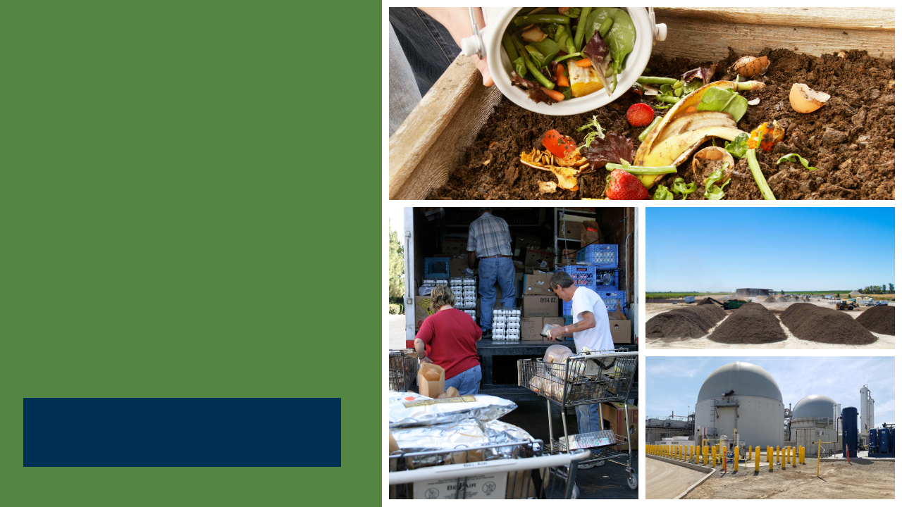

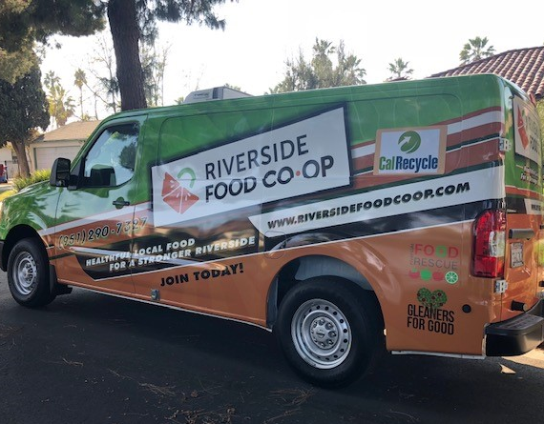
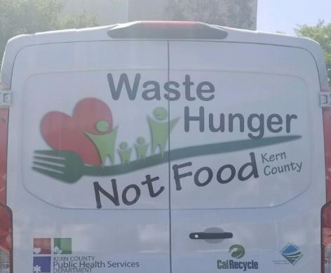
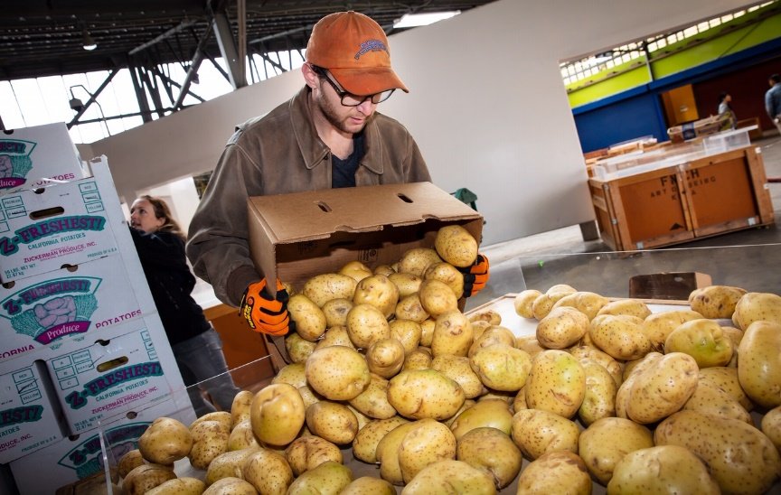
SB 1383 Edible Food Recovery Capacity Planning Tools & Guidance
Training Webinar
June 3, 2021
Notes:
This presentation will provide an overview of the SB 1383 edible food recovery capacity planning tools and guidance document

Slide 2
Instructions for Q&A Session(a)
If using GoToWebinar, type your question or a summary of your question into the “Question” pane.
Questions should focus on SB 1383 implementation and tools only.
CalRecycle staff will go through the questions on a first come first served basis.
We will aim to get to as many different people as possible.
To ask a question over the webinar, you must unmute yourself on your end; please state your affiliation.
If we are unable to answer your question during the webinar, CalRecycle staff will follow up with you.
We will not use the “raise hand” function.
If watching via the CalEPA Broadcast, email your questions to: SLCP.Organics@calrecycle.ca.gov
1
Notes:
As a reminder, please use the instructions shown on the slide for the Q&A session.
If you are using the GoToWebinar platform and would like to ask a question, please type your question into the “question” pane.
If you are watching the webinar via the CalEPA broadcast, please email your questions to the SLCP inbox.
Staff will unmute participants in the order that questions come in.
You will need to unmute yourself on your end when asked to by CalRecycle staff.
Please state your affiliation before asking your question.
CalRecycle staff may respond to some questions in writing through GoToWebinar.
We will verbalize these written responses for everyone to hear.
Now I will hand it over to our moderators, Rae and Esmeralda

Slide 3
Today’s Webinar
Disclaimer
Context
Edible Food Recovery Capacity Planning Requirements Overview
Survey (plus Q&A)
Edible Food Recovery Capacity Planning Calculator & Associated Guidance Document
  Background
  Calculator (plus Q&A)
  Guidance Document (plus Q&A)
Final Q&A and Wrap-Up
2
Notes:
This slide shows each item that will be covered in today’s webinar.
CalRecycle’s disclaimer about the use of the edible food recovery capacity planning tools.
We’re going to set the context to help explain why edible food recovery capacity planning is critical.
We will cover each of the tools starting with the Edible Food Recovery Capacity Planning Survey (Survey) first, the Calculator tool second, and the guidance document last.
We will host a brief question and answer session to answer questions specific to that tool.
Please be aware that we will also have more time to answer questions at the end of the webinar.

Slide 4
Disclaimer
This guidance tool was developed by CalRecycle as a courtesy for informational and example purposes only. Use of this tool is optional and is not a regulatory requirement. In the event of any conflict with this guidance tool or information herein, applicable statutory and regulatory provisions shall control. This tool and information herein are based on known facts and legal authority as understood by CalRecycle at the time of release. Any analysis, guidance, or other information herein may be subject to change based on changed facts or legal authority, actual or understood, subsequent to the time of this communication. The provision of this guidance tool and any analysis, guidance, or other information herein shall not be construed as a waiver of any rights or remedies available to CalRecycle. Recipients of this communication are encouraged to seek the assistance of legal counsel to comply with applicable state law based on their pertinent facts and circumstances. CalRecycle makes no representation that use of this tool will ensure compliance with regulatory requirements. The user assumes all risk and CalRecycle accepts no responsibility or liability to any person because of the use of, or reliance upon, this tool or the information herein.
3
Notes:
The disclaimer is included in each document and specifies that the use of these documents is optional and not an enforceable regulatory requirement and do not ensure regulatory compliance if they are used.
Please read the disclaimer in its entirety before using any of the documents discussed in this webinar.

Slide 5
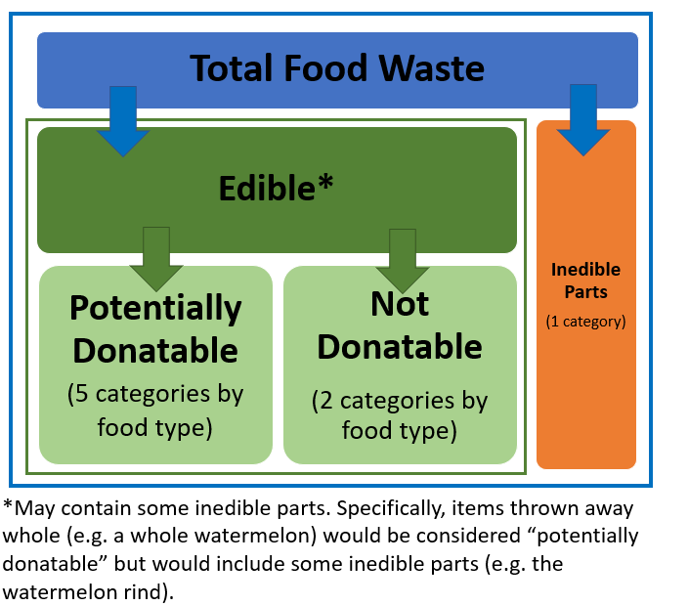
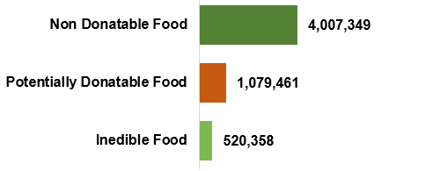
Food Disposed to Landfill in California (tons)
4
Source: 2018 Disposal Facility-Based Characterization of Solid Waste in California
Notes:
Context to help explain why edible food recovery capacity planning is critical.
In 2018, CalRecycle conducted a Disposal-Facility-Based Characterization of Solid Waste in California Study that separated disposed food materials into 8 categories based on edibility, recoverability, and food type.
The figure on the left gives a high-level overview of the food material categories used in this study.
The figure on the right shows some of the key results from the study. Specifically, that over 1 million tons of potentially donatable food were disposed in landfills in 2018.
Approximately 1.8 billion meals per year that could have potentially been recovered, but instead were disposed.

Slide 6
Why is Capacity Planning Needed?
Commercial Food Waste
Los Angeles, CA
Dumpster is emptied multiple times each day
Everything in it is sent to a landfill
5
Notes:
Everything in this photo of a dumpster in Los Angeles was going to be sent to a landfill and the dumpster needed to be emptied multiple times each and every day.
Food vendors at this facility tried to donate as much of this as possible, but the food recovery organization that they work with (which also happens to be one of the largest produce recovery organizations in California) was at full capacity.
This situation highlights a critical issue that we have in California where often there are significant amounts of edible food available for food recovery, but capacity to recover the food and distribute it to the community is lacking.
Without adequate and proper capacity planning, California will continue to send over one million tons of potentially donatable food to landfills annually.
SB 1383’s regulations include critical capacity planning requirements for edible food recovery.

Slide 7
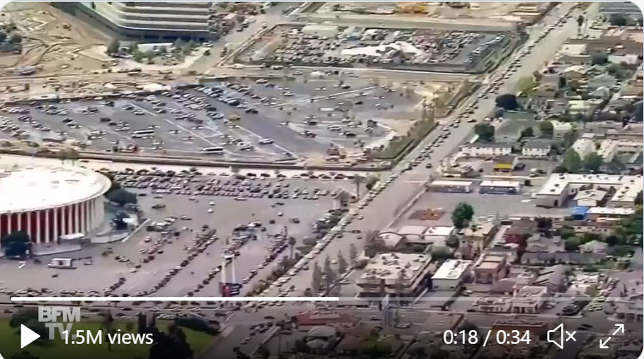
Hunger in California has doubled
6
Notes:
While millions of pounds of recoverable food are being disposed every day, hunger has doubled in California, and even tripled in some areas, in the aftermath of the COVID pandemic.
This is an aerial photo of a line of cars in Los Angeles waiting to receive food from a food distribution site last year.

Slide 8

SB1383 Edible Food Recovery Goal
50% | Reduction in the statewide disposal of organic waste (from the 2014 level) by 2020
75% | Reduction in the statewide disposal of organic waste (from the 2014 level) by 2025
20% | Of currently disposed edible food must be recovered for human consumption by 2025
7
Notes:
SB 1383’s statute includes the goal that not less than 20% of edible food that would otherwise be disposed must be recovered for human consumption by 2025.
The law also required CalRecycle to adopt regulations intended to help achieve this 20% edible food recovery goal.
This is a statewide goal that California must collectively achieve, not a goal for each individual jurisdiction.

Slide 9
Defining “Edible Food”
In the regulations, “edible food” is defined as food intended for human consumption.
  The regulatory definition also specifies however, that nothing in the regulations requires or authorizes the recovery of edible food that does not meet the food safety requirements of the California Retail Food Code.
8
Notes:
In the SB 1383 regulations, edible food is defined as “food intended for human consumption.”
Nothing in the regulations requires or authorizes the recovery of edible food that does not meet the food safety requirements of the California Retail Food Code.
For food to be considered “edible” under SB 1383, the food must be intended for human consumption and also meet all of the food safety requirements of the California Retail Food Code.

Slide 10
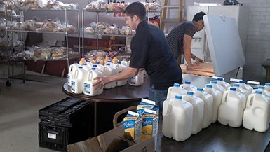
Counties, in collaboration with cities, special districts that provide solid waste collection services, and regional agencies located in the county, are required to:
Estimate the amount of edible food that will be disposed by Tier 1 and 2 commercial edible food generators
Identify existing capacity at food recovery organizations and services
9
Notes:
The SB 1383 regulations require counties, and each jurisdiction located within the county, meaning cities, regional agencies, and special districts that provide solid waste collection services, to plan for adequate edible food recovery capacity.
The regulations specify that each jurisdiction is required to do the following to complete their capacity planning analysis.
Jurisdictions must estimate the amount of edible food that will be disposed by Tier 1 and Tier 2 Commercial Edible Food Generators (CEFG’s) located in the jurisdiction.
To calculate this, jurisdictions will first need to identify the Tier 1 and Tier 2 Commercial Edible Food Generators that are in the jurisdiction.
CalRecycle developed a guidance document on approaches that jurisdictions can use to help them identify their Tier 1 and Tier 2 Commercial Edible Food Generators.
The link to the webpage: https://www.calrecycle.ca.gov/organics/slcp/foodrecovery/capacityplanning
The link to the document: https://www2.calrecycle.ca.gov/Docs/Web/118917
CalRecycle also developed the Calculator tool to assist jurisdictions with estimating the amount of edible food that will be disposed by Tier 1 and 2 Commercial Edible Food Generators.
The second part of the capacity planning analysis involves identifying existing capacity of food recovery organizations and food recovery services that is available to Commercial Edible Food Generators located in the jurisdictions with in the county.
CalRecycle published an Edible Food Recovery Capacity Planning Survey that provides jurisdictions with guidance on how to collect information from food recovery organizations and food recovery services and also includes a customizable Survey that can be used to help gather information on edible food recovery capacity.

Slide 11

Planning includes consultation with the following:
Food recovery organizations
Food recovery services
Entities must respond within 60 days
10
Notes:
To comply with these requirements, the county, in coordination with each jurisdiction, is required to consult with food recovery organizations and services about their current capacity and new or expanded capacity needs.
With this collaboration, these organizations can inform the jurisdictions about their current capacity and what would be needed most to expand or create new capacity.
Food recovery organizations and services contacted by a jurisdiction must respond to the jurisdiction within 60 days regarding available and potential new or expanded capacity.

Slide 12
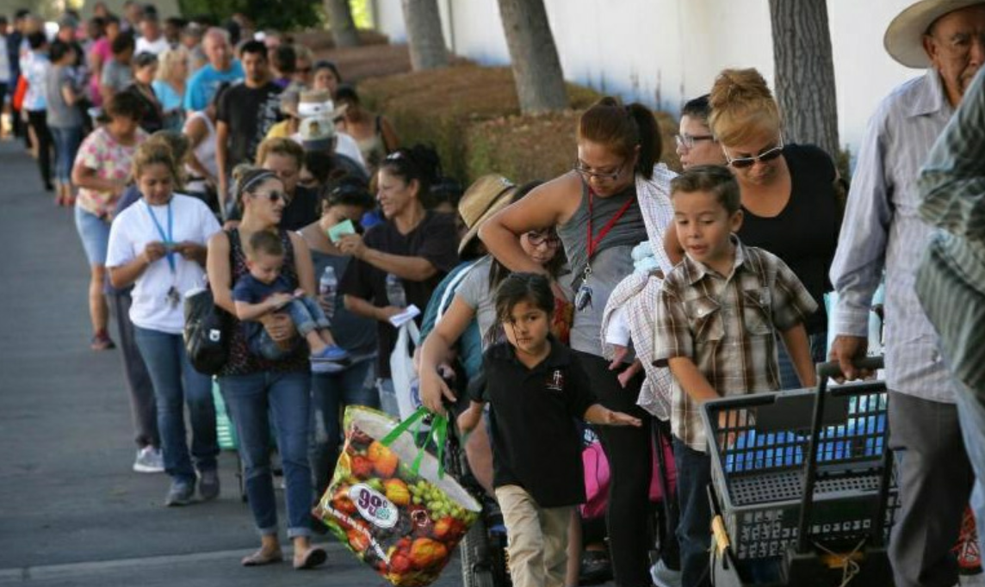
Counties, in collaboration with cities, special districts that provide solid waste collection services, and regional agencies located in the county, are required to identify within each jurisdiction:
Identify proposed new or expanded food recovery organizations and services that will be used
Identify, if any, the amount of new or expanded capacity needed
11
Notes:
The regulations require jurisdictions to identify proposed new or expanded food recovery organizations and services that will be used to recover the edible food that is estimated to be disposed.
Approaches to complying with this requirement include communicating with existing food recovery organizations and food recovery services to find out if they plan to expand their capacity.
The Survey document that CalRecycle developed, provides questions that will help jurisdictions gather data on this.
The final SB 1383 requirement for capacity planning is to identify the amount, if any, of additional existing, new or expanded edible food recovery capacity that is needed to recover the amount of edible food that is estimated to be disposed by Tier 1 and Tier 2 Commercial Edible Food Generators located in the jurisdiction.
Please note that because this effort requires the County to submit a report to CalRecycle, each jurisdiction that is contacted by County staff must respond to the request for information within 120 days.
This timeline ensures that the county staff can submit all the capacity planning information to CalRecycle in the time required by the regulation.
If this timeline is not met by a jurisdiction, the county does not need to include edible food recovery estimates for that jurisdiction in its report to CalRecycle.
The county must include in its report any jurisdictions that did not provide the necessary information to comply with the requirements. This is necessary because the jurisdiction can be penalized financially for failing to estimate edible food recovery capacity.

Slide 13
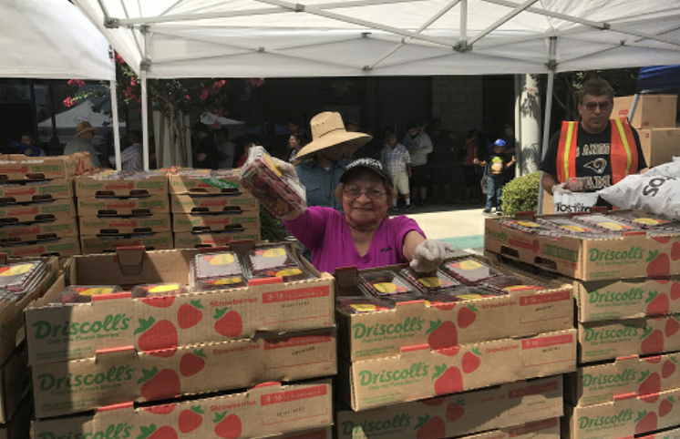
If the county determines that edible food recovery capacity is needed, the county must notify any jurisdiction that lacks capacity that it is required to:
Submit an implementation schedule to the Department
Consult with food recovery organizations and food recovery services
12
Notes:
If a jurisdiction’s capacity planning analysis shows that they do not have sufficient capacity to recover the amount of edible food that is estimated to be disposed, that jurisdiction is required to submit an implementation schedule to CalRecycle that demonstrates how it will ensure there will be enough existing, new, or expanded capacity to recover the edible food disposed by Commercial Edible Food Generators within its jurisdiction by the end of the reporting period.
The implementation schedule must include timelines and milestones for these planning efforts.
This includes timelines and milestones for obtaining funding for edible food recovery infrastructure.
This can potentially be done through modifying franchise agreements or demonstrating other means of financially supporting the expansion of edible food recovery capacity.
This also includes timelines and milestones for the identification of facilities, operations, or activities that could be used for additional capacity.
Each jurisdiction is required to consult with food recovery organizations and services regarding existing, new, or expanded capacity that could be accessed by the jurisdiction’s Commercial Edible Food Generators.
Jurisdictions can decide how to coordinate this activity with the other jurisdictions located in the county.
Please be aware that there are no waivers for edible food recovery, so all jurisdictions must plan and submit the required data.

Slide 14
Remainder of Today’s Webinar
Disclaimer
Context
Edible Food Recovery Capacity Planning Requirements Overview
Survey (plus Q&A)
Edible Food Recovery Capacity Planning Calculator & Associated Guidance Document
  Background
  Calculator (plus Q&A)
  Guidance Document (plus Q&A)
Final Q&A and Wrap-Up
13

Slide 15
How Can We Assess Edible Food Recovery Capacity?
Distribute an edible food recovery capacity planning survey
14
Notes:
One way to complete this analysis is through distributing an electronic Survey that is specifically focused on gathering information about food recovery organizations’ and food recovery services’ current food recovery capacity, and what they would need most to increase their capacity.
The Survey is a tool that was designed specifically to assist counties and jurisdictions in their efforts to achieve this critical task.

Slide 16
Pictures of Food Recovery Organizations and Services
15
Notes:
This slide starts shows some examples of what is meant by the term “capacity” in the context of edible food recovery.
Each photo provides an example of something that was funded in total or in part using CalRecycle grant funds specifically so that the organization could increase their capacity to rescue more food.
Things that can help a food recovery organization increase their capacity to rescue more food include, but are not limited to:
Refrigerated trucks, refrigerated vans, cold storage, increased warehouse space, paid staff, volunteers, kitchen equipment, bins and crates, food donation matching software, and much more.

Slide 17
SB 1383 Edible Food Recovery Capacity Planning Survey
16
Notes:
The first few pages of the Survey document contain information about the purpose of the Survey, an overview of the SB 1383 edible food recovery capacity planning requirements, information about Survey distribution, Survey confidentiality, and a disclaimer for the use of the tool.
This Survey is a companion piece to the Edible Food Recovery Calculator tool.
Edible Food Recovery Calculator will help jurisdictions estimate the amount of edible food disposed by Commercial Edible Food Generators in the jurisdiction.
This Survey can then be used to help jurisdictions determine if they have sufficient capacity to recover the amount of edible food that is estimated to be disposed.

Slide 18
Survey Confidentiality
Those responsible for administering the survey may need to evaluate the need for confidentiality of survey responses.
Jurisdictions may consider exploring methods to ensure confidentiality as a method to increase survey responsiveness.
17
Notes:
The survey document states that those responsible for administering the Survey may need to evaluate the need for confidentiality of Survey responses.
The reason for this is because Survey respondents may have concerns regarding the confidentiality of the information they provide and may seek assurances that information will not be shared with other food recovery organizations and services.
Jurisdictions may consider exploring methods to ensure confidentiality as a method to increase Survey responsiveness.

Slide 19
Sample Survey Questions
18
Notes:
Jurisdictions can customize the Survey by adding, removing, or editing questions and then sending it out to local food recovery organizations and services to collect information about current food recovery capacity within the jurisdiction.

Slide 20
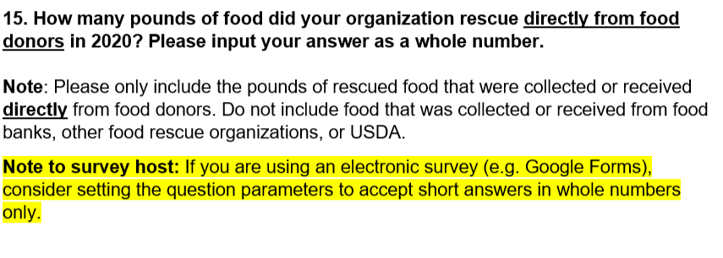
More Sample Survey Questions
19
Notes:
The Survey includes tips and guidance for how to write and program questions in electronic Surveys such as Google Forms.
These important notes for the Survey host are all highlighted in yellow.
The highlighted note to the Survey host could say, “If you are using an electronic Survey (for example, Google Forms), the response options should be in "checkboxes" form where multiple boxes can be selected.”
Please consider using an electronic Survey that best suits your specific needs including data needs.
Options for electronic Surveys that can be used are Google Forms, Qualtrics, and Survey Monkey.

Slide 21
Survey Distribution
Those responsible for distributing the survey may want to consider preventing food recovery organizations and food recovery services from receiving the same survey multiple times.
Counties should consider coordinating with all jurisdictions within the county regarding how best to distribute the survey, collect responses, and report information back to the county.
Consider providing these surveys in such a manner as to promote participation.
20
Notes:
If counties choose to use this optional Survey, they should consider coordinating with all jurisdictions within the county regarding how best to distribute the Survey, collect responses, and report information back to the county.
Consider providing these Surveys in such a manner as to promote participation from food recovery organizations and services and ensure their collaboration with jurisdictions.

Slide 22
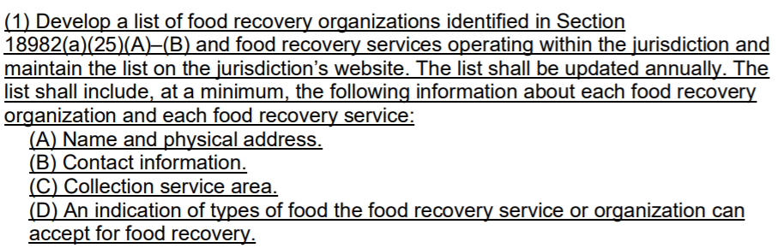
Section 18985.2. Edible Food Recovery Education and Outreach
On or before February 1, 2022 a jurisdiction shall:
21
Notes:
Some of the questions included in the Survey can also be used to assist jurisdictions with gathering information that will help them comply with the edible food recovery education and outreach requirements.
For example, Section 18985.2 in the regulations requires jurisdictions to develop a list of food recovery organizations and services operating in the jurisdiction.
The list must include specific information about each food recovery organization and service that is included such as the name and address, contact information, food recovery collection service area, and an indication of the types of food accepted for food recovery.
CalRecycle’s Edible Food Recovery Capacity Planning Survey includes questions that address each of these points and can serve to help you collect information to include on your list of food recovery organizations and services.

Slide 23
Survey Questions
22
Notes:
That concludes overview of the edible food recovery capacity planning Survey.

Slide 24
Instructions for Q&A Session
If using GoToWebinar, type your question or a summary of your question into the “Question” pane.
Questions should focus on SB 1383 implementation and tools only.
CalRecycle staff will go through the questions on a first come first served basis.
We will aim to get to as many different people as possible.
To ask a question over the webinar, you must unmute yourself on your end; please state your affiliation.
If we are unable to answer your question during the webinar, CalRecycle staff will follow up with you.
We will not use the “raise hand” function.
If watching via the CalEPA Broadcast, email your questions to: SLCP.Organics@calrecycle.ca.gov
23
Notes:
As a reminder, please use the instructions shown on the slide for the Q&A session.
If you are using the GoToWebinar platform and would like to ask a question, please type your question into the “question” pane.
If you are watching the webinar via the CalEPA broadcast, please email your questions to the SLCP inbox.
Staff will unmute participants in the order that questions come in.
You will need to unmute yourself on your end when asked to by CalRecycle staff.
Please state your affiliation before asking your question.
CalRecycle staff may respond to some questions in writing through GoToWebinar.
We will verbalize these written responses for everyone to hear.

Slide 25
How Can We Determine Needed Edible Food Recovery Capacity?
Estimate edible food disposed by commercial edible food generators and compare to existing capacity
24
Notes:
This is a brief overview of the Excel Calculator and associated guidance document that was developed by CalRecycle to assist jurisdictions and counties in estimating edible food disposed by Commercial Edible Food Generators and comparing to their existing capacity.
The Calculator can be found at: https://www2.calrecycle.ca.gov/Docs/Web/118914

Slide 26
Edible Food Recovery Capacity Planning Calculator
The Excel-based Calculator has two primary functions related to edible food recovery capacity planning:
Estimating edible food disposed by Generator type
Recording existing, new, or expanded capacity to estimate if additional capacity needed to recover edible food disposed by Generators
User can use one or both functions of the tool.
If both functions are used, the Calculator also estimates the difference between the two – needed capacity to recover all edible food disposed by Generators.
25
Notes:
The Edible Food Recovery Capacity Planning Calculator has two primary functions:
Estimating edible food disposed by each Tier 1 and Tier 2 Commercial Edible Food Waste Generator type.
Recording existing, new, or expanded capacity to estimate if additional capacity is needed to recover edible food disposed by Commercial Edible Food Generators.
The Calculator can be used for one or both functions.
If both functions are used, the Calculator estimates the difference between edible food estimated to be disposed and existing capacity for food recovery to estimate the needed capacity to recover all edible food disposed by Commercial Edible Food Generators.

Slide 27
How Calculator + Survey Work Together
Both the Calculator and Survey have functions to help estimate capacity for edible food recovery by organization or service
  The Calculator is designed to help jurisdictions estimate the amount of edible food disposed by Generators in the jurisdiction.
  The Survey is designed to help jurisdictions determine if they have sufficient edible food recovery capacity to recover the amount of edible food that is estimated to be disposed.
  Data collected as part of the Survey can be used to help populate the Calculator to record estimated capacity for jurisdictions within a county
26
Notes:
The tools can be used together as they provide complementary functions.
The Calculator is designed to help jurisdictions estimate the amount of edible food disposed by Commercial Edible Food Generators in the jurisdiction.
The Survey is designed to help jurisdictions determine if they have sufficient edible food recovery capacity to recover the amount of edible food that is estimated to be disposed.

Slide 28
Estimating “Edible Food” – Concept of “Potentially Donatable”
In 2018, CalRecycle’s Waste Characterization Studies (WCS) started sorting food waste into 8 categories based on edibility and type
For the purposes of the Calculator, “edible food” is considered food intended for human consumption that could be safely recovered, similar to potentially donatable food as defined in the WCS.
27
Notes:
In the 2018 Disposal-Facility-Based Characterization of Solid Waste in California Study (WCS), CalRecycle began separating the category of “food waste” into eight categories based on edibility, recoverability, and type.
Food waste was delineated between edible food and inedible parts (e.g., banana peels or eggshells).
Within edible food, discarded food was characterized as being “potentially donatable” or “non-donatable” based on whether it was likely that the food could have been safely recovered for human consumption prior to discard.
Potentially donatable categories include items discarded whole or in a manner that would have made it potentially recoverable (e.g., discarded in unopened original packaging).
Non-donatable categories include items that were partially eaten or discarded in open packages.
“Edible food” is considered food intended for human consumption that could be safely recovered.

Slide 29
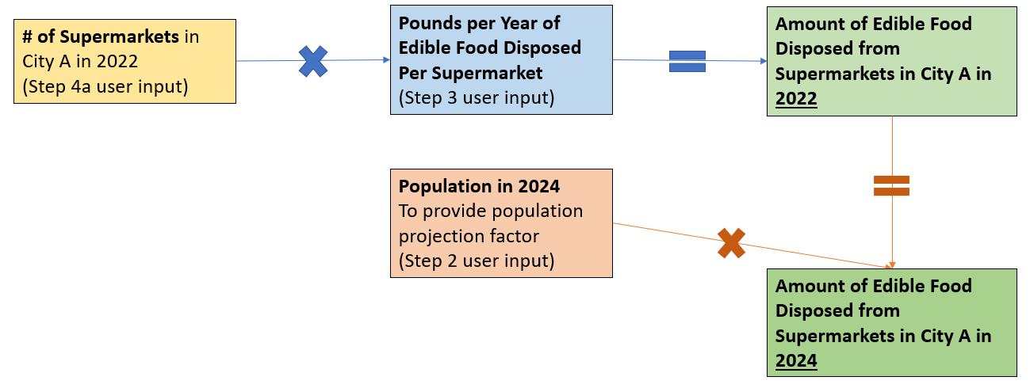
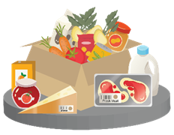
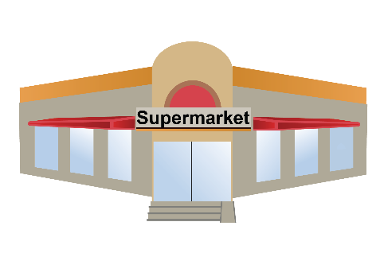
Using Calculator to Estimate Edible Food Disposed by Generators
28
Notes:
To use the Calculator, the user would input the number of Tier 1 or Tier 2 CEFGs in their city ; for example, supermarkets. This calculator is not just for supermarkets though, correct? If so, then my edits will help clarify for anyone referring to these slides.
To convert the number of supermarkets to an estimate of the amount of edible food disposed by those supermarkets in their city, the number of supermarkets is multiplied by an estimated factor for average pounds of edible food disposed per supermarket per year.
Regulations require users to estimate edible food disposed at the end of the reporting period, in this example 2024.
To estimate this, the Calculator requires users to input current and projected population numbers.
The projection for edible food disposed in the future is estimated by using the population projection.

Slide 30
Statewide Factors by Generator Type
Due to COVID-related delays in the waste characterization studies, statewide factors for edible food disposed are not yet available
Future versions of Calculator will provide factors for estimating the amount of edible food disposed per facility, by generator type
29
Notes:
The number of Commercial Edible Food Generators is multiplied by a factor of pounds of edible food disposed per generator per year.
Currently users must provide these estimates.
In the future, statewide factors will be provided.
The upcoming Waste Characterization Studies will be the data source for statewide factors.
When that data is available, CalRecycle will update the Calculator to provide statewide factors.
In the interim, CalRecycle has provided a guidance document to help users of the Calculator estimate their own factors.

Slide 31
Diving Deeper: Estimates by Food Type
Although not required by SB 1383, the Calculator provides an optional function to split total edible food disposed into food types
  Vegetative
  Meat
  Eggs, Dairy, and Dairy Alternatives
  Cooked/Baked/Prepared Perishable Items
  Packaged Non-Perishable
This information may be helpful to jurisdictions in planning for supplemental food recovery infrastructure and capacity.
30
Notes:
Splitting total edible food disposed into food types may help jurisdictions plan for supplemental food recovery infrastructure and capacity.
This could include refrigerated vehicles, additional cold storage, kitchen space, or staffing.
To estimate total edible food disposed by food type, the Calculator requires the user to provide information on the percentage of each food type within the total edible food disposed.
These percentages should sum to 100% for each type of Commercial Edible Food Generator.
The food types included in the Calculator are defined in CalRecycle’s 2018 Disposal-Facility-Based Characterization of Solid Waste in California Study, and are as follows:
Vegetative
Meat
Eggs, Dairy, and Dairy Alternatives
Cooked/Baked/Prepared Perishable Items
Packaged Non-Perishable
More information on estimations by food type can also be found in the associated guidance document.

Slide 32
Using Calculator to Estimate Existing Food Recovery Capacity
Users can record the details of “existing” and “new or expanded” food recovery capacity
  Designed for tracking capacity at the jurisdiction level
Existing capacity is recorded in pounds per month for each food recovery organization or service
  Monthly amounts are extrapolated to provide an annual estimate of existing capacity
Users can optionally track capacity by food type, using same food types from edible food disposal tab
31
Notes:
The Calculator can also be used to record the details of existing, proposed new, and expanded food recovery capacity.
This data can be collected through the Survey or through some other mechanism. The type of data includes:
Tracking food recovery capacity at the jurisdiction level.
Existing capacity recorded as pounds per month for each food recovery organization or service.
Extrapolation of monthly amounts to provide an annual estimate of existing capacity.
Users can track capacity by food type, using the same food types from the edible food disposal tab.

Slide 33
Using Calculator to Estimate Additional Food Recovery Capacity Needed
If users have input data to estimate the annual amounts of…
Edible food disposed by generators; AND
Existing, new, or expanded capacity at food recovery organizations and services that is available
…Then, the Calculator will automatically estimate the difference– whether there is sufficient capacity or not to capture the total amount of edible food estimated to be disposed by commercial edible food generators.
32
Notes:
The Calculator can also estimate additional food recovery capacity that is needed by comparing the estimated amount of edible food disposed by Commercial Edible Food Generators with the existing, new, or expanded capacity.
Using this information, the Calculator will estimate if there is sufficient capacity or not to capture the total amount of edible food estimated to be disposed by Tier 1 and Tier 2 Commercial Edible Food Generators.

Slide 34
Other Tools & Guidance for Capacity Planning
County of San Diego Edible Food (Disposal & Recovery) Estimator for Tier 1 & 2 Generators
  https://www.sandiegocounty.gov/content/sdc/dpw/recycling/factsfigures.html (see bottom of page under Training and Resources)
Natural Resources Defense Council Calculator for Baselining of Food Waste Generation and Food Rescue Potential
  https://www.nrdc.org/resources/food-waste-generation-and-food-rescue-potential-baseline-calculator-guide
33
Notes:
Other stakeholders have created similar tools for this purpose that could potentially be used. For example, the County of San Diego developed and Edible Food Estimator that can be found at the following link: https://www.sandiegocounty.gov/content/sdc/dpw/recycling/factsfigures.html
The Natural Resources Defense Council has a Calculator used to estimate a baseline for food waste generation and food rescue potential. https://www.nrdc.org/resources/food-waste-generation-and-food-rescue-potential-baseline-Calculator-guide

Slide 35
Calculator
34

Slide 36
Calculator Questions
35

Slide 37
Instructions for Q&A Session (1)
If using GoToWebinar, type your question or a summary of your question into the “Question” pane.
Questions should focus on SB 1383 implementation and tools only.
CalRecycle staff will go through the questions on a first come first served basis.
We will aim to get to as many different people as possible.
To ask a question over the webinar, you must unmute yourself on your end; please state your affiliation.
If we are unable to answer your question during the webinar, CalRecycle staff will follow up with you.
We will not use the “raise hand” function.
If watching via the CalEPA Broadcast, email your questions to: SLCP.Organics@calrecycle.ca.gov
36
Notes:
Please use the instructions shown on the slide for the Q&A session.
If you are using the GoToWebinar platform and would like to ask a question, please type your question into the “question” pane.
If you are watching the webinar via the CalEPA broadcast, please email your questions to the SLCP inbox.
Staff will unmute participants in the order that questions come in.
You will need to unmute yourself on your end when asked to by CalRecycle staff.
Please state your affiliation before asking your question.
CalRecycle staff may respond to some questions in writing through GoToWebinar.
We will verbalize these written responses for everyone to hear.
Questions and comments regarding the merit of the regulations were responded to during the rulemaking period.
Therefore, today we will focus on questions or clarifications regarding implementation and tools.
Now I will hand it over to our moderators, Rae Carranza and Esmeralda Alvarado

Slide 38
How Can We Estimate Factors for Edible Food Disposed?
Associated Guidance Document
37
Notes:
The Calculator’s associated guidance document is designed to help users identify estimates for the amount of edible food disposed, by Commercial Edible Food Generators, by type.
This input is required for the use of the Calculator as part of step 3.

Slide 39
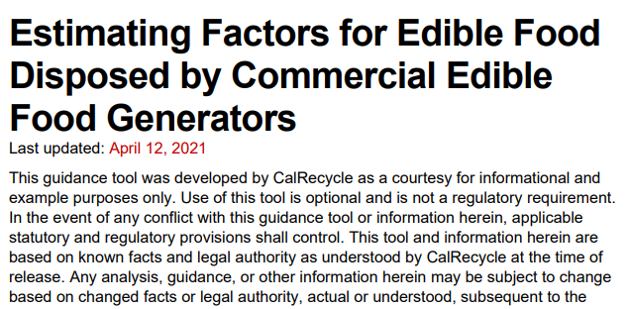
Guidance Document
Primary purpose: Help users select and alter factors to input into the Calculator representing average pounds of edible food disposed per facility per year by Generator Type
38
Notes:
The purpose of this guidance document is to help users of the Calculator select and alter factors to use in the Calculator.
The users of the Calculator will enter a factor of “average pounds of edible food disposed per facility per year” for each Tier 1 and Tier 2 Commercial Edible Food Generator Type, except for Large Events which require an input of “average pounds of edible food disposed per event”.

Slide 40
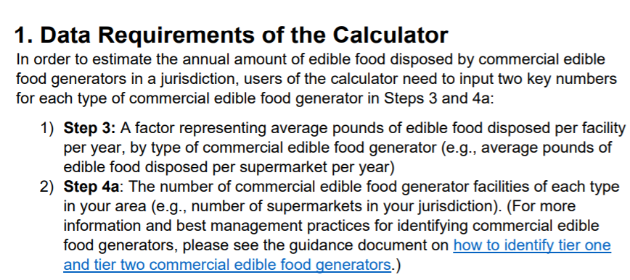
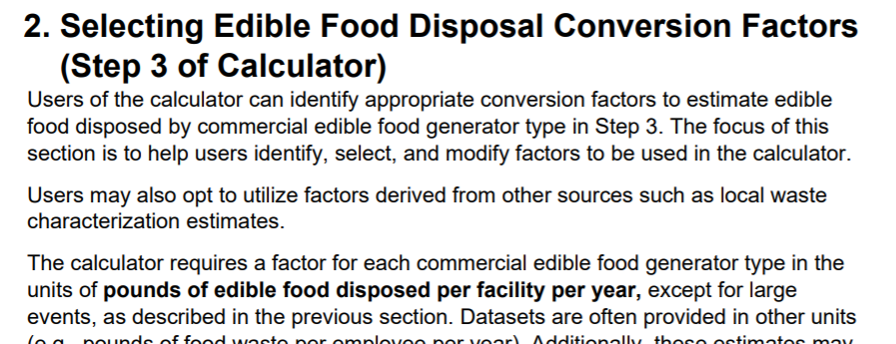
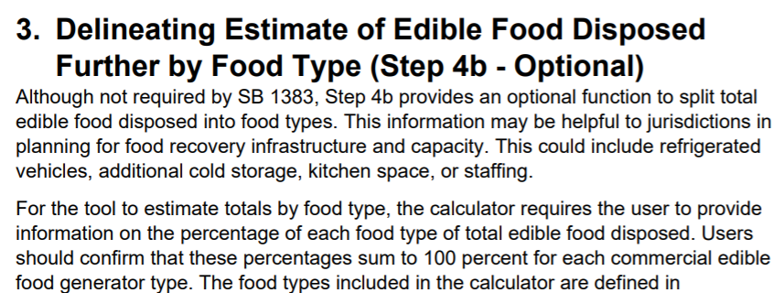
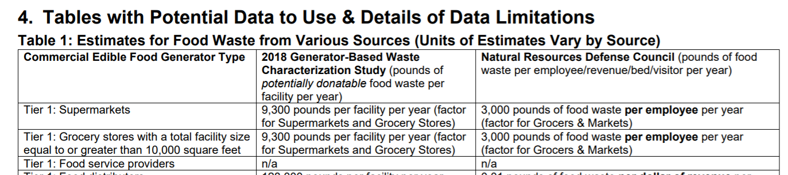
Guidance Document Overview
39
Notes:
The guidance document is split into four main sections:
Data requirements of the Calculator.
Selecting edible food disposal conversion factors from existing sources, including how to convert external sources of data to the units required for the Calculator.
Additional information and data related to delineating estimates for total edible food disposed by food type.
Additional data tables and limitations of that data.

Slide 41
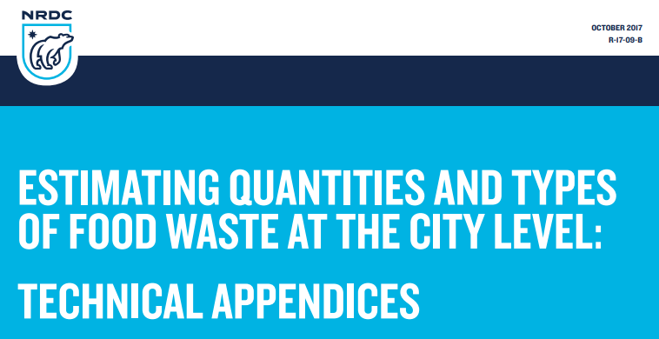

Main Data Sources
2018 CalRecycle Waste Characterization Studies
  Generator-based data for a small number of industry groups
  Disposal-based data for commercial sector
Reports from Natural Resources Defense Council (NRDC)
40
Notes:
The two main sources of data included in the document are:
2018 CalRecycle Waste Characterization Studies
Generator-based data for a small number of industry groups
Disposal-based data for the commercial sector
Reports from Natural Resources Defense Council (NRDC)

Slide 42
Challenges to Consider When Using Existing Data
2018 Waste Characterization Study Data
  Estimates available for a limited number of industry groups derived from small sample sizes
  Definition of “edible food” and units of data align with data needs of the calculator
External Data
  Estimates include materials or businesses that are not targeted by SB 1383
  Estimates are generally not provided in the appropriate units for the calculator
41
Notes:
Currently there is not a comprehensive list of statewide factors estimating edible food disposed by Commercial Edible Food Generator types.
There are other data sets that can help estimate those factors.
The main limitation of the 2018 Generator-based data set is the small sample size for the limited number of industry groups sampled.
The main challenge of using external data, is that such estimates may include materials or generators that are not specified by SB 1383 regulations.
The second challenge is that the estimates are generally not provided in the appropriate units for the Calculator.

Slide 43
Example: Deriving Supermarket Factor Using Info in Guidance Document – Option 1
Goal: Estimate a factor for pounds of edible food disposed per average Supermarket per year
Option 1: Use 2018 CalRecycle WCS Data for Supermarkets and Grocery Stores
  Estimate: 9,300 pounds of potentially donatable food disposed per facility per year
42
Notes:
This example will demonstrate how to estimate a factor for pounds of edible food disposed per average supermarket per year.
The first option is to use 2018 CalRecycle Waste Characterization data for supermarkets and grocery stores.
This dataset is in the appropriate units and estimate that 9,300 pounds of potentially donatable food are disposed per facility per year.
The limitations of this data-set is the small sample size and that supermarkets and grocery stores are considered a single industry group.

Slide 44
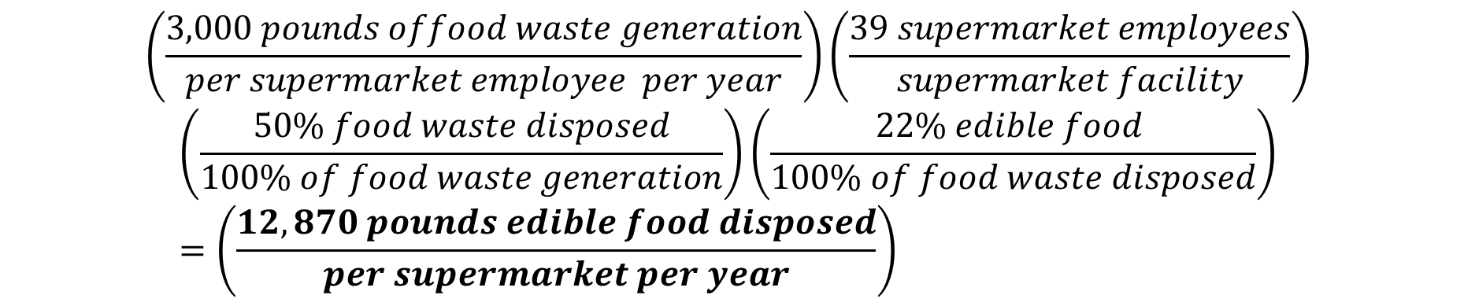
Example: Deriving Supermarket Factor Using Info in Guidance Document - Option 2
Goal: Estimate a factor for pounds of edible food disposed per average Supermarket per year
Option 2: Use NRDC Estimate Converted to Proper Units
  NRDC Estimate: 3,000 pounds food waste per employee per year
$$\left(\frac{3,000 pounds offood waste generation}{per supermarket employee per year}\right)\left(\frac{39 supermarket employees}{supermarket facility}\right)$$
$$\left(\frac{50\% food waste disposed}{100\% of food waste generation}\right)\left(\frac{22\% edible food }{100\% of food waste disposed}\right)=\left(\frac{12,870 pounds edible food disposed}{per supermarket per year}\right)$$
43
Notes:
Estimating a factor for supermarkets using NRDC’s estimates.
The NRDC’s report estimates that 3,000 pounds of food waste is generated per supermarket employee per year.
This data will need to be converted into the appropriate units for the Calculator.
Major limitations of this option are that these estimates also include supermarkets and grocery stores as one industry group despite being separated as different Tier 1 Commercial Edible Food Generators.

Slide 45
Example: Deriving Supermarket Factor Using Info in Guidance Document - Recap
Goal: Estimate a factor for pounds of edible food disposed per average Supermarket per year
Using 2018 WCS Data
9,300 pounds of edible food disposed per supermarket per year
Using NRDC Data
12,870 pounds of edible food disposed per supermarket per year
44
Notes:
In summary, factors were estimated two ways (though there may be additional variation to the calculations) and are relatively close. It is up to the user to determine which is most appropriate for their purposes. For example, in the NRDC dataset mock calculations, it was assumed that 50% of edible food waste generated was sent to landfills. If a user has a more accurate estimate, they should use those for their calculations.

Slide 46
Participants Wanted! Commercial Generator-Based Edible Food Waste Characterization Study
A statewide study to gather accurate, representative data to measure edible food discarded in California
Collecting samples directly from generators in industry groups known to discard food
Participating generators will receive their composition summary upon study completion
Sampling will begin in late 2021 (tentative)
Data will only be used for study, and participant data will remain confidential
Recommendations desired for:
K-12 schools
Assisted Living Facilities
Hospitals
Performing arts, spectator sports and related industries (large venues and large events)
Correctional facilities
wastechar@calrecycle.ca.gov
45
Notes:
CalRecycle is conducting a waste characterization study to collect data to establish statewide factors that can be used for the Calculator.
The Contractor, Tetra Tech, is beginning to recruit businesses and organizations in selected industry groups to participate in the study. If you know of any Commercial Edible Food Generators that might be interested in participating, please email the Waste Characterization Team at wastechar@calrecycle.ca.gov.
What is required of businesses and organizations participating in the study?
Fill out a Survey on their food waste management practices.
Allow the field team to take a minimum 200lb sample from both the trash and organics bins.
A visual assessment of the recycling bin to determine if any food waste is discarded in the recycling bin.
The team will sort the samples into 11 material categories: 8 food categories and 3 non-food categories.
Participating sites will receive a composition report of what was in their trash and organics samples.
We anticipate that some industry groups (listed above) will be more difficult to recruit than others. If you have any recommendations on businesses/organizations in these groups that may be interested in participating and getting a composition report of their organics and trash bins, please let us know.
Email us at wastechar@calrecycle.ca.gov with suggestions or any questions.

Slide 47
Guidance Document Questions
46

Slide 48
Instructions for Q&A Session (2)
If using GoToWebinar, type your question or a summary of your question into the “Question” pane.
Questions should focus on SB 1383 implementation and tools only.
CalRecycle staff will go through the questions on a first come first served basis.
We will aim to get to as many different people as possible.
To ask a question over the webinar, you must unmute yourself on your end; please state your affiliation.
If we are unable to answer your question during the webinar, CalRecycle staff will follow up with you.
We will not use the “raise hand” function.
If watching via the CalEPA Broadcast, email your questions to: SLCP.Organics@calrecycle.ca.gov
47
Notes:
As a reminder, please use the instructions shown on the slide for the Q&A session.
If you are using the GoToWebinar platform and would like to ask a question, please type your question into the “question” pane.
If you are watching the webinar via the CalEPA broadcast, please email your questions to the SLCP inbox.
Staff will unmute participants in the order that questions come in.
You will need to unmute yourself on your end when asked to by CalRecycle staff.
Please state your affiliation before asking your question.
CalRecycle staff may respond to some questions in writing through GoToWebinar.
We will verbalize these written responses for everyone to hear.
Now I will hand it over to our moderators, Rae and Esmeralda

Slide 49
Acknowledgements
Thank you to everyone who contributed to these tools!
48

Slide 50


Stay Engaged
Contact your LAMD Liaison
Or email:
SLCP.Organics@calrecycle.ca.gov
Visit CalRecycle’s Capacity Planning for Food Recovery Webpage: www.calrecycle.ca.gov/organics/slcp/foodrecovery/capacityplanning
Links to Tools & Guidance Documents
SB 1383 Edible Food Recovery Capacity Planning Survey
SB 1383 Edible Food Recovery Capacity Planning Calculator Tool
Guidance Document: Estimating Factors for Edible Food Disposed by Commercial Edible Food Generators
Guidance Document: How to Identify SB 1383 Commercial Edible Food Generators
49
Notes:
If you have questions after this webinar you can contact us using the following information or send your questions to the SLCP mailbox at slcp.organics@calrecycle.ca.gov.

Slide 51
Questions
50

