Slide 1


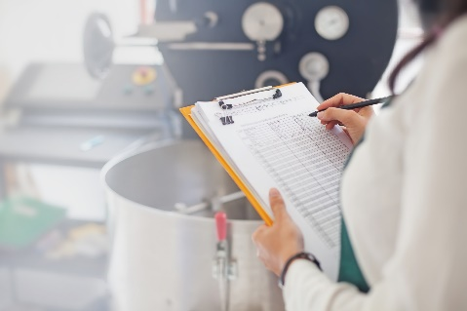
SB 1383 Model Implementation Record Tools
Model Implementation Record Tool
Model Performance-Based
Implementation Record Tool
Notes:
Today’s presentation is regarding the SB 1383 Model Implementation Record Tool and the SB 1383 Model Performance-Based Implementation Record Tool developed by CalRecycle.

Slide 2
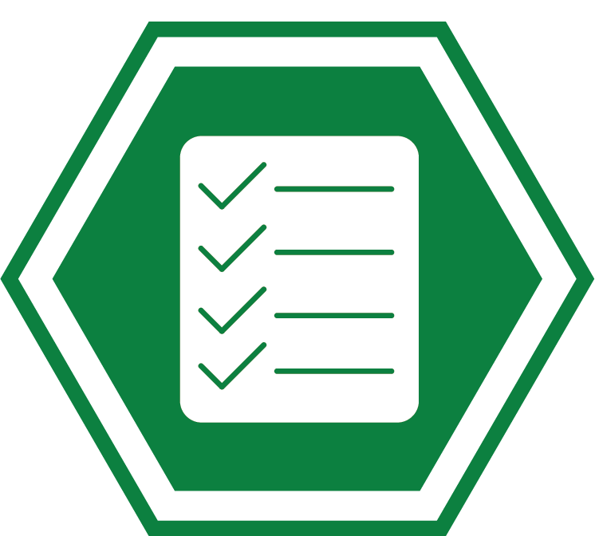
The SB 1383 regulations outline recordkeeping requirements for:
Jurisdictions
Self-Haulers of Organic Waste
Food Recovery
Transfer/Processing Facilities
3
Notes:
While this presentation will focus on recordkeeping for jurisdictions, there are also recordkeeping requirements for self-haulers of organic waste, food recovery, and transfer and processing facilities, that will not be covered during this presentation.

Slide 3

Implementation Record and Recordkeeping Requirements
Maintain all required records within the Implementation Record ( 14 CCR Section 18995.2)
  Physical or electronic in one central location
  Includes records or information within 60 days of creation
  Access granted to CalRecycle within 10 business days of request
  Records retained for 5 years
4
Notes:
A jurisdiction is required to maintain all required records within the Implementation Record.
The implementation record is to be stored in one central location, physical or electronic, that can be readily accessed by CalRecycle within 10 business days of request.
The implementation record is to include records or information within 60 days of the creation of the record or information.
All records are to be retained by the jurisdiction for 5 years.
The implementation record is to include at a minimum:
A copy of all ordinances or enforceable mechanisms, contracts, and agreements,
A written description of the inspection and enforcement program
All organic waste collection service records
All contamination minimization records
All waiver and exemption records
All education and outreach records
All hauler program records
All jurisdiction edible food recovery program records
All recovered organic waste procurement target records
All recycling content paper procurement records
All inspection, route review, and compliance review documents
All records of enforcement actions
All records of complaints and investigations of complaints and compliance with the jurisdiction’s inspection and enforcement requirements
All records required by jurisdictions implementing a performance-based sourced separated organic waste collection service

Slide 4
Model Implementation Record Tools
To assist in meeting implementation record and recordkeeping requirements, CalRecycle has developed:
SB 1383 Model Implementation Record Tool
SB 1383 Model Performance-Based
Implementation Record Tool
5
Notes:
To assist in meeting implementation record and recordkeeping requirements, CalRecycle has developed the SB 1383 Model Implementation Record Tool and SB 1383 Model Performance-Based Implementation Record Tool.

Slide 5

Live Demonstration
6
Notes:
We will now provide a live demonstration of the model implementation record tools.

Slide 6





Stay
Engaged
Subscribe to the SLCP Listserv:
https://www2.calrecycle.ca.gov/Listservs/
Subscribe/152
SB 1383 Model Implementation Record Tools
https://www.calrecycle.ca.gov/organics/slcp/
recordkeeping/implementationrecord
Questions
SLCP.Organics@calrecycle.ca.gov
7
Notes:
If you have questions, contact the SLCP mailbox at slcp.organics@calrecycle.ca.gov.

Slide 7
Disclaimer
This guidance tool was developed by CalRecycle as a courtesy for informational and example purposes only. Use of this tool is optional and is not a regulatory requirement. In the event of any conflict with this guidance tool or information herein, applicable statutory and regulatory provisions shall control. This tool and information herein are based on known facts and legal authority as understood by CalRecycle at the time of release. Any analysis, guidance, or other information herein may be subject to change based on changed facts or legal authority, actual or understood, subsequent to the time of this communication. The provision of this guidance tool and any analysis, guidance, or other information herein shall not be construed as a waiver of any rights or remedies available to CalRecycle. Recipients of this communication are encouraged to seek the assistance of legal counsel to comply with applicable state law based on their pertinent facts and circumstances. CalRecycle makes no representation that use of this tool will ensure compliance with regulatory requirements. The user assumes all risk and CalRecycle accepts no responsibility or liability to any person because of the use of, or reliance upon, this tool or the information herein.
8
Notes:
This presentation is a guidance tool developed for information and example purposes only. The disclaimer specifies that the use of these documents is optional and not an enforceable regulatory requirement and do not ensure regulatory compliance if they are used.

