Slide 1

SB 1383 Notification of Intent to Comply Form
CalRecycle
November 18, 2021
Notes:
Good morning everyone. Thank you for joining us.
Today we will be presenting on CalRecycle’s development of the SB 1383 Notification of Intent to Comply form.

Slide 2
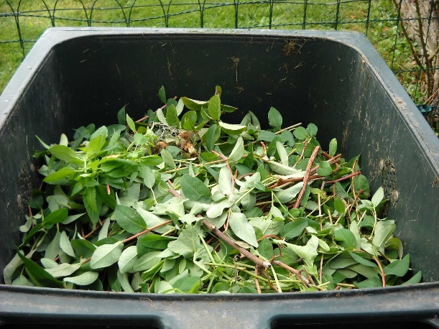


Background
SB 619 by Senator John Laird (D-Santa Cruz)
Organic waste: reduction regulations: local jurisdiction compliance.
3
Notes:
Jurisdictions are required to implement the SB 1383 regulations starting in January 1, 2022.
As jurisdictions are preparing to implement the regulations, many local governments are facing challenges in response to the COVID-19 pandemic.
In response, Governor Newsom signed SB 619 (Laird, Chapter 508, Statutes of 2021) into law to support local governments as they design and implement successful organic waste recycling programs throughout the state.
The law authorizes CalRecycle to waive civil penalties if a jurisdiction submits a Notification of Intent to Comply for some or all of the regulatory requirements and implements the planned actions and timelines.
Upon approval by CalRecycle of a jurisdiction’s notification and implementation by the jurisdiction, a jurisdiction may be eligible for both of the following:
Administrative civil penalty relief for the 2022 calendar year pursuant to PRC section 42652.5(d).
A corrective action plan pursuant to 14 CCR section 18996.2.
CalRecycle may address through a corrective action plan any violations disclosed in a jurisdiction’s notification that will take more than 180 days to correct. In this situation, the proposed actions and schedule in the jurisdiction’s approved notification will be in effect until a corrective action plan is issued.

Slide 3

Notification Requirements
A description of the continuing violations.
Reasons why the jurisdiction is unable to comply.
Impacts of the COVID-19 pandemic on compliance.
Proposed actions to remedy the violations.
4
Notes:
PRC section 42625.5(e)(1) - through (4)
A jurisdiction shall, at minimum, include the following in its notification:
A description, with specificity, of the continuing violations.
A detailed explanation of the reasons, supported by documentation, why the jurisdiction is unable to comply.
A description of the impacts of the COVID-19 pandemic on compliance.
A description of the proposed actions the jurisdiction will take to remedy the violations within the timelines established in 14 CCR section 18996.2 with a proposed schedule for doing so. The proposed actions shall be tailored to remedy the violations in a timely manner.
Jurisdictions are to adopt a resolution by its respective governing body affirming the contents and timeline of its Notification of Intent to Comply.
As stated in the previous slide regarding Administrative civil penalty relief,
For violations of the regulations that are disclosed in the notification and approved by CalRecycle, CalRecycle will waive administrative civil penalties and penalties will not accrue for the outlined violations in the notification during the 2022 calendar year, if the jurisdiction implements the proposed actions according to the schedule proposed in the notification.

Slide 4

Submit to CalRecycle
March 1, 2022
Notifications and Resolution should be sent to:
NOIC@CalRecycle.ca.gov
5
Notes:
The notification, and a resolution adopted by the governing body of the jurisdiction, shall be sent to CalRecycle no later than Tuesday, March 1, 2022.
Notifications and the resolution should be emailed to the Notification of Intent to Comply inbox, NOIC@CalRecycle.ca.gov.
Although we will not be reviewing any notifications until January 1, 2022, we will accept notifications with resolutions beginning December 1, 2021.

Slide 5



CalRecycle Response
Approval
Disapproval
Request for additional information
Timeline for a decision on approval or disapproval
6
Notes:
CalRecycle will respond in writing to a jurisdiction’s notification submission within 45 business days of receiving the notification with one of the following:
An approval
A disapproval
A request for additional information
Or a timeline for a decision on approval or disapproval
If CalRecycle disapproves the notification due to the notification not meeting the requirements, CalRecycle will include in the response a justification for the disapproval.

Slide 6

Live Demonstration
7
Notes:
CalRecycle has developed and is providing a notification form as a convenience to assist jurisdictions (counties, cities, a county and city, or special districts providing solid waste collection services) for purposes of submitting a notification of intent to comply to CalRecycle, as described in Public Resources Code section 42652.5(c). I want to point out that use of this form is optional and not a regulatory requirement.
From the CalRecycle homepage, scroll down to the Updates Section and find "New 1383 Resources." Click on the Learn More button. This will take you to the Short Lived Climate Pollutant reduction strategy webpage.
Next you will scroll to the Enforcement Section and Click on the Learn More button. This will take you to the Enforcement webpages where you will find the SB 619 Notification of Intent to Comply section. Click on the Learn More button.
Here you will find information about the Notification of Intent to Comply including the process and Application Form. Once today's presentation and webinar recording have been made ADA compliant, they will be posted here. We also plan to post a list of jurisdictions with approved notifications on this page.
To access the form we developed, click on the Application Form button.
The first page of this form summarizes all of the same information Alan covered in previous slides.
The fillable portion of the form begins with administrative information.
#1, We provided some check boxes for ease of identifying some of the most common violations, however it is not all inclusive.
You may select violations using the check boxes or write in the violations for each applicable regulatory section.
For each regulatory section selected or written, you will describe the specific violations related to that regulatory section.
We have provided an example to give you an idea of what we are expecting in the way of identifying and describing specific violations.
#2, provide a detailed explanation of the reasons why the jurisdiction is unable to comply, supported by documentation, if applicable.
#3, provide a description of the impacts of the COVID-19 pandemic on compliance
#4, provide a description of the proposed actions the jurisdiction will take to remedy the violations with a proposed schedule for completing each action.
We have provided an optional format in this document, so let's take a look at that.
We are looking for tasks associated with remedying the violations/achieving compliance.
We have provided examples to give an idea of what we are expecting in the way of identifying tasks
Using the example from the checkboxes, we identified section 18984.1 - three container organic waste collection services.
Included a description of the specific violations – not implementing mandatory residential foodwaste collection for all residents.
Identified tasks that may be needed in order to provide mandatory residential foodwaste collection. We identified purchasing additional collection vehicles and working with the hauler to find a facility to accept mixed organic waste with associated completion dates.
Lastly, you will sign the form and send it, along with the resolution adopted by your governing body, to NOIC@Calrecycle.ca.gov
That concludes the overview of CalRecycle’s notification of intent to comply form.

Slide 7



Stay
Engaged
Subscribe to the SLCP Listserv:
https://www2.calrecycle.ca.gov/Listservs/
Subscribe/152
https://www.calrecycle.ca.gov/organics/slcp/enforcement/noic
Questions
LAMD Liaison or NOIC@calrecycle.ca.gov
8
Notes:
For more information, please subscribe to the SLCP listserv, visit the SLCP home page on the CalRecycle website, contact your Local Assistance and Market Development liaison, or e-mail the Notification of Intent to Comply inbox listed here.

Slide 8
Disclaimer
This guidance tool was developed by CalRecycle as a courtesy for informational and example purposes only. Use of this tool is optional and is not a regulatory requirement. In the event of any conflict with this guidance tool or information herein, applicable statutory and regulatory provisions shall control. This tool and information herein are based on known facts and legal authority as understood by CalRecycle at the time of release. Any analysis, guidance, or other information herein may be subject to change based on changed facts or legal authority, actual or understood, subsequent to the time of this communication. The provision of this guidance tool and any analysis, guidance, or other information herein shall not be construed as a waiver of any rights or remedies available to CalRecycle. Recipients of this communication are encouraged to seek the assistance of legal counsel to comply with applicable state law based on their pertinent facts and circumstances. CalRecycle makes no representation that use of this tool will ensure compliance with regulatory requirements. The user assumes all risk and CalRecycle accepts no responsibility or liability to any person because of the use of, or reliance upon, this tool or the information herein.
9
Notes:
This presentation is a guidance tool developed for information and example purposes only. The disclaimer specifies use of these documents is optional and not an enforceable regulatory requirement and does not ensure regulatory compliance if they are used.

