Slide 1
SB1383 Recycling and Disposal Reporting System Reporting Requirements Starting in 2022
October 26, 2021
Notes:
This webinar will cover SB 1383 Recycling and Disposal Reporting system reporting requirements. Please note that CalRecycle anticipates putting on another webinar or training video close to start of reporting describing in greater detail the material covered in this webinar.

Slide 2
Disclaimer
These guidance tools were developed by CalRecycle as a courtesy for informational and example purposes only. Use of these tools is optional and is not a regulatory requirement. In the event of any conflict with these guidance tools or information herein, applicable statutory and regulatory provisions shall control. These tools and information herein are based on known facts and legal authority as understood by CalRecycle at the time of release. Any analysis, guidance, or other information herein may be subject to change based on changed facts or legal authority, actual or understood, subsequent to the publishing of these tools. The provision of these guidance tools and any analysis, guidance, or other information herein shall not be construed as a waiver of any rights or remedies available to CalRecycle. Users are encouraged to seek the assistance of legal counsel to comply with applicable state law based on their pertinent facts and circumstances. CalRecycle makes no representation that use of these tools will ensure compliance with regulatory requirements. The user assumes all risk and CalRecycle accepts no responsibility or liability to any person because of the use of, or reliance upon, these tools or the information herein.
Notes:
The disclaimer is included in each document and specifies that the use of these documents is optional and not an enforceable regulatory requirement and do not ensure regulatory compliance if they are used.
Please read the disclaimer in its entirety before using any of the documents discussed in this webinar.

Slide 3
Instructions for Q&A Session
If using GoToWebinar, type your question or a summary of your question into the “Question” pane.
We will not use the “raise hand” function.
If watching via the CalEPA Broadcast, email your questions to: SLCP.Organics@calrecycle.ca.gov
Questions should focus on SB 1383 and RDRS Reporting only.
CalRecycle staff will go through the questions as they come in.
To ask a question over the webinar, you must unmute yourself on your end; please state your affiliation.
If we are unable to answer your question during the webinar, please email the SLCP inbox and we will get back to you soon.
Notes:
Good morning.
After this morning’s presentation we will have Q&A session
Please use the instructions shown on the slide for the Q&A session.
If you are using the GoToWebinar platform and would like to ask a question, please type your question into the “question” pane.
If you are watching the webinar via the CalEPA broadcast, please email your questions to the SLCP inbox.
Staff will unmute participants in the order that questions come in.
You will need to unmute yourself on your end when asked to by CalRecycle staff.
Please state your affiliation before asking your question.
CalRecycle staff may respond to some questions in writing through GoToWebinar.
We will verbalize these written responses for everyone to hear.
Questions and comments regarding the merit of the regulations were responded to during the rulemaking period.
Therefore, today we will focus on questions or clarifications regarding implementation and tools.
Now I will hand it off to Curie and Arlene for their presentation.

Slide 4
Purpose of This Presentation
Highlight the entities and data required to be reported via Recycling and Disposal Reporting System (RDRS) to comply with SB1383 Regulations regarding organic material recovery, commencing with the first RDRS reporting period in 2022
Notes:
The purpose of this presentation is to Highlight the entities and data required to be report via RDRS to comply with SB 1383 Regulations regarding organic material recovery.
This reporting will commence with the first RDRS reporting period in 2022, and every reporting period thereafter.

Slide 5
Presentation Outline
SB1383 Regulation Sections that Pertain to RDRS Reporting Requirements for:
  Haulers
  Transfer/Processors
  Recycling and Composting Facilities and Operations
II. Questions?
Notes:
The presentation will cover
I. SB1383 Regulation Sections that pertain to RDRS reporting requirements for:
Haulers
Transfer/Processors (T/P), and
Recycling and Composting Facilities and Operations
II. Once the material in the presentation has been covered, we will open the webinar to questions

Slide 6
Who Needs to Comply with SB1383 RDRS Reporting?
SB1383 RDRS reporting only applies to entities that are required to report pursuant to AB901
If you are not registered in RDRS, and need to assess if you are required to report pursuant to AB901, please navigate to the following links:
  Do I need to Register and Report in RDRS?
  RDRS Registration and Reporting Training Resources
Notes:
Please note that, SB 1383 RDRS reporting only applies to entities that are required to report pursuant to AB 901
If you are not registered in RDRS, and need to assess if you are required do report pursuant to AB 901, please navigate to the following links:

Slide 7
SB1383 Regulations Sections Pertaining to RDRS
Planning Guidelines and Procedures for Preparing and Revising Countywide Integrated Waste Management Plans: Chapter 9
Recycling and Disposal Reporting System: Article 9.25
Reporting Requirements for Haulers: Section 18815.4
Reporting Requirements for Transfer/Processors (T/P’s): Section 18815.5
Reporting Requirements for Recycling and Composting Facilities and Operations: Section 18815.7
Notes:
SB 1383 Regulation that cover RDRS reporting requirements are covered in chapter 9, article 9.25 and sections 18815.4 (for haulers), 18815.5 (for Transfer/Processors) and 18815.7 (for Recycling and Composting Facilities and Operations)

Slide 8
SB1383 RDRS Reporting Requirements for Various Entities
Notes:
Now, we will cover the SB 1383 RDRS Reporting Requirements for Various Entities

Slide 9
A Hauler Providing an Organic Waste Collection Service…
This information is not reported in RDRS, but is given from hauler to accepting facility
Shall identify (at the time of delivery), for all materials delivered to each receiving reporting entity whether the material is collected from a…
Source separated organic waste collection stream OR
Mixed Waste organic collection stream
Section Referenced: 18815.4(F)(1) and (2), 18815.4(g)
Notes:
Haulers, do not need to report additional information to RDRS but are required to identify (at the time of delivery), for all materials delivered to each receiving reporting entity whether the material is collected from a, Source separated organic waste collection stream OR from a Mixed waste organics collection stream.

Slide 10
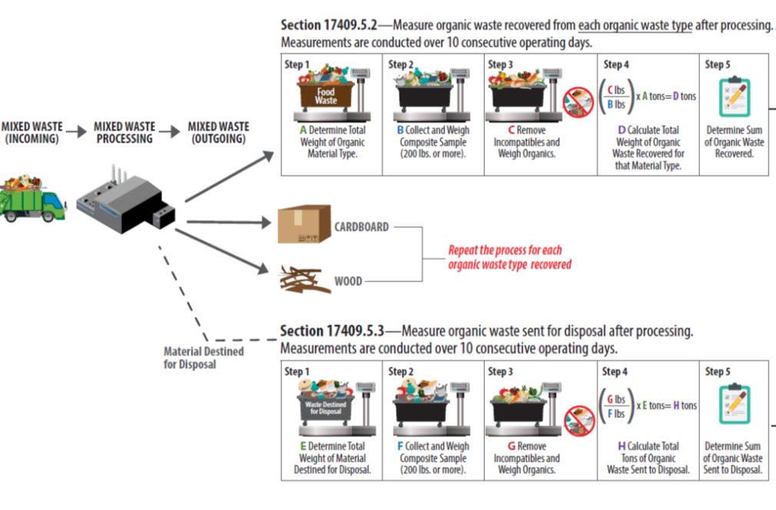
T/Ps Receiving “Mixed Waste” Collection Stream
For determining the annual average organic content recovery rate
Report to CalRecycle via RDRS Each Quarter
Total organics recovered during the 10-day measurement period.
Total organics sent to disposal during the 10-day measurement period.
Sum of daily records for the quarter:
  Outgoing weight of material recovered
  Outgoing weight of material sent to disposal
  Incoming weight of Mixed Waste stream
Section Referenced: 18815.5(d)(1)(A), (B), and (C)
Notes:
Transfer/processors receiving “Mixed Waste” collection stream, for the purpose of determining the annual average organic content recovery rate must report to CalRecycle via RDRS
Total organics recovered during the 10-day measurement period.
Total organics sent to disposal during the 10-day measurement period.
Sum of daily records for the quarter of the following:
Outgoing wight of material recovered
Outgoing weight of material sent to disposal
Incoming weight of Mixed Waste stream
The panel on the left shows in greater detail the calculations that are required to generate the data for RDRS. A link to this supporting document is available in the “Relevant Links” slide later in the presentation.

Slide 11
T/Ps Receiving “Source Separated” Collection Stream
For determining the annual average organic content recovery rate
Report to CalRecycle via RDRS Each Quarter
Total organics recovered during the 10-day measurement period.
Total organics sent to disposal during the 10-day measurement period.
Sum of daily records for the quarter:
  Outgoing weight of material recovered
  Outgoing weight of material sent to disposal
  Incoming weight of Source Separated waste stream
Section Referenced: 18815.5(d)(2)(A), (B), and (C)
Notes:
Transfer/processors receiving “Source Separated” collection stream, for the purpose of determining the annual average organic content recovery rate must report to CalRecycle vis RDRS
Total organics recovered during the 10-day measurement period.
Total organics sent to disposal during the 10-day measurement period.
Sum of daily records for the quarter of the following:
Outgoing wight of material recovered
Outgoing weight of material sent to disposal
Incoming weight of Source Separated waste stream
The panel on the left shows in greater detail the calculations that are required to generate the data for RDRS. A link to this supporting document is available in the “Relevant Links” slide later in the presentation.

Slide 12
Additional Requirement for T/Ps
A reporting receiving facility shall report the following to the department on a quarterly basis:
The average ratio of remnant organic waste, to non-organic waste measured in the Gray Container Waste Evaluation samples performed by the facility pursuant to Section 17409.5.7.
Section Referenced 18815.5(g)
Gray Container Waste Evaluation Overview
An operation or facility that receives a
gray container collection stream, AND
More than 500 tons of solid waste from at least one jurisdiction annually,
Shall conduct waste evaluations on the gray container collection stream, once per quarter
Notes:
Additionally, T/Ps may also need to report, on a quarterly basis, the average ratio of remnant organic waste, to non-organic waste measured in the Gray Container Waste Evaluation samples performed by the facility pursuant to Section 17409.5.7.
Gray Container Waste Evaluation Overview Includes:
An operation or facility that receives a gray container collection stream, AND
More than 500 tons of solid waste from at least one jurisdiction annually,
Shall conduct waste evaluations on the gray container collection stream, once per quarter
Please see section 17409.5.7 for more details on the Gray Container Waste Evaluation Overview

Slide 13
Recycling and Composting Facilities and Operations
A recycling or compost facility or operation shall, if applicable, additionally report the following to the department on a quarterly basis:
  The percentage of organic waste contained in materials sent to landfill disposal as calculated pursuant to Section 17869(e)(1) or 17896(a)(1)
Section Referenced: 18815.7(f)(1)(A)
Notes:
Recycling and Composting Facilities and Operations shall, if applicable, additionally report the following to the department on a quarterly basis:
The percentage of organic waste contained in materials sent to landfill disposal as calculated pursuant Section 17869e(1) or 17896(a)(1)
Once again, appropriate supporting document for this requirement can be found on the “Relevant Links” slide of this presentation.

Slide 14
Relevant Links for SB1383 RDRS Reporting
Information and Detailed Sampling Guidance For Transfer/Processing Facilities:
Transfer/Processing Facilities Operations and Landfills SLCP Webpage
Measuring Organic Waste in a Source Separated Organic Collection Stream at Transfer/Processing Facilities and Operations
Measuring Organic Waste in Mixed Waste Organic Collection Stream at Transfer/Processing Facilities and Operations
Information and Detailed Sampling Guidance for Recycling And Composting Facilities:
Organics Waste Recovery and Recycling Activities SLCP Webpage
Measuring Organic Waste Sent to Disposal from Compostable Material Handling Facilities & Operations and In-Vessel Digestion Facilities & Operations
Notes:
This page provides web links for:
Information and Detailed Sampling Guidance For Transfer/Processing Facilities AND
Information and Detailed Sampling Guidance for Recycling And Composting Facilities:

Slide 15
Questions?
Please send any additional questions to:
RDRS@CalRecycle.ca.gov
Notes:
Thank you for you attention. Please note that CalRecycle anticipates putting on another webinar or training video close to start of reporting describing in greater detail the material covered in this webinar. .
The webinar is now open to questions.

Slide 16
Reminder:
Instructions for Q&A Session
If using GoToWebinar, type your question or a summary of your question into the “Question” pane.
We will not use the “raise hand” function.
If watching via the CalEPA Broadcast, email your questions to: SLCP.Organics@calrecycle.ca.gov
Questions should focus on SB 1383 and RDRS Reporting only.
CalRecycle staff will go through the questions as they come in.
To ask a question over the webinar, you must unmute yourself on your end; please state your affiliation.
If we are unable to answer your question during the webinar, please email the SLCP inbox and we will get back to you soon.
Notes:
Please use the instructions shown on the slide for the Q&A session.
If you are using the GoToWebinar platform and would like to ask a question, please type your question into the “question” pane.
If you are watching the webinar via the CalEPA broadcast, please email your questions to the SLCP inbox.
Staff will unmute participants in the order that questions come in.
You will need to unmute yourself on your end when asked to by CalRecycle staff.
Please state your affiliation before asking your question.
CalRecycle staff may respond to some questions in writing through GoToWebinar.
We will verbalize these written responses for everyone to hear.
Questions and comments regarding the merit of the regulations were responded to during the rulemaking period.
Therefore, today we will focus on questions or clarifications regarding implementation and tools.
Now I will hand it off to Curie and Arlene for their presentation.

