Slide 1
SB1383 Recycling and Disposal Reporting System Reporting Requirements Starting in 2022
Part II
March 1st, 2022
Notes:
Good morning and thank you for joining us today. This webinar will cover SB 1383 Recycling and Disposal Reporting system reporting requirements. This webinar contains more specific details on how the required data will be entered into the RDRS system. Please note that this is a follow up webinar with the same title that was presented on October 26, 2021. Links to that webinar and the presentation can be found in the Relevant Link slide later in the presentation.

Slide 2
Disclaimer
These guidance tools were developed by CalRecycle as a courtesy for informational and example purposes only. Use of these tools is optional and is not a regulatory requirement. In the event of any conflict with these guidance tools or information herein, applicable statutory and regulatory provisions shall control. These tools and information herein are based on known facts and legal authority as understood by CalRecycle at the time of release. Any analysis, guidance, or other information herein may be subject to change based on changed facts or legal authority, actual or understood, subsequent to the publishing of these tools. The provision of these guidance tools and any analysis, guidance, or other information herein shall not be construed as a waiver of any rights or remedies available to CalRecycle. Users are encouraged to seek the assistance of legal counsel to comply with applicable state law based on their pertinent facts and circumstances. CalRecycle makes no representation that use of these tools will ensure compliance with regulatory requirements. The user assumes all risk and CalRecycle accepts no responsibility or liability to any person because of the use of, or reliance upon, these tools or the information herein.
Notes:
The disclaimer before you is included in each document and specifies that the use of these documents is optional and not an enforceable regulatory requirement and do not ensure regulatory compliance if they are used.
Please read the disclaimer in its entirety before using any of the documents discussed in this webinar.

Slide 3
Instructions for Q&A Session
If using GoToWebinar, type your question or a summary of your question into the “Question” pane.
We will not use the “raise hand” function.
If watching via the CalEPA Broadcast, email your questions to: SLCP.Organics@calrecycle.ca.gov
Questions should focus on SB 1383 and RDRS Reporting only.
CalRecycle staff will go through the questions as they come in.
If we are unable to answer your question during the webinar, please email the SLCP inbox and we will get back to you soon.
Notes:
After this morning’s presentation we will have Q&A session
Please use the instructions shown on the slide for the Q&A session.

Slide 4
Purpose of this Presentation
Regulations for SB1383 created new reporting requirements for CalRecycle’s Recycling and Disposal Reporting System.
This Presentation will cover these changes to RDRS.
Notes:
The purpose of this presentation is to provide information and guidance regarding the fact that
Regulations for SB1383 created new reporting requirements for CalRecycle’s Recycling and Disposal Reporting System.
This Presentation will cover these changes to RDRS.

Slide 5
Presentation Outline
Who needs to comply with SB1383 RDRS Reporting?
SB1383 Regulation Sections that pertain to RDRS Reporting Requirements, and,
Description of the data and screenshots of the RDRS “Organics Measurement” section, for:
  Haulers (No additional reporting required in RDRS pursuant to SB1383)
  Transfer/Processors (T/P’s) (Q1 2022 Reporting Period: May 1 - May 30)
  Recycling and Composting Facilities and Operations (Q1 2022 Reporting Period: May 1 - May 30)
  Disposal Facilities and Operations (Q1 2022 Reporting Period: June 1 - June 30)
IV. Questions?
Notes:
This presentation will cover:
Who needs to comply with SB1383 RDRS Reporting?
SB1383 Regulation Sections that pertain to RDRS Reporting Requirements,
Description of the data and screen-shots of the RDRS “Organics Measurement” section, for:
Haulers (which have no additional reporting required in RDRS pursuant to SB1383)
Transfer/Processors
Recycling and Composting Facilities and Operations, and
Disposal Facilities and Operations
IV. Finally, at the end of the presentation we will open the webinar for questions

Slide 6
Who Needs to Comply with SB1383 RDRS Reporting?
SB1383 RDRS reporting only applies to entities that are required to report pursuant to AB901
If you are not registered in RDRS, and need to assess if you are required to report pursuant to AB901, please navigate to the following links:
  Do I need to Register and Report in RDRS?
  RDRS Registration and Reporting Training Resources
Notes:
Please note that, SB 1383 RDRS reporting only applies to entities that are required to report pursuant to AB 901
If you are not registered in RDRS, and need to assess if you are required to report pursuant to AB 901, please navigate to the following links:

Slide 7
Registering a “Dependent” Activity in RDRS
A recycling and composting facility and operation may combine their RDRS reporting with a parent transfer/processor or disposal facility if the parent has the same operator and is located at the same physical location.
The recycling and composting facility and operation would be called a "dependent" entity in this case.
For additional information on how to register a “dependent” activity please navigate to the following training video : How to register a complex site.
For additional help, you may also contact the RDRS Team by emailing us at RDRS@Calrecycle.ca.gov
Notes:
I would like to say a few words regarding “Dependent” activities, which will become important later in this presentation.
A recycling and composting facility and operation may combine their RDRS reporting with a parent transfer/processor or disposal facility if the parent has the same operator and is located at the same physical location.
The recycling and composting facility and operation would be called a "dependent" entity in this case.
For additional information on how to register a “dependent” activity please navigate to the following training video : How to register a complex site.
For additional help, you may also contact the RDRS Team by emailing us at RDRS@Calrecycle.ca.gov

Slide 8
SB1383 Regulations: Sections Pertaining to RDRS
California Code of Regulations, Title 14, Division 7, Chapter 9, Article 9.25:
  Reporting Requirements for Haulers: Section 18815.4
  Reporting Requirements for Transfer/Processors (T/Ps): Section 18815.5
  Reporting Requirements for Recycling and Composting Facilities and Operations: Section 18815.7
Notes:
SB 1383 Regulation that cover RDRS reporting requirements are covered in California Code of Regulations, Title14, Division 7, Chapter 9, Article 9.25, and Sections:
18815.4 for Haulers
18815.5 For Transfer/Processors
18815.7 for recycling and composting Facilities and Operations

Slide 9
SB1383 RDRS Reporting
Requirements for Various Entity Types
Notes:
Now, I will cover the SB 1383 RDRS Reporting Requirements for the various entity types

Slide 10
A Hauler Providing an Organic Waste Collection Service
This information is not reported in RDRS, but is provided by hauler to accepting facility
Shall identify (at the time of delivery), for all materials delivered to each receiving reporting entity whether the material is collected from a…
Source separated organic waste collection stream OR
Mixed waste organic collection stream
Section Referenced: 18815.4(f)(1) and (2), 18815.4(g)
Notes:
Haulers, do not need to report additional information to RDRS but are required to identify (at the time of delivery), for all materials delivered to each receiving reporting entity whether the material is collected from a, Source separated organic waste collection stream OR from a Mixed waste organic collection stream.

Slide 11
Disclaimer About the Screenshots and Associated Text
Please note that the screenshots and associated text shown in this part of the presentation are not final and may be fine-tuned as the system is finalized
Notes:
Let me provide a quick disclaimer about the screen-shots and associated text you will see in this part of the presentation.
Please note that the screen-shots and associated texts shown in this part of the presentation are not final and may be fine-tuned as the system is finalized.

Slide 12
Transfer/Processor Organic Measurement Reporting Requirements
Transfer/Processors will need to report on:
Mixed waste organic collection streams
Source-separated organic waste collection streams
gray Container Evaluations (if applicable), and
Any “Dependent” recycling and composting facilities and operations
This information will be collected in a new "Organics Measurement" tab.
Notes:
Now I will start with describing the SB 1383 RDRS reporting requirements for Transfer/Processors who will need to report on:
Mixed waste organic collection streams
Source-separated organic waste collection streams
gray Container Evaluations (if applicable), and
Any “Dependent” recycling and composting facilities and operations.
This information will be collected in a new "Organics Measurement" tab.

Slide 13
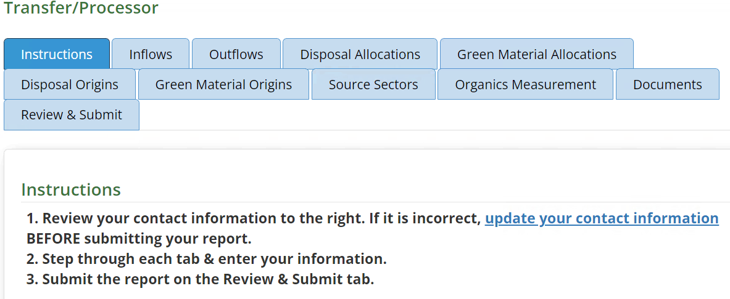
T/Ps RDRS Reporting for Organic Measurements
Notes:
Now I will go over in more detail, the organic measurement requirements for Transfer and Processors.
Once you log in to RDRS per usual for the 2022 Q1 reporting window (May 1 to May 31), you will see an additional tab for “Organic Measurements”
This is where you will enter data pursuant SB 1383 regulations.

Slide 14
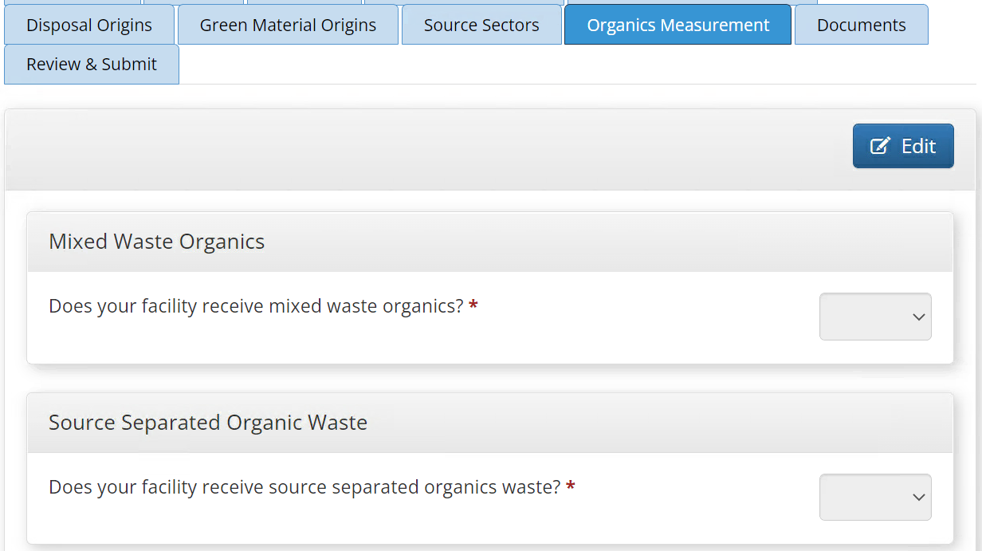
T/Ps RDRS Reporting for Organic Measurements-Cont.
Notes:
Once you click on the Organics Measurement Tab, you will see the following screen
To select the appropriate response or enter values into the fields, you must first click the Edit button, shown here on the top right, below the tabs
Once you click the EDIT button, then you can start making selections for the questions
Depending on if your facility receives “Mixed Waste Organic streams” or “Source Separated Organic Waste Collection streams”, you will make the appropriate selection and move on to provide the required data.

Slide 15
T/Ps Receiving “Mixed Waste” Organic Collection Stream(s)
For Determining the Annual Average Organic Content Recovery Rate
Report to CalRecycle via RDRS Each Quarter
From the 10-day measurement period:
  Outgoing weight of organic waste recovered from mixed waste organic collection streams (sent for end use, recovery or further processing)
  Outgoing weight of organic waste from mixed waste organic collection stream sent for landfill disposal
Sum of daily records for the quarter:
  Total outgoing weight of material recovered from mixed waste organic collection streams (sent for end use, recovery and further processing) (tons)
  Total outgoing weight of material sent to landfill disposal from mixed waste organic collection streams (tons)
  Total incoming weight of mixed waste organic collection streams (tons)
Section Referenced: 18815.5(d)(1)(A), (B), and (C)
Notes:
This slide shows in more detail, the data that is required
Transfer/processors receiving “Mixed Waste” organics streams, for the purpose of determining the annual average organic content recovery rate must report to CalRecycle via RDRS
From the 10-day measurement period:
Outgoing weight of organic waste recovered from mixed waste organic collection streams (sent for end use, recovery or further processing)
Outgoing weight of organic waste from mixed waste organic collection stream sent for landfill disposal
Sum of daily records for the quarter:
Total outgoing weight of material recovered from mixed waste organic collection streams (sent for end use, recovery and further processing) (tons)
Total outgoing weight of material sent to landfill disposal from mixed waste organic collection streams (tons)
Total incoming weight of mixed waste organic collection streams (tons)
A note regarding “landfill disposal” in this presentation. "landfill disposal" does not refer to "landfills" in RDRS, but rather to the definition of landfill disposal in SB 1383 regulations 18983.1.
A link to CalRecycle supporting documents explaining in detail how to obtain this data is available in the “Relevant Links” slide later in the presentation.

Slide 16
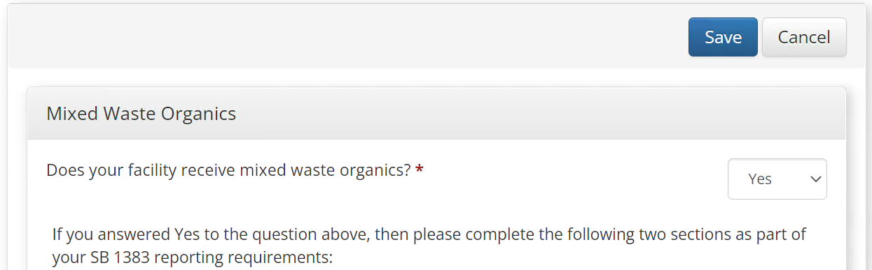
T/Ps RDRS Reporting for Organic Measurements Mixed Waste Organic Collection Streams
Notes:
Going back to the RDRS “Organic Measurements” Tab, If your facility receives “Mixed Waste Organic Collection Streams”, you will choose YES to the first question. Subsequently, additional fields will appear where you must enter the data covered in the previous slide.

Slide 17
T/Ps Receiving “Source Separated” Organic Waste Collection Stream(s)
For Determining the Annual Average Organic Content Recovery Rate
Report to CalRecycle via RDRS Each Quarter
From the 10-day measurement period:
  Outgoing weight of organic waste recovered from source separated organic waste collection streams (sent for end use, recovery or further processing)
  Outgoing weight of organic waste from source separated organic waste collection streams sent for landfill disposal
Sum of daily records for the quarter:
  Total outgoing weight of material recovered from source separated organic waste collection streams (sent for end use, recovery and further processing) (tons)
  Total outgoing weight of material sent to landfill disposal from source separated organic waste collection streams (tons)
  Total incoming weight of source separated organic waste collection streams (tons)
Section Referenced: 18815.5(d)(2)(A), (B), and (C)
Notes:
Now I will cover the data requirements for Transfer/processors receiving “Source Separated” organic streams, for the purpose of determining the annual average organic content recovery rate that must be reported to CalRecycle via RDRS. This data includes:
From the 10-day measurement period:
Outgoing weight of organic waste recovered from source separated organic waste collection streams (sent for end use, recovery or further processing)
Outgoing weight of organic waste from source separated organic waste collection streams sent for landfill disposal
Sum of daily records for the quarter:
Total outgoing weight of material recovered from source separated organic waste collection streams (sent for end use, recovery and further processing) (tons)
Total outgoing weight of material sent to landfill disposal from source separated organic waste collection streams (tons)
Total incoming weight of source separated organic waste collection streams (tons)
A link to CalRecycle supporting documents explain in detail how to obtain this data is available in the “Relevant Links” slide later in the presentation.

Slide 18
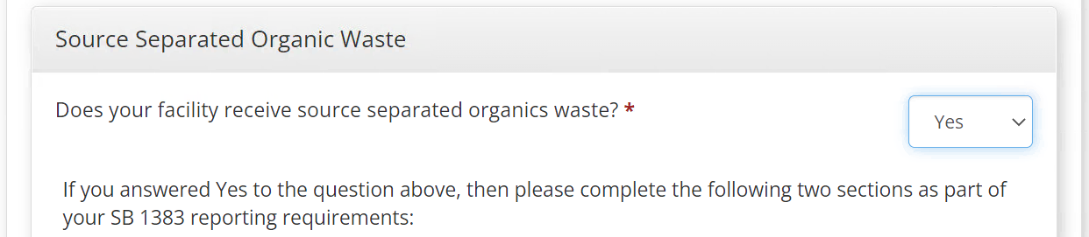
T/Ps RDRS Reporting for Organic Measurements Source Separated Organic Waste Collection Streams
Notes:
Going back to the RDRS “Organic Measurements” Tab, similar to answering YES to the first question, if you answer YES to the second question, “Does your facility receive source separated organic waste collection streams?” , new fields will appear, where you will enter the specified data as covered in the previous slide
I would like to point out that is if a T/P Receives Both Source Separated Organic waste collection streams and Mixed Waste organic collection Streams:
Then the operation must perform a 10-day evaluation on each stream per quarter, and enter the data specific to each stream

Slide 19
Additional Requirement for T/Ps
Commencing July 1, 2022, a reporting receiving facility shall report the following to the department on a quarterly basis:
The ratio of remnant organic waste to total weight of the random composite sample collected and measured in the Gray Container Waste Evaluation samples performed by the facility pursuant to Section 17409.5.7.
The Gray Container Waste Evaluation is Required if:
An operation or facility receives a gray container collection stream, AND
More than 500 tons of solid waste from at least one jurisdiction annually,
If qualified, the entity shall conduct waste evaluations on the gray container collection stream, once per quarter
Section Referenced 18815.5(g)
Notes:
Additionally, starting July 1, 2022, T/Ps may also need to report, on a quarterly basis The ratio of remnant organic waste, to total weight of the random composite sample collected and measured in the Gray Container Waste Evaluation samples performed by the facility pursuant to Section 17409.5.7.
The Gray Container Waste Evaluation is required if:
An operation or facility receives a gray container collection stream, AND
More than 500 tons of solid waste from at least one jurisdiction annually,
If qualified, the entity shall conduct waste evaluations on the gray container collection stream, once per quarter

Slide 20
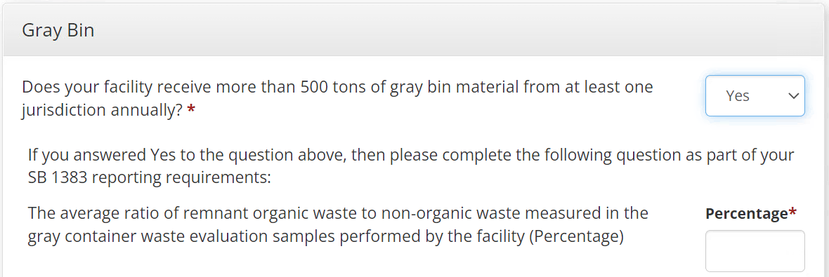
T/Ps RDRS Reporting for Organic Measurements gray Container Evaluations
Notes:
Going back to the RDRS “Organic Measurements” Tab
The 3rd question on the Organic Measurements Tab is regarding the gray Container evaluations as detailed in the SB 1383 regulations and highlighted in the previous slide.
If your facility receives at least 500 tons of gray container material from at least one jurisdiction annually, you will select YES.
Upon selecting YES, an additional field will appear asking for the “ratio (in percentage) of remnant organic waste to the total weight of the random composite sample collected and measured in the gray container evaluation samples performed by the facility

Slide 21
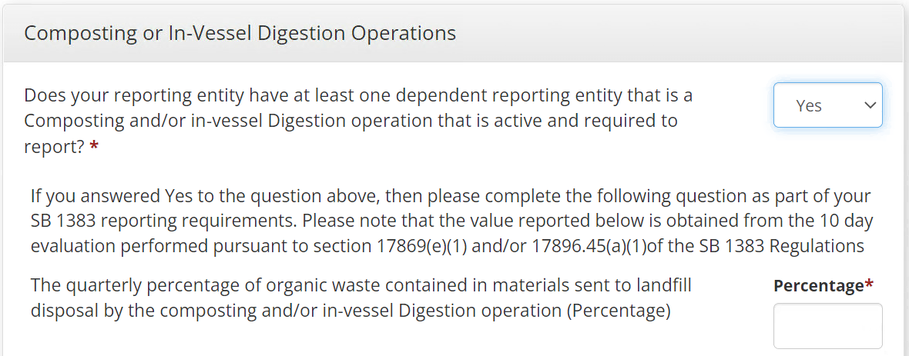
T/Ps RDRS Reporting for Organic Measurements Dependent Composting or In-Vessel Digestion Activity
Notes:
Additionally, If your facility has at least one dependent composting and/or in-vessel digestion activity, you must select YES to the 4th question on the Organic Measurement tab.
If you answer YES, you must complete the question below per SB 1383 reporting requirements. Please note that the value reported is obtained from the 10 day evaluation outlined in the referenced section.
Specifically, the question asks you to report the quarterly percentage of organic waste contained in materials sent to landfill disposal by the composting and/or in-vessel digestion operation.

Slide 22
Recycling and Composting Facilities and Operations
A recycling and compost facility and operation shall, if applicable, additionally report the following to the department on a quarterly basis:
  The percentage of organic waste contained in materials sent to landfill disposal as calculated pursuant to Section 17869(e)(1) or 17896.45(a)(1)
Section Referenced: 18815.7(f)(1)(A)
Notes:
Now we will move on to Recycling and Composting Facilities and Operations.
These facilities shall, if applicable, additionally report the following to the department on a quarterly basis:
The percentage of organic waste contained in materials sent to landfill disposal as calculated pursuant Section 17869e(1) or 17896.45(a)(1)
Once again, appropriate supporting document for this requirement can be found on the “Relevant Links” slide of this presentation.

Slide 23
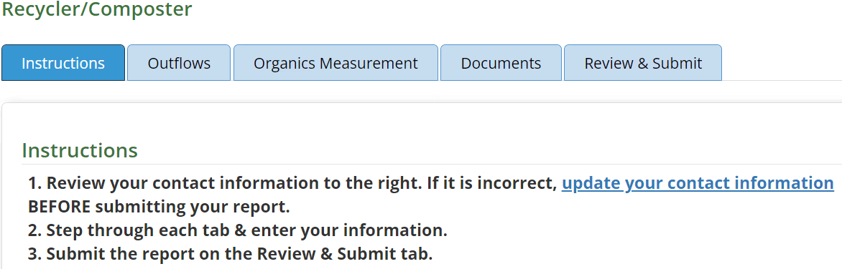
Recycling and Composting Facilities and Operations RDRS Reporting for Organic Measurements
Notes:
Now I will go over in more detail, the organic measurement requirements for Recycling and Composting Facilities and Operations.
Once you log in to RDRS per usual for the 2022 Q1 reporting window (May 1 to May 31), you will see an additional tab, “Organic Measurements”
This is where you will enter data pursuant SB 1383 regulations.

Slide 24
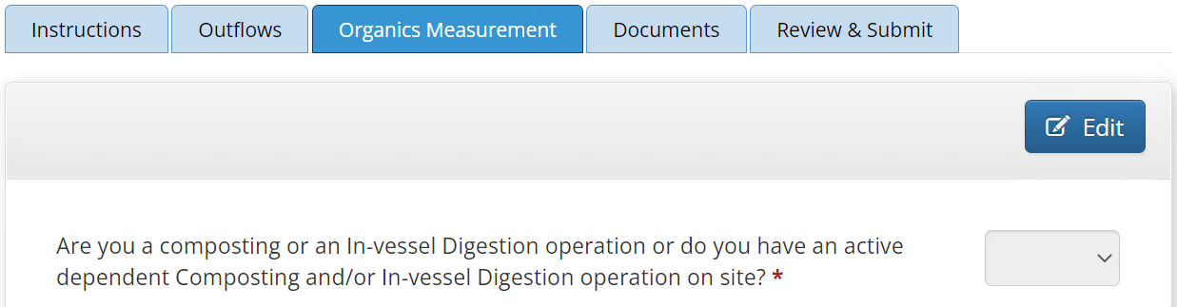
Recycling and Composting Facilities and Operations RDRS Reporting for Organic Measurements-Cont. 1
Notes:
Once you click on the Organic Measurements Tab, you will see the following window.
Before you can start answering the questions on this page, you must first click the EDIT button

Slide 25
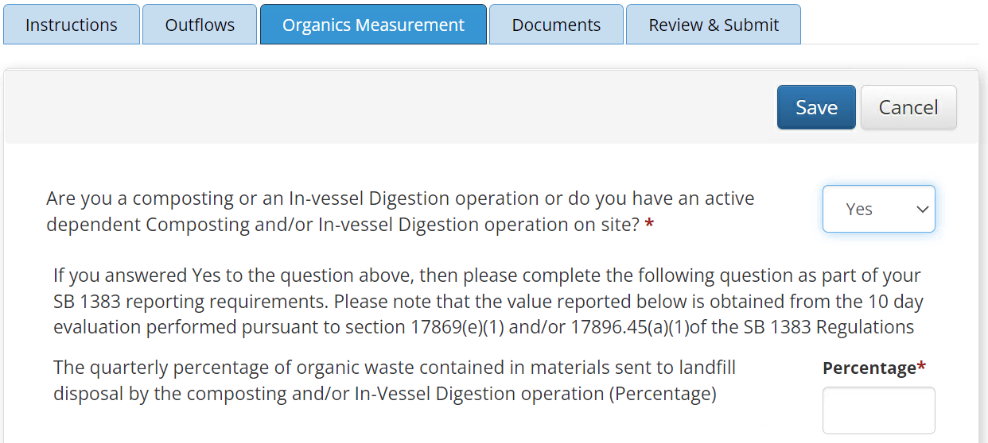
Recycling and Composting Facilities and Operations RDRS Reporting for Organic Measurements-Cont. 2
Notes:
Once you click the EDIT button, you can answer the first question “ Are you a composting or an in-vessel digestion operation or do you have an active dependent composting and/or in-vessel digestion operation on site?”
If you answer YES, the you must complete the questions below as part of your SB 1383 reporting requirements. The values reported below are obtained from the 10 day measurement outlined in the referenced sections.

Slide 26
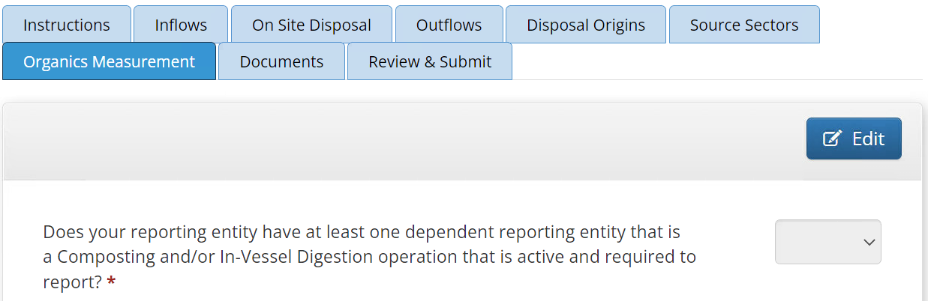
Disposal Facilities and Operations
RDRS Reporting for Organic Measurements
Notes:
If you are registered as a disposal facility., you will also see an “Organics Measurement” tab starting Q1 2022.
Once you click on the tab, you will need to answer the following question by clicking on the EDIT button
Does your reporting entity have at least one dependent entity that is a Composting and/or In-vessel digestion operation that is active and required to report.

Slide 27
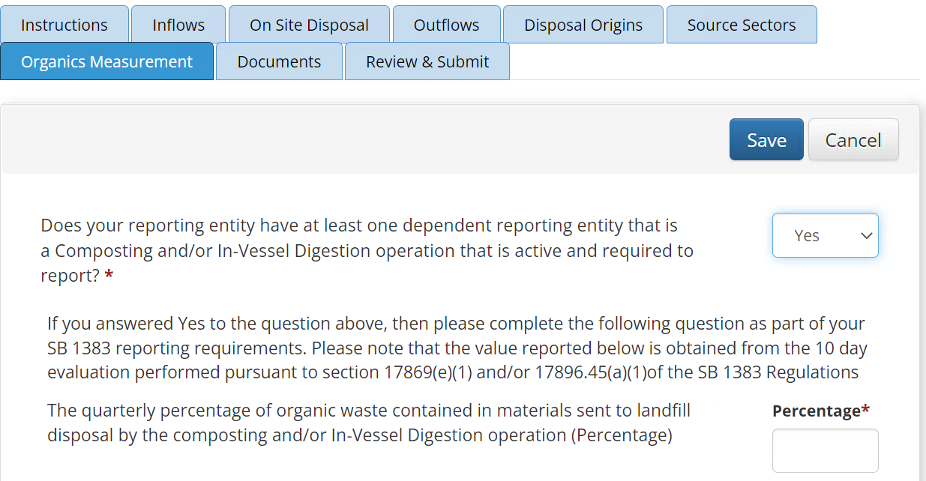
Disposal Facilities and Operations
RDRS Reporting for Organic Measurements-cont.1
Notes:
If you answer YES to the questions above, then you must complete the following question as part of your SB 1383 reporting requirements.
Please note that the value reported below is obtained from the 10 day evaluation outlined in the referenced sections.

Slide 28
Transformation Facilities Reporting Under SB1383
In RDRS, Transformation Facilities report both as a Disposal Facility and a Transfer/Processor due to the nature of their operations
As such, they are required to perform the same measurements and
report the same data in RDRS as a Transfer/Processor, using their
Transfer/Processor RDRS activity
Please review the Transfer/Processor Facilities requirements for the appropriate details
Notes:
Before we move on, I would like to provide some additional details regarding Transformation Facilities
In RDRS, Transformation Facilities report both as a Disposal Facility and a Transfer/Processor due to the nature of their operations
As such, they are required to perform the same measurements and report the same data in RDRS as a Transfer/Processor, using their Transfer/Processor RDRS activity
Please review the Transfer/Processor Facilities requirements for the appropriate details

Slide 29
Additional Details for
Organic Measurement Reporting in RDRS
Flags
RDRS generates “Flags” to ensure that the input data is “coherent” or when explanations are required
The flag types are:
  Correction flag: When the data must be corrected before the system will allow the user to submit the report
  Verification flag: When the data must be verified correct, or an explanation provided in the notes section
  before the system will allow the user to submit the report
Data Entry Details
  For Yes/No type questions, the user must choose either YES or NO. The question cannot be left unanswered
  For fields where values are required (such as tons or percentages), if the user enters zero, then the user must
  also enter an explanation explaining the zero. The explanation cannot be blank.
Notes:
I want to go over a few addition details regarding organic measurement reporting in RDRS
First a note about flags. RDRS generates “Flags” to ensure that the input data is “coherent” or when explanations are required.
Currently the two flag types associated with organic measurement reporting are:
Correction flags: Where the data must be corrected before the system will allow the user to submit the report
Verification flag: Where the data must be verified correct, or an explanation provided in the notes section
before the system will allow the user to submit the report
Flags will be discussed in greater details as part of an instructional video at a later time
Secondly, I would like to go over a few additional points on data entry
For Yes/No type questions, the user must choose either YES or NO. The question cannot be left unanswered
For fields where values are required (such as tons or percentages), if the user enters zero, then the user must
also enter an explanation explaining the zero. The explanation cannot be blank.

Slide 30
Relevant Links for SB1383 RDRS Reporting
Information and Detailed Sampling Guidance For Transfer/Processing Facilities:
Transfer/Processing Facilities Operations(T/P) and Landfills SLCP Webpage
Measuring Organic Waste in a Source Separated Organic Stream at T/P Facilities and Operations
Measuring Organic Waste in Mixed Waste Organic Stream at T/P Facilities and Operations
Information and Detailed Sampling Guidance for Recycling And Composting Facilities:
Organics Waste Recovery and Recycling Activities SLCP Webpage
  Measuring Organic Waste Sent to Disposal from Compostable Material Handling Facilities & Operations and In-Vessel Digestion Facilities & Operations
SB1383 and RDRS Reporting Requirements:
PowerPoint Presentation With Talking Points
Webinar Recording
Notes:
As mentioned through out the webinar, this page provides web links for:
Information and Detailed Sampling Guidance For Transfer/Processing Facilities AND
Information and Detailed Sampling Guidance for Recycling And Composting Facilities, and
SB 1383 and RDRS reporting Requirements PowerPoint Presentation and Webinar from October 26, 2021
Please use these CalRecycle resources to ensure you understand how to obtain the data required for input into RDRS

Slide 31
Questions?
Please send any additional questions to:
RDRS@CalRecycle.ca.gov
This PowerPoint presentation and webinar will be uploaded to the CalRecycle RDRS Training Website
Notes:
This concludes the presentation part of the webinar.
Please note that This PowerPoint Presentation and Webinar will be uploaded to the CalRecycle RDRS Website
I thank you for you attention. The webinar is now open to questions.

Slide 32
Reminder:
Instructions for Q&A Session
If using GoToWebinar, type your question or a summary of your question into the “Question” pane.
We will not use the “raise hand” function.
If watching via the CalEPA Broadcast, email your questions to: SLCP.Organics@calrecycle.ca.gov
Questions should focus on SB 1383 and RDRS Reporting only.
CalRecycle staff will go through the questions as they come in.
If we are unable to answer your question during the webinar, please email the SLCP inbox and we will get back to you soon.
Notes:
Once again, Please use the instructions shown on the slide for the Q&A session.

