Slide 1
Disclaimer
This webinar was developed by CalRecycle as a courtesy for informational and example purposes only. Use of this information is optional and is not a regulatory requirement. In the event of any conflict with this information herein, applicable statutory and regulatory provisions shall control. This information herein are based on known facts and legal authority as understood by CalRecycle at the time of release. Any analysis, guidance, or other information herein may be subject to change based on changed facts or legal authority, actual or understood, subsequent to the time of this communication. The provision of any analysis, guidance, or other information herein shall not be construed as a waiver of any rights or remedies available to CalRecycle. Recipients of this communication are encouraged to seek the assistance of legal counsel to comply with applicable state law based on their pertinent facts and circumstances. CalRecycle makes no representation that use of this information will ensure compliance with regulatory requirements. The user assumes all risk and CalRecycle accepts no responsibility or liability to any person because of the use of, or reliance upon, the information herein.

Slide 2
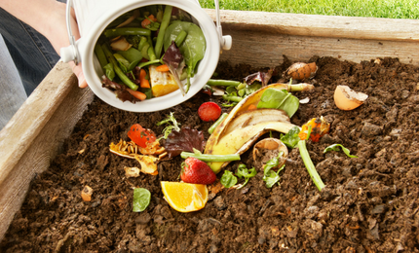
CalRecycle
September 27, 2022
Electronic Annual Report (EAR) and SB 1383 (Open Q&A)

Slide 3
Instructions for Q&A Session
If using GoToWebinar, type your question or a summary of your question into the “Question” pane.
Questions should focus on the presentation and discussion in the webinar
CalRecycle staff will go through the questions on a first come first served basis.
When prompted to ask a question over the webinar, you must unmute yourself on your end; please state your affiliation.
If we are unable to answer your question during the webinar, CalRecycle staff will follow up with you.
We will not use the “raise hand” function.
If watching via the CalEPA Broadcast, email your questions to: SLCP.Organics@calrecycle.ca.gov.

Slide 4
Collection Container System Grid Scenario
For Collection grid:
There are 1,000 total commercial generators
  100 generators have gray only (no green or blue service)
  400 generators have gray + blue (no green due to not having subscribed yet)
  200 generators have gray + blue (no green due to waiver)
  300 generators have gray + blue + green
Report 500 generators having 3-container collection system
In Additional Description box that the 100 generators + 400 (not subscribed to full service)

Slide 5




Stay
Engaged
Subscribe to the SLCP Listserv:
https://www2.calrecycle.ca.gov/Listservs/
Subscribe/152
SB 1383 homepage
https://calrecycle.ca.gov/organics/slcp/
Questions
SLCP.Organics@calrecycle.ca.gov
Notes:
For more information, we encourage you to subscribe to the SLCP listserv, visit the SLCP home page on the CalRecycle website, contact your Local Assistance and Market Development liaison, or e-mail the SLCP inbox listed here.

