Slide 1
Disclaimer
This guidance tool was developed by CalRecycle as a courtesy for informational and example purposes only. Use of this tool is optional and is not a regulatory requirement. In the event of any conflict with this guidance tool or information herein, applicable statutory and regulatory provisions shall control. This tool and information herein are based on known facts and legal authority as understood by CalRecycle at the time of release. Any analysis, guidance, or other information herein may be subject to change based on changed facts or legal authority, actual or understood, subsequent to the time of this communication. The provision of this guidance tool and any analysis, guidance, or other information herein shall not be construed as a waiver of any rights or remedies available to CalRecycle. Recipients of this communication are encouraged to seek the assistance of legal counsel to comply with applicable state law based on their pertinent facts and circumstances. CalRecycle makes no representation that use of this tool will ensure compliance with regulatory requirements. The user assumes all risk and CalRecycle accepts no responsibility or liability to any person because of the use of, or reliance upon, this tool or the information herein.

Slide 2

Non-Local Entities Waivers
January 17, 2023, 10:00 – 12:00
Notes:
For the purposes of SB 1383 state agencies are included in the definition for non-local entity. Since most participants of this webinar are from state agencies, we will use the term agency instead of non-local entity.

Slide 3
Overview
What can and cannot be waived
Types of waivers
Why to submit
What to submit
Where to submit
Notes:
Here’s an overview of what we will be covering today:

Slide 4
What can be waived?
Subscribing to an organic waste collection service, or self-haul organic waste to a recovery facility
Providing containers for the collection of organic waste and non-organic recyclables in all areas where disposal containers are located
Prohibit employees from placing organic waste in a container not designated for organic waste
Periodic inspections of containers for contamination and inform employees if containers are contaminated
Provide information to employees on methods for prevention of organic waste generation
Notes:
Read bullets off slide.

Slide 5
What cannot be waived?
Edible food recovery if a commercial edible food generator
Recycling of bottles, cans, glass, paper cardboard (blue bin materials)
Notes:
Read bullets off slide.

Slide 6
Types of waivers
De-minimis
Non-local entity is located within a jurisdiction or census tract that has been granted a waiver by the Department
Physical space
Notes:
The types of waivers that state agencies can submit an application for include de-minimis, if a state agency is located within a jurisdiction or census tract that has been granted a waiver by CalRecycle, and physical space. These reasons will be broken down in greater detail later in the presentation.

Slide 7
Why to Submit
Due to remote work the number of employees permanently in the office is not equal to the number of employees employed by an agency
Waivers provide your agency with the proper documentation and reasoning for why organics diversion does not need to occur at a location(s).
Notes:
Reasons why your agency may want to submit a waiver from some or all of the organic waste collection services requirements of Article 5 for some or all of your agency’s locations or facilities are in large part due to agency’s adopting a hybrid or mostly remote working environment the number of employees reported as employed by an agency may not be an accurate reflection of the number of employees working at a location or facility. Which therefore in turn correlates to the amount of solid waste that is produced at a location or facility.
A waiver is the documentation that your agency will need to support that organics diversion does not need to occur at an individual location. A waiver will be needed for each location or facility. An agency cannot submit one waiver that will cover all of its facilities or agency as a whole. More detail on this process to come as part of this presentation.

Slide 8
Instructions for Q&A Session
Please type your question or a summary of your question into the “Chat” pane.
CalRecycle staff will go through the questions on a first come first served basis.
We will aim to get to as many different people as possible.
To ask a question over the webinar, you must unmute yourself on your end; please state your name and affiliation.
We will not use the “raise hand” function.
If you cannot unmute, or we do not get to your question, please submit it to: SARC@calrecycle.ca.gov
Notes:
I just want to give a quick reminder of how the question and answer session will go
To ask a question via the Zoom platform, type your question into the “chat” pane.
Once called upon, please unmute yourself and state your name and affiliation when asked by CalRecycle staff.
If you cannot unmute, or we are not able to get to your question, please also submit it to: SARC@calrecycle.ca.gov

Slide 9
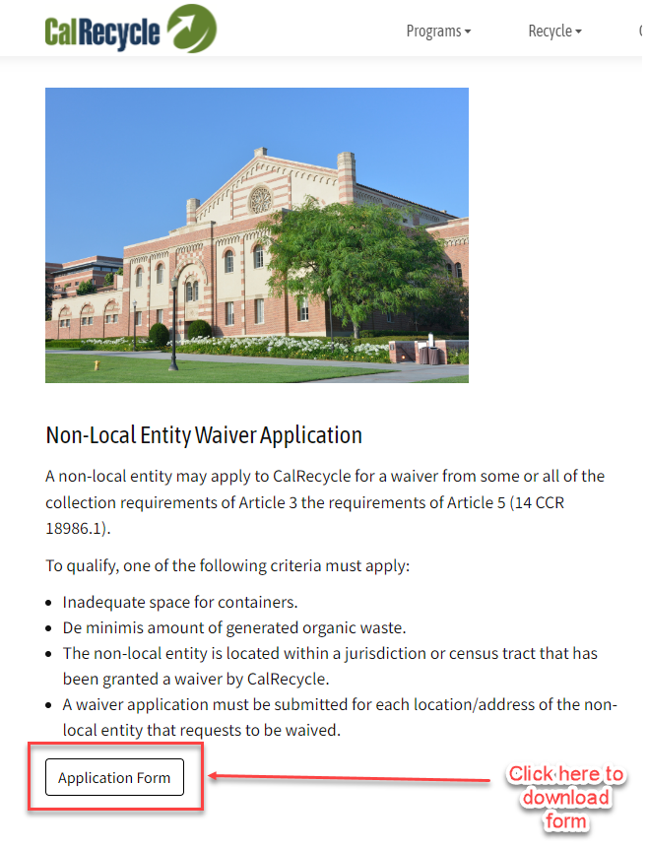
Waiver Application Location
Navigate to: Department-Issued Waivers - CalRecycle Home Page
Download Non-Local Entity Waiver Application
Notes:
Here is where you can find a link to download the application form. Calrecycle.ca.gov/organics/slcp/waivers
DEMO: Go to website and show where the form can be found.

Slide 10
Waste definitions
“Solid waste” includes all types of solid means garbage, sludges, and other discarded solid materials resulting from residential activities, and industrial and commercial operations.
“Organic waste” means solid wastes containing material originated from living organisms and their metabolic waste products including, but not limited to, food, green material, landscape and pruning waste, organic textiles and carpets, lumber, wood, paper products, printing and writing paper, manure, biosolids, digestate, and sludges.
Notes:
Solid waste is trash, recycling, and organic waste collectively. The organic waste materials that most state agencies will manage are food scraps, food soiled paper, grass, landscaping and pruning waste, paper, and cardboard.

Slide 11
Reasons to Submit a Waiver for Non-Local Entities
(Section 18986.3)
De Minimis:
  Solid waste is 2 cy or more per week and organic waste is less than 20 gallons per week per container (blue/green)
  Solid waste is less than 2 cy per week and organic waste is less than 10 gallons per week per container (blue/green)
Non-local entity is located within a jurisdiction or census tract that has been granted a waiver by the Department pursuant to 14 CCR Section 18984.12.
Physical space: Inadequate space for organic containers
Notes:
CalRecycle can issue a waiver if a non-local entity provides documentation that any of the following apply:
The first waiver for collection service can be issued if a non-local entity generates a de minimis amount of material in the blue and/or green container. De minimis amounts of waste are either of the following:
Solid waste is 2 cy or more and organic waste is less than 20 gallons per week
Solid waste is less than 2 cy and organic waste is less than 10 gallons per week
For example: In a three container collection service, if there is no organic waste stream present (material that would go in the green container) , then a green container collection service is not necessary. However, a blue recycling container collection service would still need to be provided for the collection of other organic waste, such as paper products and cardboard.
If there is a de minimis waiver for collection, then the associated internal container would not be necessary.
In the example above if you have no material for the green container, such as an office building that does not generate food or greenwaste, then the office building would not need to have internal containers for food.
If a jurisdiction that a non-local entity is located in is granted a waiver pursuant to Section 18984.12, then the non-local entity will not have to comply with the requirements in Article 5. The non-local entity will need to submit a request to CalRecycle.
This was done because if the jurisdictions in these areas do not have to comply with Article 3 then there will not be collection services available for non-local entities to utilize.
CalRecycle will be publishing on its website the jurisdictions and census tracts (for unincorporated areas) that meet the thresholds for a waiver. This will be published after the 2020 Census data is available. Non-local entities will be able to review this information to determine if they are in a jurisdiction or census tract that is waived.
A physical space waiver may be granted for a non-local entity if it provides documentation that a hauler, licensed architect, licensed engineer, or a similarly qualified entity has determined there is inadequate space for separate organic waste containers.
This waiver is only applicable in limited scenarios and should decrease in use over the years.
There are few instances in which an existing waste collection space could not accommodate an additional organic waste recycling container if the existing containers were downsized.
References:
Low Population:
(1) A jurisdiction may apply to the Department for a waiver for the jurisdiction and some or all its generators from some or all of the requirements of this article if the following apply:
(A) The jurisdiction disposed of less than 5,000 tons of solid waste in 2014 as reported in the Disposal Reporting System.
(B) The jurisdiction has a total population of less than 7,500 people.
(2) A jurisdiction may apply to the Department for a waiver from some or all of the requirements of this article for census tracts that have a population density of less than 75 people per square mile that are served by the jurisdiction and are located in unincorporated portions of a county.
Rural exemption:
The Department shall grant an exemption from complying with the organic waste collection requirements specified in this article for rural jurisdictions that meet the definition of a “Rural Jurisdiction” in Section 42649.8 of the Public Resources Code (MORe), if the governing body of the jurisdiction adopts a resolution that includes a finding as to the purpose of and need for the exemption.
Elevation

Slide 12
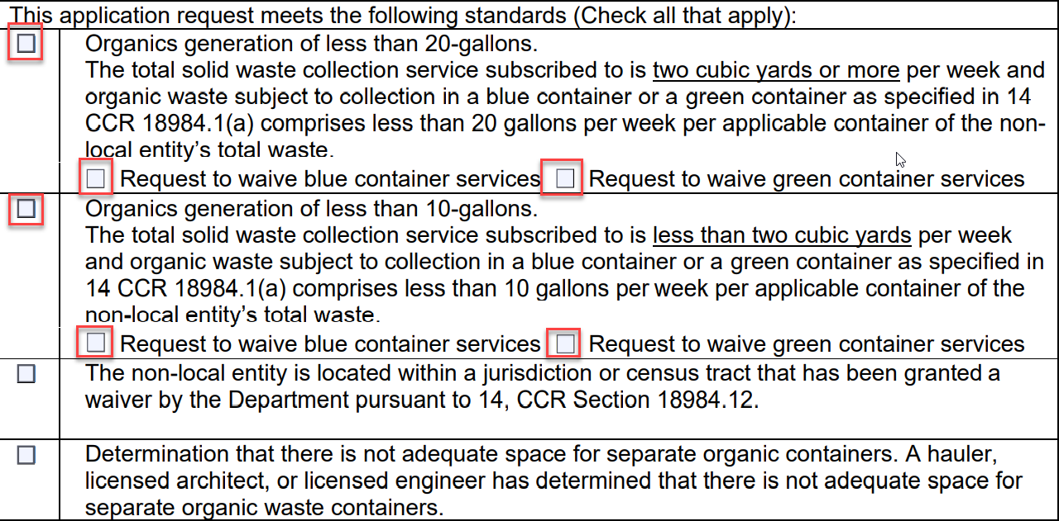
De-minimis Generation
Notes:
The first two options on the waiver application for which a waiver can be requested are for what we refer to as de-minimis generation, which means not very much. We will now walk you through the details of these two options. First, we would like to point out that these two options are based on the total solid waste collection service that is subscribed to for your agency. As previously mentioned, solid waste includes all materials (trash, recycling, and organics) generated regardless of the container that they go in.
The first option of organics generation of less than 20-gallons.
This option would be selected if your agency’s total solid waste collection service subscribed to is two cubic yards or more per week and organic waste subject to collection in a blue or green container is less than 20 gallons per week per container.
The second option of organics generation of less than 10-gallons.
This option would be selected if your agency’s total solid waste collection service subscribed to is less than two cubic yards per week and organic waste subject to collection in a blue or green container is less than 10 gallons per week per container.
A visual to help explain these volumes:
Two cubic yards is equal to a dumpster or bin that is approximately 4 feet by 4 feet by 6 feet
20 gallons is equal to four (4) orange five (5) gallon Home Deport buckets
10 gallons is equal to two (2) orange five (5) gallon Home Deport buckets
On this slide you can see six (6) red boxes. What was just discussed was to determine which box to select on the left side of the screen. Either organics generation of less than 20-gallons or organics generation of less than 10-gallons. Do not select both options. It is one or the other. We will now go into greater detail for the other four (4) red boxes representing the request to waiver blue container services or request to waiver green container services.

Slide 13
Common Organic Waste Materials and Containers
“Green container” organic waste may include:
  Food scraps, food soiled paper, grass, tree trimmings, bush clippings
“Blue container” organic waste may include:
  Writing paper, copy paper, and cardboard
Notes:
You can see in both options there is also the second requirement to request a waiver from the blue and/or green container services. The materials that can be placed in a green or blue container differ by jurisdiction. Be sure to check with your property manager, hauler, or jurisdiction for which materials go in which containers.
Common examples of organic materials that can be placed in a green container are food scraps, food soiled paper, grass, tree trimmings, and bush clippings.
Common examples of organic materials that can be placed in a blue container are writing paper, copy paper, and cardboard.
It is likely that the organic materials for which your agency is requesting a waiver from the collection of will be for food scraps and food soiled paper which for most collection services would be placed in the green container. If your agency is responsible for managing landscaping materials, these organic materials would also most likely be placed in the green container. A request to waive green container services in this case would only be approved if your agency can document that the grass and landscaping and pruning waste is diverted from disposal by self-hauling or by the landscaping company that manages the property.
A request to waive blue container services will be very rare since other materials (aluminum cans, plastic water bottles, and glass) are also typically mixed with the organic materials (paper and cardboard) for recycling. Not having a blue container collection service may also impact your agency’s ability to successfully maintain diversion requirements established by AB 75 and Mandatory Commercial Recycling or MCR.

Slide 14
Instructions for Q&A Session
Please type your question or a summary of your question into the “Chat” pane.
CalRecycle staff will go through the questions on a first come first served basis.
We will aim to get to as many different people as possible.
To ask a question over the webinar, you must unmute yourself on your end; please state your name and affiliation.
We will not use the “raise hand” function.
If you cannot unmute, or we do not get to your question, please submit it to: SARC@calrecycle.ca.gov
Notes:
I just want to give a quick reminder of how the question and answer session will go
To ask a question via the Zoom platform, type your question into the “chat” pane.
Once called upon, please unmute yourself and state your name and affiliation when asked by CalRecycle staff.
If you cannot unmute, or we are not able to get to your question, please also submit it to: SARC@calrecycle.ca.gov

Slide 15
Located in Jurisdiction with Department Approved Waiver
Non-local entity is located within a jurisdiction or census tract that has been granted a waiver by the Department pursuant to 14 CCR Section 18984.12.
Navigate to: Department-Approved Waivers for Reporting Entities - CalRecycle Home Page
Contact the State Agency Team for assistance in determining eligible census tracts in a county
Notes:
Another reason an agency may request a waiver from organic collection service is because that non-local entity may be located within a jurisdiction or census tract that has been granted a waiver by CalRecycle. In this case it is likely that your agency’s ability to divert all organic materials will be limited because the collection service for a particular organic material may not be available.
You can navigate to our website to see a listing of jurisdictions that have approved waivers with CalRecycle at calrecycle.ca.gov/organics/slcp/waivers/approved. You can also reach out to SARC@calrecycle.ca.gov if you need assistance with determining if your agency or facility falls within an approved census tract that is waived from organic collection services.
DEMO: Show how to get to the page that lists the jurisdictions with waivers.

Slide 16
Physical Space
Physical space: Inadequate space for organic containers
Option if there is no external space for a green or blue container
Determination must be made by a hauler, licensed architect, or licensed engineer
Submit written documentation to support finding
Notes:
The final reason for which you can apply for a waiver is if there is physically not space for the placement of a separate organic container. This determination must be done by a hauler, licensed architect, or licensed engineer. Provide supporting documentation from one of sources mentioned as part of your waiver application if this option is selected.

Slide 17
Instructions for Q&A Session
Please type your question or a summary of your question into the “Chat” pane.
CalRecycle staff will go through the questions on a first come first served basis.
We will aim to get to as many different people as possible.
To ask a question over the webinar, you must unmute yourself on your end; please state your name and affiliation.
We will not use the “raise hand” function.
If you cannot unmute, or we do not get to your question, please submit it to: SARC@calrecycle.ca.gov
Notes:
I just want to give a quick reminder of how the question and answer session will go
To ask a question via the Zoom platform, type your question into the “chat” pane.
Once called upon, please unmute yourself and state your name and affiliation when asked by CalRecycle staff.
If you cannot unmute, or we are not able to get to your question, please also submit it to: SARC@calrecycle.ca.gov

Slide 18
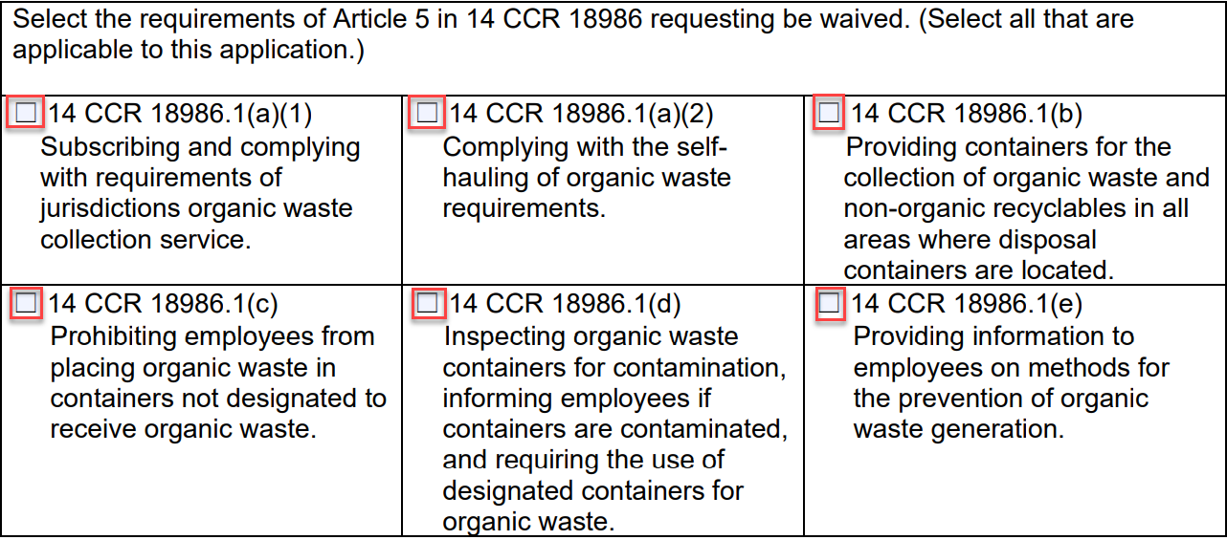
Waiver Requirements Selections
Notes:
On the second page of the waiver application, you will find the requirements of Article 5 in 14 CCR 18986 for which you are requesting a waiver. For most agencies, you would select all six (6) options for which you are requesting a waiver. If an option is not selected CalRecycle’s expectation is that that requirement will be implemented by the agency.
The requirement to subscribe and comply with requirements of jurisdictions organic waste collection service would be if your agency is requesting a waiver to subscribe to the jurisdiction’s or hauler’s collection service. You will also likely need an approved waiver as documentation for the jurisdiction and/or hauler for why you do not need to subscribe to mandatory service.
The requirement to self-haul organic waste would be selected if your agency is requesting a waiver from having to manage the diversion of organic material itself.
The requirement of providing containers for the collection of organic waste and non-organic recyclables in all areas where disposal containers are located (internally) should be selected so that containers do not need to provided for materials that are not required to be diverted from disposal.
The requirement of prohibiting employees from placing organic waste in containers not designated to receive organic waste should be selected to allow for the disposal of de-minimis amounts of organic material in the trash.
The requirement to inspect organic waste containers for contamination, informing employees if containers are contaminated, and requiring the use of designated containers for organic waste should be selected since the organic material for which a waiver is being requested does not need to be separated from disposal, therefore it is not considered contamination.
The requirement of providing information to employees on methods for the prevention or organic waste generation should be selected in reference specially to the material(s) for which the waiver is being requested.
As part of AB 2812 state agencies are still required to:
Have dedicated recycling staff to implement recycling programs
Have required signage (signs, posters, and labels for recycling bins)
Have required employee training or recycling programs and
Have required adequate number and condition or recycling receptacles
This would apply for the materials that are still diverted from disposal and being recycled.

Slide 19
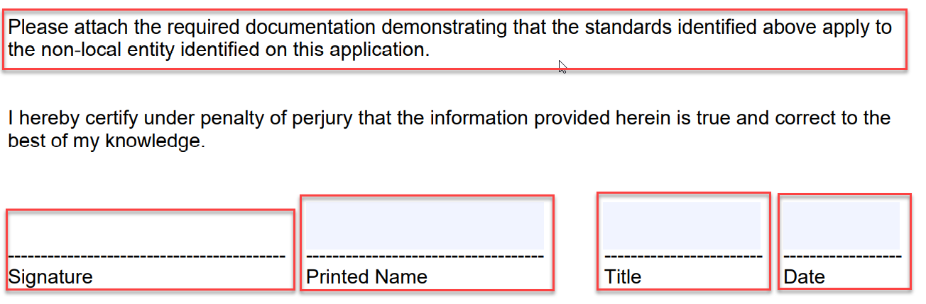
Additional Documentation and Signature
Notes:
Here we would just like to point out to attach required documentation that support the reasons selected for the waiver request. Be sure to sign, print name, provide your title, and date the document prior to submittal.

Slide 20
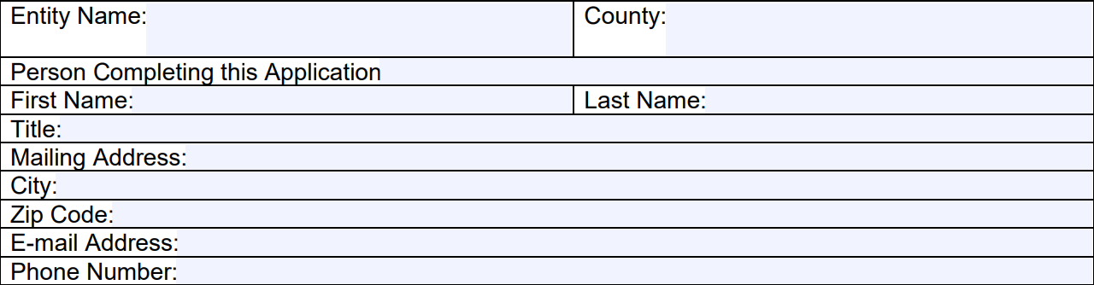
Waiver Application
Entity name and address for the location which a waiver is being requested
If for multiple facilities write: Multiple locations (see attached)
Provide contact information for person completing application and is the best contact for follow up if necessary
Notes:
We will now talk about the very beginning of the form. If submitting a waiver application for a single location or facility in “entity name” put the name and address of the location for which the waiver is being requested. For the person completing this application enter the contact information for the person we can contact if we have questions or need additional information about the wavier application.

Slide 21
Submitting for Multiple Locations (facilities)
If the selected reason for a waiver request is the same for multiple locations, follow these steps:
On waiver application, “Entity Name” box write “(Agency name) multiple locations (see attached)”
Compile a list (Word or Excel document) with each individual facility name, address, and county
Attach the list as part of your waiver application submittal
Notes:
If the same reason is being selected (de-minimis, jurisdiction approved waiver, or physical space) for multiple locations or facilities submit one waiver application and follow these steps as part of the submittal. On the waiver application “entity name” write “multiple locations (see attached). Then list the name, address, and county that the locations or facilities on a separate Word or Excel document. Include this document as an attachment to your waiver submittal.

Slide 22
Instructions for Q&A Session
Please type your question or a summary of your question into the “Chat” pane.
CalRecycle staff will go through the questions on a first come first served basis.
We will aim to get to as many different people as possible.
To ask a question over the webinar, you must unmute yourself on your end; please state your name and affiliation.
We will not use the “raise hand” function.
If you cannot unmute, or we do not get to your question, please submit it to: SARC@calrecycle.ca.gov
Notes:
I just want to give a quick reminder of how the question and answer session will go
To ask a question via the Zoom platform, type your question into the “chat” pane.
Once called upon, please unmute yourself and state your name and affiliation when asked by CalRecycle staff.
If you cannot unmute, or we are not able to get to your question, please also submit it to: SARC@calrecycle.ca.gov

Slide 23
Where to Submit
Compile complete application package
  Waiver application form
  List of locations (facilities) waiver request is for (if necessary)
  Supporting documentation (if necessary)
Submit to: SLCP.Organics@calrecycle.ca.gov
Notes:
Once you have compiled your waiver applications and any supporting documentation submit your complete package to SLCP.Organics@calrecycle.ca.gov. Approved waivers will be verified as part of compliance evaluations. Be sure to maintain records that support the selected reasoning on the waiver application.

Slide 24
Instructions for Q&A Session
Please type your question or a summary of your question into the “Chat” pane.
CalRecycle staff will go through the questions on a first come first served basis.
We will aim to get to as many different people as possible.
To ask a question over the webinar, you must unmute yourself on your end; please state your name and affiliation.
We will not use the “raise hand” function.
If you cannot unmute, or we do not get to your question, please submit it to: SARC@calrecycle.ca.gov
Notes:
I just want to give a quick reminder of how the question and answer session will go
To ask a question via the Zoom platform, type your question into the “chat” pane.
Once called upon, please unmute yourself and state your name and affiliation when asked by CalRecycle staff.
If you cannot unmute, or we are not able to get to your question, please also submit it to: SARC@calrecycle.ca.gov

Slide 25
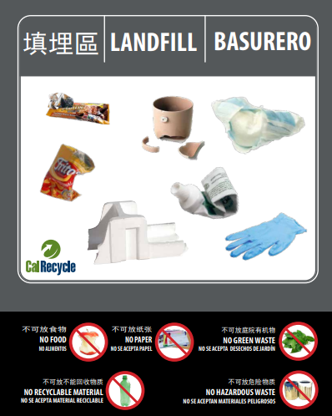
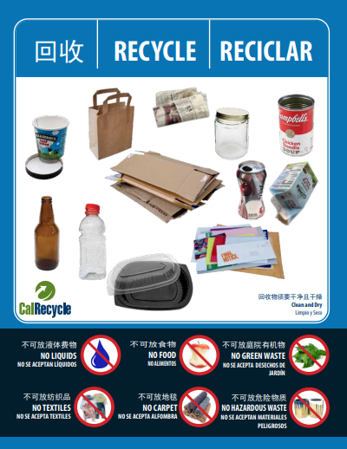
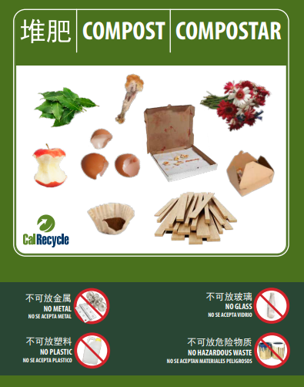
Resources
Non-Local Entities:
https://calrecycle.ca.gov/organics/slcp/nonlocalentities/
Outreach, Education and Signage: https://www.calrecycle.ca.gov/stateagency/assistance/organics
Sign up for CalRecycle’s Short-Lived Climate Pollutants (SLCP) listserv: https://www2.calrecycle.ca.gov/Listservs/
State Agency Team support: SARC@calrecycle.ca.gov
Notes:
For resources, visit our website that outlines the requirements for SB1383. The webpage for non-local entities is not yet published but is coming soon.
CalRecycle developed the SB 1383 compliant model labels, signage, brochures for non local entities to utilize. This information is available on our website.
The new signage is available for three-, two-, and single unsegregated collection services in English, Spanish, Mandarin, Punjabi, Russian, and Korean.
The materials are designed to include the most widely acceptable and prohibited items.
Each sign is fully customizable using Adobe Acrobat Pro. Users can add and/delete the material(s) they collect in their program.
To stay up to date, you can sign up for the SLCP listserv
If you need further assistance, we encourage you to work with your local jurisdiction or you can contact the State Agency Team at SARC@calrecycle.ca.gov

