Slide 1
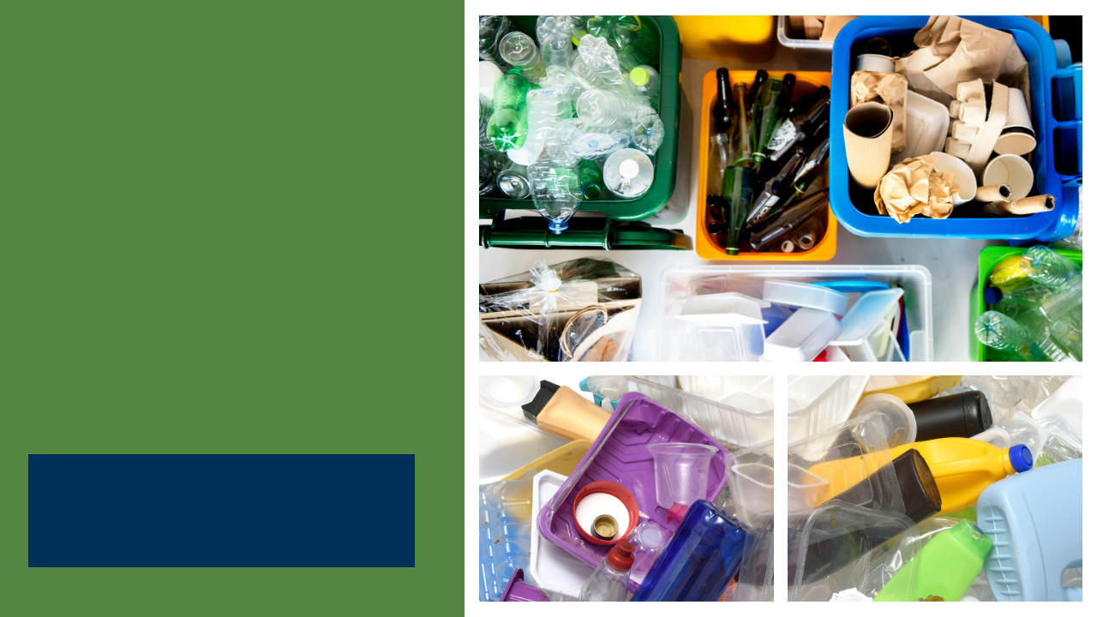
State Agency Buy Recycled Campaign (SABRC)
Training +
AB 661
Webinar
March 30, 2023

Slide 2
Instructions for Questions
Please type your question or a summary of your question into the “Q&A” pane.
Questions submitted to the “chat” pane will not be answered live.
CalRecycle staff will go through the questions on a first come first served basis.
We will aim to get to as many different people as possible.
To ask a question over the webinar, you must unmute yourself on your end; please state your name and affiliation.
We will not use the “raise hand” function.
If you cannot unmute, or we do not get to your question, please submit it to: SABRC@calrecycle.ca.gov
Notes:
A quick reminder of how the question and answer sessions will go.
Please type your question or a summary of your question into the “Q&A” pane. Make sure you have the most up to date version of Zoom if you do not see this option.
Once called upon, please unmute yourself and state your name and affiliation when asked by CalRecycle staff.
You may also submit EAR feedback, peer share requests, and panelist questions to SLCP.Organics@CalRecycle.ca.gov using the subject line: "SB1383 Chat with CalRecycle".
If you cannot unmute, or we are not able to get to your question, please also submit it to: SABRC@calrecycle.ca.gov

Slide 3
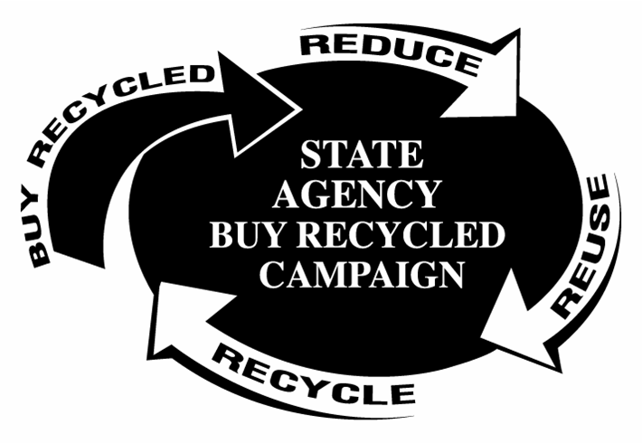
Topic Covered
What is SABRC and why is it important
Requirements for State Agencies
Finding SABRC-Compliant Products
Tracking Purchases
Reporting SABRC (Annual Report)
CalRecycle LAMD and JACE branches and their roles

Slide 4
SABRC Program Overview
Requires agencies to purchase recycled-content products in 16 categories. (Public Contract Code (PCC) Sections 12200-12217)
Requires 75% of all purchases in these categories meet a minimum percentage of post-consumer recycled-content (PCRC) except for paint, antifreeze, and tires (50%).
Notes:
The goal of the State Agency Buy Recycled Campaign or SABRC is to promote the purchase of products that contain post-consumer recycled content material (or PCRC). This is part of the California push for a circular economy.
There are currently 16 product categories that agencies must track purchases under and these purchases must meet a minimum PCRC percentage.
We will refer to various resource web pages including CalRecycle’s. Our web pages are updated regularly and are instructional for specific users.
There is the link to the SABRC website. And for your convenience we also have an online manual (http://www.calrecycle.ca.gov/buyrecycled/stateagency/Manual/default.html) which includes useful information such as a single page SABRC overview handout.

Slide 5
Who Administers SABRC?
CalRecycle
Oversees SABRC reporting and agency training
Collects and analyzes data
Provides individual agency assistance
Department of General Services
Environmentally Preferable Purchasing (EPP)
Manages Statewide Commodity Contracts
Oversees EPP Program and procurement training (CalPCA)
Notes:
SABRC is a joint program between DGS and CalRecycle. The Department of General Services (DGS) is our statutory partner in SABRC and we collaborate to assist state agencies and to help increase the procurement of PCRC products.
DGS integrates the SABRC statute requirements into state contracts by highlighting eligibility and composition of PCRC products sold to state agencies. DGS also administers their Environmentally Preferable Purchasing (EPP) program and provides EPP & SABRC education via the CalPCA classes. DGS provides non-compliance oversight through their Purchasing Authority Unit.
CalRecycle provides SABRC training, resources, technical assistance and analyzes annual report data. We also provide DGS the SABRC annual report results to post on to their Green Buyer website.

Slide 6
Post-Consumer Recycled Content (PCRC)
Post-Consumer (PC) = Material derived from products that were purchased, used, and then recycled by a consumer. This recovered material becomes feedstock for new products.
Notes:
It is important to understand the meaning of “Postconsumer” in order to fully understand and comply with SABRC requirements.

Slide 7
Benefits of purchasing PCRC products
Supports the state’s goals towards a circular economy
Diverts resources instead of sending to landfills
Improves markets for recycled commodities
Creates jobs
Reduces greenhouse gases (GHGs) and air pollution
Reduces energy consumption
Reduces mining of resources
Notes:
These are the many benefits to purchasing post-consumer recycled-content products and with state purchasing power – we have the ability to make a market difference. The SABRC program is part of a circular economy to purchase recycled-content goods and support recycled-content manufacturing.
FY 2020-2021 – the state spent $3.9 billion in total purchases, where $248 million (6%) were SABRC compliant purchases. In the last 10 years, the program has gone from 2011-2012 - 70% SABRC compliant spending to last FY 20-21 to 88% compliant spending.

Slide 8
What’s required of state agencies?
Purchase post-consumer recycled content products based on the minimum post-consumer content requirements in statute
Track purchases of all products that fall within the 16 specified SABRC product categories.
Report total dollars spent on products that meet the minimum PCRC requirements.
Procure at least 75% total dollars spent in all categories except paint, antifreeze and tires (50%)
Annual training for all procurement officers, and their designees
Public Contract Code (PCC)
Sections 12200-12217
Notes:
All purchases of SABRC Reportable products must be tracked and reported annually.
Even those products that contain no postconsumer material.
SABRC Reportable Purchase = Any purchase of a product that falls within one of the 16 SABRC categories.
All purchases of SABRC Reportable products must be tracked and reported annually.
Even those products that contain no postconsumer material.
SABRC Reportable Purchase = Any purchase of a product that falls within one of the 16 SABRC categories.

Slide 9
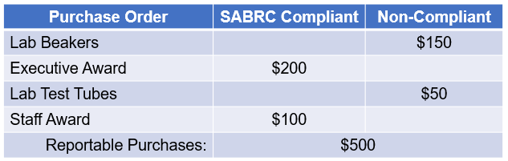
SABRC Definitions
SABRC Reportable Purchase: Any purchase of a product that falls within one of the 16 SABRC product categories
SABRC Compliant Purchase: Any purchase of a product that falls within one of the 16 SABRC categories and meets the minimum post-consumer recycled content for the product category
Glass Example:
Notes:
It is really important to know the difference between reportable purchases vs. compliant purchases. Many find this confusing.
SABRC Reportable Purchase = Any purchase of a product that falls within one of the 16 SABRC product categories.
SABRC Compliant Purchase = Any purchase of a product that falls within one of the 16 SABRC categories AND meets the minimum PCRC percentage for that product category.
Here’s a quick example for glass:
A state agency has 4 purchase orders that totaled $500 for items made of glass. Two purchase orders were for the laboratory which required beakers and test tubes equaling $200 dollars. Because of the nature of these products, they are not available with post-consumer recycled content. The other two purchase orders were for awards to the executive director & staff and were made with 15% post-consumer recycled glass which equaled $300. The minimum PCRC requirement for glass is 10%.
Therefore the agency had $500 in reportable purchases and $300 in SABRC compliant purchases.

Slide 10
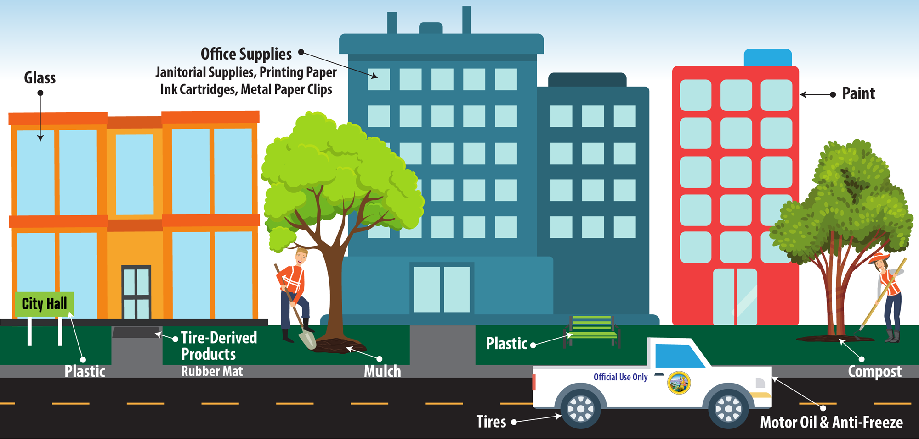
Where are products used?

Slide 11
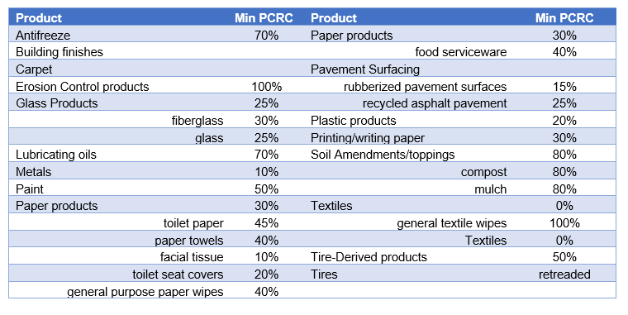
AB 661 – Categories/Subcategories and minimum PCRC
Section 12209
Notes:
Categories –
Antifreeze
Building finishes – open panel system
- Carpet is it’s own category and shall contain a minimum postconsumer recycled content that shall be determined by the department and published in the State Contracting Manual by July 1, 2018, and subsequently updated by the department. The department shall include carpet recycling requirements for state buildings in the State Contracting Manual
- Erosion Control Products which include compost filter socks, compost blankets and hydraulic mulch.
Glass
Lube oils
Metals
Paints
Paper products
Food serviceware SB 1335 – CalRecycle page https://calrecycle.ca.gov/packaging/statefoodservice/
List of Approved Food Service Packaging - https://calrecycle.ca.gov/packaging/statefoodservice/list/
Printing/writing paper
Pavement Surfacing including rubberized pavement surfaces and recycled asphalt pavement contain at least 15 percent recycled waste tires by weight and the recycled products shall be derived from no less than 100 percent California recycled materials diverted from the solid waste stream
Recycled asphalt shall contain a minimum of 25 percent reclaimed asphalt pavement by weight as permitted by specs and standards developed by Caltrans.
Rubberized pavement surfaces
- Plastic products
- Soil amendment/toppings which is where the previous category of mulch and compost moved to
- Textiles – where general textiles do not have a minimum PCRC content, but general textile wipes are minimum of 100%.
-Tire-derived products - recycled tire-derived products include crumb rubber (used in asphalt and other products), mulch and bark, sidewalks, tree wells, pour-in-place playgrounds, tiles and rolled floor, agriculture mats (cow mats), sports tracks, synthetic turf infill
- Tires – retread tires
PAUSE

Slide 12
AB 661 Updates – effective Jan 1st, 2023
Section 12201(c)
Fitness and quality are equal
Recycled products are no more than 10% greater total cost
and one of the following apply…
The agency uses leveraged procurement agreement (LPA) through which both recycled and nonrecycled products are available
The agency is awarding contract using Sec 14838.5 of Government Code and received offers for both recycled and nonrecycled products.
The agency awards a contract without soliciting multiple offers based that the price is fair and reasonable.
Notes:
The statute indicates that if fitness and quality were equal, that agencies should purchase products with recycled content. AB 661 has language that the recycled products should be purchased if the fitness and quality are equal and the cost is no more than 10% greater of total cost.

Slide 13
AB 661 Updates
Section 12202
The University of California is not subject to procurement requirements but shall:
  report on purchases in the product lists in Section 12207
  What percentage of those purchases met the associated minimum recycled content requirements in Section 12209.
Section 12203
The agencies shall require contracted businesses to use recycled products to the maximum extent economically feasible in performance of the contracted work
Notes:
The University of California is new to SABRC reporting – the statute includes them to report, but not to meet the procurement requirements.
Businesses contracted by state agencies are also required to used recycled products to the maximum extent economically feasible.

Slide 14
AB 661 Updates (continued)
Section 12211
Annual reporting to CalRecycle on purchases within the 16 categories
Section 12217
Required annual training for procurement and contracting officers from all agencies.
Training will be a joint effort between CalRecycle and DGS through CalPCA
Each agency shall establish purchasing practices of products with post-consumer recycled content, or require the vendor has a take back program for proper management after use.
Notes:
Working with DGS’s Procurement Division to include AB 661 information into a newly created EPP Intermediate training module.
The updates were sent to DGS 12/12, and we hope to have the changes made by the end of the year and the training live in January.
Once training is live, a listserv message will go out to all agency contacts, and LAMD staff will also be notified where to direct agency contacts to. The website will also be updated to have a link to the training.
We are still working through the process of getting the training from DGS annually, and when training must be completed – calendar year or report due date of October 31st.
PAUSE

Slide 15
Other Reportable Products
Reused or Refurbished products automatically qualify as SABRC compliant in all product categories (and there is no minimum post-consumer recycled content requirement).
  Report the total cost in the appropriate product category
  Examples:
    Reused metal file cabinets from another agency
    Refurbished chairs or equipment
Notes:
Reused/Refurbished/Remanufactured products qualify as 100% SABRC compliant

Slide 16
Composite Products
Composite Product is any product consisting of two more material types.
A composite product may only be reported in one SABRC category. The cost cannot be divided between different product categories.
The entire purchase cost may be reported for SABRC if more than half of the product as a whole (by weight or volume) is made from a single SABRC reportable material.
Example: a PCRC product made of 10 pounds of metal and 5 pounds of plastic costs $100 dollars, should be reported as:
Category: Metal, Reportable Dollars = $100 and SABRC Compliant
Dollars = $100
Notes:
Composite products are products that consist of two or more material types. The cost and recycled content of a composite product can only be recorded in one SABRC category.
If an agency reports composites, then the agency should do so by choosing one appropriate SABRC category to record the product in, and by using the following guidelines:
The entire purchase cost can be documented as SABRC "Reportable Dollars" if more than half of the product as a whole (by weight or volume) is made from a single material in a SABRC category. If that material also meets the minimum post-consumer recycled content, then the entire cost can be reported as SABRC “Compliant Dollars.”
Go over example.
Note: A State agency can only “count” composite products [containing two (or more) materials] in one reportable category pursuant to PCC 12203 (c). In the case where the percentage of the composite is known, for a SABRC material type, then the product can be reported in the one corresponding SABRC category. In other words, you cannot claim one product, and its cost, in two categories. And if an item contains more than one recycled-content material, then see the guidance above.

Slide 17
How to find PCRC products
DGS
E-Procure: www.caleprocure.ca.gov
Buying Green: www.dgs.ca.gov/PD/Resources/Find-EPP-Goods-and-Services
    Statewide Plastic Bags (Contract ID 1-18-81-05)
Statewide contracts with SABRC compliant products:
Recycled Bond Paper (Contract ID 1-17-75-30)
Recycled Envelopes (Contract ID 1-21-75-04)
Recycled Newsprint (Contract ID 1-19-75-41A)
Recycled Exterior Paint (Contract ID 1-21-80-10)
Notes:
Department of General Services EPP and partnership with SABRC they have several resources for purchasing PCRC items. :
Search the DGS e-procurement system for recycled content contracts.
Also check out DGS Buying Green website which they developed as a best practices manual. It has tools and tips for buyers and provides insight to suppliers on how the state views green products and businesses.
Through a quick search on Eprocure we found 4 state contracts that meet the SABRC minimum PCRC percentage requirements. These contracts are available to all state agencies and even to city & county contacts. So spread the word.

Slide 18
More ways to find PCRC products
CalRecycle webpages:
SABRC Product Category webpages: calrecycle.ca.gov/BuyRecycled/StateAgency/Categories/
Tire-Derived Product (TDP) Catalog: e-productcatalog.com/TDPCatalog/
Plastic Trash Bag List: calrecycle.ca.gov/buyrecycled/trashbags/complylist
Recycled-Content Product Manufacturers (RCPM) directory: www2.calrecycle.ca.gov/buyrecycled/manufacturers/directory/
Sustainable Packaging Act (SB 1335): www.calrecycle.ca.gov/laws/rulemaking/foodservice
Notes:
CalRecycle web sites:
CalRecycle has created a product category webpage for the 16 SABRC product categories that not only provides examples of different products that can be purchased in that category but also highlights different California manufacturers who utilize PCRC in their products
TDP catalog is 500 pages of products made from tires and is organized by use (accessibility products, animal care, automotive, etc.)
Compliant plastic trash bag manufacturers – state agencies must purchase plastic trash bags from certified manufacturers and wholesalers who use 30% PCRC plastic
Recycled Content product manufacturers directory – showcases innovative recycled content products made by CA manufacturers
Although there is no directory yet we did want to note a new state law, SB 1335, that will require state agencies to purchase sustainable food service packaging for food facilities located in and on state-owned properties. Food service packaging must be reusable, recyclable, or compostable.

Slide 19
Additional Resources for PCRC Products
Prison Industry Authority (PIA): catalog.calpia.ca.gov
US EPA’s Comprehensive Procurement Guideline (CPG) program: www.epa.gov/smm/comprehensive-procurement-guideline-cpg-program
Green Office Supply Catalogs:
Office Depot: www.officedepot.com/cm/marketing/greener-office
Staples: www.staples.com/sbd/cre/marketing/sustainability-center/
REUSE!
Notes:
PIA - Prison Industry Authority’s online catalog now have items with recycled content certification forms showing post-consumer material types and its percentages.
US EPA recognizes the importance of purchasing PCRC products and has a nationwide CPG product supplier directory
Office supply stores have green office catalogs
Office Depot’s “Greener Office” or Staples “Eco-ID” (www.staples.com/ecoeasy)
Remember that REUSE counts.
- Buying reused/refurbished/remanufactured products count as 100% SABRC Compliant.
- Surplus property sold by DGS and other State agencies may be a good source of used items.
Check for donations/free or low cost materials and products.
For RFP’s and RFQ’s – the certification webpage (https://calrecycle.ca.gov/BuyRecycled/StateAgency/Certify/) has boilerplate language for solicitations to request vendors to include recycled content products in the bid.

Slide 20
Certification
All state agencies and business vendors are required to certify the minimum percentage, if not the exact percentage, of post-consumer recycled content, PCC section 12205(a).
The SABRC Certification website is a great resource
  Use boilerplate language for contracts and solicitations
  Postconsumer-Content Certification Form (CalRecycle Form 74)
Notes:
All state agencies and business vendors are required to certify the minimum percentage, if not the exact percentage, of post-consumer recycled content, PCC section 12205(a).
However, statute also indicates that this certification can be waived if the recycled content information is available by other written means.
When reviewing and analyzing a SABRC report, CalRecycle may need to view a certification for verification or may request more information. DGS may also chose to review the purchases during its Purchase Delegation review or other audits.
We have updated our SABRC certification website to assist procurement staff.
- we recommend the use of boilerplate language in contracts and bid solicitations. This ensures that not only your agency but your contractors are aware that they need to purchase and track purchased products.
- The Post-Consumer Recycled Content Certification Form (CalRecycle Form 74) is a tool we created that should be provided to vendors, distributors and contractors to certify PCRC, I will show you that form in a later slide.

Slide 21
PCRC Verification Methods
Verification of certification can be achieved by written means, including, but not limited to:
Product Labels, Packaging
Catalogs (online or hardcopy)
Websites
Cal PIA, DGS Buying Green or E-procure, Manufacturers, and Suppliers
Product Advertisement
Notes:
These are the different methods of verifying PCRC.
Check out Section 12205(a) of the PCC that state agencies shall require businesses to certify In writing the minimum percentage, if not exact percentage, of postconsumer material in products, materials, goods or supplies. Finally, a state agency may waive the certification requirement pursuant to Section 12205(b)(3) if the percentage of postconsumer material in the products, materials, goods, or supplies can be verified in a written advertisement, including, but not limited to, a product label, a catalog, or a manufacturer or vendor Internet Web site.

Slide 22
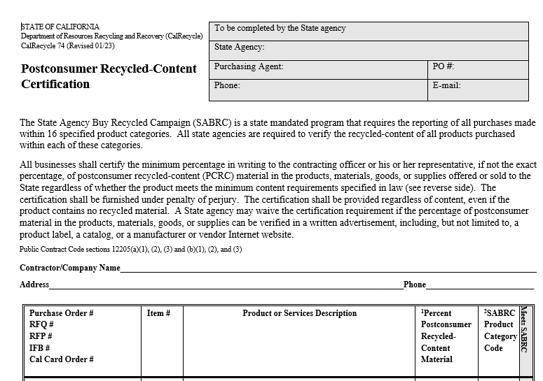
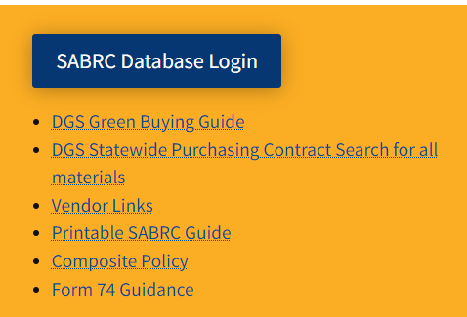
CalRecycle Form 74
Notes:
CalRecycle created form 74 for state agencies to use in the event that post-consumer recycled content information cannot be easily found.
It is available on our website in both fillable worddoc or PDF. It is tool to help state agencies capture the required information they need from vendors, suppliers, and contractors, which they sign under penalty of perjury, to track SABRC purchases for annual reporting.
Form 74 will be updated to include FI$Cal sub-category codes and which of the 16 product categories they fall under.

Slide 23
Vendor Resources
Vendor Resources page on CalRecycle website www.calrecycle.ca.gov/buyrecycled/stateagency/vendored
  How to Sell to the State of California: Strategies and tools for marketing products to state government customers.
  Guidance on Form 74 for Vendors.
  Frequently Asked Questions: CalRecycle's responses to frequently asked vendor questions.
Notes:
We have resources for vendors if they have questions or need assistance.

Slide 24
Tracking Purchases
All products purchased within the 16 categories (whether they meet the SABRC post-consumer requirements or not) must be tracked and reported regardless of how the products were purchased.
CalRecycle website for product examples:
www.calrecycle.ca.gov/buyrecycled/StateAgency/Categories
Notes:
All products that fall within the 16 product categories are reportable purchases, even if they DO NOT contain recycled content.
It does not matter how the SABRC products were purchased; if an agency spends money on a product/material in a SABRC category, then it is reportable.
Again, you can visit the CalRecycle website for product examples: http://www.calrecycle.ca.gov/buyrecycled/StateAgency/Categories

Slide 25
Types of Purchases to Track
CAL-Card Purchase Orders (CPOs)
Purchasing Authority Purchase Order (STD. 65)
Contracts (construction, SB/DVBE)
DGS
Statewide Contracts (MSA, LPA)
State Price Schedule (SPS)
California Multiple Award Schedule (CMAS)
Purchase Estimates (PE)
California Strategic Souring Initiative (CSSI) Contracts
Etc.
Notes:
It does not matter how the product was purchased whether that is through commodity contract, service contract, or a direct purchase from a vendor with a CalCard; if any agency spends money on a product that falls under one of the 11 SABRC product categories, then it is reportable, even if it does not contain recycled content.

Slide 26
Methods of Tracking
State agency’s own tracking program (via an electronic accounting system, assigning specific object codes, or capturing information on purchase orders, etc.)
CalRecycle’s tracking tools: www.calrecycle.ca.gov/buyrecycled/Resources/Tools#Tracking
Financial Information System for California (FI$Cal):
  FI$Cal Purchasing Authority Purchase Order (STD. 65)
  How to Record EPP/SABRC in FI$Cal by DGS: www.dgs.ca.gov/PD/Resources/Find-EPP-Goods-and-Services
  FI$Cal data export: www.calrecycle.ca.gov/buyrecycled/stateagency/manual/
Notes:
Knowing that it does not matter how the purchase of SABRC products are made; if an agency spends money on a product in a SABRC category, it must be reported – so tracking all purchases over a fiscal year is important.
Here are some resources for tracking purchases and establishing a process. The key is to track SABRC purchases at the time they were purchased and not months later.
The CalRecycle team has created an excel tracking sheet to assist agencies in tracking purchases. Tracking purchases is also helpful is identifying large purchases, understanding what products should be purchased with PCRC, and for ease of reporting for the SABRC annual report.
Purchases can also be tracked in FI$Cal. DGS has guidance on how to track that on their website under FI$Cal job aids. And CalRecycle has information on how to export FI$Cal data for the SABRC annual report.

Slide 27
FI$Cal SCPRS Search
FI$Cal SCPRS system tracks overall contracting dollars and contracts procured by each agency
  Search by department
  Can select transaction start and end date to download specific data within a timeline (example fiscal year total spend).
  Once search has completed, select download detail information
    Will export an excel spreadsheet where you can filter by SABRC reportable and SABRC compliant purchase within each reportable category.

Slide 28
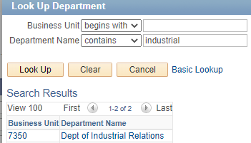
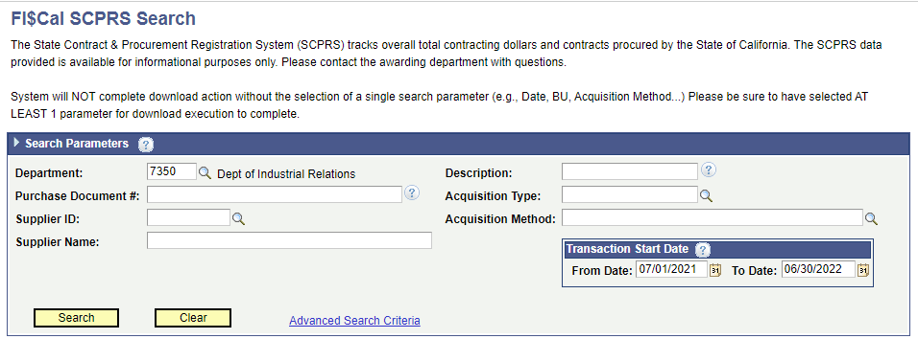
FI$Cal SCPRS
Business Unit Search
Notes:
Website - https://suppliers.fiscal.ca.gov/psc/psfpd1/SUPPLIER/ERP/c/ZZ_PO.ZZ_SCPRS1_CMP.GBL?FolderPath=PORTAL_ROOT_OBJECT.ZZ_FISCAL_SCPRS.ZZ_SCPRS1_CMP_GBL&IsFolder=false&IgnoreParamTempl=FolderPath%2cIsFolder&
Search by:
using the magnifying glass
Click on Department Name dropdown and select contains, enter in part of the agency name and click lookup.
Select the corresponding business unit name
Then add transaction date for timeframe searching - typically the fiscal year - example FY 2021-2022 is July 1st 2022 to June 30th, 2022.
Click Search

Slide 29
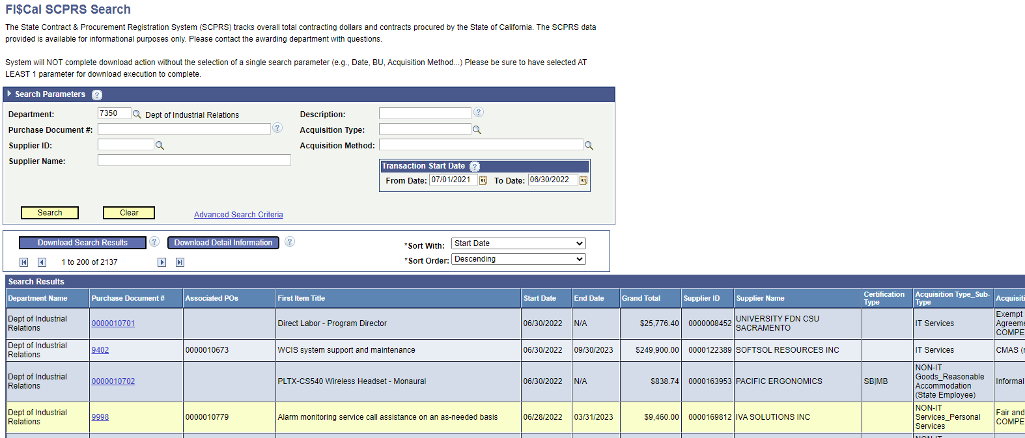

FI$Cal SCPRS Export
Notes:
Once the search is completed, click on download detail information and the data will be exported to an excel spreadsheet.

Slide 30
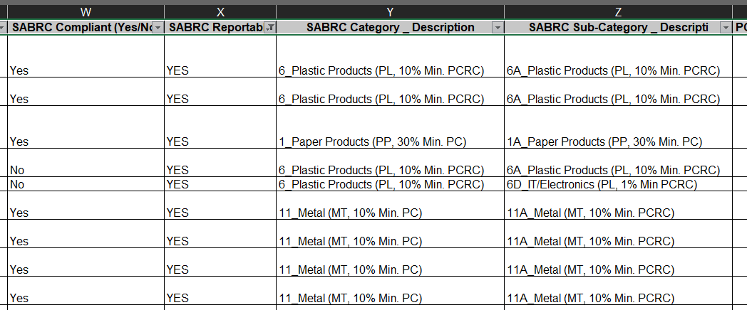
FI$Cal SCPRS Data
Notes:
The data will be exported to an excel spreadsheet. Some agencies may need assistance on how to find the SABRC reportable and compliant data.
Assisting agencies with their data takes time, and they need to QA/QC their information. The data in the spreadsheet is only as good as the information they entered in.
To assist-

Slide 31
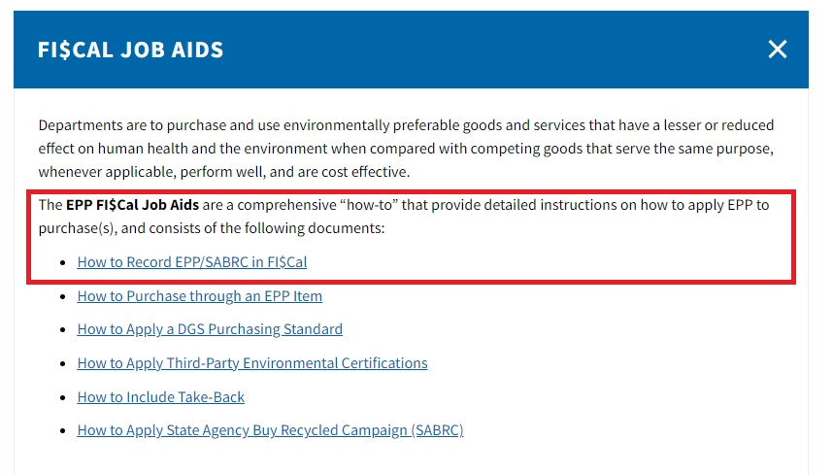
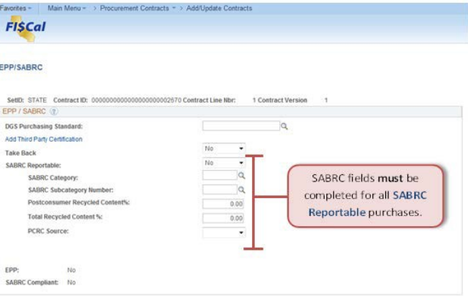
FI$Cal Resources
https://www.dgs.ca.gov/PD/Resources/Find-EPP-Goods-and-Services
Notes:
The picture on the left is the information needed to be entered in when the procurement staff is ordering items. Staff has to fill in data for each item, so there’s potential for error. That’s why a good training program for procurement staff comes in so the data going in is good, and then on the backend QA/QC of the rows to catch items that may have been missed.
Data to enter:
Take back – program where the
SABRC Reportable – Y/N
SABRC Category- soon to be 16 categories
SABRC Subcategory – will be updated as well
PCRC % -
Total recycled content
PCRC source

Slide 32
SABRC Annual Report
The State Agency Buy Recycled Campaign (SABRC) Annual Report summarizes purchases of recycled content products to meet purchasing mandates of Public Contract Code (PCC) Sections 12200-12217.
SABRC annual reports are based on fiscal year and are due October 31 each year
All agencies use CalRecycle’s secure online SABRC Annual Report system
https://secure.calrecycle.ca.gov/SABRC/SignIn.aspx
Notes:
SABRC reports are due and submitted to CalRecycle by October 31 each year
If a due date falls on a weekend, the report is due the following Monday.
State Agency Fiscal Year is July 1 – June 30.

Slide 33
Justification
If the product does fall within one of the 16 SABRC categories but does not meet the minimum PCRC for the SABRC category, SABRC coordinators must provide justification as to why the product did not meet the minimum PCRC.
If the total products purchases for a specific product category does not meet the 50% or 75% requirement for SABRC compliant dollars, SABRC coordinators must provide justification as to why purchases did not meet the purchase requirement.
Notes:
If the product falls within one of the 16 SABRC categories but does not meet the minimum PCRC for the SABRC category OR if the total product purchases for a specific category does not meet the 50% or 75% requirement - SABRC Coordinators must document justification as to why the product did not meet the minimum PCRC or purchase requirement.
This helps us determine compliance with the program and understand state agency buy recycled markets and trends.
Examples of reasonable justifications:
Antifreeze -
Compost-comulch – by definition, compost and mulch is a recycled content, so all purchases in this category should be compliant.
Lub oils – hydraulic oils and greases may not have recycled content options
Glass – safety, lab equipment, windshields, tempered prison glass
Metals -
Paper -
Plastic- depends on purchases
Printing and Writing Paper – legal publications, required subscriptions, etc.,
Paint – aerosols, craft paint, interior paint
Tire-derived products – depends on purchases
Retread Tires – passenger vehicles, safety concerns due to emergency vehicle,

Slide 34
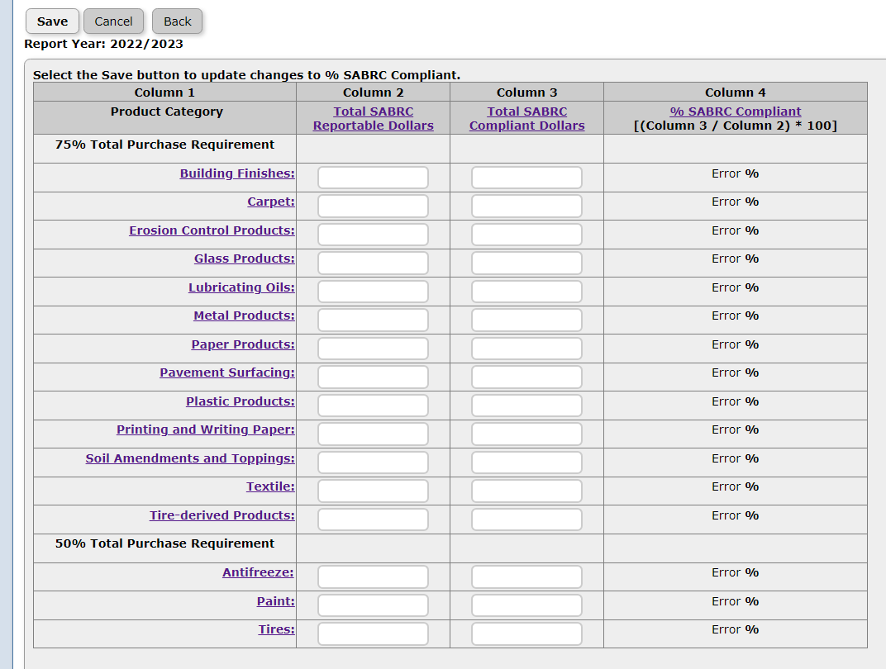
Layout for FY 22/23 Reporting Cycle
Notes:
If the product falls within one of the 16 SABRC categories but does not meet the minimum PCRC for the SABRC category OR if the total product purchases for a specific category does not meet the 50% or 75% requirement - SABRC Coordinators must document justification as to why the product did not meet the minimum PCRC or purchase requirement.
This helps us determine compliance with the program and understand state agency buy recycled markets and trends.
Examples of reasonable justifications:
Antifreeze -
Compost-comulch – by definition, compost and mulch is a recycled content, so all purchases in this category should be compliant.
Lub oils – hydraulic oils and greases may not have recycled content options
Glass – safety, lab equipment, windshields, tempered prison glass
Metals -
Paper -
Plastic- depends on purchases
Printing and Writing Paper – legal publications, required subscriptions, etc.,
Paint – aerosols, craft paint, interior paint
Tire-derived products – depends on purchases
Retread Tires – passenger vehicles, safety concerns due to emergency vehicle,

Slide 35
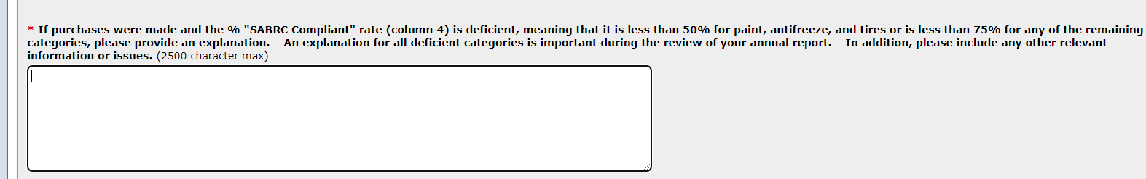
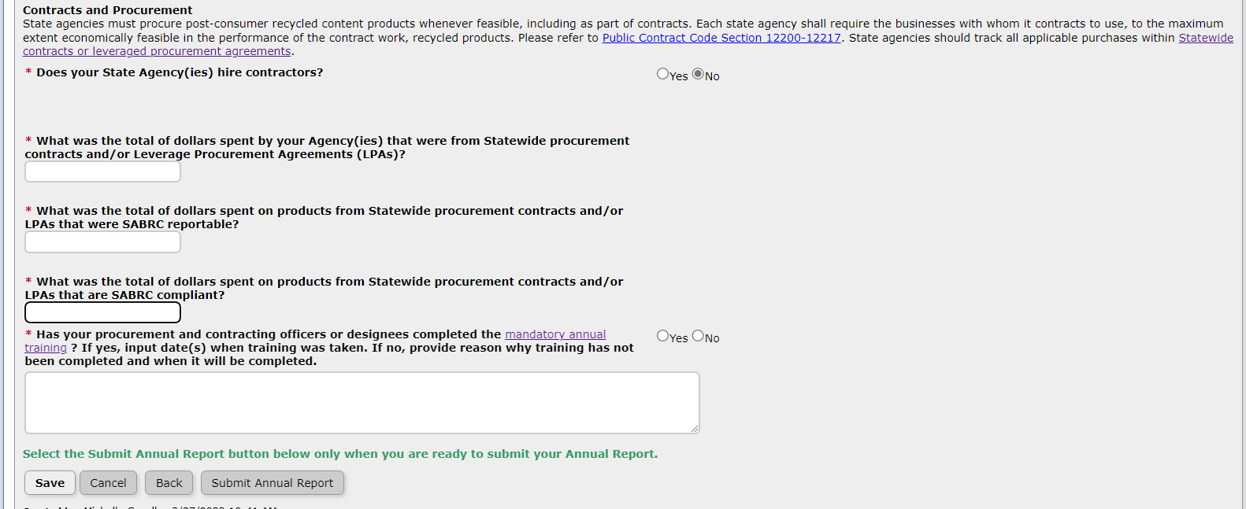
Questions in Report
FY 22/23 Reporting Cycle
Notes:
If the product falls within one of the 16 SABRC categories but does not meet the minimum PCRC for the SABRC category OR if the total product purchases for a specific category does not meet the 50% or 75% requirement - SABRC Coordinators must document justification as to why the product did not meet the minimum PCRC or purchase requirement.
This helps us determine compliance with the program and understand state agency buy recycled markets and trends.
Examples of reasonable justifications:
Antifreeze -
Compost-comulch – by definition, compost and mulch is a recycled content, so all purchases in this category should be compliant.
Lub oils – hydraulic oils and greases may not have recycled content options
Glass – safety, lab equipment, windshields, tempered prison glass
Metals -
Paper -
Plastic- depends on purchases
Printing and Writing Paper – legal publications, required subscriptions, etc.,
Paint – aerosols, craft paint, interior paint
Tire-derived products – depends on purchases
Retread Tires – passenger vehicles, safety concerns due to emergency vehicle,

Slide 36
Purchasing Authority Accreditation
CalRecycle reports SABRC compliance and non-compliance to the Department of General Services on an annual basis.
Departments are reviewed by DGS, using their own accreditation evaluation. Department’s purchasing authority could be in jeopardy if SABRC compliance is not met.
To learn more about DGS’ accreditation process visit www.dgs.ca.gov/PD/About/Page-Content/PD-Branch-Intro-Accordion-List/Policy-Training-and-Customer-Service/Purchasing-Authority-Unit
Notes:
CalRecycle reports SABRC compliance and non-compliance to the Department of General Services an annually in February. Since DGS has statute authority to grant purchasing to state agencies, the procurement division is the entity responsible for determining the appropriate levels of purchasing authority to grant to state agencies. In carrying out this responsibility, PAU must verify that state agencies:
Meet purchasing authority requirements (aka “standards”) provided by law and policy
Demonstrate capability to effectively use the authority granted
State agencies subject to DGS oversight that have been granted purchasing authority by the DGS must participate in PA Accreditation in order to maintain the authority granted.
DGS/PD/PAU prepares a triennial schedule for monitoring state agencies that have been granted purchasing authority.
To be in good standing means that the state agency is reporting as required, does not have unresolved, severe, or continuous deficiencies, and has procurement policy and procedures that have been approved by PAU.
Accreditation of a state agency is based on demonstration of conformity with established standards and is an indication of the state agency’s capacity to properly manage and administer a purchasing program. The PD Deputy Director has the ultimate decision authority. The PD management team is charged with reviewing recommended accreditation status provided by the purchasing authority specialist. Each accreditation review results in one of the following five accreditation decisions:
Accredited
Accredited with Deficiencies and Plan of Correction
Accredited with Reduction in Purchasing Authority
Accredited with Increase in Purchasing Authority
Not Accredited – Revoke Purchasing Authority
The purchasing authority specialist will follow-up on plans, mutually agreed to by DGS and the state agency, to correct areas of non-conformity identified in the Standards and Measures spreadsheet. If the state agency fails to comply with implementing corrective actions by specified due dates or to the extent agreed to, the accreditation decision will be revisited. Revisiting the accreditation decision may result in a reduction or revocation of purchasing authority. If the state agency complies with implementing corrective actions by specified due dates or to the extent agreed to, the accreditation decision may be revisited. Revisiting the accreditation decision in this scenario may result in restoring purchasing authority at current or increased levels.
Process -
In June, PAU receives a list of non-compliant departments from CalRecycle.
1. For non-reporting agencies, the SABRC coordinator is contacted from PAU and is requested to submit the SABRC report to CalRecycle.
For non-complaint agencies, a PAU specialist is assigned, and if an agency is being accredited in that Fiscal Year, PA Specialist will document on the Standards and Measures. For State Agencies that are not due to be accredited; PA Specialist will Issue a Non-Compliant Allegation Notice to the state agency (department), and CC CalRecycle
For non-compliant: The Deficiency Notice should cite the applicable law and policy and direct the department to respond within 30 calendar days to CalRecycle at SABRC@calrecycle.ca.gov.
Once the deficiency has been addressed, CalRecycle will notify PAU, and the deficiency will be closed.
DGS PAU
PAU accreditation guide - https://www.dgs.ca.gov/-/media/Divisions/PD/PTCS/PAU/PA-Accreditation-Guide-Revised-101920.pdf?la=en&hash=B56D2C94DA59CC70A161EB8C70D134CB0F9DE249

Slide 37
LAMD and JACE responsibilities
JACE
Sent non-submittal letters (early Nov.)
Non-submitters sent to DGS PAU (early Dec.)
Review reports, will compare to last year’s reports to see if a reasonable explanation was provided. (December)
If reasonable, report will be accepted.
Send over reports to LAMD that didn’t have reasonable explanations (beginning January)
LAMD
LAMD staff will reach out to agencies that need clarification on their explanations (January)
Notes:
October 31 – Reports Due. LAMD staff to reach out to non-submitting agencies.
November 7 – One week after due date, JACE will be sending a non-submittal letter to the agency directors with confirmation that LAMD staff has reached out to non-submitting state agencies.
December 5 – Five weeks after due date, issue non-submittal letter informing agency they are being referred to DGS’ Purchasing Authority Unit.
December – JACE Mini Team will analyze all SABRC annual reports
Review submittal to see if the agency provided reasonable explanation
Will compare prior year’s explanation to see if during LAMD outreach last year, reasonable explanation was provided.
If reasonable explanation was provided this year or the prior year, then the report would be acceptable (subject to change for reporting year).
January – send follow-up SABRC tasks to LAMD seniors (via excel; Michelle will convert list to SharePoint for LAMD tracking, provide responses back to JACE in excel).
Michelle will assign LAMD staff by agency group to call and get clarifying information and a reasonable explanation.
End of January – Michelle will send outreach results to JACE Seniors.
See Slide 40 for reasonable and non-reasonable explanations.

Slide 38
LAMD and JACE responsibilities (cont.)
JACE
Letters go out (end of Feb)
  Compliant
  Non-compliant but reasonable
  Non-compliant with referral to DGS PAU
Statewide memo (end of Feb)
Deficient agency reaches out if they were referred to PAU.
LAMD
Continue to provide assistance
Notes:
End of January – LAMD sends results to JACE Seniors.
Based on LAMD follow-ups, provide Ashlee and Mark recommendations on state agencies that are (1) compliant, (2) non-compliant but provided a reasonable explanation, and (3) non-compliant with a referral to DGS' PAU.
Historically, we have 3 template letters for each category. These letters are signed by Rachel Machi Wagoner and sent to the Director with a cc to the Agency Secretary and SABRC Coordinator.
New this year: LAMD added a paragraph and bulleted list on AB 661 so that SABRC Coordinators are aware of the new procurement changes which start January 1, 2023.
Once recommendations and letters are approved, JACE will work on the statewide SABRC memo and Michelle Caballero to get the letters signed by Rachel (end of February).
The statewide memo is approved by Ashlee, Mark, and Zoe before being posted online with the results from the annual report, i.e. agency spend in each product category and list of referred agencies (post end of March)
Our aim is to have the SABRC reporting cycle finished by end of March – before SARC season begins (due date May 1).
Examples of staff notes:
1. Staff compared previous reports to this year’s and observed no significant changes in the agency’s reporting. For the non-compliant categories, staff feels the agency provided a reasonable justification.
2. Staff followed-up on re-treaded tire purchases and found that the tires purchased were for pursuit vehicles and re-treads are not an option for safety reasons. Staff also asked agency to include this type of information in future annual reports.
3. Staff contacted agency offering assistance to increase SABRC compliance. Training with agency is scheduled for February 14, 2017.
Not Acceptable Explanations
an explanation that was not acceptable and what the LAMD follow-up needed to be that achieved a reasonable explanation
an example where the explanation was not reasonable and LAMD did not get a reasonable explanation, so they are forwarded on to DGS PAU?
EX from FY 2020-2021 - The institution continues to make an effort towards 100% compliance to the SABRC purchasing requirements. ANTIFREEZE: $66.96 out of the $190.53 were purchased meeting SABRC requirements. ($35% compliant) The $123.57 purchased that were non-compliant items in this category were purchased using a LPA. PAINT: The items in this category are not available to be compliant with PCRC for purchase. (0% compliant ). The institution will continue to make an effort towards SABRC purchasing requirements to be compliant. TIRE-DERIVED PRODUCTS: CDCR purchases tires primarily for law enforcement vehicles, and these tires must adhere to certain standards. All non-compliant items in this category were purchased using a LPA. (23% compliant)
Referred to PAU because - The agency did not provide a clear reason as to why they were not compliant with Anti-freeze, Paint and Tire derived products when the previous year they were 100% compliant. Many of the other products last annual report were 100% compliant as well where now they are not but still have a high rate of compliance. Staff will inquire why they did not reach 100% compliance and what is a LPA? Staff emailed agency 12/31/21.

Slide 39
Recording of Webinar
Recordings will be posted on our website at: https://calrecycle.ca.gov/BuyRecycled/StateAgency/
Will send message to SABRC Coordinators when recordings are uploaded

Slide 40
Connect with Us
For program assistance, please contact: SABRC@CalRecycle.ca.gov.
SABRC Homepage: https://calrecycle.ca.gov/BuyRecycled/StateAgency/
SABRC Printable Quick Guide https://www2.calrecycle.ca.gov/Docs/Web/114687
Notes:
Each state agency has a LAMD representative. We have an online database for you to easily connect with them.
SABRC also has a general email box if you have questions and check out the SABRC website.
The website will be revise to reflect AB 661 changes, and there should be information on the web in early January. I’ll let everyone know when that information is available, and the agencies will be notified via listserv.
We will be continually updating our website with the latest and greatest information so visit it often.

